Slide 1
Contemporary Architecture Theory
Eugene Han
Fall 2020, 11:15 – 12:30 pm
Online Instruction
August 24, 2020

Slide 2
Academic Performance and Grading Criteria
Participation – 50%
Attendance – 10%
Weekly discussion participation – 40%
Quizzes – 20%
Midterm Quiz – 10%
End of term Quiz – 10%
Final Submission – 30%
Attendance to all sections is mandatory.
If you cannot make it to class due to extenuating circumstances, please discuss issues with me before or after class.
Quizzes and the final submission are mandatory for completion of this course. Failure to complete these assignments will result in an incomplete grade.

Slide 3
Academic Integrity
If a portion of your work (e.g., in a blog) is not your own, you must cite the source completely. Images are also copyrighted.

Slide 4
Accommodations for Students with Disabilities
If you have a disability for which you are or may be requesting accommodations, please contact both your instructor and the Office of Academic Support Services, Williams Hall, Suite 301 (610-758-4152) as early as possible in the semester. You must have documentation from the Academic Support Services office before accommodations can be granted.

Slide 5
Lehigh University endorses The Principles of Our Equitable Community
We expect each member of this class to acknowledge and practice these Principles. Respect for each other and for differing viewpoints is a vital component of the learning environment inside and outside the classroom.

Slide 6
Course Objectives
This course will introduce students to a range of ideas that have defined contemporary architectural discourse by surveying well-renowned works, as well as committing to deeper readings of a limited selection. The intention is not to approach the past century through a ‘total’ or ‘official’ narrative, but instead, to confront a number of ideas that challenge conventional notions of our discipline. There is no intention to outline a unified history, but instead to acknowledge a constellation of approaches and ambitions. Students will emulate the format of case studies towards their own interpretations, and so written submissions will be heavily accompanied by mixed media. The course looks to foster critical thinking principally through peer discussion. Each major topic is introduced by the instructor, while elaboration is the responsibility of a rotating roster of student discussion leaders.

Slide 7
Learning Outcomes
Students will gain a basic understanding of a broad range of projects, yet should be able to engage more deeply with a select few that resonate with their own interests and intellectual directions. They will be cognizant of the numerous movements, styles, and individual works that define the complex manifold of architecture developed over the past century. They will be encouraged to ‘read’ theory and history by adapting past ideas towards their current world views, as applied to their own environmental experiences. It is the ambition of the course that each student will encounter a work that will serve as a catalyst for their own design thinking.

Slide 8
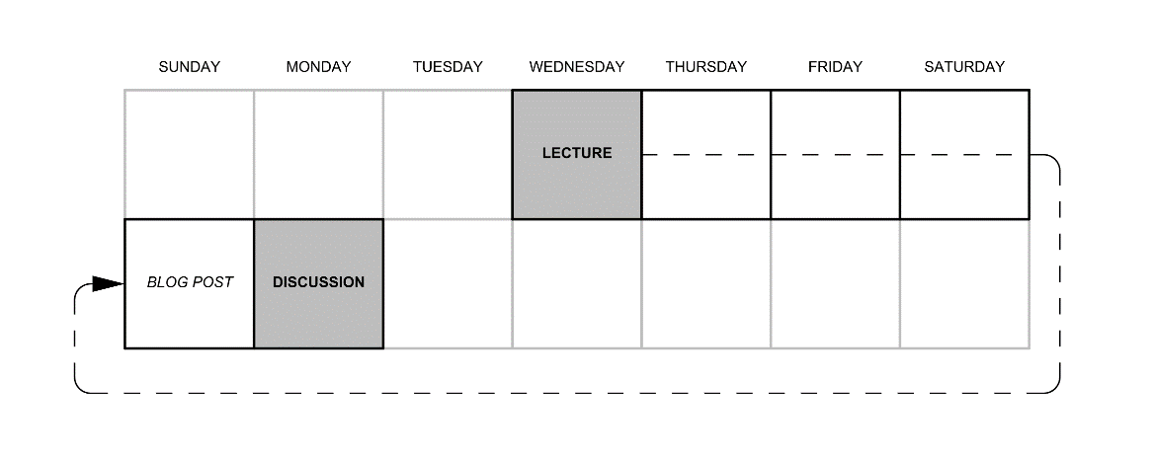

Slide 9
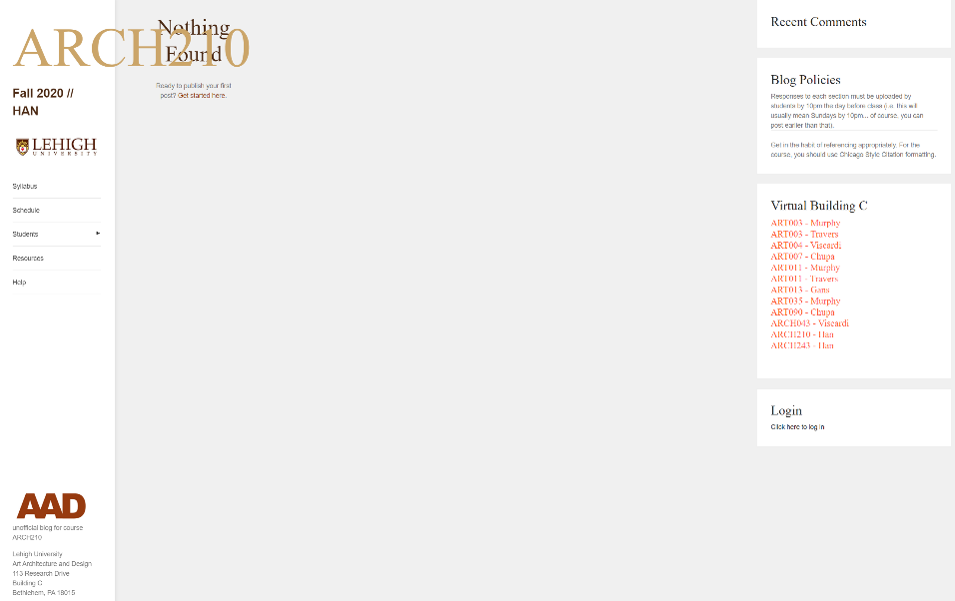
arch210fall2020.luaad.com

Slide 10
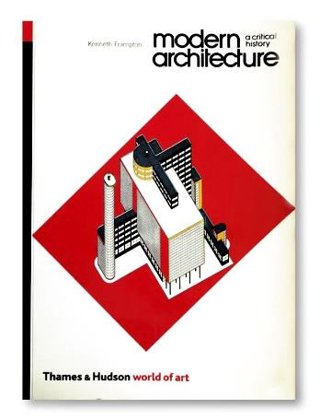
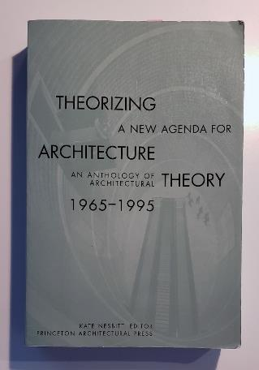
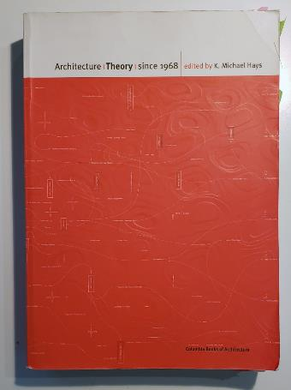
Kenneth Frampton
Kate Nesbitt
Michael Hays

Slide 11
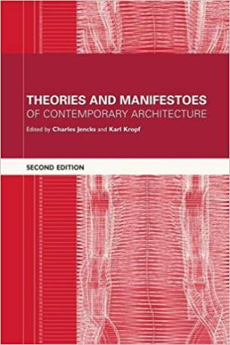
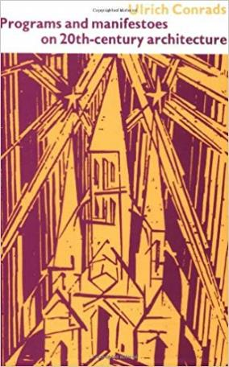
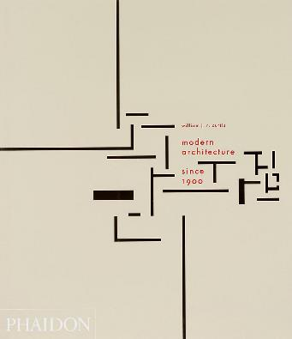
Charles Jencks & Karl Kropf
Ulrich Conrads
William Curtis

Slide 12
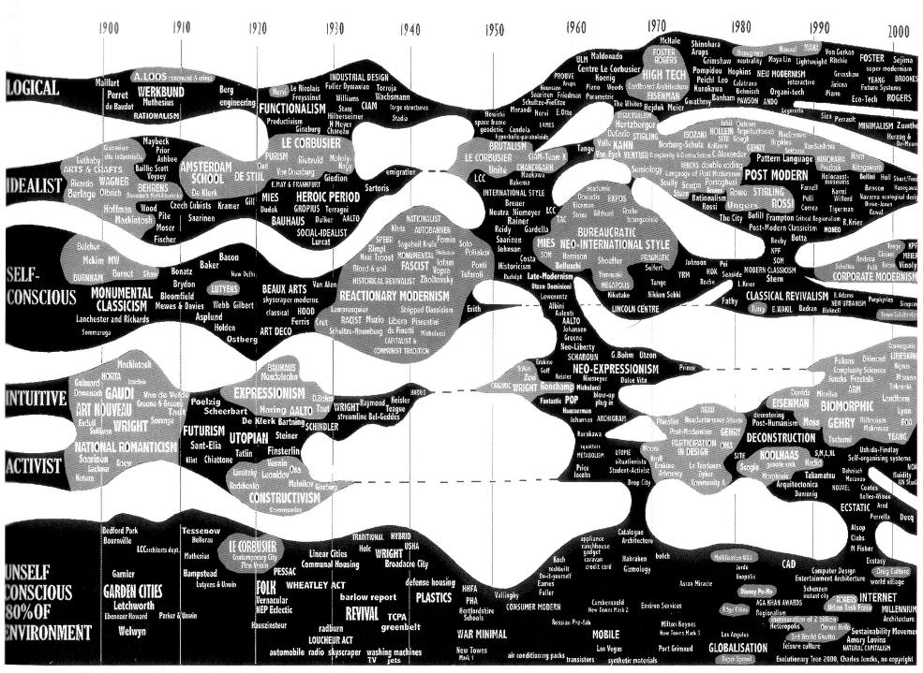

Slide 13
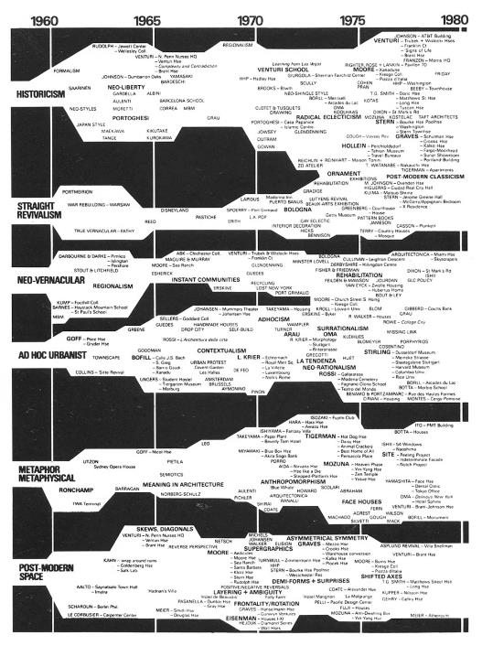

Slide 14
“What is Architecture?”

Slide 15
ARCHITECTURE ≠ THE ART OF MAKING…

Slide 16
ARCHITECTURE ≠ THE ART OF MAKING…
BUILDING

Slide 17
ARCHITECTURE ≠ THE ART OF MAKING…
BUILDING
SPACE

Slide 18
‘ARCHITECTURE THEORY’

Slide 19
CONJECTURE
HYPOTHESIS
MODEL
THEORY
LAW

Slide 20
THEORY
from Greek theōria "contemplation, speculation; a looking at, viewing; a sight, show, spectacle, things looked at“
-etymonline.com

Slide 21
THEORY
from Greek theōria "contemplation, speculation; a looking at, viewing; a sight, show, spectacle, things looked at“
-etymonline.com

Slide 23
The Turn of the Century

Slide 24
‘Modernism’
Notes:
Clarification of an important term: ‘MODERNISM’

Slide 25
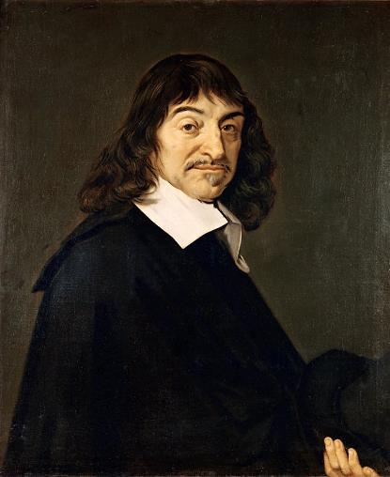
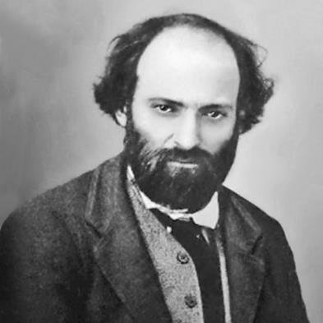
René Descartes (1596 – 1650)
Paul Cézanne (1849 – 1906)
Notes:
The term ‘Modernism’ is thrown around between disciplines, but important to know that Modernism in the arts and architecture denotes the period towards the very end of the 19th century
Whereas in philosophy, we’re talking about the middle of the 17th century… more than 2 centuries prior
Religion, and the start of science over theology
Beginning to explain the world through testable methods… the scientific method

Slide 26
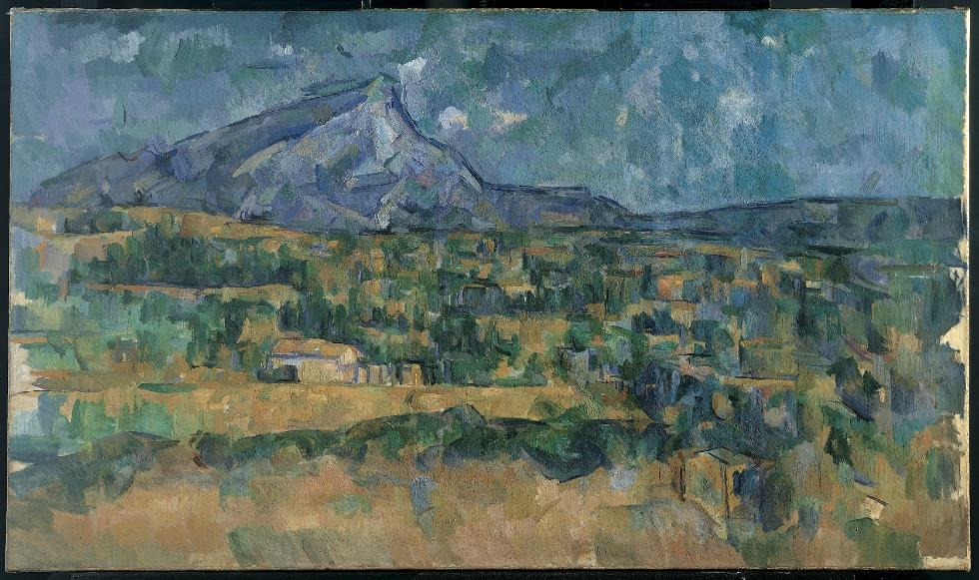
Paul Cézanne, Mont Sainte-Victoire, 1902-6.
Notes:
- Towards a view of art as something beyond artifice/representation, challenging the very process of perception.

Slide 27
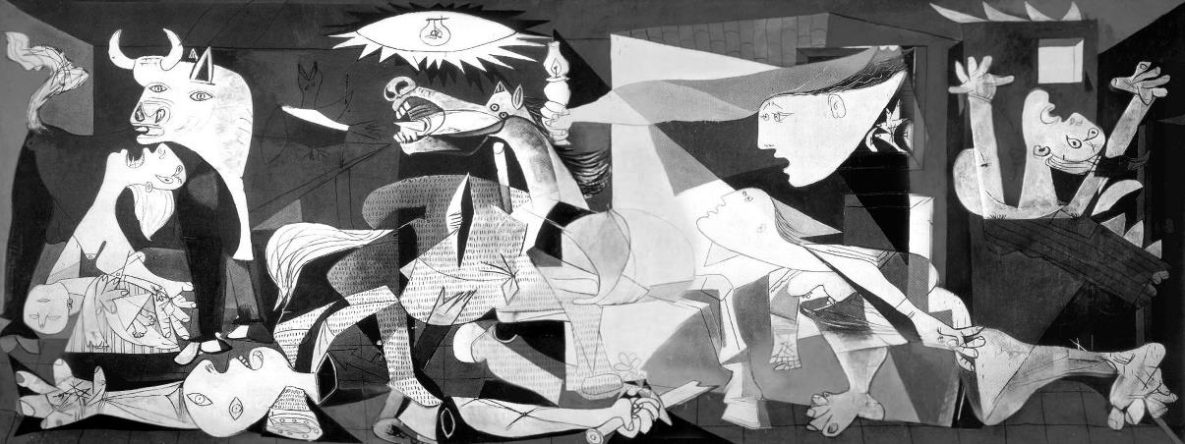
Pablo Picasso, Guernica, 1937.
Notes:
- Maturation of ‘Modernism’ with works such as Picasso’s Guernica of 1937, in which classical ideas such as symbolism extended beyond the constraint of representation

Slide 28
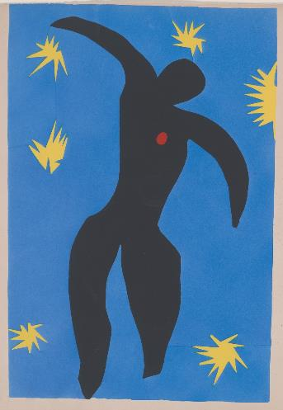
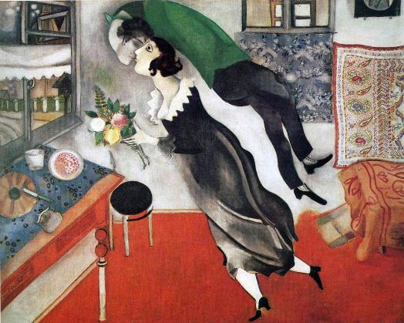
Henri Matisse, Icarus, 1947.
Marc Chagall, The Birthday, 1915.

Slide 29
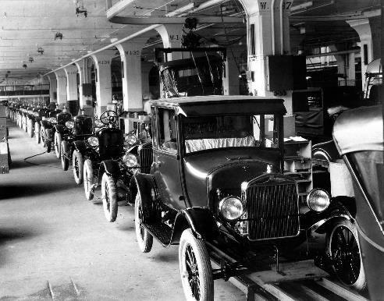
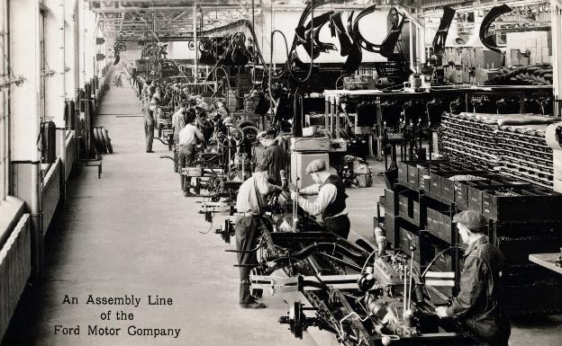
Assembly line, Ford Motor Company, River Rouge Plant, Dearborn, MI.
Notes:
Concurrent to the rise of Modernism was 2nd Industrial Revolution
River Rouge Plant construction 1917-1928.
Model T was invented in 1908.

Slide 30
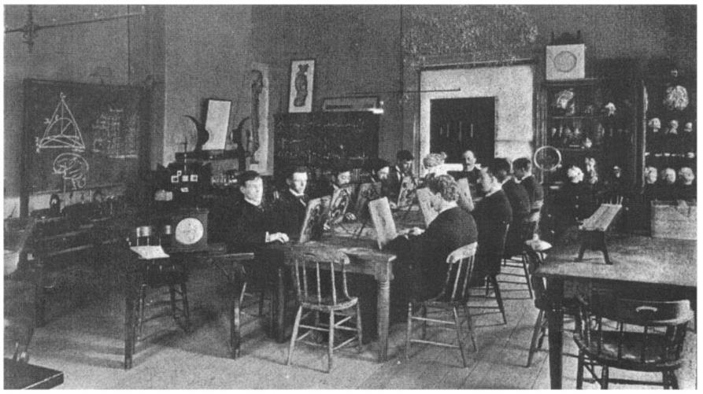
University of Leipzig, Germany. Psychology Laboratory – Wilhelm Wundt, 1879.
Notes:
This same period saw in the start of the science of Psychology
The ‘SCIENCE’ of understanding
This period is when science (in psychology) took over philosophy in how we approach knowledge, understanding, and even meaning.

Slide 31
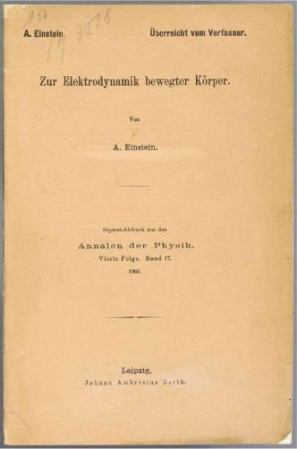
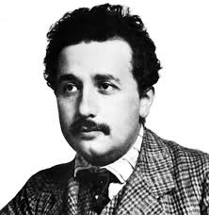
Albert Einstein, changing Weltanschauung ushered in by the sciences.
Notes:
“On the electrodynamics of moving bodies” [1905] – Special theory of relativity
“Does an object’s inertia depend on its energy content?” [1905] – the e = mc² paper <mass and energy are aspects of the same thing>
“On the general theory of relativity” [1915] – From special to all types of relativity
Relativity: The Special and General Theory [1916] – most famous publication
Things were no longer mechanical (this action has a direct consequence on that effect), but instead, they were relative and mutable.
Before Einstein, there was Bernhard Riemann who, like Galileo to Kepler, changed the face of Euclidean Geometry from of universal relations to one of relative relations (Differential Geometry).

Slide 32
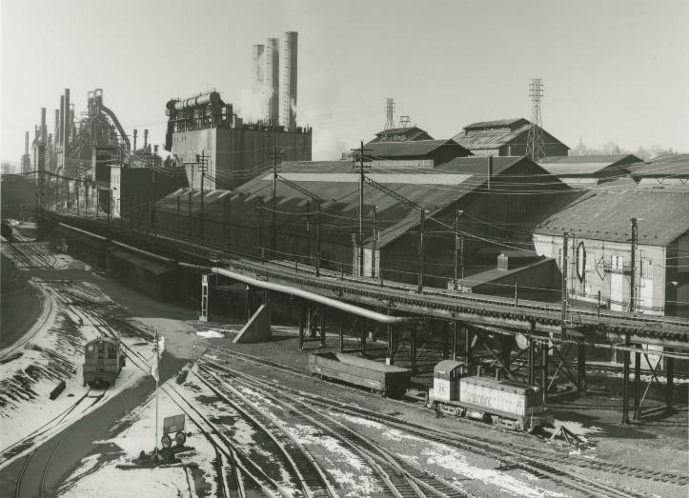
Bethlehem Steel, Bethlehem, PA.
Notes:
But moving back to the realm of construction, we have of course the industrialization of materials, and in regards to construction, that of Steel and Reinforced Concrete.
Steel was invented towards the 13th century, but industrially mass-produced in the mid-1800s, and continuously refined through the 20th century.

Slide 33
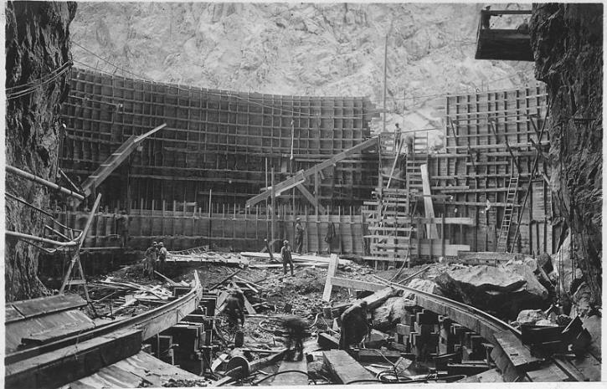
Hoover Dam construction – early example of large-scale reinforced concrete structure, 1936.
Notes:
Production methods and the refinement of materials (namely steel, glass, and concrete) had a direct affect on building
When you can make new kinds of structures, you begin to reconceive the meaning of building.

Slide 34
MODERNISM AND ITS FRACTURE
Contemporary Architecture Theory
Eugene Han
Fall 2020, 11:15 – 12:30 pm
Online Instruction
August 24, 2020
Notes:
The first section of the course is called “Modernism and its Fracture,” comprised of 3 lectures

Slide 35
MODERNISM AND ITS FRACTURE
Recapitulation: The Big 3
Contemporary Architecture Theory
Eugene Han
Fall 2020, 11:15 – 12:30 pm
Online Instruction
August 24, 2020
Notes:
So that sets the stage for our first lecture, what I’m calling “Recapitulation: The Big 3”
The Big 3 in question are Frank Lloyd Wright, Le Corbusier, and Ludwig Mies van der Rohe
Even though we start with these 3, the course really isn’t about the 3
It’s really about what happens after these 3
But to better appreciate what happens afterwards, we have to appreciate why these 3 were so important for half a century
In short, they personified a fulcrum, a pivot point

Slide 36
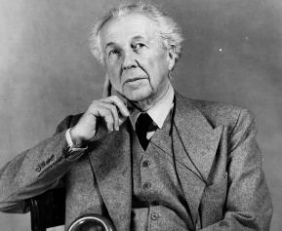
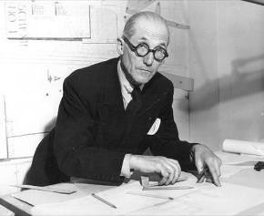
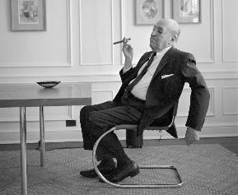
Frank Lloyd Wright
American; 1867 - 1959
Le Corbusier
Swiss; 1887 - 1965
Ludwig Mies van der Rohe
German → American; 1886 - 1969

Slide 37
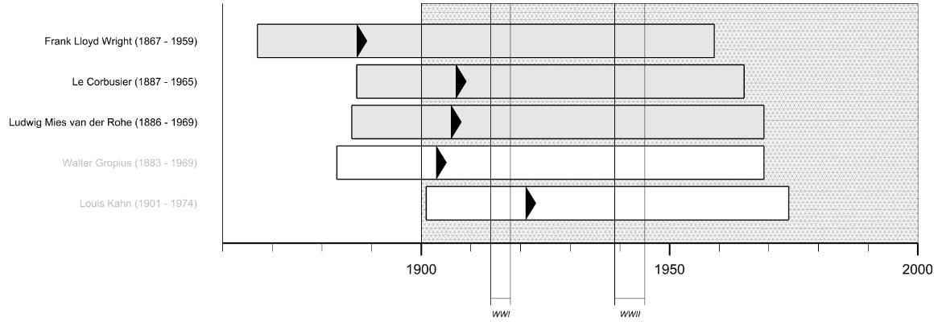

Slide 38
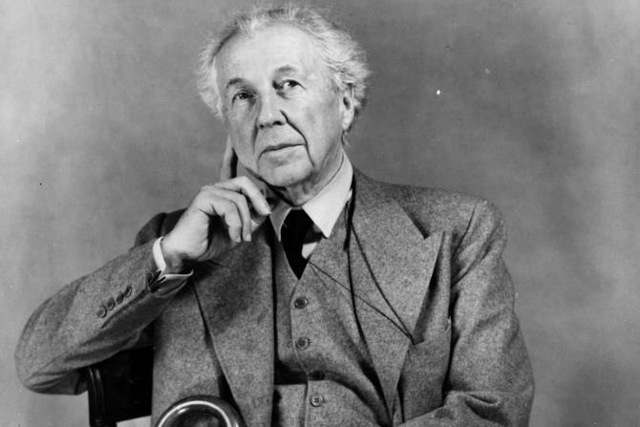
Frank Lloyd Wright
American; 1867 - 1959

Slide 39
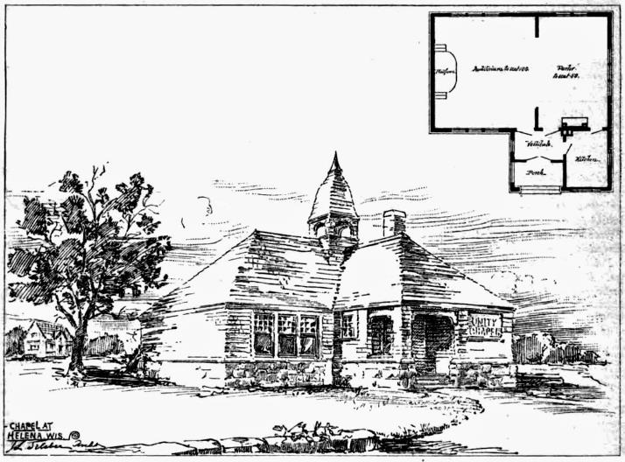
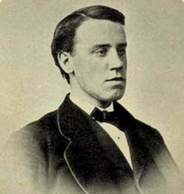
Joseph Lyman Silsbee [1848 – 1913]
Unity Chapel, Spring Green, Wisconsin (1885)
Notes:
Modernism isn’t all that special unless you’re aware of what preceded it.
So for context, here are a few examples of the type of work that Wright was producing early in his career, when he worked for the famous 19th century American architect Joseph Lyman Silsbee.

Slide 40
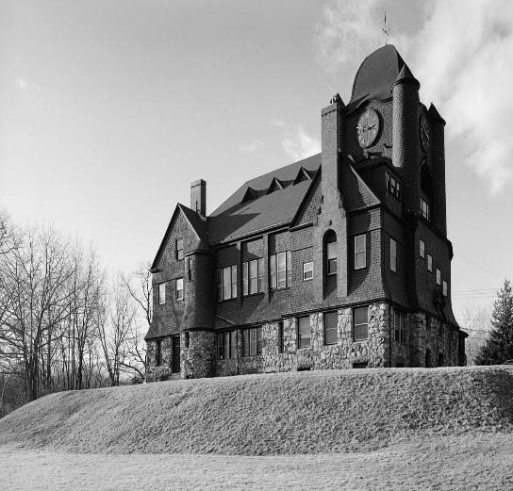
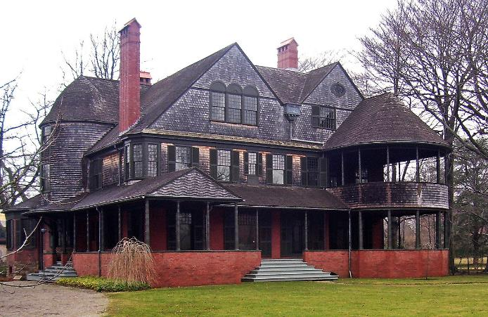
THE SHINGLE STYLE
Left: Frank Weston. Essex Town Hall, Essex, MA (1893-94)
Right: McKim, Mead, and White. Isaac Bell House, Newport, RI (1882)
Notes:
Silsbee, Shingle Style Architecture
You can see a lot of these types of houses still up in New England
Clear echoes of Victorian-Revival homes, even some accents of the Queen Anne style, but oftentimes much sedate in color, using brown, grays, and earthy reds in its color palette

Slide 41
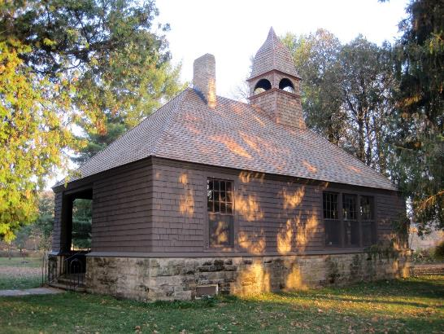
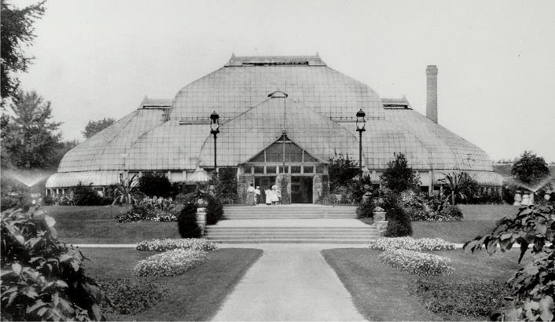
Joseph Lyman Silsbee [1848 – 1913]
Lincoln Park Conservatory, Chicago, Illinois (1889)
Notes:
- Generally speaking, many ‘Revivals’, that took tradition as a starting point, but adapting conventional forms to modern materials and production techniques (e.g. iron and plate glass)

Slide 42
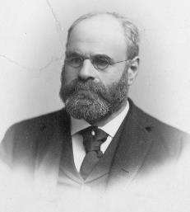
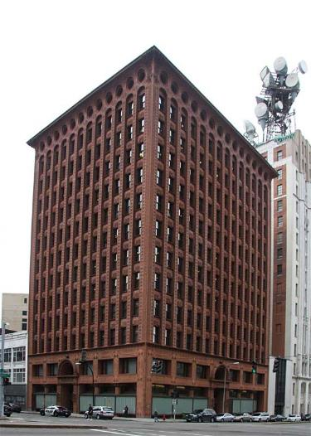
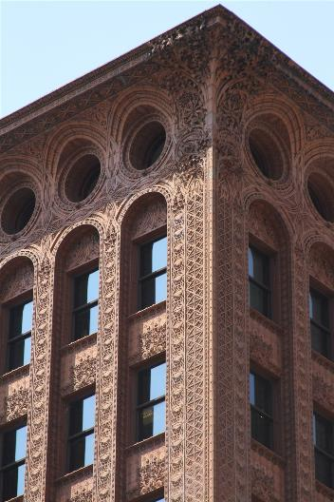
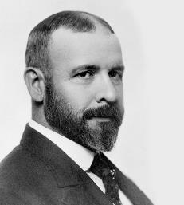
Dankmar Adler (1844 – 1900), Louis Sullivan (1856 – 1924)
Sullivan. Guaranty (Prudential) Building, Buffalo, NY (1896).
Notes:
After working for Silsbee, Wright moved on to the office of Adler and Sullivan in 1888, and ended up working their for about 5 years
When Wright arrived, the office was heavily focused on the design of tall buildings
Louis Sullivan in particular, was to become one of America’s most celebrated architects
While Adler and Sullivan were well known for designing what is often considered today as the first examples of a skyscraper, it’s important to see how their buildings balanced two seemingly contrasting aspects of architecture
Clean geometric forms
Heavy ornamentation
As demonstrated in the Guaranty Building in New York

Slide 43
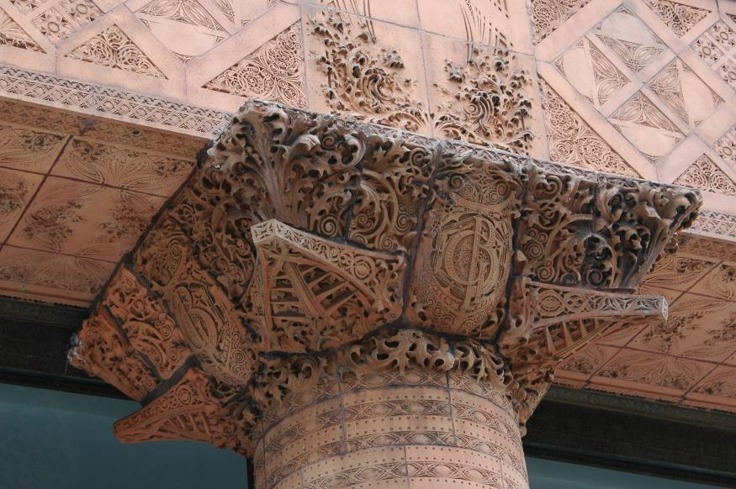
Sullivan. Guaranty (Prudential) Building (detail), Buffalo, NY (1896).
Notes:
A closeup:
General form as a very clean rectilinear architrave
Coupled with heavily ornamented tile

Slide 44
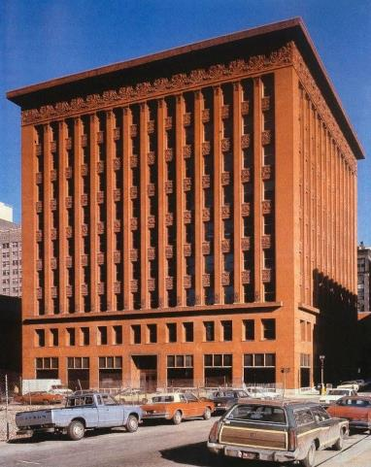
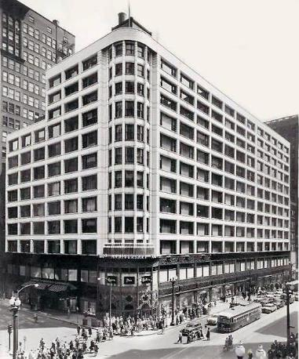
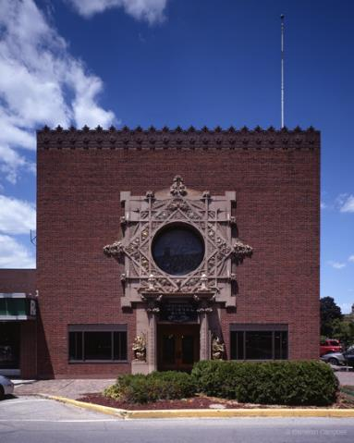
Wainwright Building, St. Louis, MO (1891).
Carson, Pirie, Scott Building, Chicago, IL (1899 and 1903-04).
Merchants’ National Bank, Grinnell, IO (1914).
Notes:
Other projects that Adler and Sullivan were well known for
Wainright Building
Clean forms, ornamentation on top frieze
Carson, Pirie, Scott Building
Modern above the lower floor
Heavy ornamentation at street level
Similar formal contrast in their Merchants’ National Bank in Iowa

Slide 45
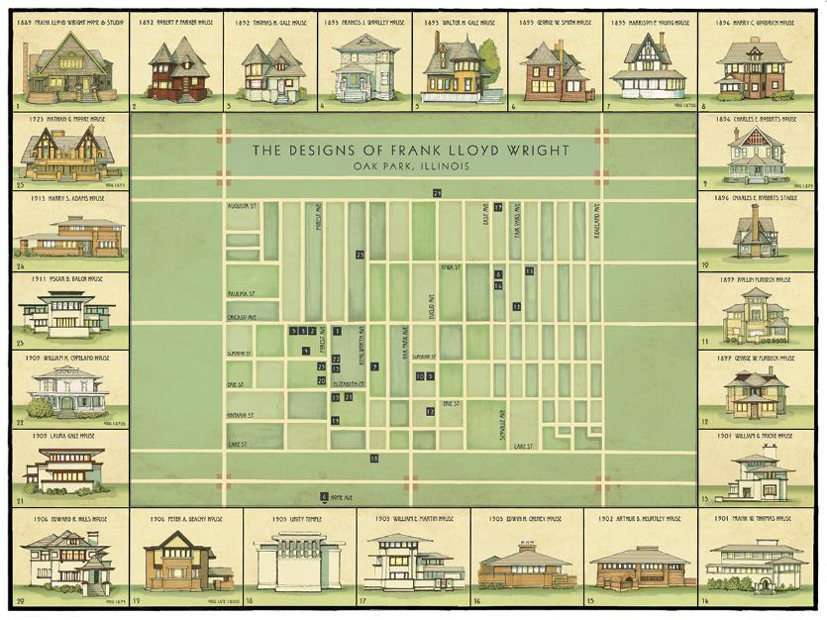
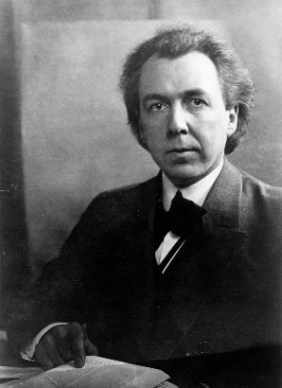
Frank Lloyd Wright [1867 – 1959)
Notes:
Moving on the work of Wright himself, after leaving Adler and Sullivan (actually during), he set up his own studio in Oak Park, IL
Many examples of Wright’s residential works throughout the city

Slide 46
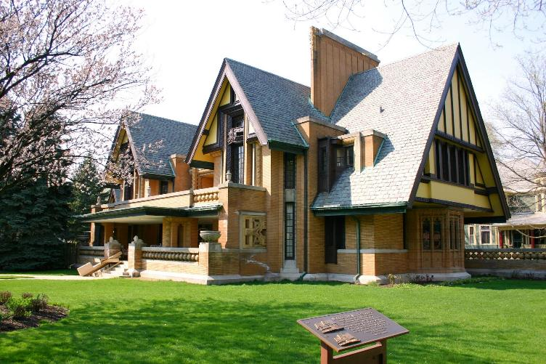
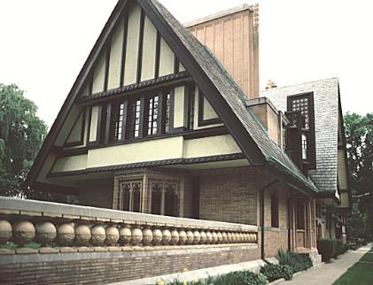
Frank Lloyd Wright
Nathan G. Moore House, Oak Park, IL (1895, 1923)
Notes:
Some of his earlier work
Not quite the FLW that we know, and we can see resonance of the Shingle Style – not necessarily in materials but proportions
Nevertheless, some oddities that aren’t Shingle... Heavy but floating horizontals

Slide 47
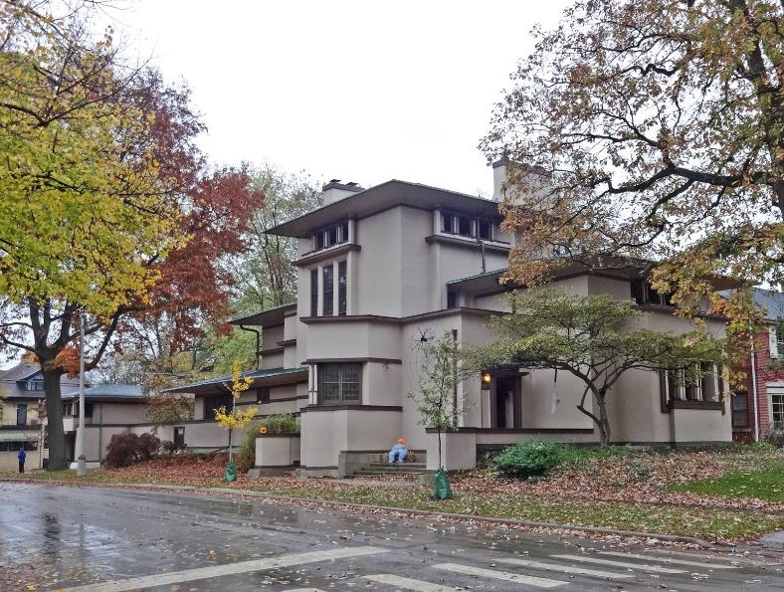
Frank Lloyd Wright
William G. Fricke House, Oak Park, IL (1901 – 02)
Notes:
- Designed a few years later, increased abstraction

Slide 48
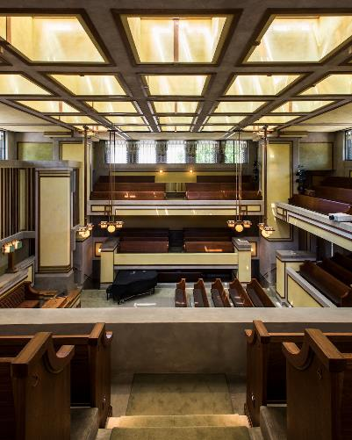
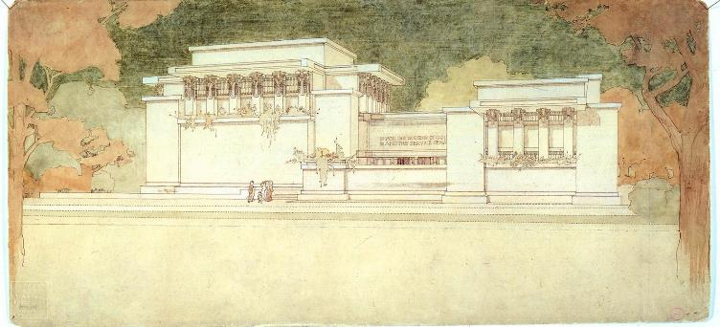
Frank Lloyd Wright
Unity Temple, Oak Park, IL, 1905-08

Slide 49
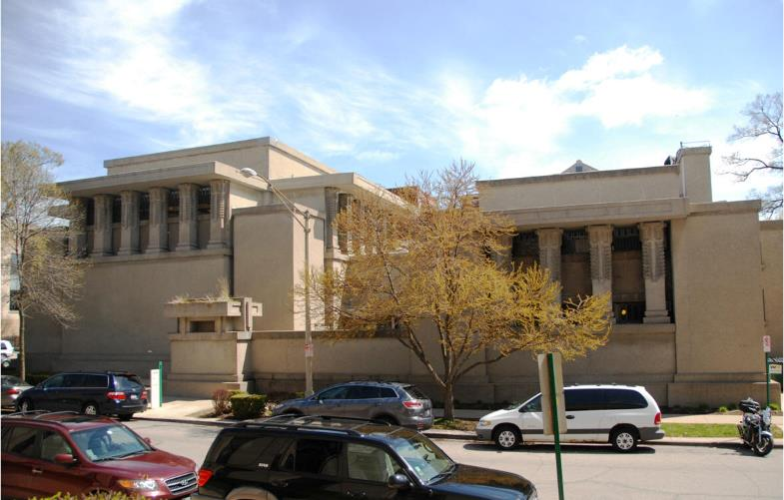
Frank Lloyd Wright
Unity Temple, Oak Park, IL, 1905-08

Slide 50
‘A Home in a Prairie Town’, The Ladies’ Home Journal, February 1907, pg. 17

Slide 51
PRAIRIE STYLE PRINCIPLES

Slide 52
First.
To reduce the number of necessary parts of the house and to separate rooms to a minimum, and make all come together as enclosed space so divided that light, air and vista permeated the whole with a sense of unity.
Wright’s ‘Prairie Style Principles’

Slide 53
Second.
To associate the building as a whole with its site by extension and emphasis of all the planes parallel to the ground, but keeping the floors off the best part of the site, thus leaving that better part for use in connection with the life of the house. Extended level planes were found useful in this connection.
Wright’s ‘Prairie Style Principles’

Slide 54
Third.
To eliminate the room as a box and the house as another by making all walls enclosing screens – the ceilings and floors and enclosing screens to flow into each other as one large enclosure of space, with inner subdivisions only. Make all house proportions more liberally human, with less wasted space in structure, and structure more appropriate to material, so the whole more liveable. Liberal is the best word. Extended straight lines or streamlines were useful in this.
Wright’s ‘Prairie Style Principles’

Slide 55
Fourth.
To get the unwholesome basement up out of the ground, entirely above it, as a low pedestal for the living-position of the home, making the foundation itself visible as a low masonry platform on which the building should stand.
Wright’s ‘Prairie Style Principles’

Slide 56
Fifth.
To harmonize all necessary openings to ‘outside’ or to ‘inside’ with good human proportions and make them occur naturally – singly or as a series in the scheme of the whole building. Usually they appeared as ‘light-screens’ instead of walls, because all the ‘Architecture’ of the house was chiefly the way these openings came in such walls as were grouped about the rooms as enclosing screens. The room as such was now the essential architectural expression, and there were to be no holes cut in walls as holes are cut in a box, because this was not in keeping with the ideal of ‘plastic.’ Cutting holes was violent.
Wright’s ‘Prairie Style Principles’

Slide 57
Sixth.
To eliminate combinations of different materials in favour of mono materials so far as possible; to use no ornament that did not come out of the nature of the materials, to make the whole building clearer and more expressive as a place to live in, and give the conception of the building appropriate revealing emphasis. Geometrical or straight lines were natural to the machinery at work in the building trades then, so the interiors took on this character naturally.
Wright’s ‘Prairie Style Principles’

Slide 58
Seventh.
To incorporate all heating, lighting, plumbing so that these systems became constituent parts of the building itself. These service features became architectural and in this attempt the ideal of an organic architecture was at work.
Wright’s ‘Prairie Style Principles’

Slide 59
Eight.
To incorporate as organic architecture – as far as possible – furnishings, making them all one with the building and designing them in simple terms for machine work. Again all straight lines and rectangular forms.
Wright’s ‘Prairie Style Principles’

Slide 60
Ninth.
Eliminate the decorator. He was all curves and all efflorescence, if not all ‘period’.
Wright’s ‘Prairie Style Principles’

Slide 61
Rosenbaum House, Florence, AL (1940)

Slide 62
Hollyhock House, Los Angeles, CA (1922)
Zimmerman House, Manchester, NH (1951)

Slide 63
Frederick C. Robie House, Oak Park, IL (1909)

Slide 64
Frederick C. Robie House, Oak Park, IL (1909)

Slide 65
Frederick C. Robie House, Oak Park, IL (1909)

Slide 66
Frederick C. Robie House, Oak Park, IL (1909)
Notes:
2 Bands
Back of house
Front of house

Slide 67
Frederick C. Robie House, Oak Park, IL (1909)

Slide 68
Frederick C. Robie House, Oak Park, IL (1909)

Slide 69
Frederick C. Robie House, Oak Park, IL (1909)

Slide 70
Frederick C. Robie House, Oak Park, IL (1909)
Notes:
- Principle of raised ‘Semi-Basement’

Slide 71
Frederick C. Robie House, Oak Park, IL (1909)
Notes:
Mortar emphasizing horizontality
‘Bed Joint’ – the horizontal band on a mortar joint
‘Head Joint’ – the vertical bands
Colored to match brick work
‘Course’
The horizontal element running across the wall

Slide 72
Frederick C. Robie House, Oak Park, IL (1909)
Notes:
Notice lack of interior walls
Just partial separation
Emphasizing continuity of spaces
Globe lights
Japanese influence

Slide 73
Frederick C. Robie House, Oak Park, IL (1909)
Notes:
Uppermost level
Lack of interior divisions
Example of Wright’s ‘Total Architecture’

Slide 74
Kaufmann House (Fallingwater), Mill Run, PA (1934-7)
Notes:
In PA, but 4 hours away
Arguably Wright’s most celebrated work
Represents one of his most mature works, towards the end of his career
Above a ravine named ‘Bear Run’

Slide 75
Kaufmann House (Fallingwater), Mill Run, PA (1934-7)
Notes:
- ‘Trays cantilevered out’

Slide 76
Kaufmann House (Fallingwater), Mill Run, PA (1934-7)

Slide 77
Kaufmann House (Fallingwater), Mill Run, PA (1934-7)
Notes:
- Strong avoidance of walls

Slide 78
Video shown in class: https://www.youtube.com/watch?v=2AIPbJRP71E
Edgar J. Kaufmann House (Fallingwater), Mill Run, PA (1934-7)
Credit: Bauhaus Movement (YouTube)
Notes:
Can be conceived as a series of floating horizontals
Integration of architecture and nature
Not about mimicking nature, but providing a counterpoint
Retain the image of this project in contrast to the International Style, specifically when we get to Mies
Similar strong rectangles and abstract geometries, but with Mies, his boxes could be placed in almost any context, whereas with Wright, his geometries are a bit more site specific

Slide 79
Edgar J. Kaufmann House (Fallingwater), Mill Run, PA (1934-7)
Ground Floor
Notes:
- Producing cave-likes shelters as you move towards the interiors of the trays

Slide 80
Edgar J. Kaufmann House (Fallingwater), Mill Run, PA (1934-7)
Second Floor

Slide 81
Edgar J. Kaufmann House (Fallingwater), Mill Run, PA (1934-7)
Third Floor

Slide 82
Kaufmann House (Fallingwater), Mill Run, PA (1934-7)

Slide 83
Kaufmann House (Fallingwater), Mill Run, PA (1934-7)

Slide 84
Kaufmann House (Fallingwater), Mill Run, PA (1934-7)

Slide 85
Johnson Wax Administration Center, Racine, WI (1936-9)
Notes:
Architect 70 years old
Culmination of his ideas
A rather large commission, so can be though of as one of his most important pieces during his lifetime
Headquarters for Jonson Wax, known better today as Johnson and Johnson
Important company at the time
Can be thought of today as a company like Tesla – high end, cutting edge… private
No windows on sides, lighting coming from top

Slide 86
Johnson Wax Administration Center, Racine, WI (1936-9)
Notes:
- Sketches of initial design idea, in typical Wright style

Slide 87
Johnson Wax Administration Center, Racine, WI (1936-9)
Notes:
Longitudinal section throughout the project
2 Major parts
Administration (offices)
Laboratory tower (R&D)
Parking throughout lower level

Slide 88
Johnson Wax Administration Center, Racine, WI (1936-9)
Notes:
Plan of entire project
Left: Administration building
Right: Tower, atop parking and lower level building

Slide 89
Johnson Wax Administration Center, Racine, WI (1936-9)

Slide 90
Johnson Wax Administration Center, Racine, WI (1936-9)
Notes:
Visually most dominant element of project: ‘Mushroom Columns’
Appear throughout the project, but are at their highest throughout the Administration building
Initially didn’t pass planning, but with self-testing, FLW eventually received approval
Columns required 6 ton load capacity

Slide 91
Video shown in class: https://www.youtube.com/watch?v=toXhTaWRyP0
Johnson Wax Administration Center, Racine, WI (1936-9)

Slide 92
Johnson Wax Administration Center, Racine, WI (1936-9)
Notes:
Main space
Main area to clerks and secretaries – lower
Management on upper level
President and senior executives on two appendages
Columns 22’ high
22cm base (9”)

Slide 93
Johnson Wax Administration Center, Racine, WI (1936-9)
Notes:
- Bridge connect administration and research tower

Slide 94
Notes:
Research Tower
Added afterwards (1940s)
No longer in use due to fire safety codes, but preserved

Slide 95
Johnson Wax Administration Center, Racine, WI (1936-9)
Laboratory Wing
Notes:
Floors with alternating shapes, so that labs are experientially ‘double-height’
At the time, a cutting-edge design, acting like a machine more like a traditional building
Exhaust (important for R&D) running through the core

Slide 96
Johnson Wax Administration Center, Racine, WI (1936-9)
Laboratory Wing

Slide 97
Johnson Wax Administration Center, Racine, WI (1936-9)
Garage, lower lobby
Notes:
- Short mushroom columns running throughout car park and car entrance

Slide 98
Johnson Wax Administration Center, Racine, WI (1936-9)
Integrated Furniture Design
Notes:
Even in commercial projects, integration of Architecture and Furniture, Space + Object

Slide 99
Solomon R. Guggenheim Museum, New York City (1937)
Notes:
Final building by FLW to be discussed
Located on the Upper East Side of Manhattan

Slide 100
Solomon R. Guggenheim Museum, New York City (1937)
Notes:
As it is today
The museum was intended by the Solomon R. Guggenheim foundation to house non-objective (abstract) art
So intended to be progressive

Slide 101
Solomon R. Guggenheim Museum, New York City (1937)
Notes:
- “The structural calculations are thus those of the cantilever and continuity rather than the post and beam”
- “no meeting of the eye with abrupt changes of form”
Full organic architecture
Spiral form
- Inward-looking atrium

Slide 102
Solomon R. Guggenheim Museum, New York City (1937)
Notes:
Plan showing major ‘spiral’ and minor ‘spiral’

Slide 103
Solomon R. Guggenheim Museum, New York City (1937)
Notes:
- Intended the building as a work of art, that exhibits works of art

Slide 104
Solomon R. Guggenheim Museum, New York City (1937)
Notes:
FLW’s intention to enter at lift on lower level, then continue exhibition going downward
Gravity facilitating free-flow of space

Slide 105
Solomon R. Guggenheim Museum, New York City (1937)

Slide 106
Left: Harley Davidson
Right: Maurizio Cattelan Exhibition
Notes:
Critiques
Constantly sloping floors
Curved walls make for strange shadows

Slide 107
Left: Alberto Giacometti
Right: Agnes Martin
Notes:
- Example of when architecture can get in the way of the things it’s supposed to house… but that’s an issue that continues today

Slide 108
Broadacre City, 1932 onward
Notes:
Impetus for urban planning for FLW
Extension of his idea of family and the built environment
The Great Depression, stock market crash of 1929
Think of as an extension to his many house designs in Oak Park, IL
Decentralized utopia
Believed that the automobile and the telephone would render the concentration of cities useless, as they were overly costly
For more economic to decentralize
The automobile provided for new opportunities for living

Slide 109
“When every man, woman, and child may be born to put his feet on his own acres, then democracy will have been realized.”
Broadacre City, 1932 onward
Notes:
Taken to its extreme, would result in a nation of farmers and proprietors
Universal ownership of land
“When every man, woman, and child may be born to put his feet on his own acres, then democracy will have been realized.”

Slide 110
Broadacre City, 1932 onward
Notes:
Providing a social form
Broadacre city as a fusion between past (country) and future (automobile, technology)
Often relied on clichés of the city – in fact he thrived on commissions from the city
Exploitation – “Rent” → the city as a locus for Rent
Rent for money (interest)
Rent for ideas (control of inventions)
Rent for land

Slide 111
Broadacre City, 1932 onward
Notes:
With Rent, the individual cannot be free, but is always in servitude
Design intimately attached to a notion of ‘Freedom’
Each family would need one acre
Government could not take away
Right to property was just that, a right

Slide 112
Broadacre City, 1932 onward
Notes:
- No distinction between city and rural

Slide 113
Broadacre City, 1932 onward
Notes:
The organic quality of his buildings were meant to translate seamlessly with the land
The house as a natural feature of the landscape

Slide 114
Broadacre City, 1932 onward
Notes:
- To be truly radical – Broadacre City would replace extant cities within three to four generations

Slide 115
Le Corbusier (Charles-Édouard Jeanneret)
Swiss, French; 1887 - 1965
Notes:
Born Charles-Edouard Jeanneret
Used this name up until 33 years of age
Changed his name to Le Corbusier
Grandfather’s (grandmother’s surname?) name was Lecorbésier
A Corbusier is a crow
Almost 20 years younger than FLW

Slide 116
Auguste Perret (1874 – 1954)
Théâtre des Champs-Élysées, Paris, France (1913)
Notes:
Worked for Auguste Perret
Prominent French architect at the time
LC was exposed to reinforced concrete, a relatively new material at the time

Slide 117
Auguste Perret (1874 – 1954)
Le Havre redevelopment, France (1945 – 64)
Notes:
With RC, could build in proportions that were unattainable up until then.

Slide 118
‘The Grand Tour’
Notes:
Universality
Like FLW, sought to use architecture to establish universal principles of space, form, and living
In 1911, age 24, set out on a long journey through Italy, Greece, and Turkey
A tradition that many Europeans did, known as ‘The Grand Tour’

Slide 119
‘The Grand Tour’
Notes:
Disgusted by Italian Baroque
Thought it was decadent, wasteful
Note that this wasn’t particular to LC – the term ‘Baroque’ itself was given a century after the movement’s height to describe it as something ugly

Slide 120
‘The Grand Tour’
Notes:
Instead, was impressed by the Parthenon
For a month, made many sketches
Cosmic order approach to the practice of architecture
Architecture was nothing more than ‘tuning in’ to the universals of the universe, understood through rational geometry, and appropriated with light, materials, and building construction.

Slide 121
‘The Grand Tour’

Slide 122
Le Corbusier and ‘Purism’
Notes:
Among his early attempts to synthesis his understanding of form was that of painting
Purism
Clearly learning from cubism (facets, deconstruction, fusion of objects)

Slide 123
Le Corbusier and ‘Purism’

Slide 124
Le Corbusier and ‘Purism’

Slide 125
Le Corbusier and ‘Purism’
Right: Piet Mondrian, Composition with Red Blue and Yellow (1929)
Notes:
Purism against the proportions of De Stijl, b/c they sought to understand proportions through the banal, through the constructed world, rather than a rejection of it

Slide 126
‘Golden Ratio,’ rational proportions, ‘Regulating Lines’
Notes:
But purportedly more insistent on proportion, that is, finding mathematical relationships of form (e.g. golden ratio)

Slide 127
Architecture is the masterly, correct and magnificent play of volumes brought together in light. Our eyes are made to see forms in light; light and shade reveal these forms; cubes, cones, spheres and cylinders or pyramids are the great primary forms which light reveals to advantage. The image of these is distinct and tangible within us and without ambiguity. It is for this reason that these are beautiful forms, the most beautiful forms. Everybody is agreed to that, the child, the savage and the metaphysician.
Le Corbusier, Vers un Architecture (1923)
Golden Ratio, rational proportions

Slide 128
Golden Ratio, rational proportions
Platonic Forms
Notes:
Akin to Plato’s Theory of Forms, Platonic Solids

Slide 129
Le Corbusier, Vers une Architecture (1923)
Notes:
His major manifesto-type work was Vers Une Architecture (Towards and Architecture) (1923)
Was supposed to lay out a radical departure for architecture, in which the discipline would become wholly modern in technique and attitude
Rather than tradition serving as a model, it was contemporary manufacturing
LC specified 2 innovations that should serve as exemplars: CAR

Slide 130
Le Corbusier, Vers une Architecture (1923)
Notes:
And the ocean liner, the ship

Slide 131
Five Points of a New Architecture (1926)
Notes:
And to develop a kind of architectural formula for architecture as a machine, he came up with a rule set, known as his ‘Five Points of a New Architecture’

Slide 132
Pilotis
Most important point
Lifted the building off the ground
Free Ground Plan
Walls to designate space rather than structure
Demands of form over structure
Free Façade
Similar to Free Plan, but in elevation
Independence of opening from structure
Ribbon Window
Dependent on Free Façade
Even lighting throughout contained room
Roof Garden
Reintroduction of nature into the city
Provide insulation for flat concrete roof
Five Points of a New Architecture (1926)

Slide 133
Pilotis
Most important point
Lifted the building off the ground
Free Ground Plan
Walls to designate space rather than structure
Demands of form over structure
Free Façade
Similar to Free Plan, but in elevation
Independence of opening from structure
Ribbon Window
Dependent on Free Façade
Even lighting throughout contained room
Roof Garden
Reintroduction of nature into the city
Provide insulation for flat concrete roof
Five Points of a New Architecture (1926)

Slide 134
Pilotis
Most important point
Lifted the building off the ground
Free Ground Plan
Walls to designate space rather than structure
Demands of form over structure
Free Façade
Similar to Free Plan, but in elevation
Independence of opening from structure
Ribbon Window
Dependent on Free Façade
Even lighting throughout contained room
Roof Garden
Reintroduction of nature into the city
Provide insulation for flat concrete roof
Five Points of a New Architecture (1926)

Slide 135
Dom-ino prototype, 1914-15, 1920s
Notes:
Maison Dom-ino [1914-15]
Domus (Latin) + Dominoes (b/c they could be connected)
Formal generator
Influenced by technology + social
Rapid construction
Generic construction (build before use)
Removed the fill from the frame (more universal)
3 horizontal slabs, supported by square sectional posts of concrete, lower level lifted from the ground on concrete blocks
‘pure’ structural idea
Cantilever (to allow for curtain wall)
Fenestration could go over corners (which were traditionally reserved for heavy structures)
Allowed for the Free Plan, Free Façade

Slide 136
‘Le Modulor’
Notes:
Modulor
6’ idealized proportions of man
To provide building with a synthesis between Metric and Imperial
Units based off of the human body
(Coudée = ‘Cubit’ in English)

Slide 137
‘Le Modulor’
Notes:
Recalling his purist approach to painting – idealized and mathematicised ratios
Recalls Vitruvian Man (Da Vinci)
Belief in a ‘grand equation’, whereby ‘man’ was endowed with divine proportions, and so buildings should respond to these ratios

