Slide 1
The Diagram and an Emerging Aesthetic
Peter Eisenman, Lebbeus Woods, Thom Mayne, Coop Himmelb(l)au
Contemporary Architecture Theory
Eugene Han
Fall 2020, 11:15 – 12:30 pm
Online Instruction
Notes:
1. This section will look at one architect in particular, Peter Eisenman
2. Followed by contemporaries of the last couple decades of the 20th century, many still practicing today

Slide 2
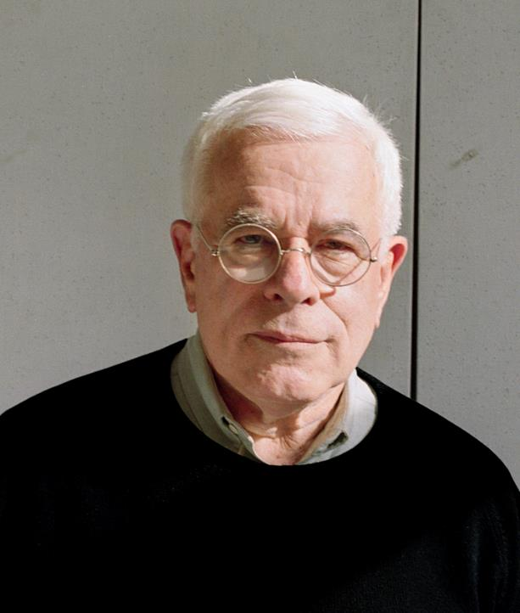
Peter Eisenman
American; 1932 -
Notes:
Important to discuss his work, because of its own merit, but also because of its direct influence to the thinking of many current architects and theorists.
American architect –alive and practicing today, at age of 88

Slide 3
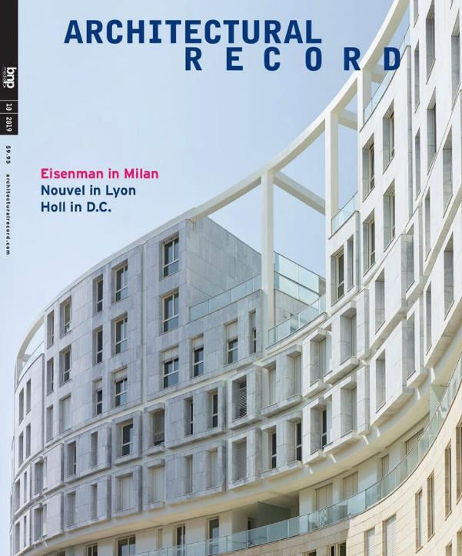
Notes:
Still building, his housing block in Milan was featured on recent cover of Architectural Record
But no question that the height of his fame was probably from the mid-80s until the early 2000s.
A major character in contemporary architecture.
Heavily engages practice with theory and history – not just one.

Slide 4
“Architecture is traditionally concerned with external phenomena: politics, social conditions, cultural values, and the like. Rarely has it theoretically examined its own discourse, its interiority. My work on the diagram is one such examination. It concerns the possibility that architecture can manifest itself, manifest its own interiority in a realized building.”
“Diagrams of Anteriority”
Notes:
This quote sums up a large part of his theory.
<<Quote…>>
Trying to look ‘within’ architecture, and not rely on other disciplines to inform what’s good or bad architecture.
Contemporaries with Rossi - autonomy

Slide 5
“Cardboard is used to signify the result of the particular way of generating and transforming a series of primitive integer relationships into a more complex set of specific relationships which become the actual building.”
“Cardboard Architecture – House I and II”
Notes:
He characterized his process of understanding architecture as kind of like working with cardboard, like in cardboard architectural models.
In one of his most important essay, “Cardboard Architecture,” he stated <<Quote…>>
So, his way of developing architecture that wasn’t about things like politics, social conditions, cultural values, and so on (think of previous quote), was to look at architecture at a purely formal basis.
Eisenman’s approach to architecture was resolutely against gauging it along functionalist terms.
And so his focus was at the level of form generation.
In large part, he was not even concerned with the functional practicability of his buildings, as he felt that architecture should first and foremost be conceived along the value of form.
It’s a bit esoteric, but nevertheless represented a shift in architectural thought

Slide 6
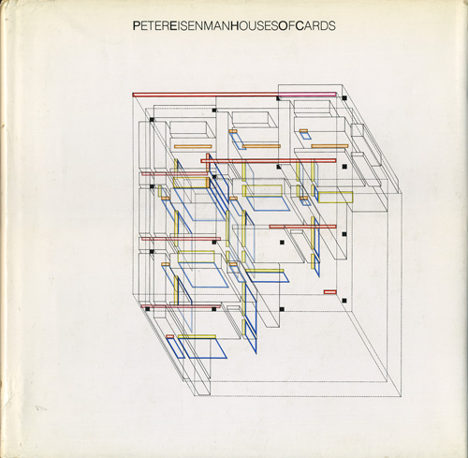
Houses of Card (1987)
Notes:
His first major publication was Houses of Cards, published in 1987.
At this stage, he already had a few built houses under his belt, but this book was a kind of manifesto for the way he approached form.
Notice the title “Houses of CARDS”
Like cardboard architecture
The material itself was considered in the abstract, and what gave form was not the thing itself, but the transformations the ‘cards’ represented.

Slide 7
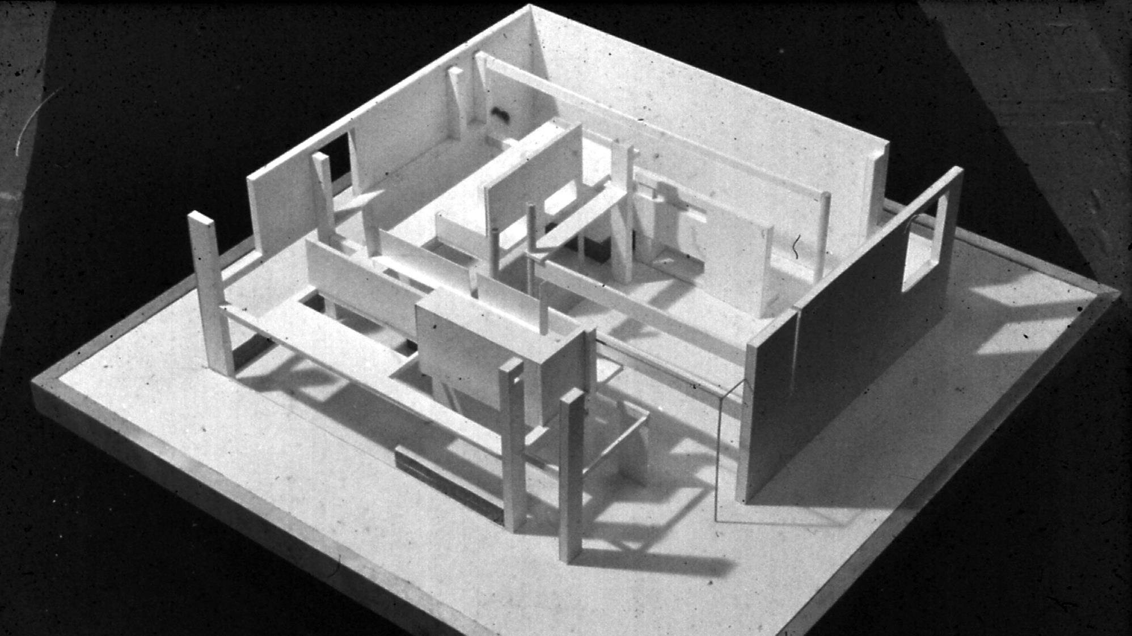
House I, Princeton, NJ (1968)
Notes:
I won’t go through all of his houses, as I think you get the picture after a few.
House I, built in New Jersey in 1968.
This house wasn’t one of his most rigorous, but shows the start of how Eisenman was looking at the transformation of proportion to generate his overall design.

Slide 8
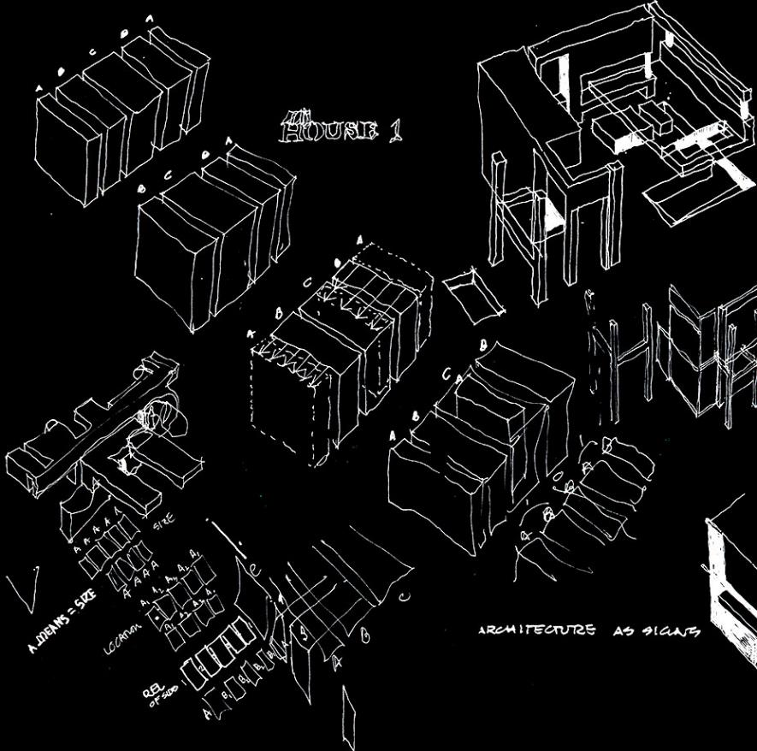
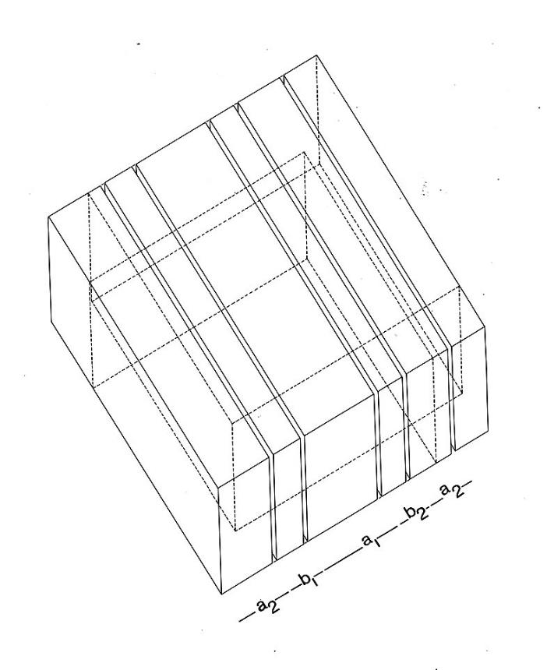
House I, Princeton, NJ (1968)
Notes:
The premise is very simply
Start off with a square extrusion, and vary its proportions through a series of slices.

Slide 9
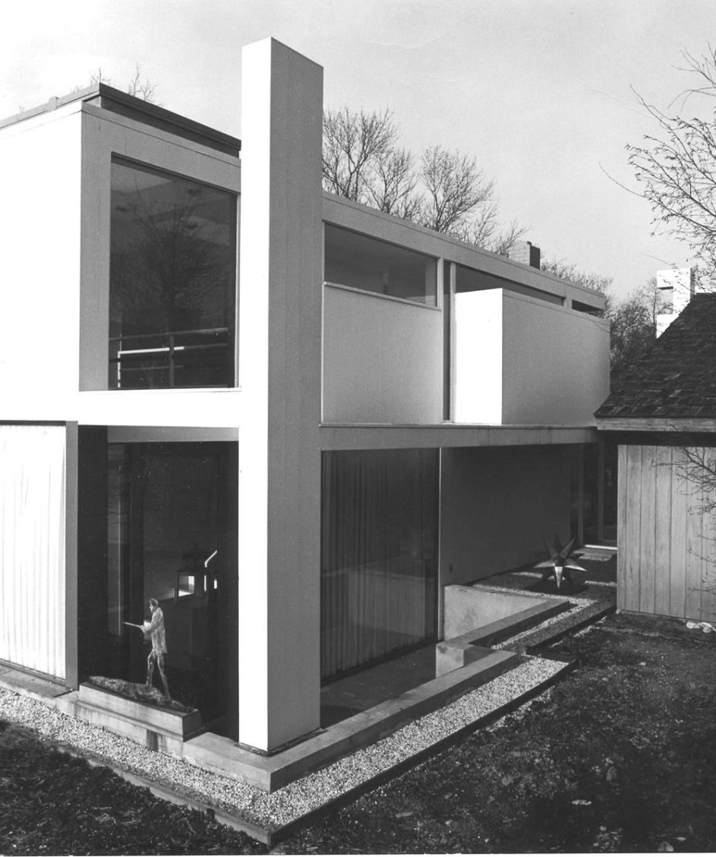
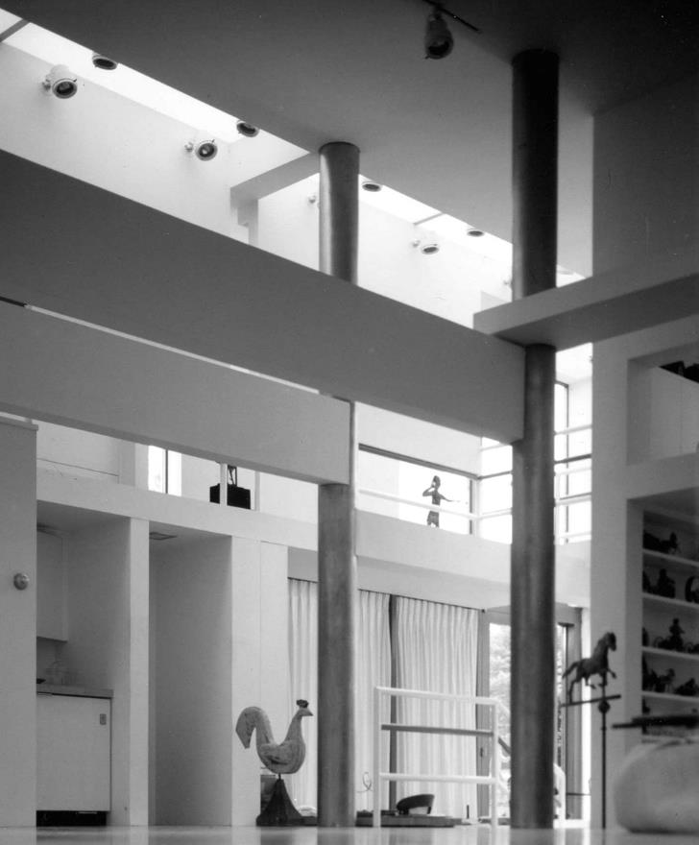
House I, Princeton, NJ (1968)
Notes:
Elements such as columns, windows, and floors resulted from these formal transformations, seemingly regardless of their ‘spatial quality’
- Not driven by the ‘experience’ of space, but by the consequence of proportions

Slide 10
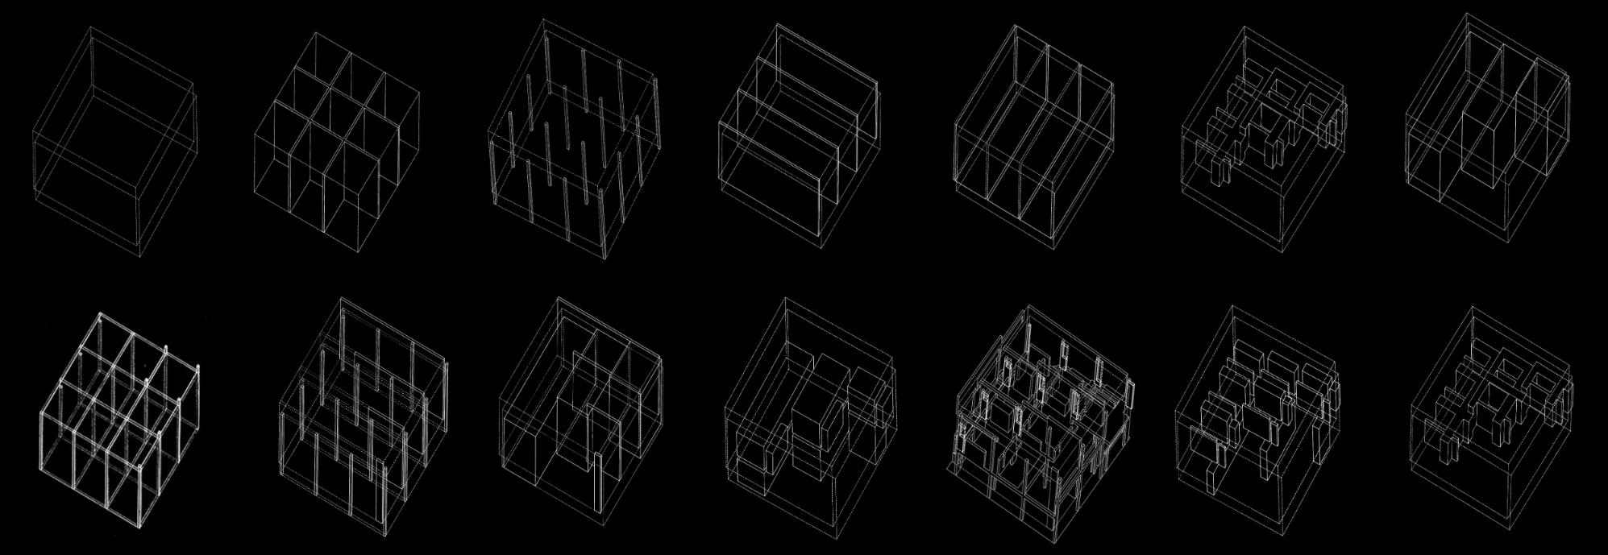
House II, Hardwick, VT (1970)
Notes:
For House II, like the others, we start off with the same square extrusion.
In this iteration, we see a more formalization of the design idea – which of course, is based on a series of formal transformation
From the division of the building in plan using a 3x3 grid
And then creating these formal gradations across the grid.

Slide 11
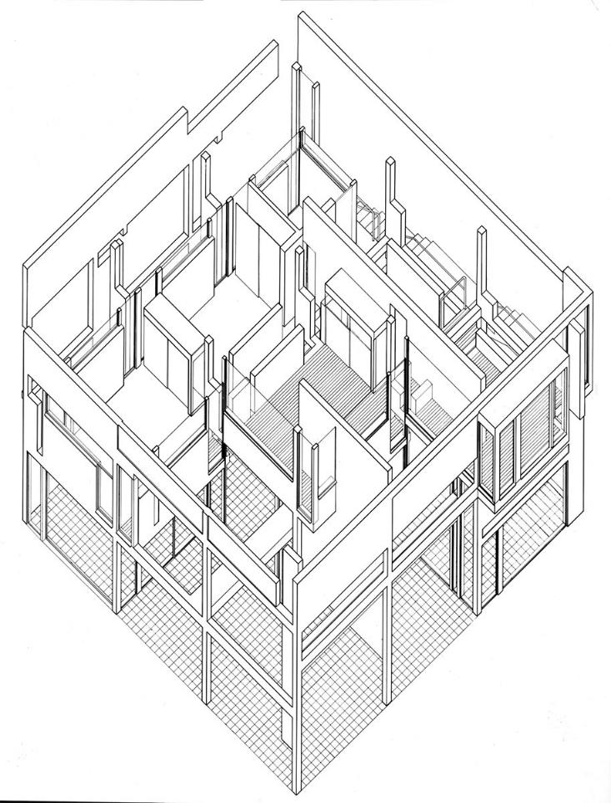
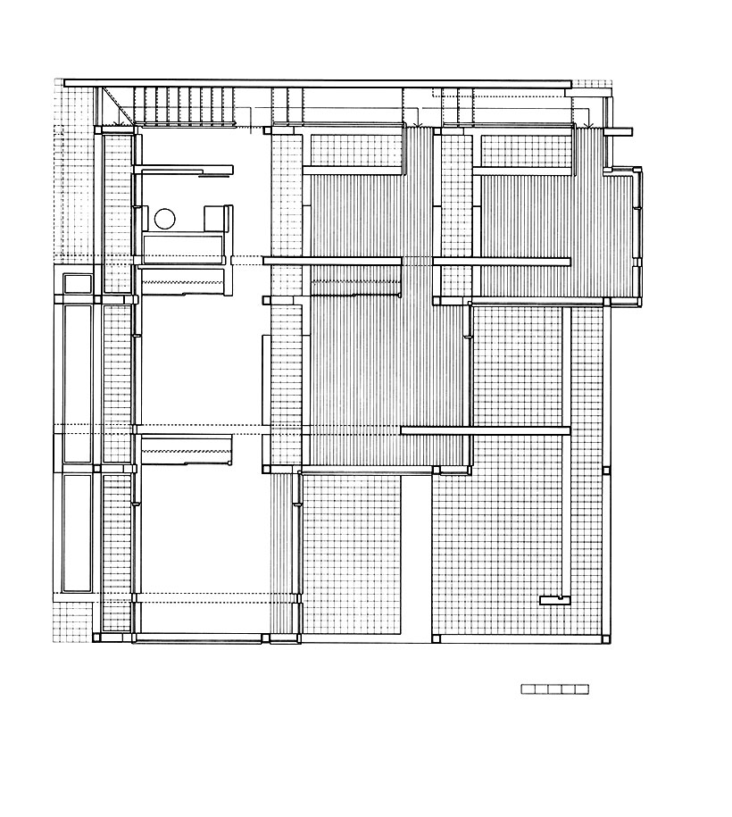
House II, Hardwick, VT (1970)
Notes:
Here we see the result
For House II, Eisenman often stated that the house is both a model and a building, which reinforces the idea that its design development was based on abstraction rather than material or even physical constraints.

Slide 12
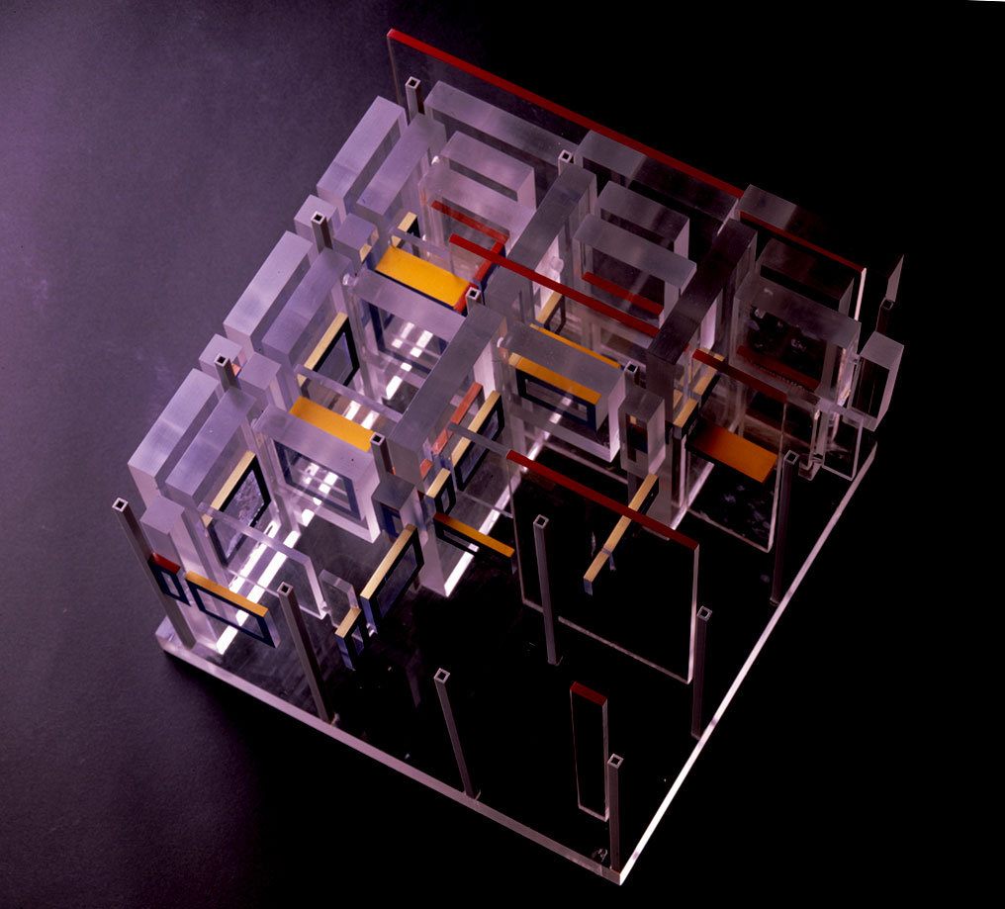
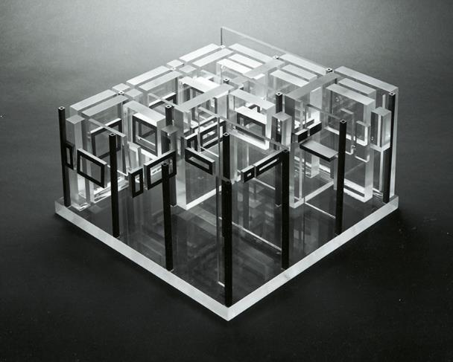
House II, Hardwick, VT (1970)
Notes:
These houses were designed well before computer modeling was commonplace in the architectural office, but it should be clear that they foreshadowed some of the formal methods that defined architectural styles even decades later.
Use of acrylic modeling for its immateriality.

Slide 13
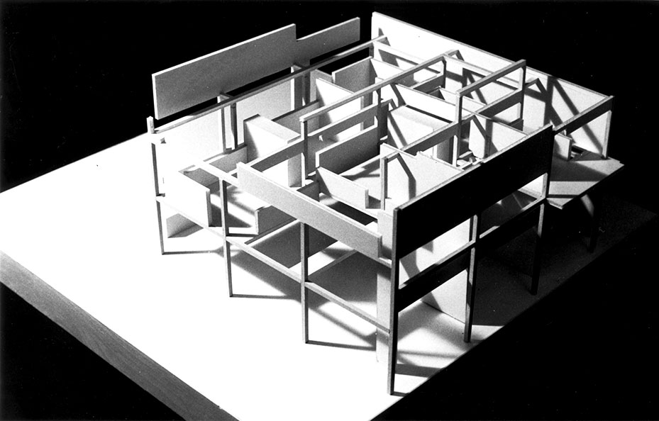
House II, Hardwick, VT (1970)
Notes:
And another view in its model

Slide 14
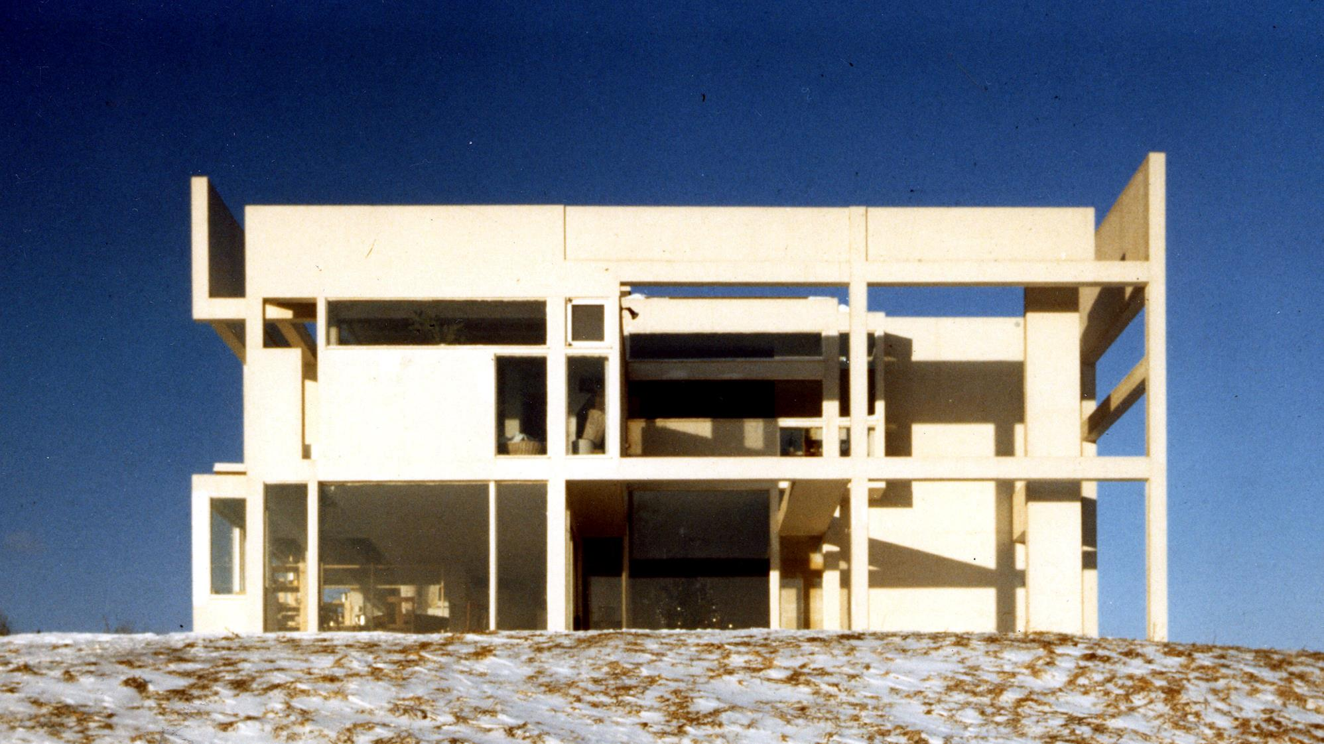
House II, Hardwick, VT (1970)
Notes:
Constructed in Vermont in 1970.

Slide 15
“Such a conception of design attempts to change the primary intention of architectural form from the perception of space to understanding the relationship of marks in that space to what is called here a deep structure. The capacity to understand, as opposed to experience....”
“Cardboard Architecture – House I and II”
Notes:
Before showing some of his other buildings, this quote helps clarify what he’s after, and what he’s working against… <<Quote…>>
“To understand, as opposed to experience”
Architecture as an intellectual activity
An exercise in understanding architectural form through systems, rather than based on projecting what users would see, experience, feel.

Slide 16
“If there is an inherent meaning implied or controlling any initial choice and subsequent transformation of a deep structure, it is a purely formal one.”
“Cardboard Architecture – House I and II”
Notes:
In polar opposition to Phenomenology, meaning for Eisenman wasn’t about realized the ‘locality’ of place within space, but about constructing form based on STRUCTURES
DEEP / SURFACE STRUCTURE
Noam Chomsky
Language – Langue / Parole

Slide 17
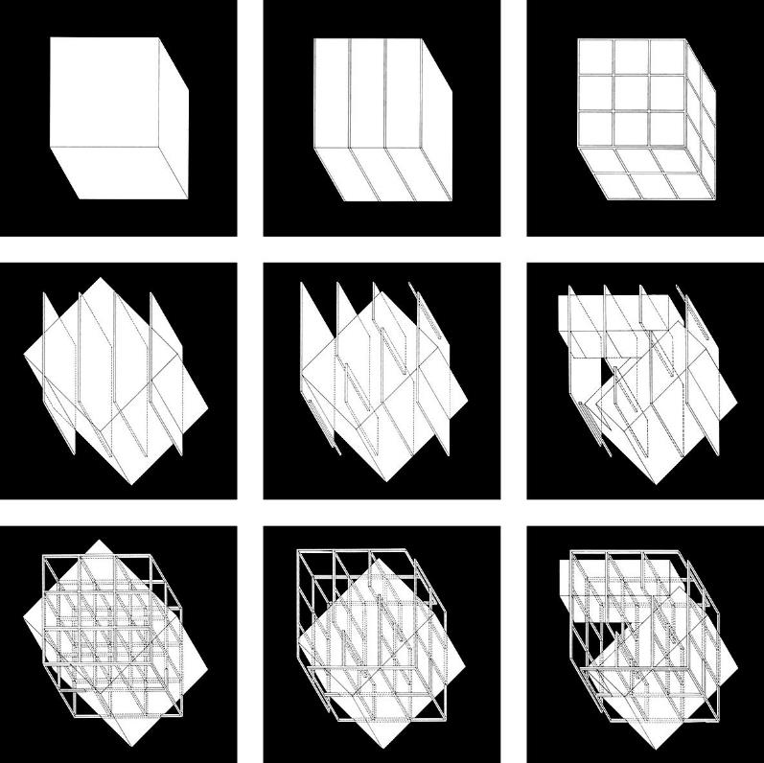
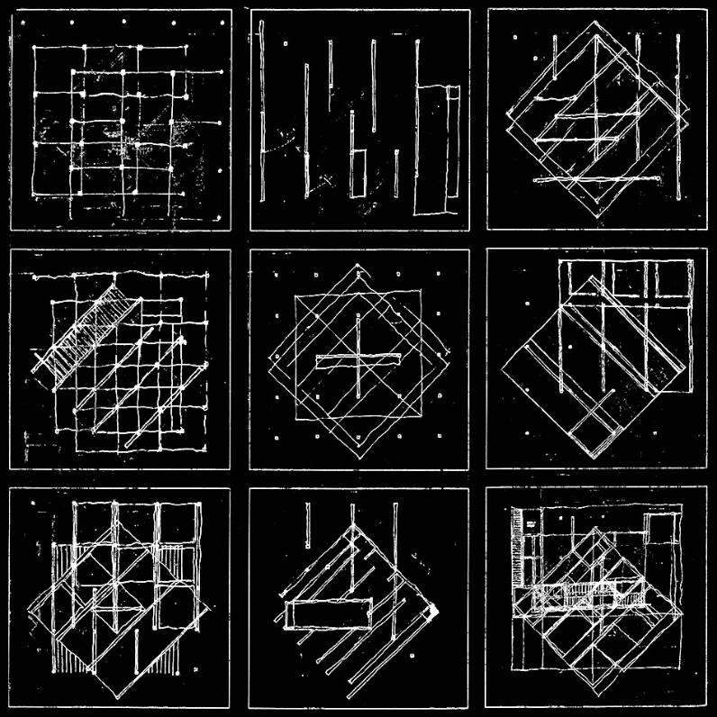
House III, Lakeville, CT (1971)
Notes:
Moving on to House III, built in 1971.
It’s important to acknowledge that Eisenman was developing both a formal model as theory, but also a form of representation that I think persists today.
So by now, we can see that Eisenman’s ‘method’ relied on the diagram.
The diagram was an architectural language in which the essence of the building was represented through a series of transformations

Slide 18
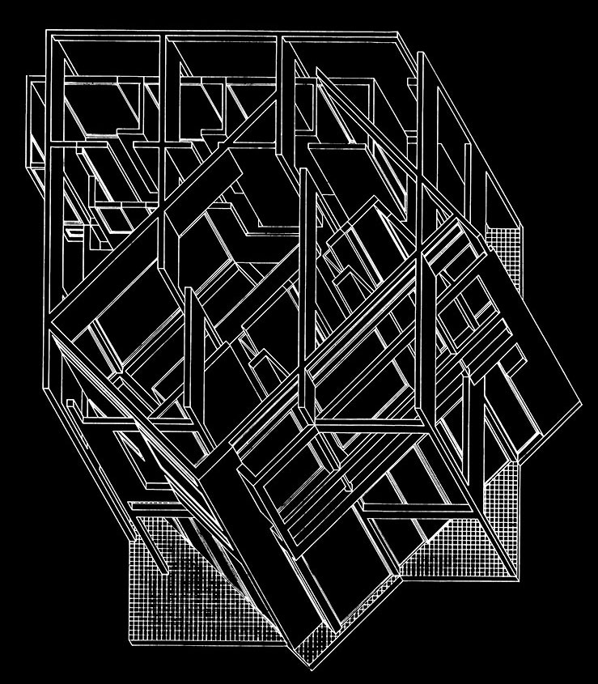
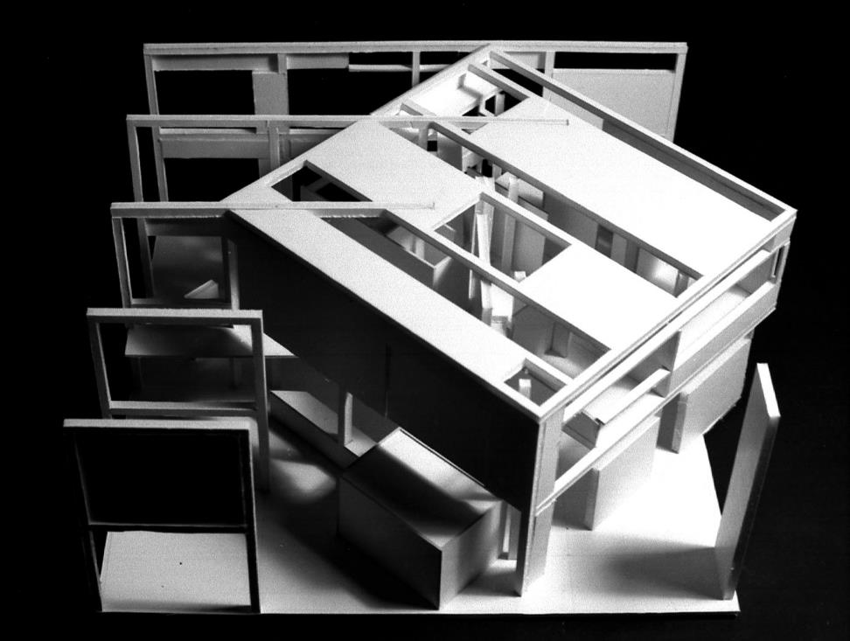
House III, Lakeville, CT (1971)
Notes:
House III the first house to introduce rotation as a transformational move
He was interested in how this simple move, rotating, would yield form that would at many times be at odds with the ‘user’
Direct contradiction to designing a space for function.

Slide 19
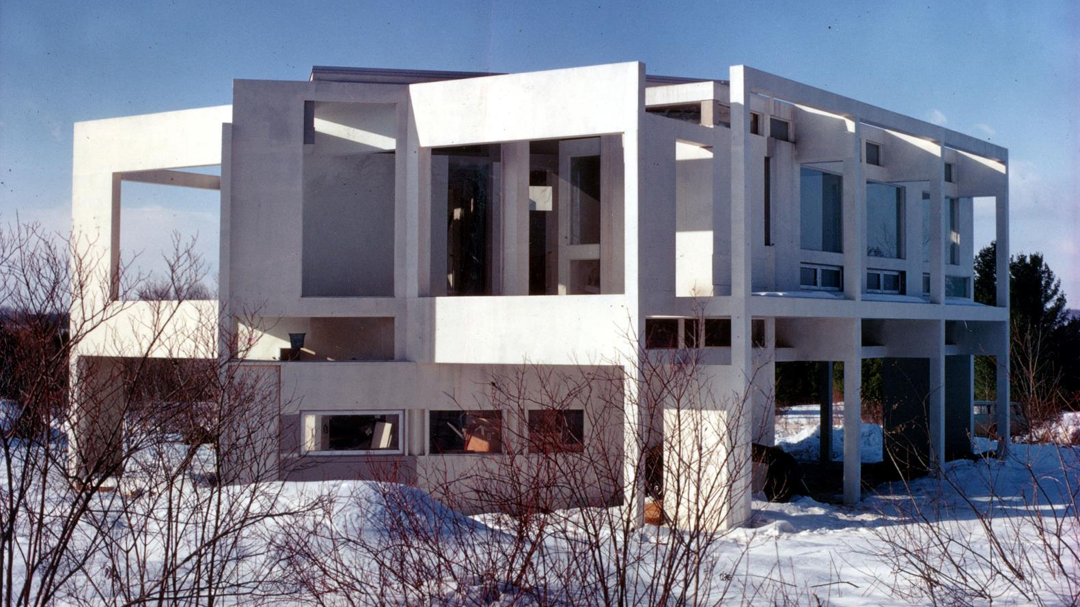
House III, Lakeville, CT (1971)
Notes:
And the house as built, in Connecticut.

Slide 20
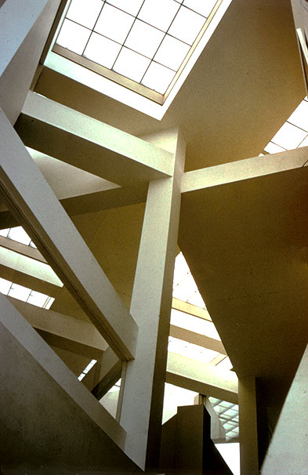
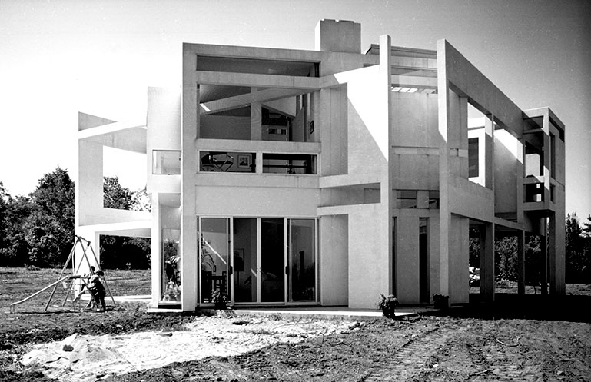
House III, Lakeville, CT (1971)
Notes:
And an interior view showing the two grids, or REGISTRATIONS, at play against each other.

Slide 21
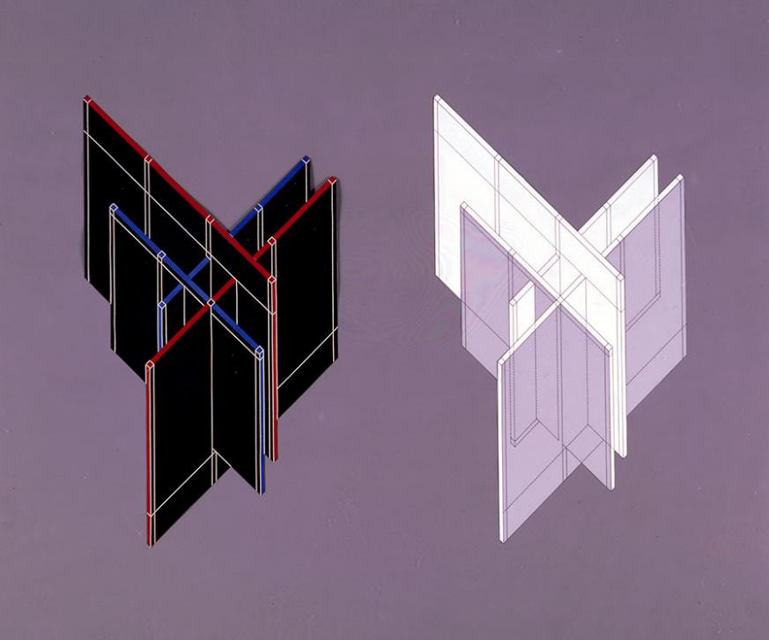
House VI, Cornwall, CT (1975)
Notes:
House VI.
Like his other houses, starts off with a basic set of geometries – planes and lines.

Slide 22
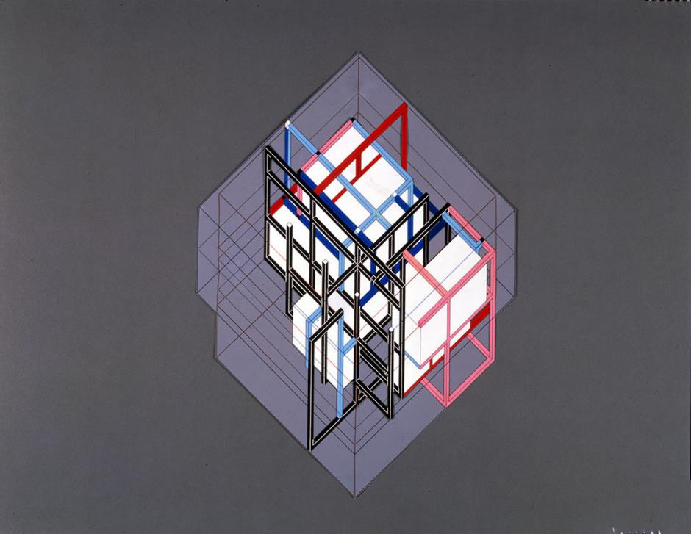
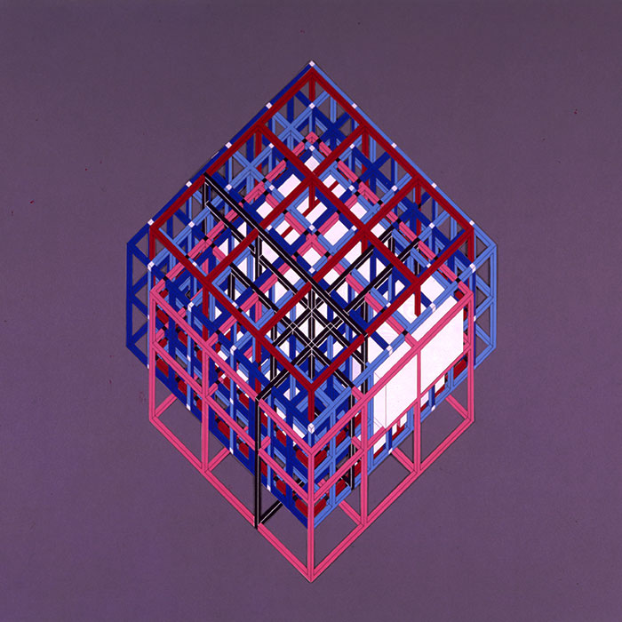
House VI, Cornwall, CT (1975)
Notes:
Can be understood as a series of shifts of these planes, with their traces left as a series of lines, creating an overall grid.

Slide 23
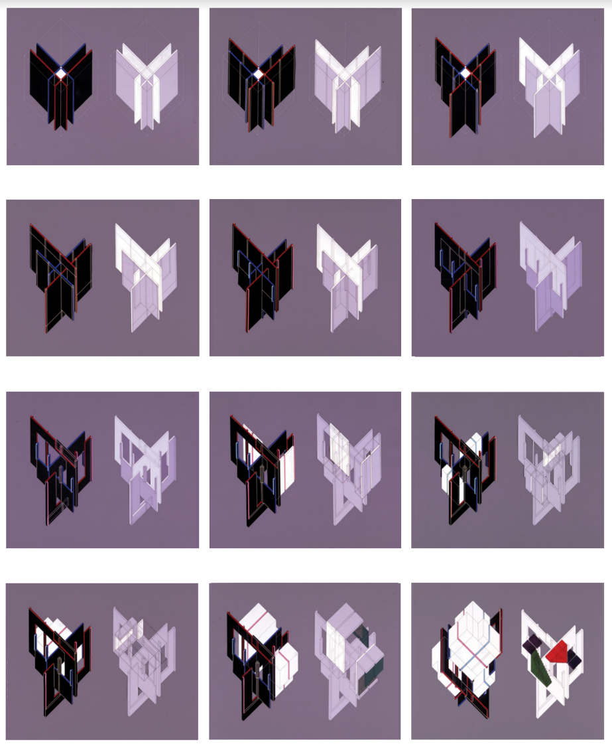
House VI, Cornwall, CT (1975)
Notes:
These transformations go through a manifold of permutations, and no where is there any consideration of function, or even human scale.

Slide 24
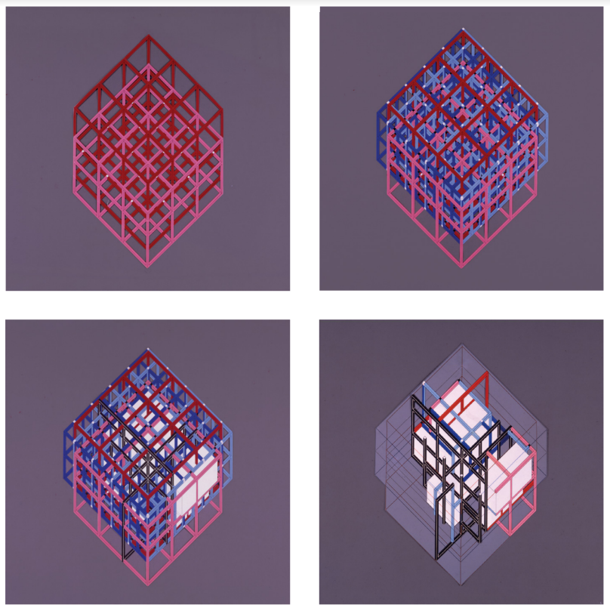
House VI, Cornwall, CT (1975)
Notes:
This is incredibly important – explicit in his process was a shift in a experiential-centric approach to one in which we, as perceiving subjects, encounter architecture, rather than dictate its form.

Slide 25
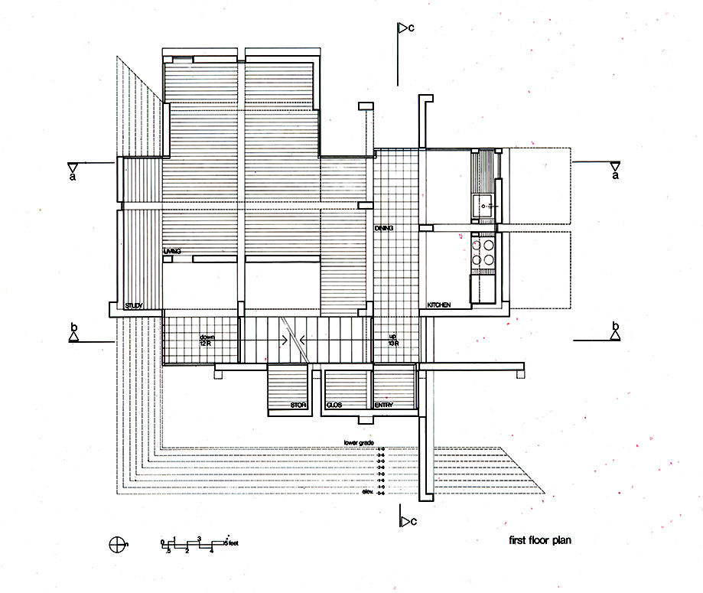
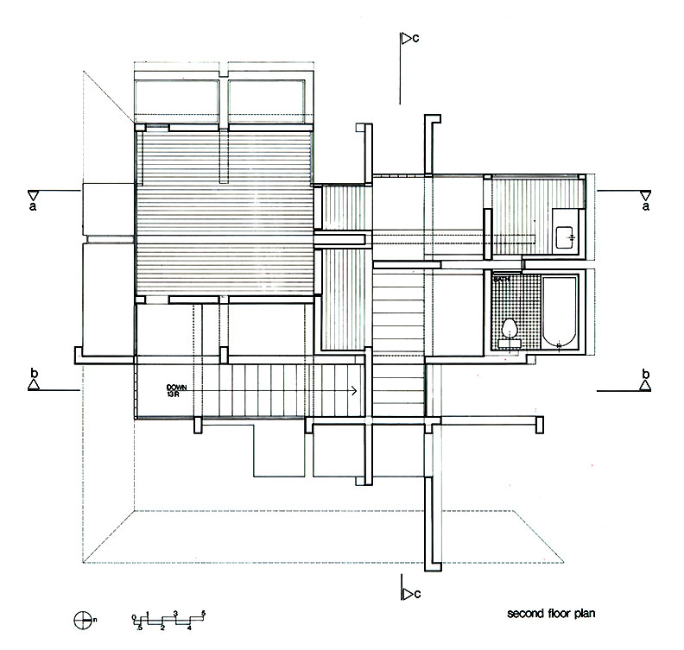
House VI, Cornwall, CT (1975)
Notes:
As Eisenman’s concern is form through the method of diagrams, drawings like plans and sections really come as an afterthought, often still negated the human figure.

Slide 26
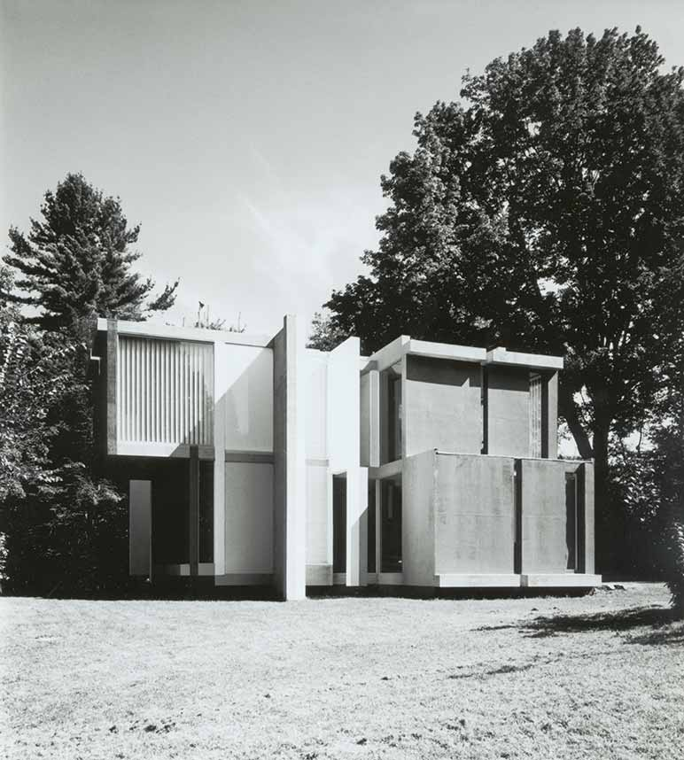
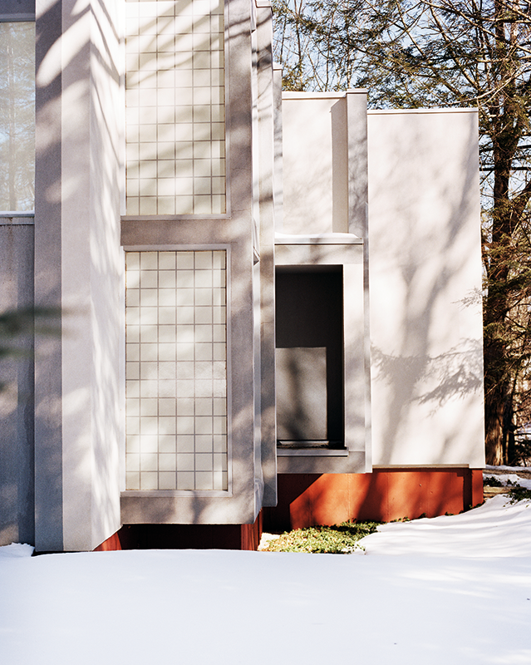
House VI, Cornwall, CT (1975)
Notes:
The project as built in CT.

Slide 27
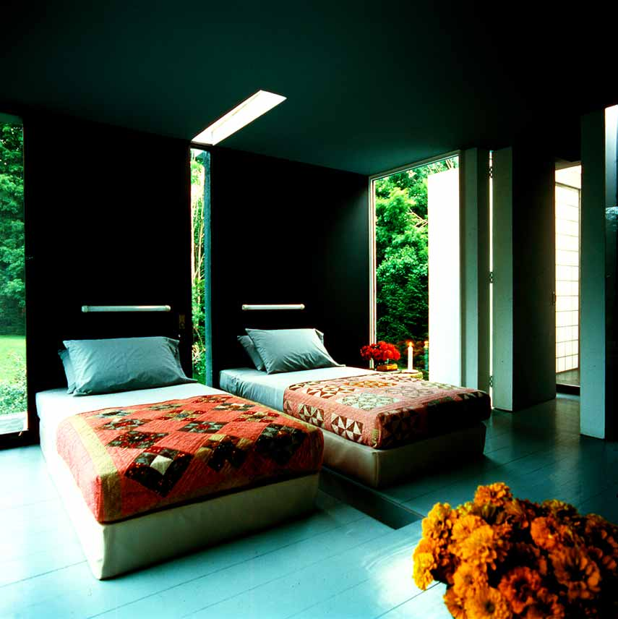
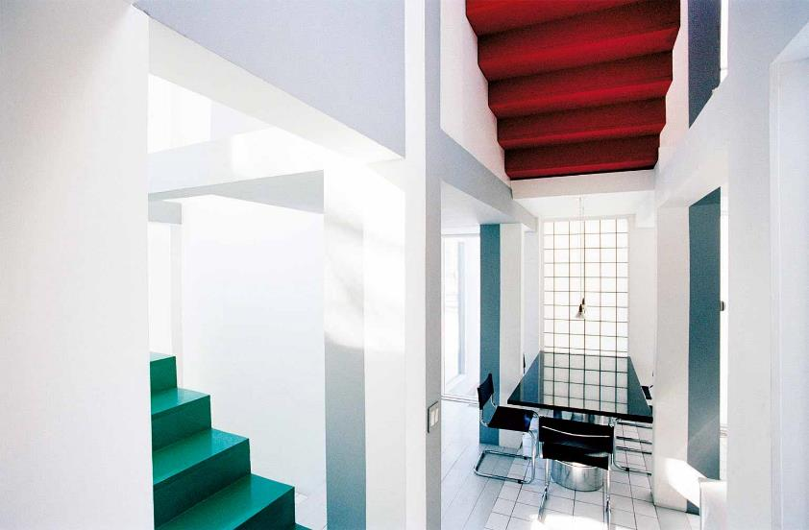
House VI, Cornwall, CT (1975)
Notes:
And part of this form-first human-last process.
The formal rules that made these subtractions
Accentuation by ‘splitting’ the master bed in two
Likewise, as part of the design, there was a transformation of the staircase
Result, upside down and reflected staircase that serves no purpose, but is formally significant as part of the formal process.

Slide 28
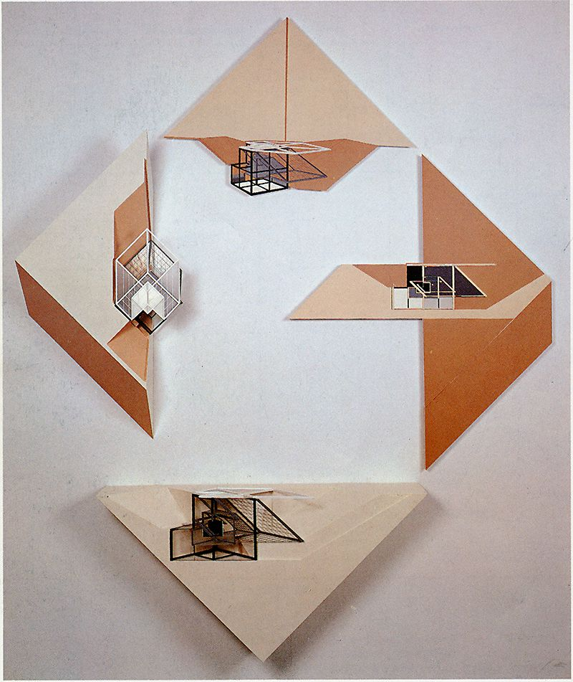
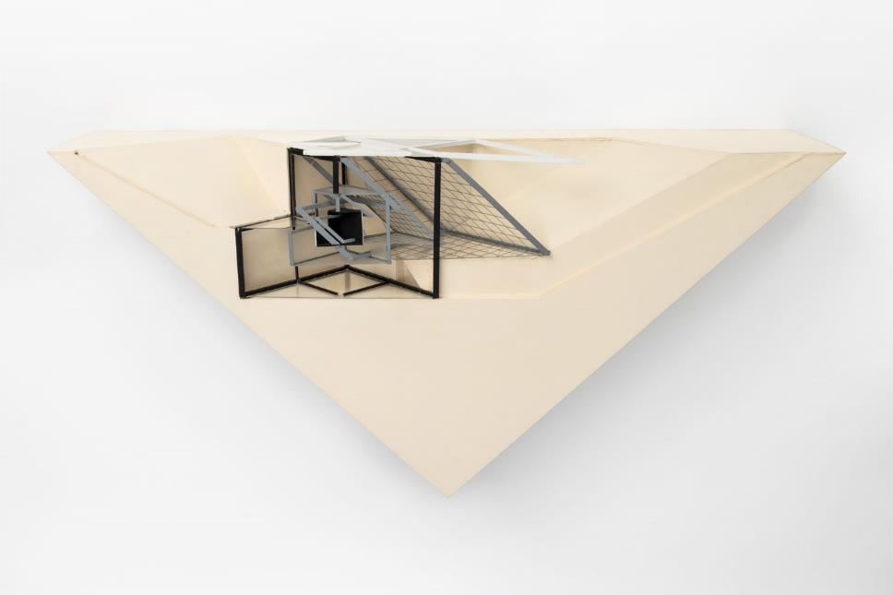
House El Even Odd (1980)
Notes:
During the last decades of the 20th century, still designed houses, even beyond the Houses of Cards series.
House El Even Odd
Play with words (“eleven”, “el” geometry)

Slide 29
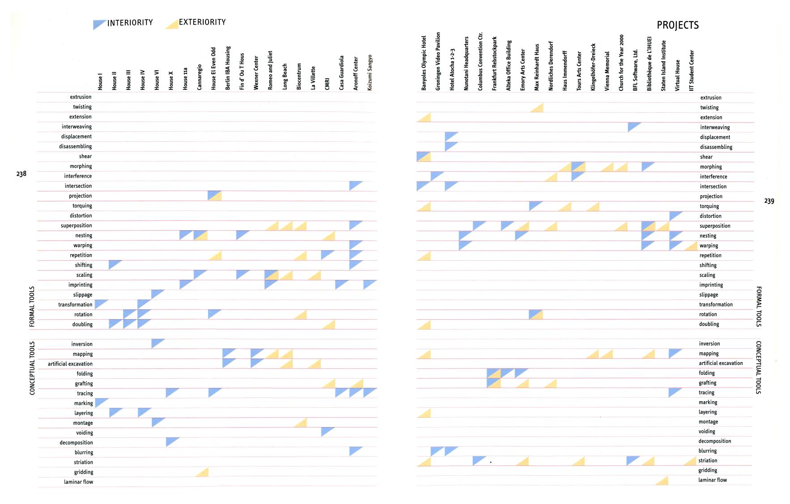
Notes:
This a table he made that summarizes the formal transformations that guided many of his projects
Distinguishing between transformations driven by the interior and the exterior.
Transformations (column) more important that program/brief/site/etc

Slide 30
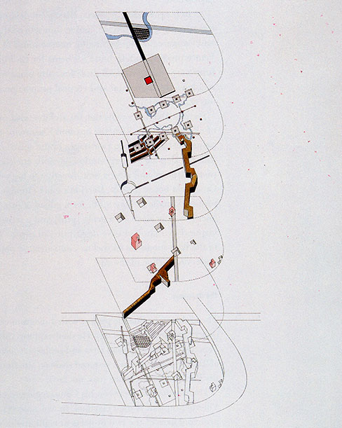
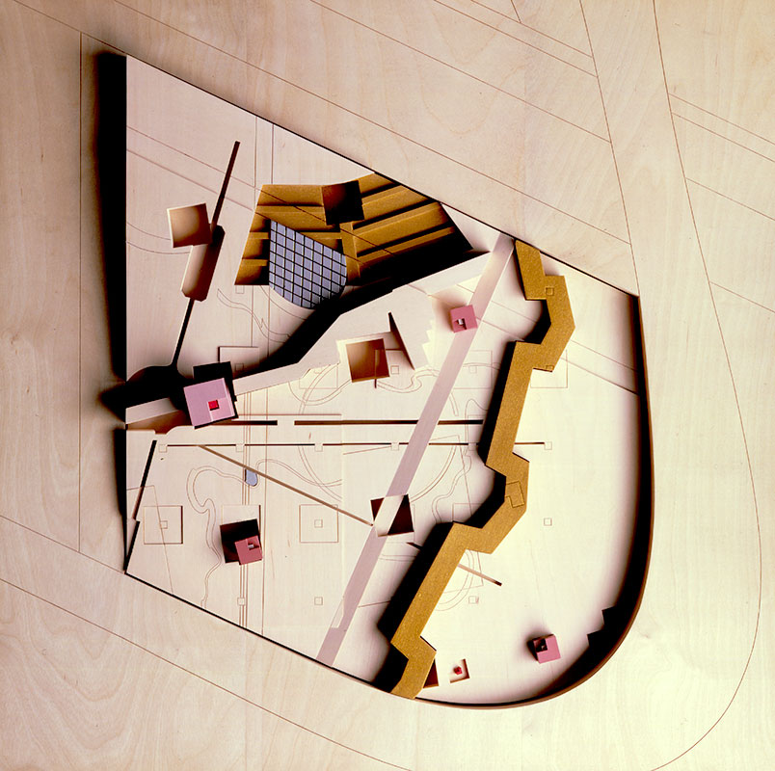
Chora L Works (Parc de la Villette) (1987)
Notes:
Collaborated with Bernard Tschumi on Parc de la Villette
Was asked by Tschumi to develop a park, a subsection
You can see the folies.
Collaboration went kind of sour, and while Eisenman didn’t build his part of the park, Eisenman with Tschumi and Derrida collaborated on a publication of their project, called Chora L Works.
Eisenman was explicitly concerned with the immaterial and universal aspects of architectural form, and so he regularly repeated formal tropes through works across different sites and programs.

Slide 31
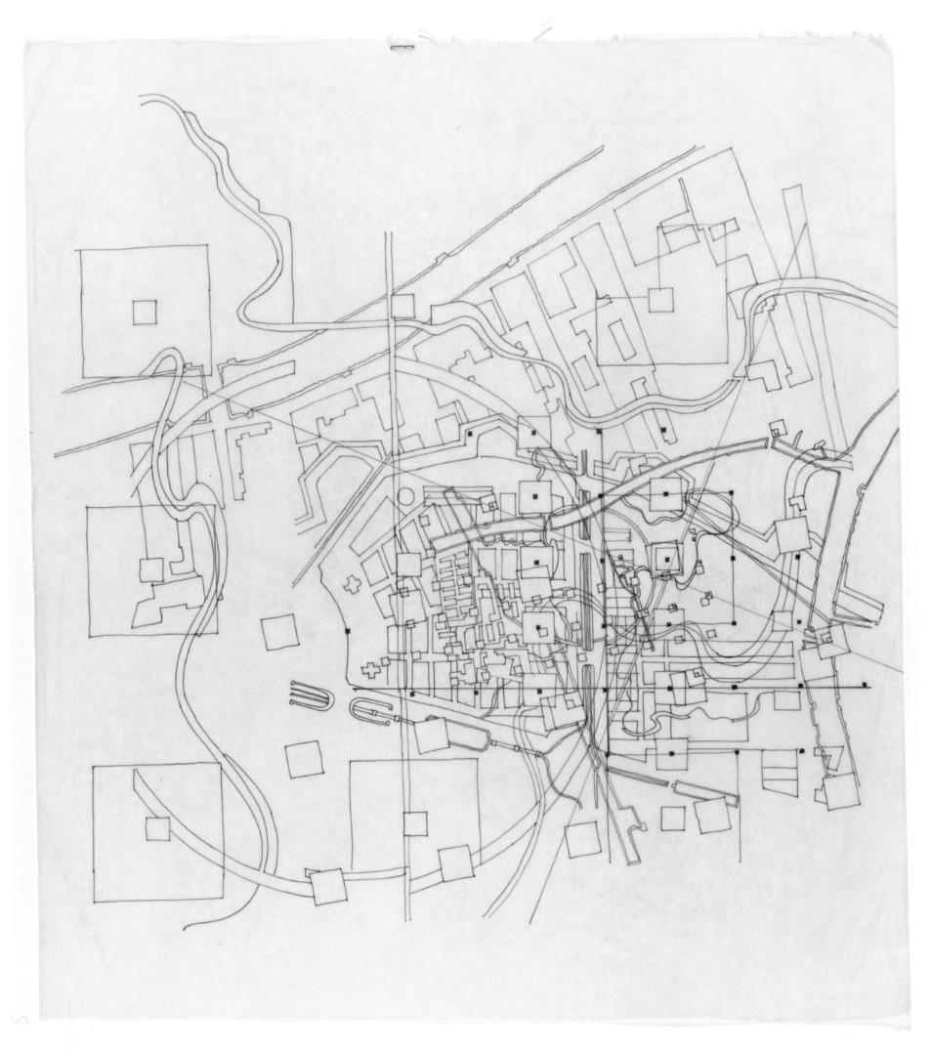
Cannaregio (1980)
Notes:
What he did for Parc de la Villette was actually a carry over from an earlier work of his, an unbuilt project in the district of Cannaregio in Venice Italy, of 1980.

Slide 32
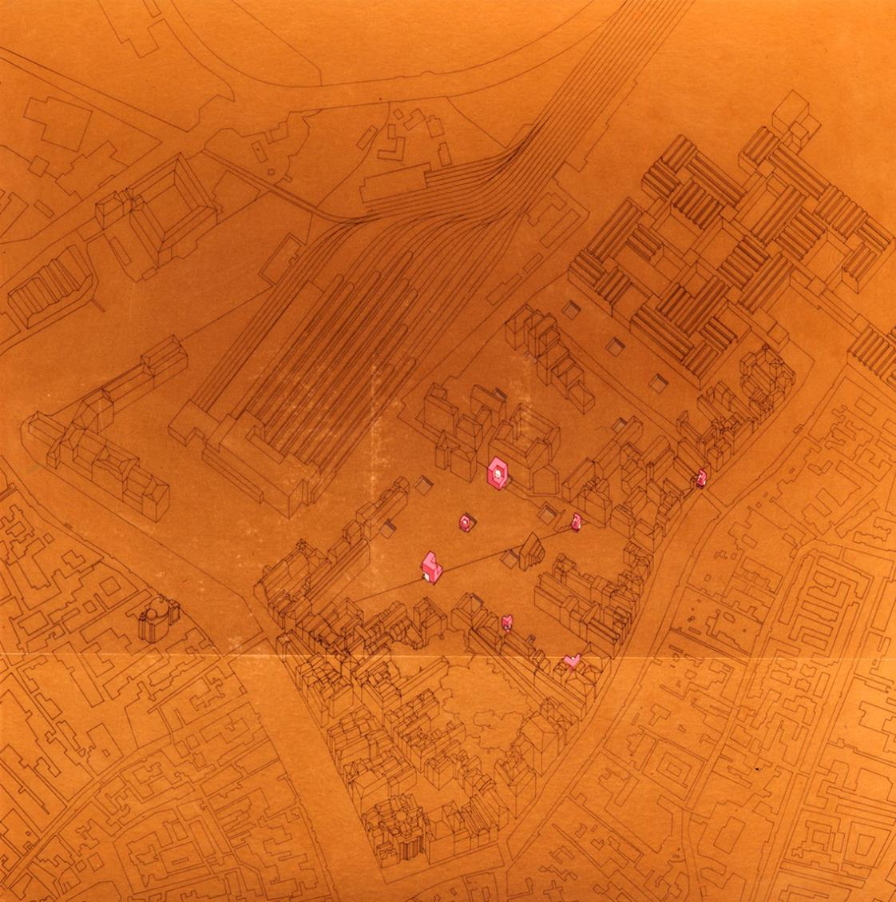
Cannaregio (1980)
Notes:
The commission called for a public square in the center of the district.
Eisenman’s concept, resonant to his other works such as his houses, was the things like ‘program’ and even ‘site’ shouldn’t be determined from outside of the project concept, but should come from within the form itself.
And so rather than look at context for things like site lines or viewing axes, he referred to a work by Le Corbusier, which was the unrealized proposal for a hospital in Venice.

Slide 33
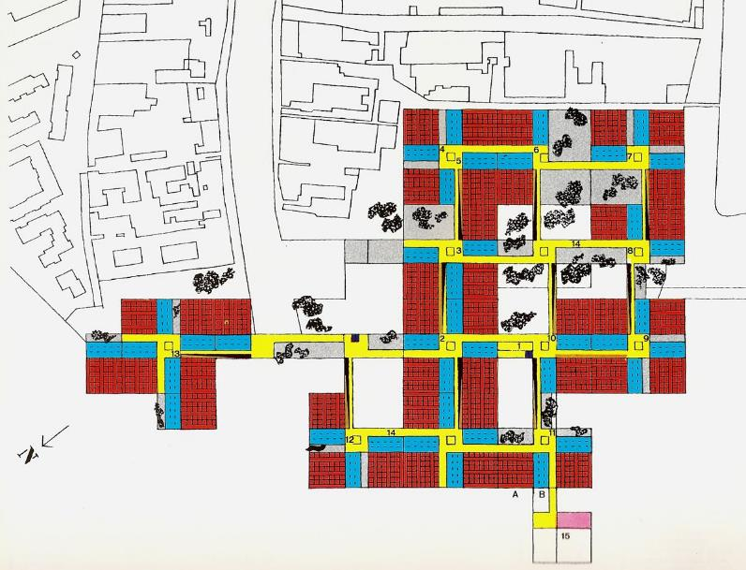
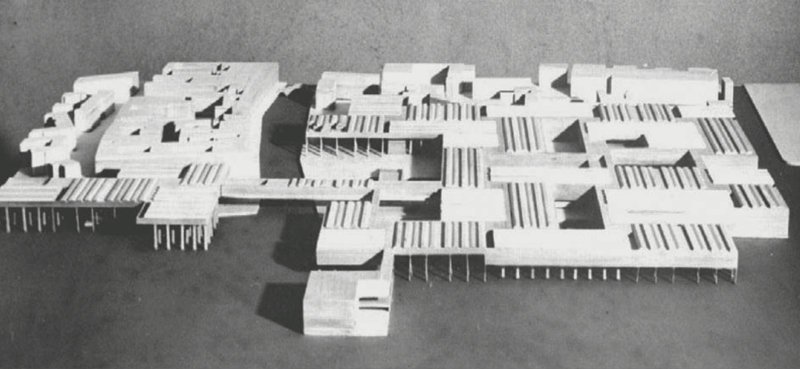
Le Corbusier, Proposal for a Hospital in Venice (1965)
Notes:
Design by Corbusier in 1965, we can see a Venice version of Plan Voisin – a grid, but now going into the water.

Slide 34
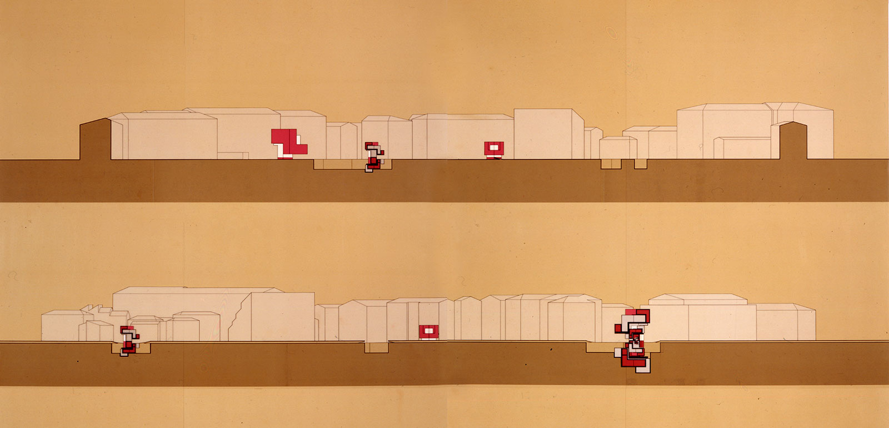
Cannaregio (1980)
Notes:
So for Eisenman, the ‘site’ was not the land given by Cannaregio town square, but the form given by the fictional project by Corbusier – in particular, the grid.
So across a grid spread out over the town square, Eisenman planted instances of a former project of his, House XI.
Remember, the fact these were houses before was completely irrelevant to Eisenman… the program holds no weight for him, just the form.
A house for the Architectural Historian Kurt Forster

Slide 35
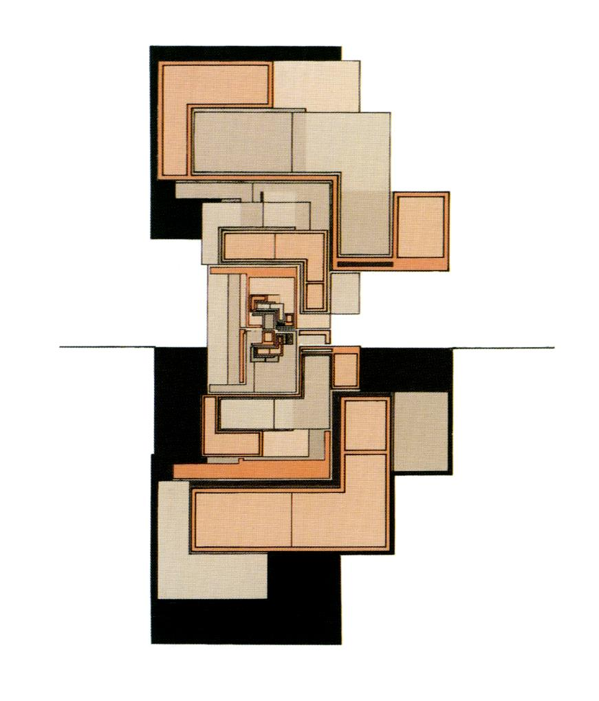
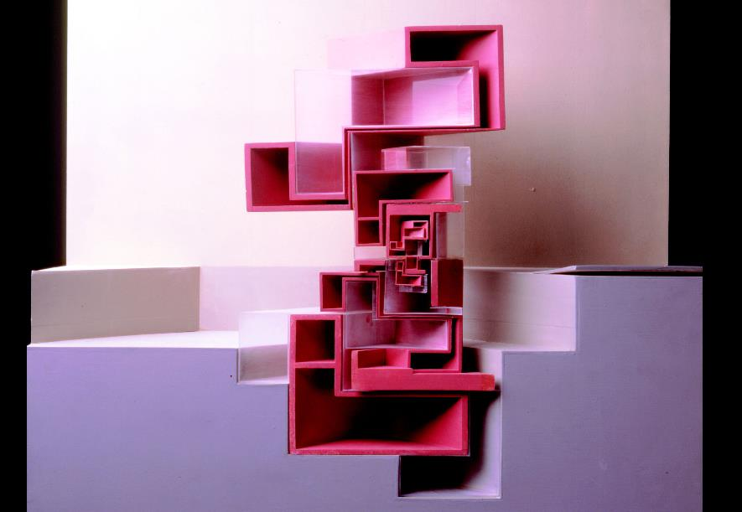
Cannaregio (1980)
Notes:
And in this case, House XI was about the transformation of nesting, about iteration inward.

Slide 36
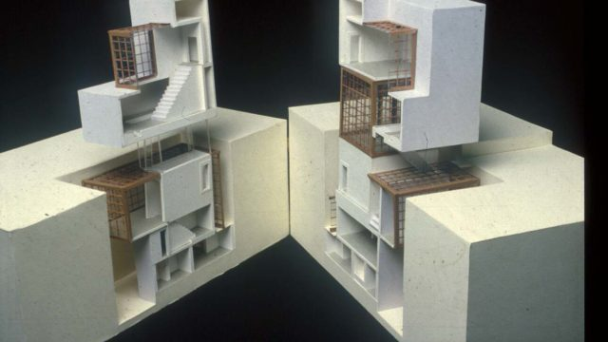
House XI (1978), Cannaregio (1980)
Notes:
On the right is a model for Cannaregio, while on the left we can see the original rendition outfitted for the purposes of inhabitation.

Slide 37
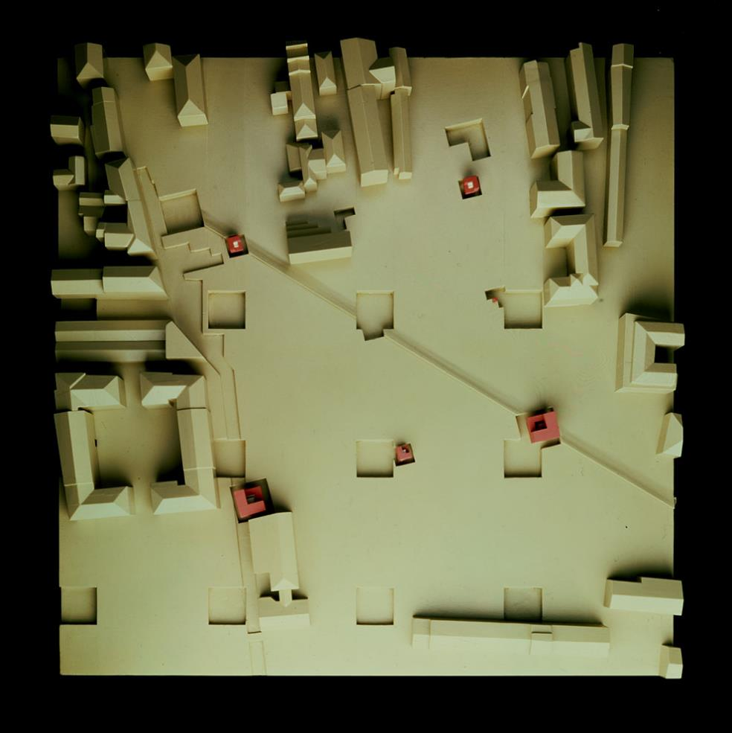
Cannaregio (1980)
Notes:
A top view of the model for Cannaregio.
Reminiscent of Parc de la Villette
Stylistically though, one of Eisenman’s major tropes was the disjunction between two or more registrations, such as the rotation of one grid over another.

Slide 38
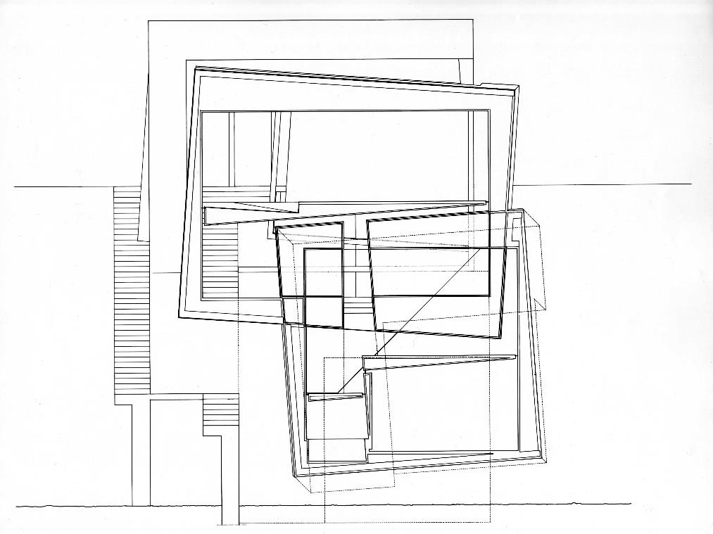
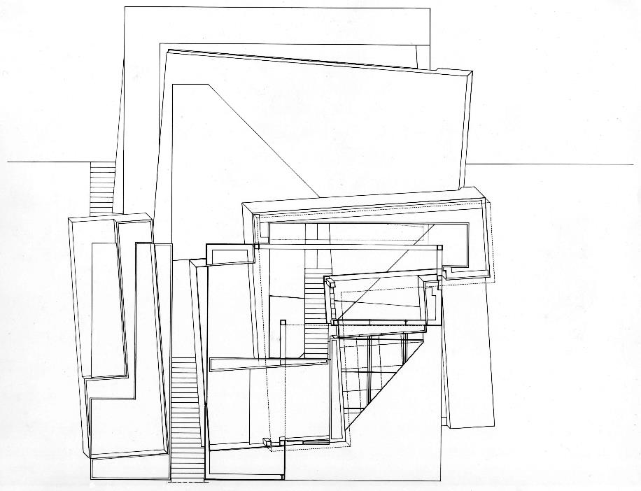
Guardiola House (1988)
Notes:
Another example, a bit later in 1988, the Guardiola House.
Clear that certain moves, such as rotation in this case, really guided his though process through decades.
Evolution of aesthetic

Slide 39
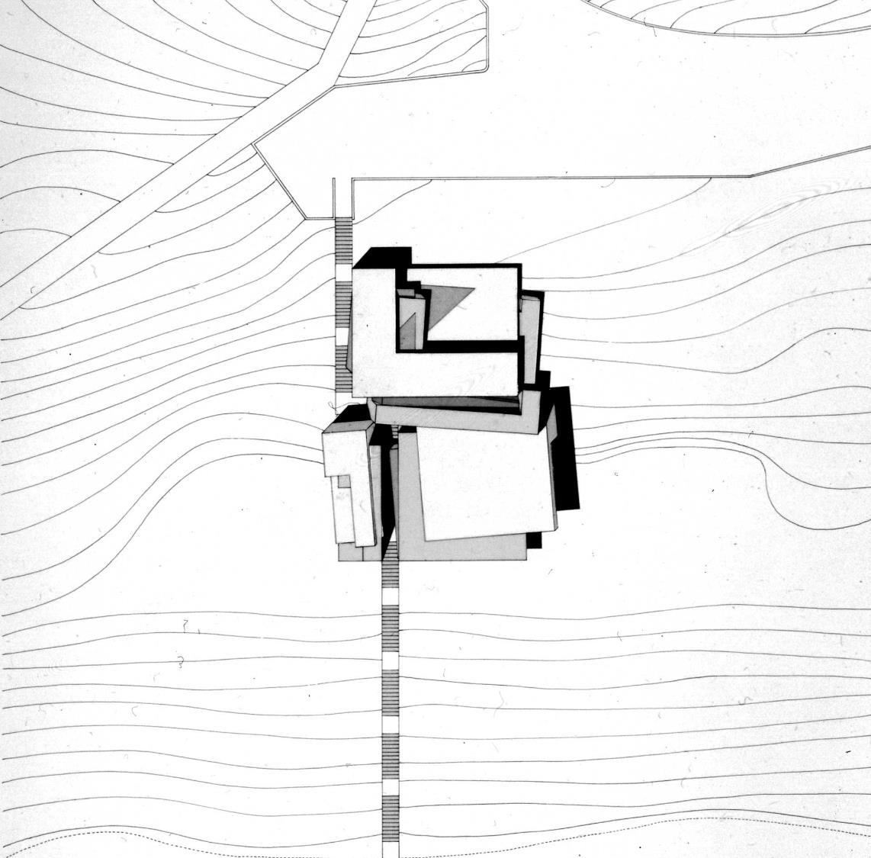
Guardiola House (1988)
Notes:
Situated along a hillside
Indicative of the rendering style of the 80’s/90’s… now making something of a return

Slide 40
Guardiola House (1988)
Notes:
Photograph of the model.

Slide 41
Guardiola House (1988)
Notes:
And a section showing its siting.

Slide 42
Guardiola House (1988)
Notes:
Another model

Slide 43
Guardiola House (1988)
Notes:
And another view of the same model.

Slide 44
City of Culture, Galicia, Spain (2011)
Notes:
As mentioned, Eisenman has been working since the late 60s up until today.
Of course, his methods evolved, but one thing I appreciate is his insistence on integrating theory with history in building.
Even with success, never let go of architecture-as-discourse.
Project: City of Culture in Galicia Spain, completed in 2011.
General program as a cultural museum.

Slide 45
City of Culture, Galicia, Spain (2011)
Notes:
In typical Eisenman fashion, now aided with computer modeling, the diagram of the formal process.
Exaggeration and then transformation of the terrain into fingers across the site.

Slide 46
City of Culture, Galicia, Spain (2011)
Notes:
Models of the site, as well as the structural strategy.

Slide 47
City of Culture, Galicia, Spain (2011)
Notes:
Section of the building through model.
In his larger projects, functional requirements undoubtedly figured more heavily, but form was always prior in concern to usage.

Slide 48
City of Culture, Galicia, Spain (2011)
Notes:
Another view of the same model.

Slide 49
City of Culture, Galicia, Spain (2011)
Notes:
Exterior view of the fenestration.

Slide 50
City of Culture, Galicia, Spain (2011)
Notes:
Interior view.
- Reading the hillscape ruptured into the interior

Slide 51
City of Culture, Galicia, Spain (2011)
Notes:
I put this photo on the right because it evidences a really important aspect to Eisenman.
Even though he himself may suggest certain programs to his spaces, he’s a firm believer on the value of subverting, or challenging how we use buildings.
Whether the program for his buildings are serious or playful, he believes that there is no inherent tie between a given form and its use, and that architecture should challenge how we conceive of ‘use’ in the first place.

Slide 52
City of Culture, Galicia, Spain (2011)
Notes:
And a final shot.

Slide 53
Berlin Memorial to the Murdered Jews of Europe, Berlin, Germany (2005)
Notes:
This last project is arguably one of my favorite architectural works, but I include it as well because he’s told me on a number of occasions that this was is his favorite project that he’s ever designed.
Berlin Memorial to the Murdered Jews of Europe, Berlin (2005)
Sites on a large site in Berlin city center, and the most prominent feature are these extrusions of various heights across the site.

Slide 54
Berlin Memorial to the Murdered Jews of Europe, Berlin, Germany (2005)
Notes:
Computer drawing of the placement of the extrusions… tombstones, cenotaphs, figures?... fluidity between form and meaning
A kind of patchwork, and slightly undulating.

Slide 55
Berlin Memorial to the Murdered Jews of Europe, Berlin, Germany (2005)
Notes:
Here we see it situated on site.
Also includes a subterranean gallery space, accessed from here.
But extrusions, major part of the project is openly accessible throughout the day.
The ‘occupiable’ space is just a minor part of the entire project.
Always challenging the role of what a ‘building’ is/can be

Slide 56
Berlin Memorial to the Murdered Jews of Europe, Berlin, Germany (2005)
Notes:
Color coded chart showing various extrusion distances, with overall grid.

Slide 57
Berlin Memorial to the Murdered Jews of Europe, Berlin, Germany (2005)
Notes:
Sections showing the irregularity of the extrusions, and the underground gallery space.

Slide 58
Berlin Memorial to the Murdered Jews of Europe, Berlin, Germany (2005)
Notes:
A more detailed section of the interior galleries.
Notice the intended ‘tilting’ of the extrusions.

Slide 59
Berlin Memorial to the Murdered Jews of Europe, Berlin, Germany (2005)
Notes:
A wonderful ‘inverse’ model of the site.

Slide 60
Berlin Memorial to the Murdered Jews of Europe, Berlin, Germany (2005)
Notes:
Model showing how the site is like a landscape, a wave, where buildings overlook.

Slide 61
“This project manifests the instability inherent in what seems to be a system, here a rational grid, and its potential for dissolution in time. It suggests that when a supposedly rational and ordered system grows too large and out of proportion to its intended purpose, it loses touch with human reason. It then begins to reveal the innate disturbances and potential for chaos in all systems of apparent order.”
Berlin Memorial to the Murdered Jews of Europe, Berlin, Germany (2005)
Notes:
<<Quote…>>

Slide 62
Berlin Memorial to the Murdered Jews of Europe, Berlin, Germany (2005)
Notes:
Some ‘interior’ views of the outside space.
Gradual build up as you traverse the site.
No explicit program, just these extrusions.
No function, just a meandering passage.

Slide 63
Berlin Memorial to the Murdered Jews of Europe, Berlin, Germany (2005)
Notes:
Image of the interior of the subterranean gallery, referencing the underlying form, the deep structure of the entire project.

Slide 64
Berlin Memorial to the Murdered Jews of Europe, Berlin, Germany (2005)
Notes:
View just after it rained.

Slide 65
Berlin Memorial to the Murdered Jews of Europe, Berlin, Germany (2005)
Notes:
Many people have complained that it’s not always treated with a somber attitude by visitors.
Eisenman himself said that just because something is a monument for a tragic event, doesn’t mean it should maintain a distance from our daily lives.
We should use it as we will, and if a monument brings happiness, let it.
There’s no prescription (function) on how monuments should be used, and architects shouldn’t pretend to have that kind of power.
Just wants to make sure it’s a real part of the city.

Slide 66
Berlin Memorial to the Murdered Jews of Europe, Berlin, Germany (2005)
Notes:
Aerial view.
Notice how people disappear – only visible on the outskirts.

Slide 67
“In this monument there is no goal, no end, no working one’s way in or out. The duration of an individual’s experience of it grants no further understanding, since understanding the Holocaust is impossible. The time of the monument, its duration from top surface to ground, is disjoined from the time of experience. In this context, there is no nostalgia, no memory of the past, only the living memory of the individual experience.”
Berlin Memorial to the Murdered Jews of Europe, Berlin, Germany (2005)

Slide 68
Berlin Memorial to the Murdered Jews of Europe, Berlin, Germany (2005)

Slide 69
Berlin Memorial to the Murdered Jews of Europe, Berlin, Germany (2005)

Slide 70
Lebbeus Woods
American; 1940 - 2012
Notes:
I’ve included the work of two other architects, not so much because they’re of the same ilk as Eisenman in theory/practice
But because their influences were contemporaneous
Lebbeus Woods

Slide 71
Lebbeus Woods, various projects
Notes:
Based on a fictional scenarios, seemingly extreme conditions, but that were in some way present today
War-torn areas
Architecture’s both positive and negative contributions

Slide 72
Lebbeus Woods, various projects
Notes:
Undoubtedly driven by a particular aesthetic

Slide 73
Lebbeus Woods, various projects
Notes:
- Work influential in entertainment design… architecture?

Slide 74
Lebbeus Woods, various projects

Slide 75
Lebbeus Woods, various projects

Slide 76
Lebbeus Woods, various projects

Slide 77
Lebbeus Woods, various projects

Slide 78
Lebbeus Woods, various projects

Slide 79
Lebbeus Woods, various projects

Slide 80
Lebbeus Woods, various projects

Slide 81
Lebbeus Woods, various projects

Slide 82
Lebbeus Woods, various projects

Slide 83
Lebbeus Woods, various projects

Slide 84
Lebbeus Woods, various projects

Slide 85
Lebbeus Woods, various projects

Slide 86
Thom Mayne (Morphosis)
American; 1944 -
Notes:
Highly representative of the experimental architecture of late 20th century Southern California architecture
Today, best represented by SCI-Arc

Slide 87
Morphosis, Diamond Ranch High School, Pomona, CA (1999)
Notes:
Arguably lesson driven philosophically, and much more by an aesthetic
Echoes of deconstructivism

Slide 88
Morphosis, 41 Cooper Square, NYC (2009)
Notes:
Relatively recent project, 41 Cooper Square, part of The Cooper Union
Without question this aesthetic has been made possible by new technologies of building

Slide 89
Morphosis, Kolon One & Only Tower, Seoul, South Korea (2018)

Slide 90
Morphosis, Kolon One & Only Tower, Seoul, South Korea (2018)

Slide 91
Wolf Prix &
Helmut Swiczinsky
(Coop Himmelb(l)au)
Austrian/Polish; est. 1968
Notes:
Last group, something of a fun pair that represented the extreme of the end of the 20th century
Himmelb(l)au
Himmel (sky)
Blau (blue)
Bau (building/construction)

Slide 92
Coop Himmelb(l)au, The Blazing Wing (1980)
Notes:
Certainly a much stronger theoretical motivation to their work
The Blazing Wing
Think of Tschumi
How much does architecture depend on building for its definition?

Slide 93
You can judge how bad the seventies were by looking at its uptight architecture.
A democracy of opinion polls and complacency thrives behind Biedermeier façades. We have no desire to build Biedermeier. Not now or no other time. We are tired of seeing Palladio and other historical masks. Because with architecture, we don’t want to exclude everything that is disquieting.
We want architecture that has more. Architecture that bleeds, that exhausts, that whirls, and even breaks. Architecture that lights up, stings, rips, and tears under stress. Architecture has to be cavernous, fiery, smooth, hard, angular, brutal, round, delicate, colorful, obscene, lustful, dreamy, attracting, repelling, wet, dry, and throbbing. Alive or dead.
If cold, then cold as a block of ice. If hot, then hot as a blazing wing. Architecture must blaze.
Coop Himmelb(l)au, The Blazing Wing (1980)
Notes:
‘Architecture must blaze’

Slide 94
Coop Himmelb(l)au, Rooftop Remodeling Falkestrasse, Vienna, Austria (1988)
Notes:
- Conference space atop a Biedermeier building in Austria

Slide 95
Coop Himmelb(l)au, Rooftop Remodeling Falkestrasse, Vienna, Austria (1988)
Notes:
Reminiscent of Woods’ work
Difficult to pinpoint the exact chronology of authorship – not important, a salient aesthetic of the 80’s, 90’s, and 00’s

Slide 96
Coop Himmelb(l)au, Energy Roof, Perugia, Italy (2009)
Notes:
Relatively recent project with students
Think of Blazing Wing – but now almost a kind of ‘pure energy’
Architecture as energy

Slide 97
Coop Himmelb(l)au, BMW Welt, Munich, Germany (2009)
Notes:
Also a portfolio of larger built works
BMW Welt, 2009

Slide 98
Coop Himmelb(l)au, BMW Welt, Munich, Germany (2009)

Slide 99
Coop Himmelb(l)au, PANEUM - Wunderkammer des Brotes (House of Bread II) for Backaldrin, Austria (2017)
Notes:
- Fun smaller projects

Slide 100
Coop Himmelb(l)au, PANEUM - Wunderkammer des Brotes (House of Bread II) for Backaldrin, Austria (2017)
Notes:
- Fun smaller projects

Slide 101
Coop Himmelb(l)au, PANEUM - Wunderkammer des Brotes (House of Bread II) for Backaldrin, Austria (2017)

Slide 102
Coop Himmelb(l)au, Musée des Confluences, Lyon, France (2009)
Notes:
Science and anthropology museum, opened in 2014
Conceived as a ‘cloud of knowledge’

Slide 103
Coop Himmelb(l)au, Musée des Confluences, Lyon, France (2009)

Slide 104
Coop Himmelb(l)au, Musée des Confluences, Lyon, France (2009)

Slide 105
Coop Himmelb(l)au, Musée des Confluences, Lyon, France (2009)

Slide 106
Coop Himmelb(l)au, Musée des Confluences, Lyon, France (2009)

Slide 107
Coop Himmelb(l)au, Musée des Confluences, Lyon, France (2009)

