Slide 1
Corporate Architecture
SOM and Eero Saarinen
Contemporary Architecture Theory
Eugene Han
Fall 2020, 11:15 – 12:30 pm
Online Instruction
Notes:
More buildings, less critical theory
Still ‘conceptual,’ but for purposes outside of the discipline ‘proper’
Personally, I find that problematic
Just like pop songs, there’s an economy, a market – schedule for production, formulaic, market-driven rather than discipline-driven
There’s absolutely nothing bad with just building, but if that’s your end game, I strongly recommend becoming a builder!
What you tend to see discussed or remembered in projects that have a proper theoretical foundation is discussion that revolves on two issues:
HISTORICAL EVENTS (first this happened, then that)
In lieu of theory, there’s emphasis on TECHNOLOGY
The nature of technology is that it changes – it’s supposed to
Nevertheless, it’s impossible to completely disregard a genre of architecture that dominates arguably the majority of works built over the past 50 years up until the present day.
And so I wanted to look at a couple architects that really embody the mid-20th century, and the rise of Corporate Architecture that served as a model for contemporary practice
One last note however on ‘Corporate Architecture’
Lazy and inaccurate term.
What do I mean by ‘corporate’?
The architect?
The client?
… a bit of both, hopefully gets clear, but most importantly, it’s about a general culture that arises from the process of design.

Slide 2
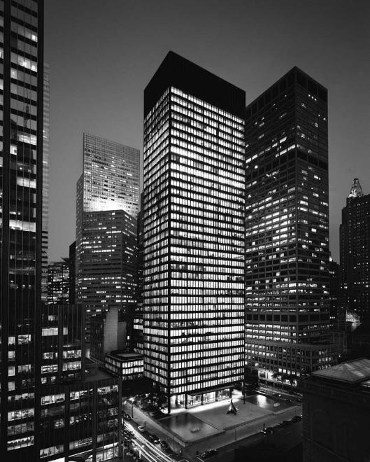
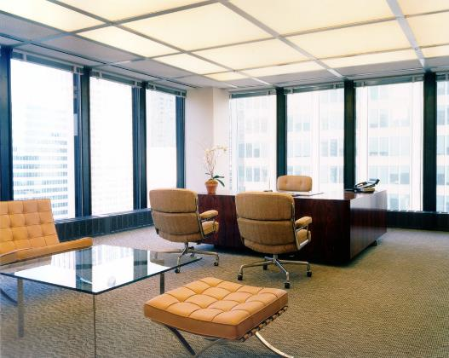
Seagram Building, 375 Park Ave, New York City (1958)
w/ Philip Johnson
Notes:
It’s impossible to overlook Mies van der Rohe’s role in the shaping of Corporate Architecture, both in America and globally
As I mentioned back a few weeks ago, part of the appeal of Mies’ work was that it was relatively easy to visually replicate
But oftentimes this replication was performed ‘at lowest cost’ – reducing proportions to production standards, changing expensive materials to cheaper ones.
What results, is a kind of ‘deadening’ effect of Mies’ idea of ‘pure form’

Slide 3
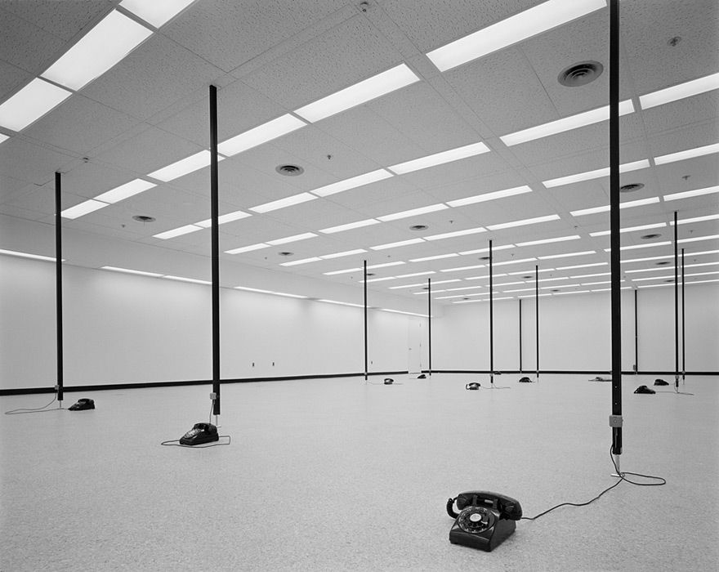
Ezra Stoller
Philip Morris Research Center Tower (1972)
Richmond, VA
Notes:
This is one of my favorite architectural photographs – by Ezra Stoller.
An emptying of the architectural idea so that architecture is now purely equipment.
The architecture itself has no purpose other than facilitating the most amount of functions here.
Any company can move in.
Any program can take place.
Zero daylight, so that lighting can be fully controlled and changed according to whatever function.
Universalization of architecture – it disappears.
Now, this kind of architecture – what criteria is there left?!
Technology (disparagingly)
Be wary – when you hear an architect discuss their project, if the only thing is how technologically advanced their building is, perhaps there’s not much else to talk about!
And why problematic? Technology, by its nature, changes, outdates itself in rapid speed.
Compare contrast ceiling Philip Morris / Seagram Building
From an idea to function-driven, with ‘least aesthetically offensive’ solution

Slide 4
Skidmore, Owings & Merrill
1936 (1939) to Present
Notes:
There’s perhaps no more significant a practice in Corporate Architecture than Skidmore, Owings, & Merrill

Slide 5
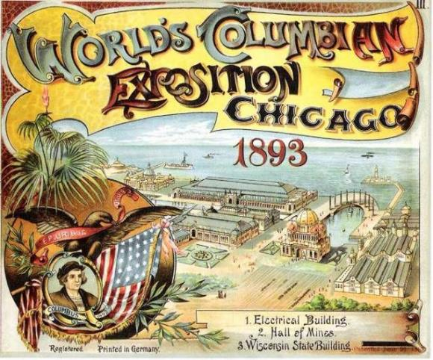
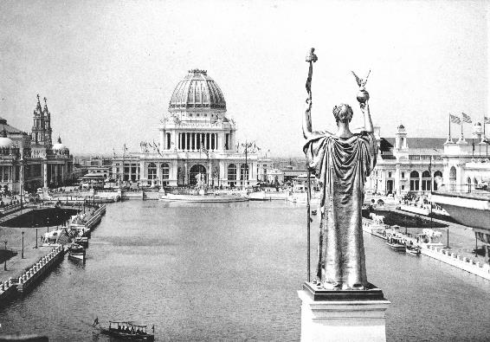
Columbian Exposition, Chicago, 1893
Notes:
To preface the practice, in 1893, the city of Chicago held the World’s Columbian Exposition, which was held as a celebration of the 400th anniversary of Christopher Columbus’ arrival in America.

Slide 6
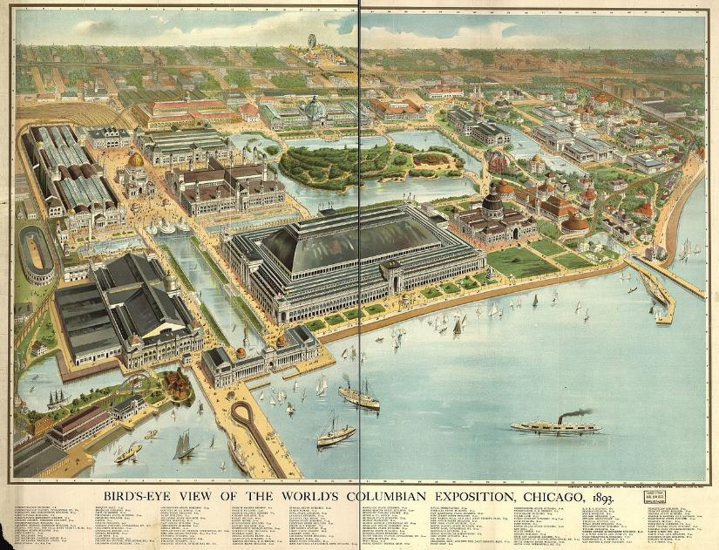
Columbian Exposition, Chicago, 1893
Notes:
So in many ways, this exhibition was a celebration of how far the country had progressed over its history.

Slide 7
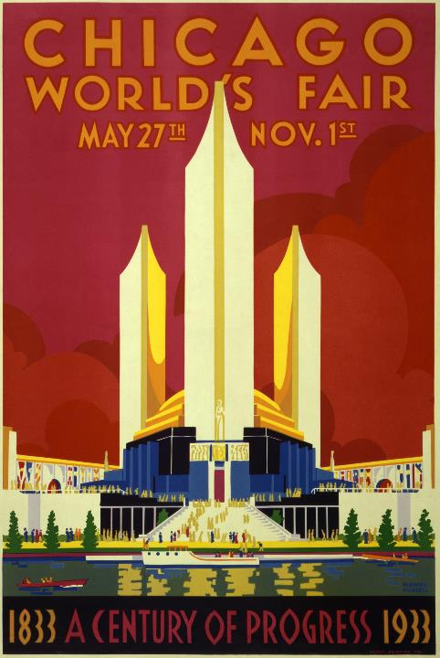
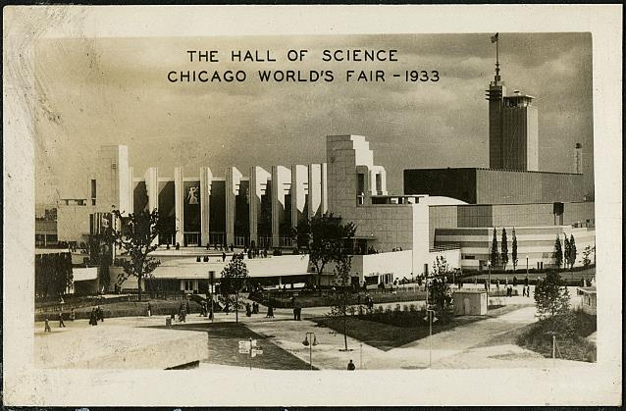
Chicago World’s Fair ‘A Century of Progress’ (1933)
Notes:
40 years later, Chicago held another exposition, this time called the Chicago World’s Fair of 1933.
As opposed to the Columbian Exposition, this one was about celebrating the future of technological progress in America – it was called “A Century of Progress” after all.

Slide 8
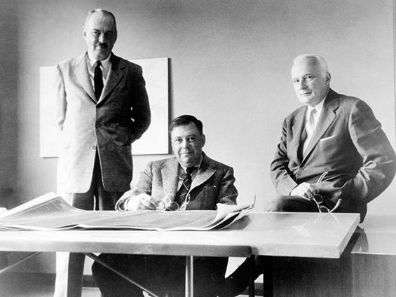
Chicago World’s Fair ‘A Century of Progress’ (1933)
Notes:
This is the first time Louis Skidmore and his brother in law, Nathaniel Owings, would work together – Skidmore was hired as the masterplanner for the fair.
While this collaboration was only a one-off, and they went their separate ways after the fair, 3 years later in 1936, they reunited in NYC and established the firm Skidmore and Owings.

Slide 9
John Merrill, Nathaniel Owings, and Louis Skidmore
Notes:
1939, John Merrill joined as partner, and the name changed to Skidmore, Owings & Merrill – or simply SOM as they are often called today.
From the get-go, they were looked at Mies’ work as a model
In fact, Frank Lloyd Wright had famously called them the ‘3 Blind Mies’
It should be pretty clear now my disdain for this type of work as a whole – though I think there are some wonderful buildings when taken individually

Slide 10
CONCEPT →
EXECUTION
Notes:
What SOM so skillfully did, and why they were so successful, was that they shifted the focus from CONCEPT to EXECUTION
Where architects like Rossi were master theorists, firms like SOM sought to master the process of making buildings.

Slide 11
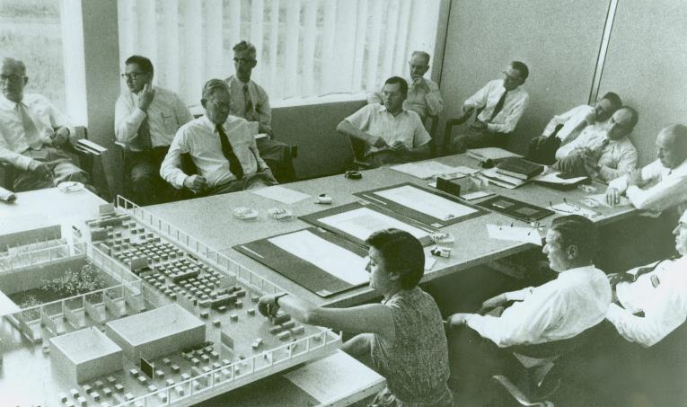
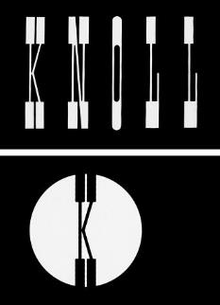
Left: Florence (Shu) Knoll presenting interior scheme for SOM
Notes:
Their model was not the architect-genius trying to piece together universal problems of humanity and the built environment, but of how you can get a group of people together, pool their talents, and get expensive projects executed.
Here’s a famous photo showing one of their typical design meetings.
You don’t see a single architect convincing the client on their genius idea, but instead much like a board meeting, the design phase is a problem to be flushed out with all options compared against each other.
Architecture a optimization
Critically, and this is what makes this particular photo famous, is that you see at the bottom Shu Knoll, who together with Hans Knoll, made the Knoll furniture company what it is today.
Knoll, East Greenville, PA (30 minutes SW of Lehigh)
But the point is that in many of their project, SOM ‘outsourced’ their interior design to people like Knoll.
Contrast that with Wright, who would design the building as much as the furniture, down to the fork to be used on his chairs.
For SOM, architecture was a business, an art form with a necessary economy tied to it.
They were about volume, about growth.
By 1950, only 14 years after founding the firm, they already had 7 partners.
By 1952, 14 partners and over 1,000 employees
Offices in Chicago, NYC, SF, and Portland

Slide 12
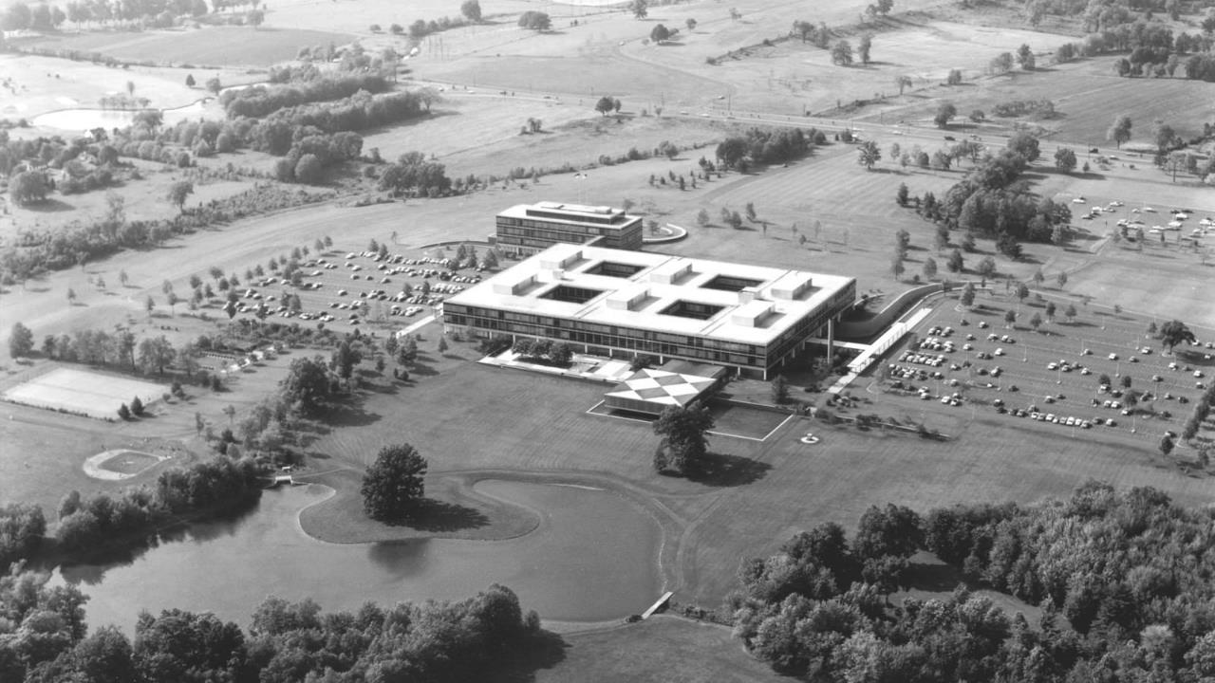
Connecticut General Insurance Company
Bloomfield, CT (1954 – 57)
Notes:
A massive part of their early success was that identified an opportunity for corporate building in the suburbs.
Typified by projects like this (and they all look quite similar), they recognized that rapidly growing American corporations were looking to build more and more outside of the downtowns.

Slide 13
Left: From Mozingo, Pastoral Capitalism
Right: James Stevenson, New Yorker (June 1967)
Notes:
This was in large part due to the evolving capitalist model of corporate development.
As company sizes increase, a larger portion is occupied by lower and middle management, who either aren’t required to be in the city, or costs would be lowered by having them there.
Moreover, the exodus from downtown to suburbs met with a changing trend in America, where those of the middle and upper economic classes preferred their own detached homes, more expensive schools for kids, and so on.
Critically, and I know this sounds sexist – because quite frankly it was – the larger the companies got, the more managers there were, and the more managers there were, the more secretaries were needed – and it was a lot more cost effective to have secretaries in the suburbs than in the cities.

Slide 14
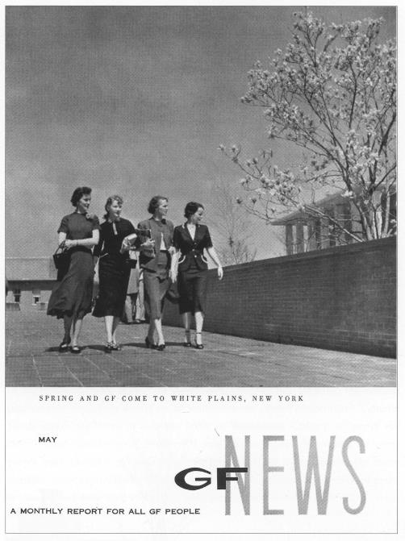
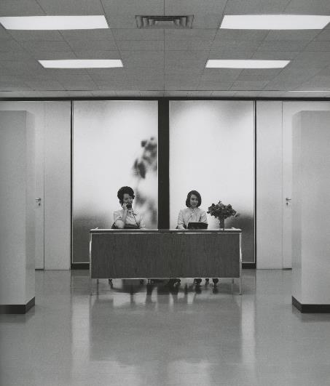
Left: From General Foods brochure 1954
Right: In front of executive offices, Branque Lambert
Notes:
This increase in the female secretarial and clerical workforce was in large part enabled by the move from city to suburb.

Slide 15
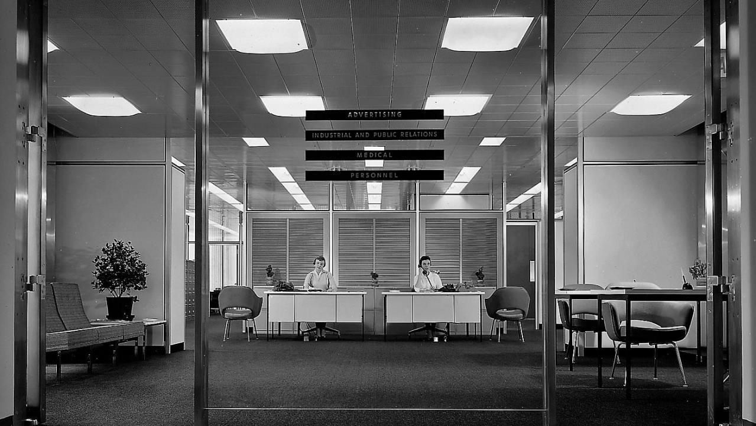
Reception desk at Inland Steel
Notes:
<cont…>

Slide 16
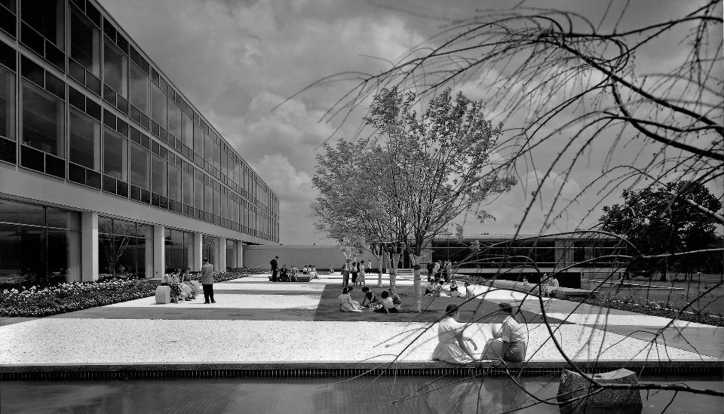
Connecticut General Insurance Company
Bloomfield, CT (1954 – 57)
Notes:
So, the point here is that SOM capitalized on this trend, and as mentioned, they were not in the business of mulling over the problems of each new commission, but instead perfected a kind of prototypical corporate architecture across many different clients and suburban sites.
I’ll shuffle through a few of these projects – but really, there were dozens that looked quite similar, and I think you get the feel pretty quickly.
Connecticut General Insurance Company

Slide 17
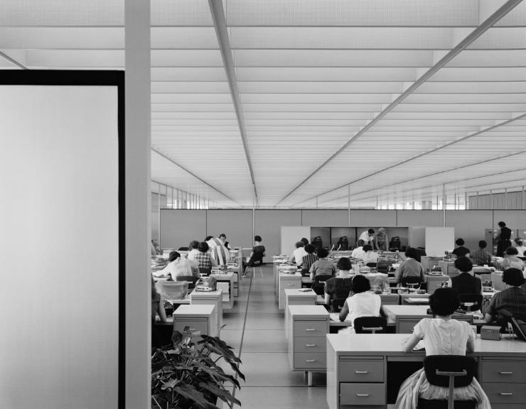
Connecticut General Insurance Company
Bloomfield, CT (1954 – 57)
Notes:
<cont…>

Slide 18
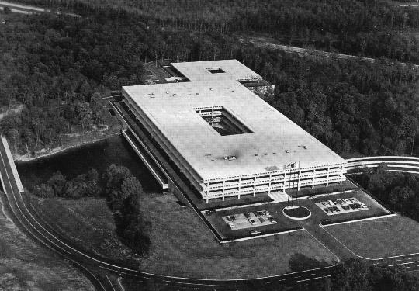
American Can Company, Greenwich, CT
Notes:
The American Can Company, Greenwich CT
A lot of these structures still exist today, but many times they’re called something else because again, these are intentionally just shells – open to different programs and clients.

Slide 19
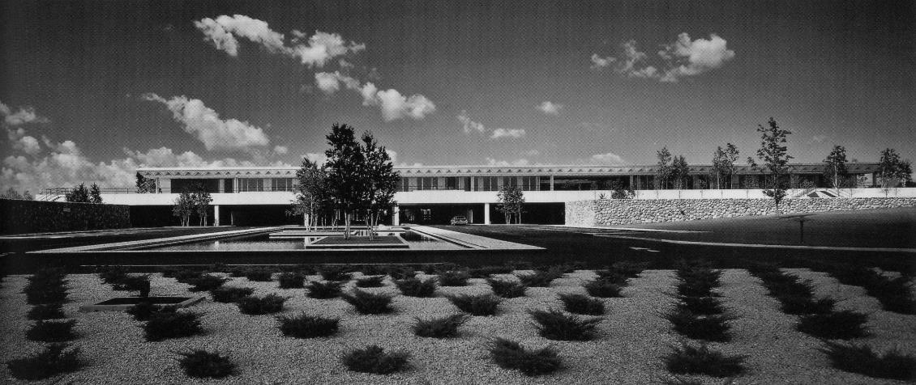
The Upjohn Company
Kalamazoo, MI ( 1959 -61)
Notes:
The Upjohn Company in Michigan.

Slide 20
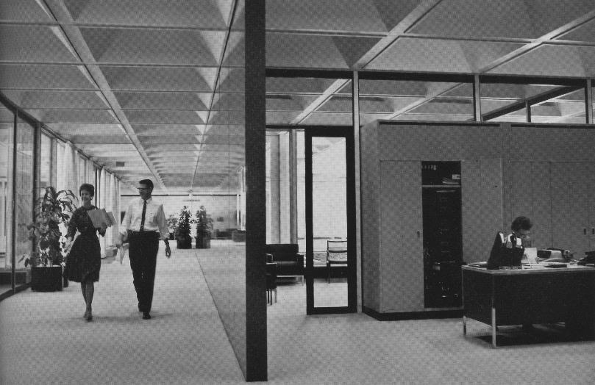
The Upjohn Company
Kalamazoo, MI ( 1959 -61)
Notes:
Diamond coffered ceiling.

Slide 21
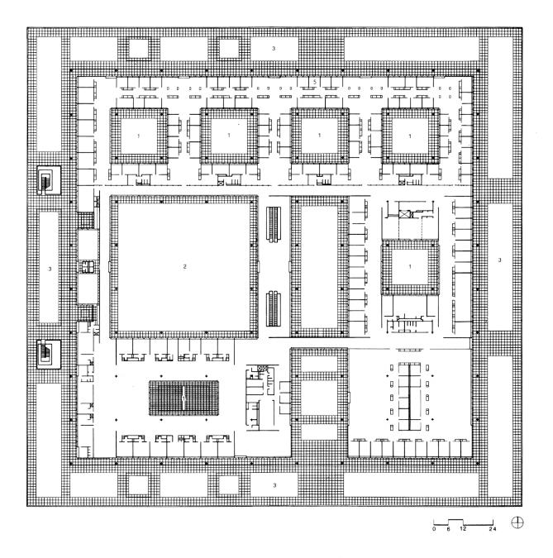
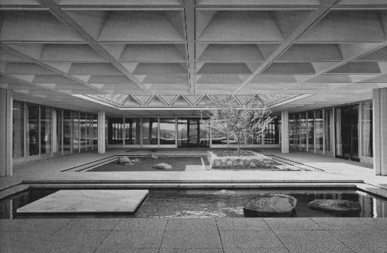
The Upjohn Company
Kalamazoo, MI ( 1959 -61)
Notes:
Typical layout
Bounding box punctuated with these courtyards.
Arrangement of offices and common spaces dependent on the envelope and courtyard openings.
A mean for introducing lighting into boxes with massive footprints

Slide 22
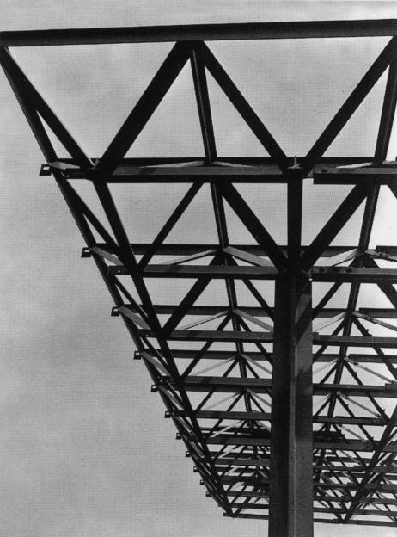
The Upjohn Company
Kalamazoo, MI ( 1959 -61)
Notes:
This building was well covered because of its use of a spaceframe, which allowed for large expanses – generic use of space
Generally structure only gets in the way of an architecture that wants to be as universal as possible.
Remember, when nothing to say, mention technology…. That’s all ☹

Slide 23
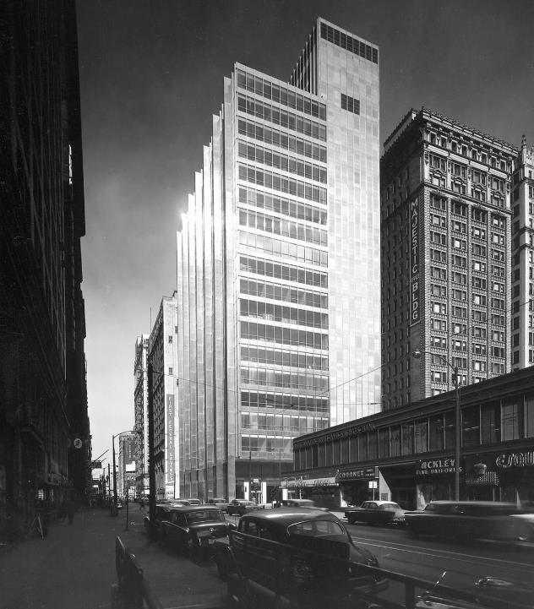
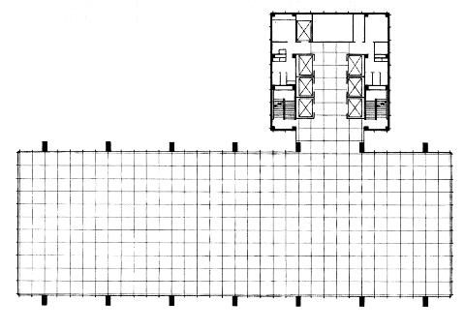
Inland Steel Building
Chicago, IL (1958)
Notes:
But of course, SOM, didn’t only build in the suburbs, but also set the standard for urban corporate architecture.
One of their most well known early projects was the corporate headquarters for Inland Steel in Chicago
Use of Stainless Steel
Duck anyone?
When talking about skyscrapers or high-rises in general, there’s an important term: TYPICAL PLAN
In the typical-typical plan of any tower structure, the layout is pretty straightforward
Core + Floor + Envelope

Slide 24
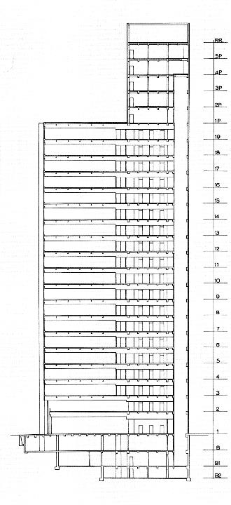
Inland Steel Building
Chicago, IL (1958)
Notes:
With that in mind, what made Inland Steel so well-known is that they in essence shifted the core ‘outside’ of the plan itself, leaving a wholly open typical floorplan
Can’t really do this anymore for fire-code (not enough ingress/egress), but still, a simple concept

Slide 25
Inland Steel Building
Chicago, IL (1958)
Notes:
Iterations of plans independent of structural consideration.

Slide 26
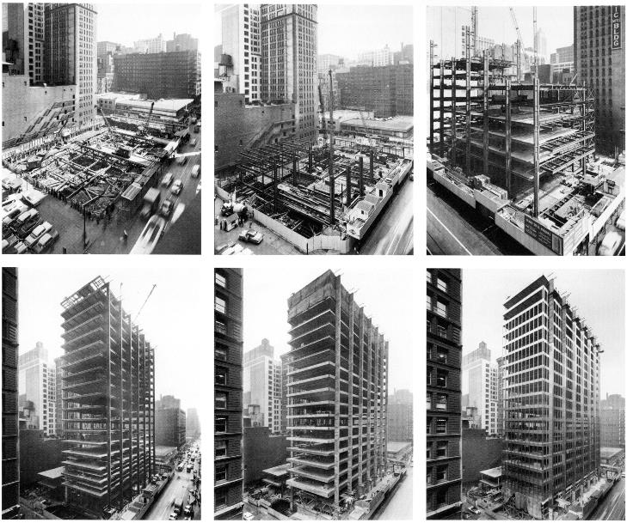
Inland Steel Building
Chicago, IL (1958)
Notes:
Photos of construction showing how the building is really just a series of open floors.

Slide 27
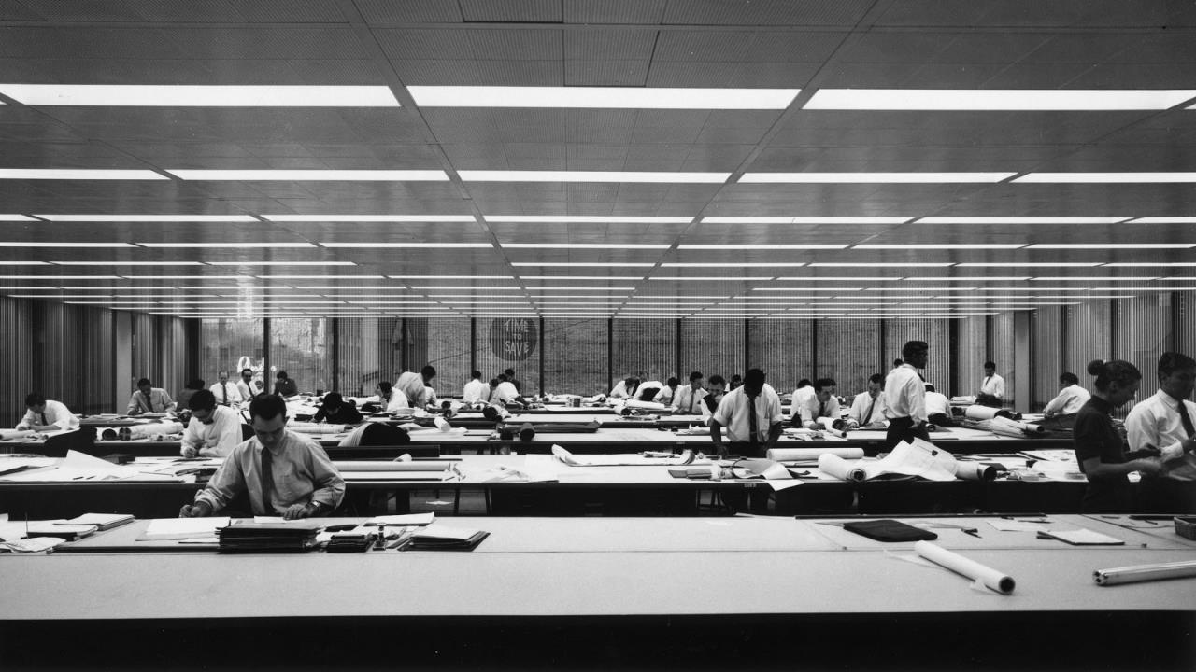
Inland Steel Building
Chicago, IL (1958)
Notes:
Such a success that SOM decided to move in themselves.
Again, no obstructions, just drafting tables.

Slide 28
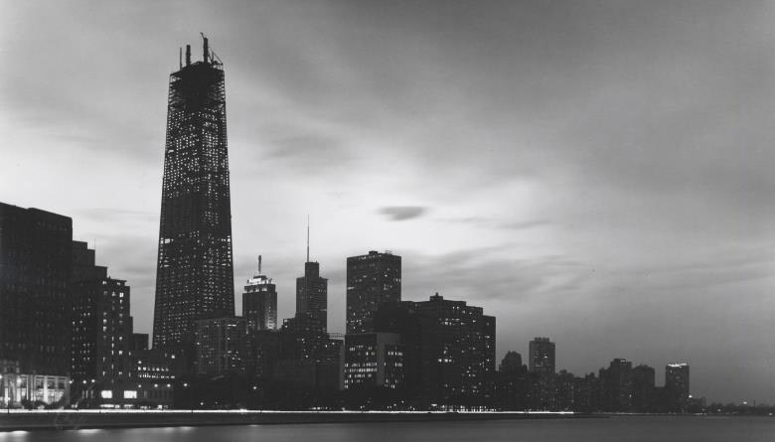
875 North Michigan Ave (John Hancock Center)
Chicago, IL (1970)
Notes:
Of course with SOM, we have even more well-known structures that they built of the past half-century, like the John Hancock Center, also in Chicago.

Slide 29
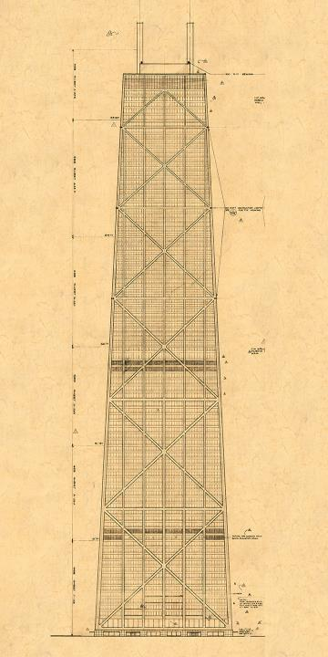
875 North Michigan Ave (John Hancock Center)
Chicago, IL (1970)
Notes:
Perhaps the most notable aspect of this tower is the visible inversion of the structure from the inside to the outside.
This wasn’t anything new, even at the time of construction.
They themselves often used this technique for shorter buildings.

Slide 30
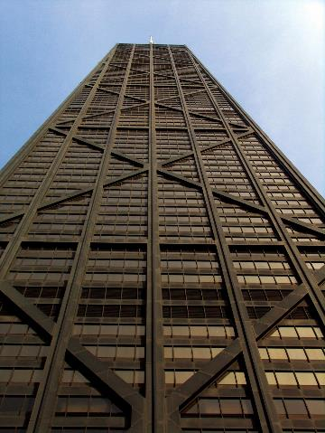
875 North Michigan Ave (John Hancock Center)
Chicago, IL (1970)
Notes:
Another view of the cross-bracing

Slide 31
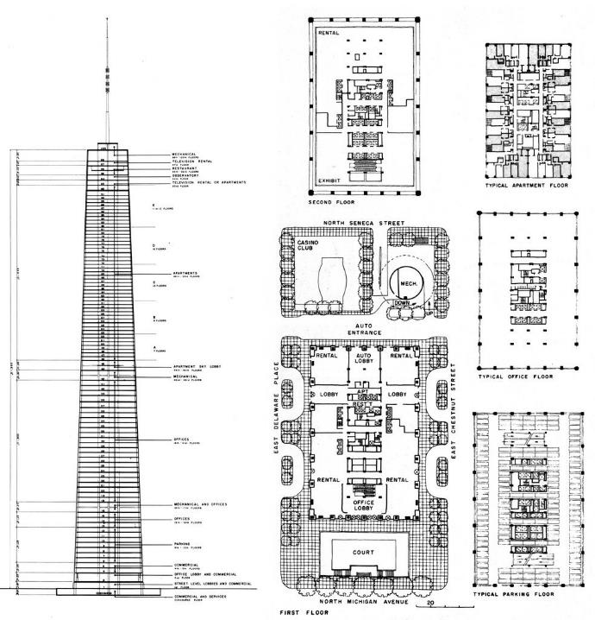
875 North Michigan Ave (John Hancock Center)
Chicago, IL (1970)
Notes:
And here we see the series of Typical Plans that define the makeup of the tower
Despite appearances, a tower is one of the least challenging architectural typologies, only because there are so many given constraints.

Slide 32
“The tower's tapered shape was chosen in order to match the different floor space requirements that decrease from bottom to top — from the entrance and commercial zones at the base to the clusters of small apartments at medium height and finally to the large apartments on top, where relatively less space is needed for ancillary rooms with artificial lighting. Structurally, the exterior members of the steel frame represent a tube where the necessary stiffness is provided by diagonal members and by those structural floors that coincide with the intersections of the diagonals and the corner columns. In keeping with the functional organization, this tubular body has its largest cross-section where the stresses caused by wind forces are greatest. Steel consumption, amounting to about 30-pounds-per-square-foot of floor space, was no greater than for a 50-story conventional tower.”
875 North Michigan Ave (John Hancock Center)
Chicago, IL (1970)
Notes:
Example of how empty the ideas are – from SOM’s own website.

Slide 33
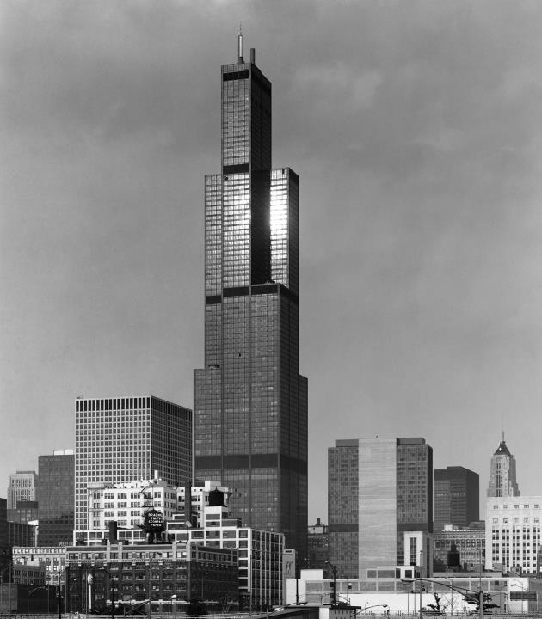
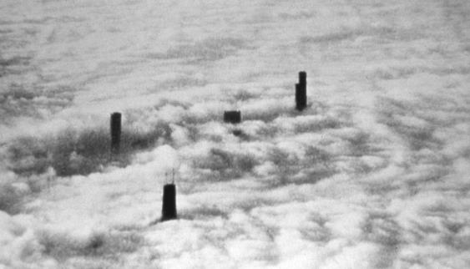
Willis Tower (Sears Tower)
Chicago, IL (1974)
Notes:
Just four years after the Hancock Tower, SOM built the Sears Tower (now Willis).

Slide 34
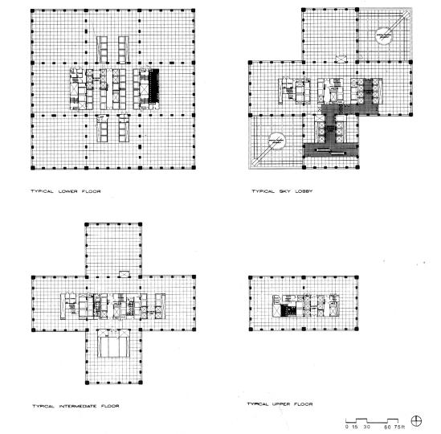
Willis Tower (Sears Tower)
Chicago, IL (1974)
Notes:
4 Typical Floor Plans
Various functions

Slide 35
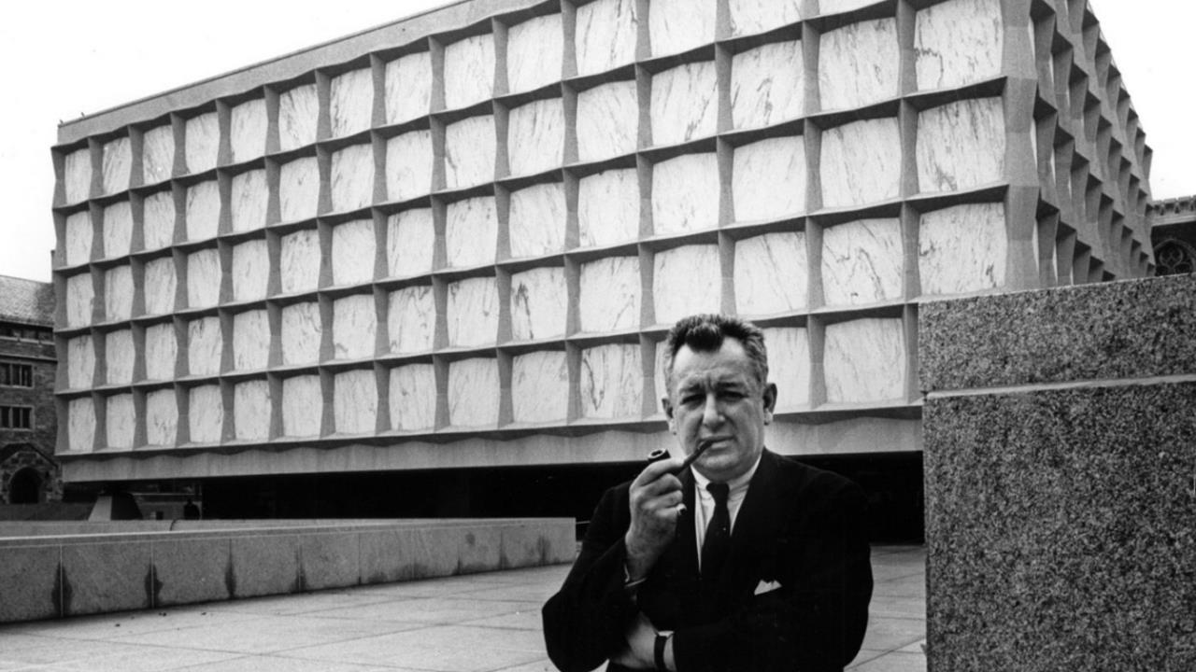
Gordon Bunshaft, Beinecke Rare Books Library (Yale University)
New Haven, CT (1963)
Notes:
Now, there are a couple highlights in SOM’s career.
As mentioned, because of the corporate structure of the firm, it was company policy that individuals not emerge from individual projects – that’s why you don’t really hear if Skidmore, Owings, OR Merrill headed this project or that.
But it was difficult to keep the anonymity going, particularly with a few partners.
The first being Gordon Bunshaft, who joined SOM in 1937 (1 year after founding), and in 1950, would lead the NYC office.

Slide 36
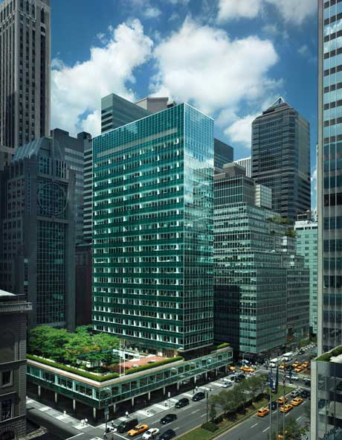
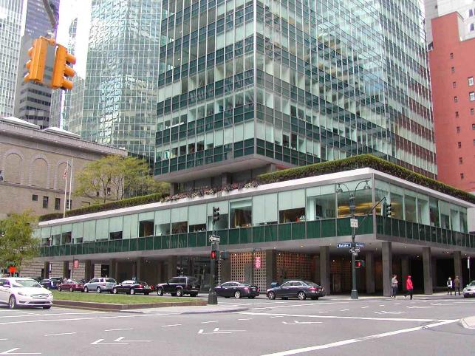
Gordon Bunshaft, Lever House (380 Park Avenue)
New York City (1952)
Notes:
One of the most important buildings for Bunshaft/SOM was the Lever House, which sits on the opposite corner of the Seagram Building.
Predated Seagram Building by 6 years
Second building in NYC built with a curtain wall system
Recently refinished entire façade
This is an advantage of curtain wall – can be updated without major structural changes

Slide 37
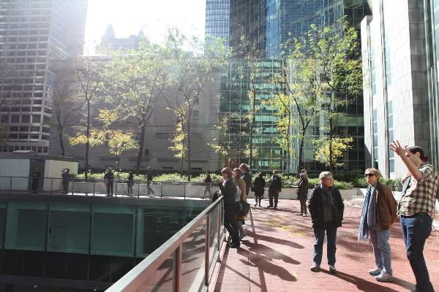
Gordon Bunshaft, Lever House (380 Park Avenue)
New York City (1952)
Notes:
Similar ambitions, of providing a ‘public’ space as an urban square, with the building proper set back from the property line.

Slide 38
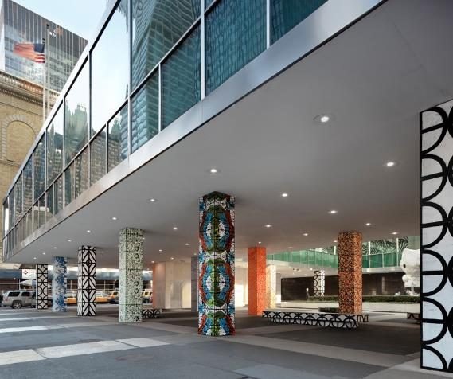
Gordon Bunshaft, Lever House (380 Park Avenue)
New York City (1952)
Notes:
Today, many art projects and installations at the ground level (inside/outside) and within the courtyard.
Tom Sachs’ Hello Kitty (22 ft) in courtyard

Slide 39
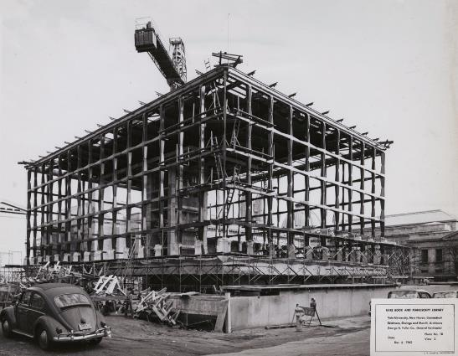
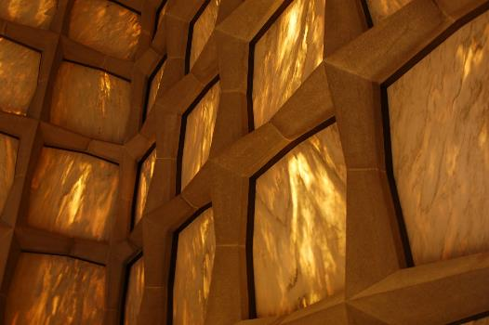
Gordon Bunshaft, Beinecke Rare Books Library (Yale University)
New Haven, CT (1963)
Notes:
The final Bunshaft-led SOM project I want to show is Beinecke Library in New Haven CT at Yale.
Library for rare books, including one of the original Gutenberg Bibles, and an original copy of the Declaration of Independence.
The building itself can be understood as a hollow box that framed all around.
Within these frames you have very thinly shaved Vermont marble, which allows enough light in for illumination, without letting too much natural daylight in for the protection of housed works.

Slide 40
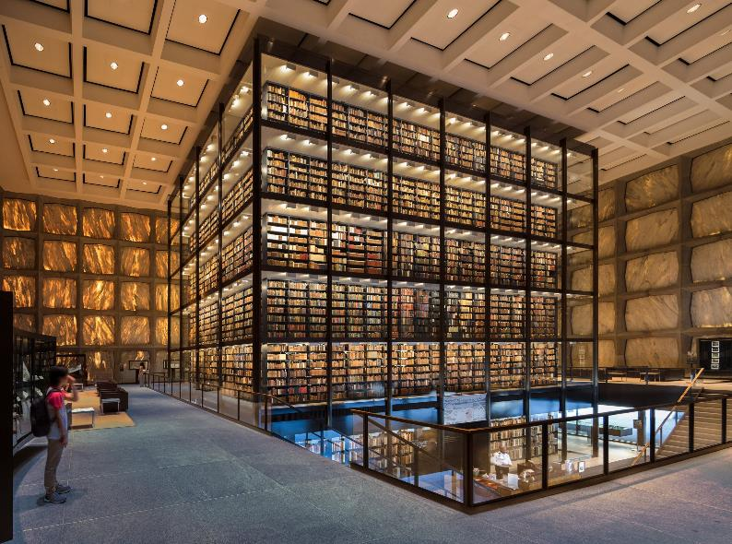
Gordon Bunshaft, Beinecke Rare Books Library (Yale University)
New Haven, CT (1963)
Notes:
At the center of the library is an open display of many of their books (not all).
Absolutely stunning building – must visit to get effect of marble lighting.

Slide 41
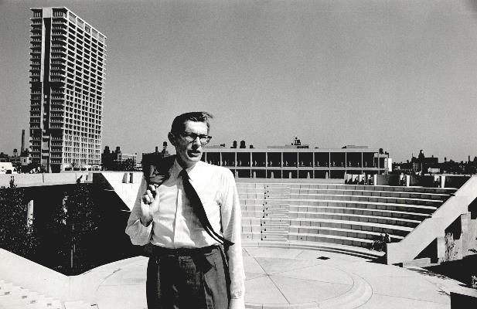
“People would come to work with me because they knew of me. They would come to learn how to think. I didn’t expect them to go out and become little “Netsches.” When I used to hang all the work on the wall, the projects would seem very different from one another, which is more like Saarinen than Skidmore. In fact, that led to criticism from the partners. I didn’t hold a line visually. Not like the box and variations on the box.”
Interview with Detlef Mertins
Walter Netsch, Partner 1951
San Francisco Office (1947 – 51), Chicago Office (1951 – 79)
Notes:
The second individual worth noting is Walter Netsch, who became partner in 1951 for SOM’s San Francisco and Chicago offices.
<Quote…>

Slide 42
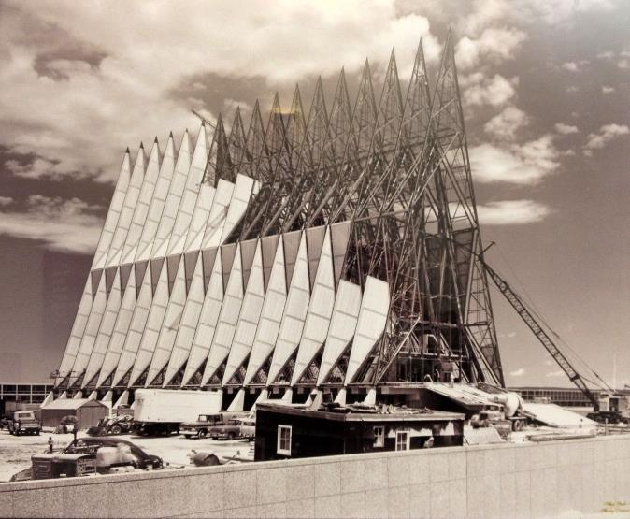
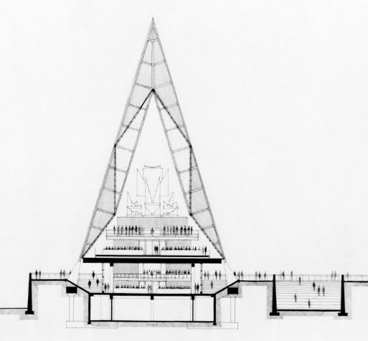
U.S. Air Force Academy – Cadet Chapel
Colorado Springs, CO (1963)
Notes:
One of his most famous projects is the Cadet Chapel for the US Air Force Academy in Colorado
Atypical SOM design, and though it stands as one of the firm’s most famous projects, many of the principals distanced themselves at the time.

Slide 43
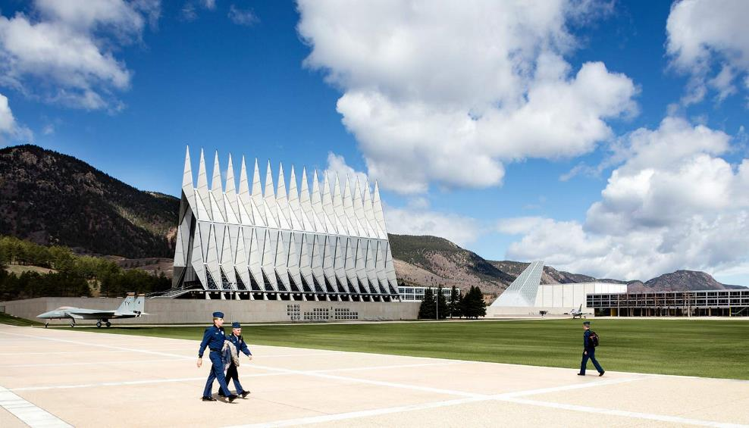
U.S. Air Force Academy – Cadet Chapel
Colorado Springs, CO (1963)
Notes:
Gordon Bunshaft oversaw the design of the chapel, though Netsch was given almost carte-blanche.

Slide 44
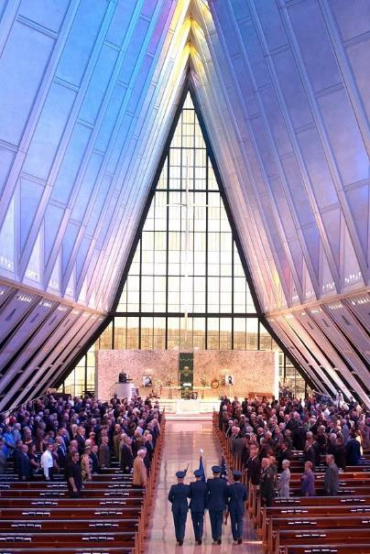
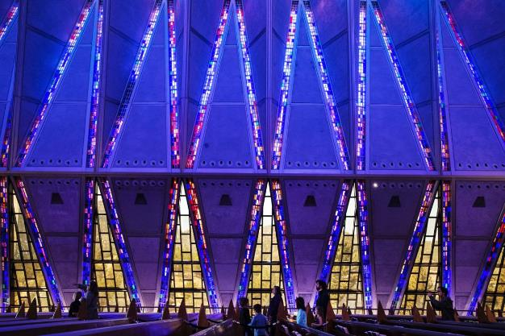
U.S. Air Force Academy – Cadet Chapel
Colorado Springs, CO (1963)

Slide 45
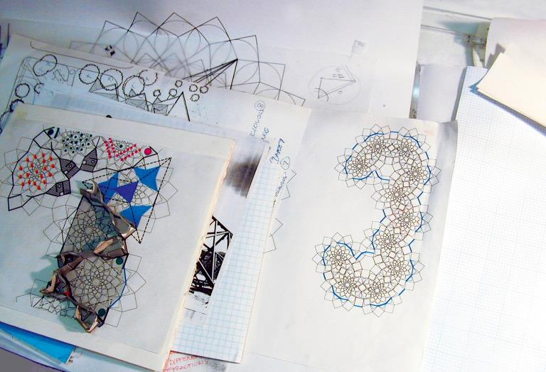
‘FIELD THEORY’
Walter Netsch, ‘Field Theory’
Notes:
Netsch was quite different – didn’t follow the Miesian fold.
Instead, was perhaps the most well-known partner that looked towards a more intellectual approach.
Among his key ideas was that of ‘FIELD THEORY’

Slide 46
Walter Netsch, Partner 1951
San Francisco Office (1947 – 51), Chicago Office (1951 – 79)
Notes:
I don’t want to overblow this as a full-on ‘theory’, but in all fairness, it was a serious approach executed from diagram to building.
In short, Netsch developed a formal grammar in which basic shapes, notably the square, transformed through rotation.
In this rotation, interstitial and remnant space were created that complicated the seemingly simple initial geometry.

Slide 47
Walter Netsch, ‘Field Theory’
Notes:
He went through a number of these kinds of studies.
Unfortunately, and in typical SOM fashion, he didn’t really develop his approach in a rigorous theoretical manner, so it was left as quite intuitive.
We know making buildings is not easy… proper construction theory is also… not easy…

Slide 48
Walter Netsch, ‘Field Theory’
Notes:
Here we see more examples, now using color as an additional parameter for design.

Slide 49
The Behavioral Sciences Building at the University of Illinois Campus in Chicago
Notes:
Here is the basic field pattern for a project realized through to construction, a building for the University of Illinois in Chicago.

Slide 50
The Behavioral Sciences Building at the University of Illinois Campus in Chicago
Notes:
As mentioned, I can’t really get into much detail, because Netsch wasn’t quite articulate with his process. Likewise, as outlined in his earlier quote, he wasn’t interested in teaching others his exact method.
So we’re kind of left just appreciating (or not), the geometrical patterns.

Slide 51
Left: Lindquist Center I & II, University of Iowa, (1972 and 1978)
Right: Generic Fibonacci Series
Notes:
Some other examples of his Field Theory approach.

Slide 52
Wells College Library, Aurora, New York (1968)
Notes:
Another built work in the Wells College Library in New York.

Slide 53
Miami University Art Muesum, Oxford, Ohio (1978)
Notes:
Miami University Art Museum.

Slide 54
Broadgate – Exchange House
London (1990)
Notes:
Now, even though my criticisms of firms like SOM are pretty clear, as mentioned, I do appreciate some of their projects – my favorite among their contemporary works perhaps being an office block in London, Broadgate Exchange House built in 1990.

Slide 55
Broadgate – Exchange House
London (1990)
Notes:
Built over Liverpool Street Station

Slide 56
Broadgate – Exchange House
London (1990)
Notes:
‘Transparent Design’ idea
This thing is essentially a building in the form of a bridge
Arch
Major Diagonal
Primary Tie
Raft Truss
Pier
With track level below raft truss

Slide 57
Broadgate – Exchange House
London (1990)
Notes:
Not just technology/Structure
Inherently open to the city, completely permeable

Slide 58
Broadgate – Exchange House
London (1990)
Notes:
Floats over the tracks, yet visually present

Slide 59
One World Trade Center
New York City (2014)
Notes:
They’re still involved with prominent projects such as the One World Trade Center.
But their heyday was certainly during the 50s to early 70s, not what they were.
The late 80s – problem: Their corporate aesthetic was beginning to look outdated – remember, their model is to refine a look at repeat it… uncritical
Moreover, financial crisis affected commercial real estate market
Japanese asset price bubble (86-92)
Black Monday (1987)
Slow down of US economy
From 1990 to 1992, turnover halved (form $134 million to $63 million)
During these years, they cut 60% of their workforce
Corporate model – CEO in 1991, complete disconnect from design, run as a business
By late 90s/early 2000s, steady rise again, in response to global economic trends
What’s the Criticism here?
There’s no inner question
Questions are made to address a specific context/program/etc.
Fabrication of questions to get the job done
Rather than a sustained pursuit of a problem

Slide 60
Eero Saarinen
(Eliel) Saarinen, Swansen and Associates (late 1930s – 1950)
Eero Saarinen and Associates (1950 – 1961)
Notes:
The next ‘corporate architect’ I want to discuss is Eero Saarinen
To call him a corporate architect, or his work corporate architecture, is particularly problematic.

Slide 61
St. Louis Gateway Arch
St. Louis, Missouri (1947 – 65)
Notes:
We know for example that he designed seminal works such as the St. Louis Gateway Arch, but much of his other work was drive by more commercial motives.

Slide 62
St. Louis Gateway Arch
Left: Eliel Saarinen with Frank Lloyd Wright and Le Corbsuier
Notes:
Eero was the son of Eliel, who himself was a major architect of his time.
Seen photographed with Frank Lloyd Wright and Le Corbusier.

Slide 63
Eliel Saarinen, Tribune Tower design (1922)
Notes:
Eliel’s work was paradigmatic urban architecture of his own period.

Slide 64
Eliel Saarinen, Tribune Tower design (1922)
Notes:
Here is the elder Saarinen’s Tribune Tower proposal, which placed second, but importantly put his name on the national stage.
For Eero Saarinen, his transition into architecture was pretty seamless, as he joined his father’s firm, and of course, was given design leadership roles.

Slide 65
General Motors Technical Center
Warren, Michigan (1948-56)
Notes:
The most important of these was his involvement with the General Motors Technical Center, and it really put Eero’s name out there.
Construction began in 1949, completed in 1955
Massive project - $100 million at the time (almost $1 billion today)
During the time of design, Eliel was getting old, and gradually passing on responsibilities to his son – so this was Eero’s first major project
38 years old, overseeing a major project

Slide 66
General Motors Technical Center
Warren, Michigan (1948-56)
Right: Mies van der Rohe, IIT Campus, Chicago
Notes:
Strong influence from Mies – IIT campus
No secret – Eero met with Mies directly asking him for advice
Again, we all celebrate Mies, but it’s important to understand how he transcended his own immediate work
But big difference – GM Technical Center was automobile scale, whereas IIT was pedestrian scaled

Slide 67
General Motors Technical Center
Warren, Michigan (1948-56)
Notes:
The GM Technical center was known for many firsts, including:
Thin porcelain-faced sandwich panel – prefabricated for interior/exterior
Modular lighting system using pans rather than diffuse baffles
Neoprene gasket weather seal which holds glass and metal panels to their aluminum frames
Complete controlled environment – HVAC integrated into ceiling system
When there’s no concept, concept becomes about execution

Slide 68
General Motors Technical Center
Warren, Michigan (1948-56)
Notes:
Also well known work due to its sheer size.

Slide 69
International Business Machines (IBM) Manufacturing and Administrative Center
Rochester, Minnesota (1956 -58)
Notes:
Just after the GM Technical Center, Saarinen was commissioned for IBM’s regional headquarters in Minnesota.
Part of a larger plan to decentralize the corporation – a common trend in mid-century American Corporatism

Slide 70
International Business Machines (IBM) Manufacturing and Administrative Center
Rochester, Minnesota (1956 -58)
Notes:
Idea of modularization in total design
Can keep adding blocks without the detriment to total scheme
Similar to the SOM approach of a big box with punctuations, but ‘courtyards’ developed from gaps between modular buildings.

Slide 71
International Business Machines (IBM) Manufacturing and Administrative Center
Rochester, Minnesota (1956 -58)
Notes:
One story throughout – 16’ feet
Same as GM center – blue porcelain-enameled aluminum panels, hung around a frame and truss structural grid
Like the GM center, a technical innovation without any particular emphasis on social or architectural contribution.

Slide 72
Bell Telephone Laboratories
Holmdel, New Jersey (1957 – 62)
Notes:
A bit closer to here, in Holmdel Township, New Jersey, Bell Telephone Labs
You have to think of this as the Google or Apple headquarters of today.
Constructed 1959-62

Slide 73
Bell Telephone Laboratories
Holmdel, New Jersey (1957 – 62)
Notes:
One of Saarinen’s last projects
2 million square feet
Essentially just a massive box, situated within its own bucolic landscape.

Slide 74
Bell Telephone Laboratories
Holmdel, New Jersey (1957 – 62)
Notes:
Photographed areas tend to be towards the common hallway

Slide 75
Bell Telephone Laboratories
Holmdel, New Jersey (1957 – 62)
Notes:
In the plan, we see that the big box is essentially divided into four, where Bell Labs organized its spaces according to research and equipment.
Like the big boxes of SOM and pretty much all mid-century corporate architecture, the principal idea was on the universality of space.
In 2006, was sold to a Real Estate development company, that wanted to raze it and turn the land into homes
Action against this plan
2013, another development company purchased it, and redeveloped the interior for a variety of functions
No particular use, no particular concept, just a big box

Slide 76
TWA Flight Center at JFK Airport
New York City (1962)
Notes:
But to Saarinen’s credit, we have a lot of other more noteworthy structures.
I won’t talk about them in any detail, as they don’t pertain directly to the idea of ‘Corporate Architecture’, but I think it’s important to be exposed to the range of Saarinen’s projects.
Arguable his most famous work, he designed the TWA terminal at JFK Airport, which operated from 1962 – 2001.

Slide 77
TWA Flight Center at JFK Airport
New York City (1962)
Notes:
Closed in 2001 because it could no longer serve the larger throughput of passengers and modern aircraft.
From 2001 until just last year, it was off limits, but has since reopened as a hotel.

Slide 78
TWA Flight Center at JFK Airport
New York City (1962)
Notes:
Here’s a photo of Eero Saarinen and his employee, Kevin Roche, putting together a mock up model of the terminal.

Slide 79
TWA Flight Center at JFK Airport
New York City (1962)
Notes:
It was regarded as a masterful work using the limits of reinforced concrete.
You’ll notice that the majority of curves are actual double-curved, and so could only be achieved through plastic modeling

Slide 80
Eero Saarinen
Left: Womb Chair (1948)
Right: Tulip Chair and Table (1956)
Notes:
If you remember Florence Shu Knoll – the photograph with SOM – Saarinen had also been close with her, and through Knoll, designed two iconic furniture lines: the Womb and the Tulip series.

Slide 81
Massachusetts Institute of Technology (MIT), Kresge Auditorium and MIT Chapel
Cambridge, Massachusetts (1950 – 55)
Notes:
Still operating today – and I strongly encourage you to visit – are a pair of smaller buildings at MIT’s campus: the Kresge Auditorium and the MIT Chapel, sitting right next to each other.

Slide 82
Massachusetts Institute of Technology (MIT), Kresge Auditorium and MIT Chapel
Cambridge, Massachusetts (1950 – 55)
Notes:
The auditorium was quite advanced in its construction technology of building a double-curved surface that’s incredibly thin – as low as 9 cm (roughly 3/8”) – using curved Reibar reinforcement.

Slide 83
Massachusetts Institute of Technology (MIT), Kresge Auditorium and MIT Chapel
Cambridge, Massachusetts (1950 – 55)
Notes:
Directly across the auditorium is the MIT chapel.
Something of a modestly-sized work for Saarinen, but I think it’s quite beautiful.

Slide 84
Massachusetts Institute of Technology (MIT), Kresge Auditorium and MIT Chapel
Cambridge, Massachusetts (1950 – 55)
Notes:
The composition looks like a short silo connected to a bar.
You enter through the flank.
The chapel is on one side, and the service spaces on the other.

Slide 85
Massachusetts Institute of Technology (MIT), Kresge Auditorium and MIT Chapel
Cambridge, Massachusetts (1950 – 55)
Notes:
The interior – I find more value in this space than the entirety of some of his corporate campuses.

Slide 86
Yale University, David S. Ingalls Hockey Rink
New Haven, Connecticut (1956 – 59)
Notes:
Finally, we have Ingalls Hockey Rink in New Haven, which many say resembles a Viking Ship, and is often called the Yale Whale.

Slide 87
Yale University, David S. Ingalls Hockey Rink
New Haven, Connecticut (1956 – 59)
Notes:
A very particular plan – enter from the left here, with seating along the sides.

Slide 88
Yale University, David S. Ingalls Hockey Rink
New Haven, Connecticut (1956 – 59)
Notes:
And the interior.

Slide 89
Yale University, David S. Ingalls Hockey Rink
New Haven, Connecticut (1956 – 59)
Notes:
The construction is pretty straightforward – a major spine holding the entire load across the building, with the roof held in tension by cables.

Slide 90
St. Louis Gateway Arch
St. Louis, Missouri (1947 – 65)
Notes:
I’ll end Saarinen here, without getting into the arch – it’s an arch, not that complicated.
But important to show that with Saarinen, there were really two sides.
He was amongst the most corporate of corporate architects in mid-century America, but also was adamant in testing the limits of architectural construction and form.
Still don’t think he was an intellectual, but at least unlike SOM, I felt he was pushing the limits of architectural convention, rather than testing the business of architectural production and consumption.

Slide 91
The Upjohn Company
Kalamazoo, MI ( 1959 -61)
Notes:
Now, during the 1950s, in line with the rise of Corporate Architecture, the idea of office planning was an important topic, namely because for firms like SOM who were trying to devise replicable corporate buildings, it was important to devise equally repeatable spatial organizations for labor.

Slide 92
Bürolandschaft / Großraumbüro (Office Landscape), Quickborner Team
Notes:
But in Europe, contrary to the cut/paste model adopted by firms like SOM, the Quickborner team, inspired by Cybernetics, thought that office layout should be responsive, bottom-up, rather than rigidly hierarchical.

Slide 93
Bürolandschaft / Großraumbüro (Office Landscape), Quickborner Team
Notes:
They devised a system called “Burolandschaft” (“office landscape”), in which desk-to-desk connections dictated the overall layout, rather than echoing the perimeters of the building.
For them, the shape of the architecture was incidental, as you can see in this case study.

Slide 94
Bürolandschaft / Großraumbüro (Office Landscape), Quickborner Team
Notes:
More so here, we don’t even need to see the walls of the building to devise a bottom-up, cybernetic layout of desks and office furniture.

Slide 95
Bürolandschaft / Großraumbüro (Office Landscape), Quickborner Team
Notes:
And some more examples, which show the autonomy of office layout in relation to the architectural form.
I wanted to include these to show that architectural theory and the design of workplaces are not mutually exclusive, and that ideas regarding how we engage with the built environment were very much being developed at the same time as Corporate Architectures that prioritized business and production models over those that were intellectual.

Slide 96
Bürolandschaft / Großraumbüro (Office Landscape), Quickborner Team
Notes:
Some examples, with contrasts to the traditional hierarchies at the left.

Slide 97
Bürolandschaft / Großraumbüro (Office Landscape), Quickborner Team
Notes:
<Review…>

Slide 98
Left: Google Office (Dublin, Ireland)
Notes:
It’s only now that we begin to see large-scale repercussions of some of the Quickborner’s studies developed in the 1950s, made particularly fashionable with a lot of tech firms.

Slide 99
Foster + Partners, Apple Park campus, ‘The Ring’
Cupertino, California (2018)
Notes:
I’ll leave you with a few examples of how I think Corporate Architecture persists today.
In large part, I find them to be problematic, especially because these kinds of mega-projects often serve as the paradigm of contemporary architecture.

Slide 100
Foster + Partners, Apple Park campus, ‘The Ring’
Cupertino, California (2018)
Notes:
In my opinion, they say very little with regards to the discipline of architecture, and their motivation is much more on the functionalization of space, and/or the prioritization of technologies and building structures.

Slide 101
Clive Wilkinson Architects, Googleplex
Mountainview, California (2005)
Notes:
There’s no question that these kinds of Corporate Architectures find resonance with an image-based culture of building,

Slide 102
Clive Wilkinson Architects, Googleplex
Mountainview, California (2005)
Notes:
Where it’s more important to look innovative, rather than use massive building budgets to ask questions on the nature of buildings, the city, and of space generally speaking.

Slide 103
Google HQ, Mountain View, California (2020)
Notes:
Conclusion
When you’re design empty shells, naturally, emphasis goes on the image of the building.
A lot of these corporate architecture we know very little of, and my guess is that it’s because there’s little to know about them.
Impermanence
Reproducibility
Iconicity

