Slide 1
Situationism, Deconstructivism
Contemporary Architecture Theory
Eugene Han
Fall 2020, 11:15 – 12:30 pm
Online Instruction
Notes:
Looking at 2 movements, not inherently related, but certainly some strong overlaps
More importantly, representative of a period that sought new inspiration, rather than mere reaction to the old guard

Slide 2
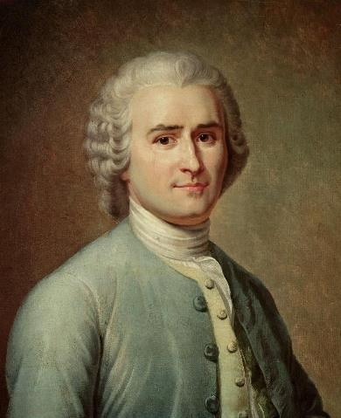
Jean-Jacques Rousseau
Swiss/French; 1712 - 1778
Notes:
We begin way back, with a French philosopher named Jean-Jacques Rousseau
Again, going back to the Enlightenment period

Slide 3
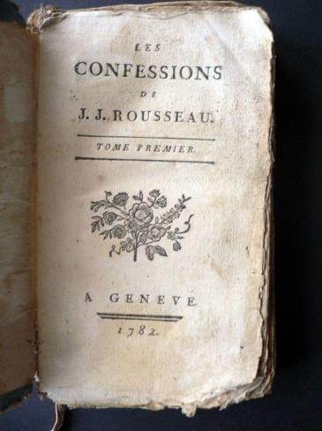
Jean-Jacques Rousseau
Les Rêveries du promeneur solitaire (1782)
Notes:
We covered him briefly with regards to the idea of the ‘Noble Savage,’ important figure regarding political philosophy, morality, a champion of ‘freedom’ (remember the French Revolution, 1789)
We don’t have to get into any detail with him, other than the fact that he wrote this book called The Confessions

Slide 4
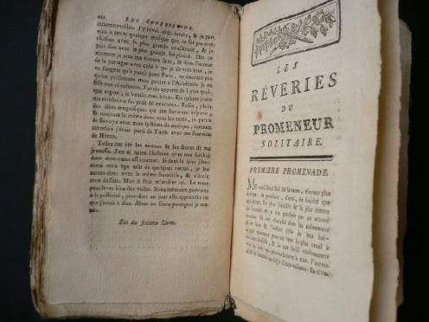
Jean-Jacques Rousseau
Les Rêveries du promeneur solitaire (1782)
Notes:
Together with this book, there was a section called Reveries of the Solitary Walker, written in 1782.
This book is structured into chapters, called ‘walks’
First walk, second walk, third walk, etc.
In each of these walks, he philosophizes about various things in life, mainly about how one should live their lives in relation to society
I wouldn’t call it a particularly serious book, but it’s really about following Rousseau’s stream of consciousness as he goes along these walks.

Slide 5
“My whole life has been little else than a long reverie divided into chapters by my daily walks.”
Jean-Jacques Rousseau
Les Rêveries du promeneur solitaire (1782)
Notes:
About the walks, he realizes that his life can be summarized as the accumulation of such walks, stating that <<Quote… >>
So again, his life is understood as a series of discreet walks, journeys

Slide 6
SITUATIONISM
1957 - 1972
Notes:
- Fast forward 170 years, and we arrive at a predominantly French movement called Situationism… the connection with Rousseau will get clearer in a bit

Slide 7
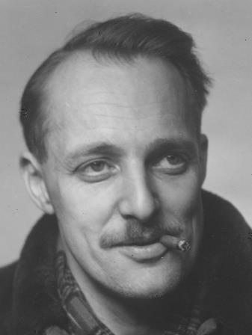
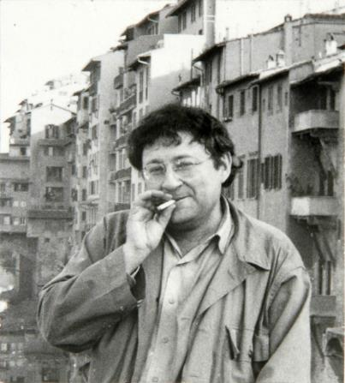
Asger Jorn
Danish; 1914 - 1973
Guy Debord
French; 1931 - 1994
Notes:
Like most movements, it’s often inaccurate to say there’s a hard line as a beginning date, and such was the case with Situationism.
However, it’s pretty clear that these two people, Asger Jorn and Guy Debord, certainly incited a collection of small avant-garde movements together, who collectively but informally were often identified as Situationists.
Guy Debord however was often regarded as the movement’s leader.
Situationism = Situationist International

Slide 8
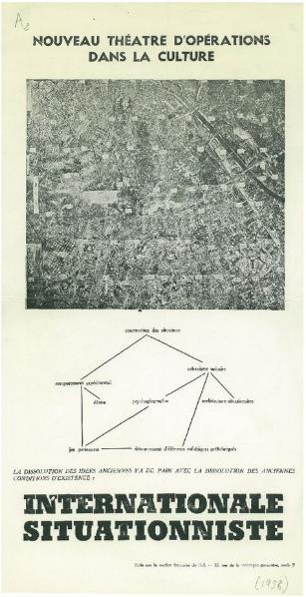
Internationale Situationniste
French; 1958 - 1969
Notes:
Published between 1958 – 1969 (12 issues), with various contributions throughout

Slide 9
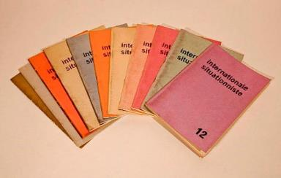
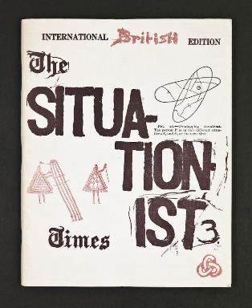
Internationale Situationniste
French; 1958 - 1969
Notes:
A spread of the 12 issues – with copy-cat or homage publications around Europe

Slide 10
SPECTACLE
DÉTOURNEMENT
PSYCHOGEOGRAPHY
DÉRIVE
Notes:
There was no single idea, as Situationism spanned across the arts to general culture, but the basis political.
More specifically, the Situationists adopted a very Leftist position, particularly against the domination of Capitalism across Western civilization.
Importantly, they used the City as their platform for political dissonance.
So what was their beef?
These 4 words help summarize their project

Slide 11
SPECTACLE
DÉTOURNEMENT
- The consumerism of all aspects of life
PSYCHOGEOGRAPHY
DÉRIVE
Notes:
Spectacle
‘The Consumerism of all aspects of life’
Instead of people enjoying the commodities of modern living as Capitalism had so optimistically promised, we are in fact slaves to those commodities.
This enslavement serves one purpose: to keep those in power at power.
When we are wholly dependent on goods as made so readily available by capitalism, we are supporting the political and economic structures that keep the rich and powerful over us.
E.g.: “A strong stock market means I must be having a better life”

Slide 12
SPECTACLE
Barbara Kruger
Untitled (I shop therefore I am) (1987)
Notes:
While not a Situationist work per se, Barbara Kruger’s piece expresses exactly the Situationist critique of modern living
We are defined by the goods we own – we consume things rather than living our own lives… or, are lives are measured by what we can consume (afford)
By extension, leaders are the ones that help us consume more, and can themselves consume more than others

Slide 13
SPECTACLE
DÉTOURNEMENT
- hijacking, intentional misuse
PSYCHOGEOGRAPHY
DÉRIVE
Notes:
Detournement
The concept of detournement is simply a concerted misuse, as subversion, a hijacking
This concept embodied how the Situationists carried out their art, for example…

Slide 14
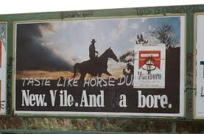
DÉTOURNEMENT
Notes:
Detournement often happened in the form of graffiti, and the alteration of existing advertisements.
Working on advertisements was of course important, because these were the forms of communication of Capitalism.

Slide 15
SPECTACLE
DÉTOURNEMENT
- unplanned paths through varied ambiances
PSYCHOGEOGRAPHY
DÉRIVE
Notes:
Derive
A term in which the role of the city/urban context is very clear.
Experiencing the contemporary urban condition by taking unplanned paths, absorbing the passages through the city through varied ambiances.
Unplanned journey through an urban landscape
ROUSSEAU!
Recognizing the emotional disorientation brought about the urban context

Slide 16
SPECTACLE
DÉTOURNEMENT
- developing new awareness of the city through playful encounters
PSYCHOGEOGRAPHY
DÉRIVE
Notes:
Psychogeography
A mode of exploring the urban environment by ‘drifting’ through it, unplanned
Playful, inventive ways of exploring the city
Intentionally finding informal routes, new readings
“new awareness” of the city
Personal, arbitrary, not dictated by others

Slide 17
SPECTACLE
DÉTOURNEMENT
PSYCHOGEOGRAPHY
DÉRIVE
Notes:
So when we put all this together, we get a kind of guidebook on how we can understand the urban condition through an anti-capitalist, subversive mode of experience.
Rather than following prescribed ways of ‘consuming’ the city as dictated by those in power, we should lose ourselves, find unconventional juxtapositions, turn conventions on their heads

Slide 18
SPECTACLE
- The consumerism of all aspects of life
DÉTOURNEMENT
- hijacking, intentional misuse
DÉRIVE
- unplanned paths through varied ambiances
PSYCHOGEOGRAPHY
- developing new awareness of the city through playful encounters
Notes:
So, to refresh ourselves on the terms of Situationism:
Spectacle
That our lives have become dominated by consumerism brought about by the Capitalist model of living
This is not just about products, but about solidifying a system that keeps the powerful in their positions, and like kids stupefied by spectacle, the masses are more concerned with attaining goods, products, being like everyone else, and so we don’t realize the inherent systems of power
Detournement
Hijacking, misappropriation
Remember the kind of guerilla art using billboards (signs of commerce) to convey messages of subversion
Derive
Unplanned paths through varied ambiances
Psychogeography
Developing new awareness so the city through playful encounters

Slide 19
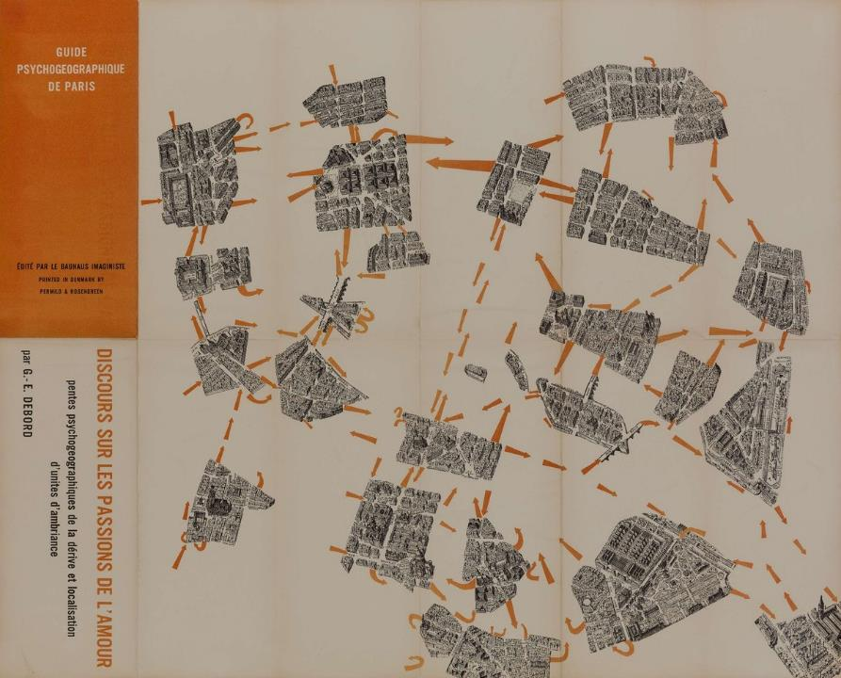
Guy Debord
Guide psychogéographique de Paris (1957)
Notes:
Debord produced a series of these kinds of maps, in which the city was conceived of through discreet ‘Situations’
Wonderful interpretation of a city
Archipelago
About a network of passages – at critical moments, situations are created, then the passage, the unplanned journey continues.
In this ‘Psychogeography’, we see situations represented through blocks

Slide 20
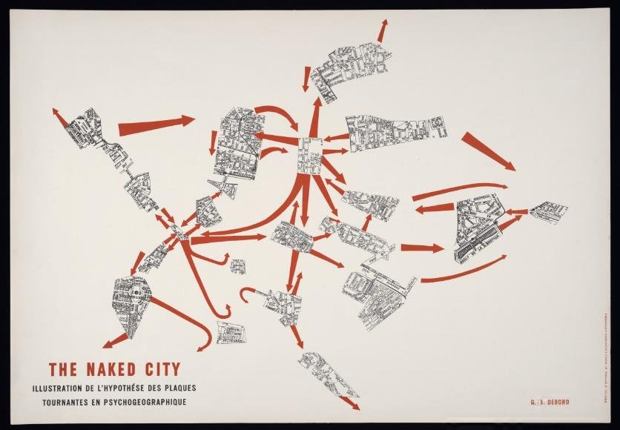
Guy Debord
The Naked City (1957)
Notes:
And in the Naked City, situations are defined by situations of streets
So for Debord, this would be the image of the city
Not determined by overarching axes, but through playful and inventive passage

Slide 21
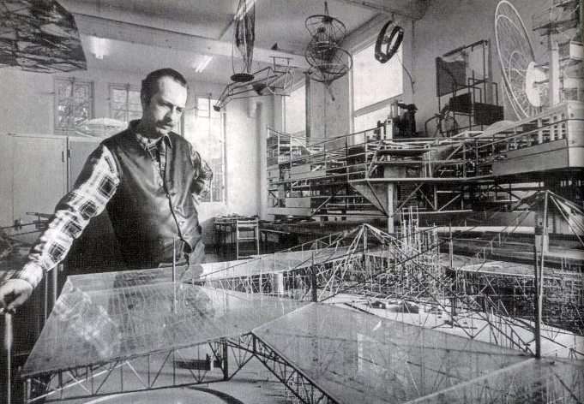
Constant Nieuwenhuys
Dutch; 1920 - 2005
Constant Nieuwenhuys
New Babylon (1959 – 74)
Notes:
As mentioned, Debord was not an architect, nor were the Situationists, but there were two architects in particular that really embraced their lessons
The first being Constant Nieuwenhuys (Nee-wen-house)

Slide 22
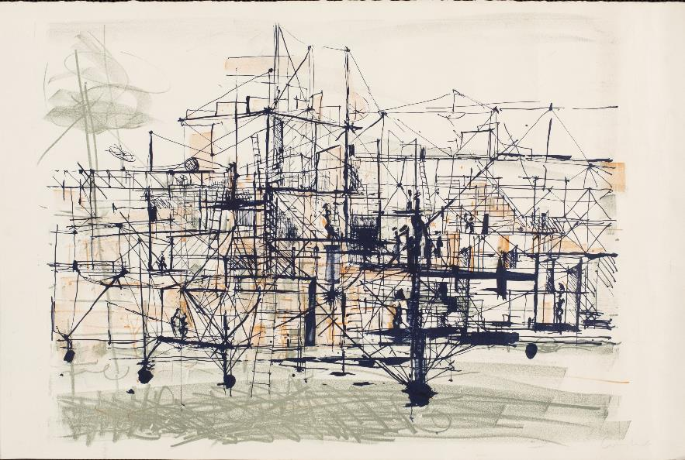
Constant Nieuwenhuys
New Babylon (1959 – 74)
Notes:
I won’t dwell on his work, in large part because I think his ideas are quite self-evident in the context of the larger Situationist movement.
His most well-known project was called New Babylon, which like Corbusier’s Plan Voisin, was a revisioning of Paris.

Slide 23
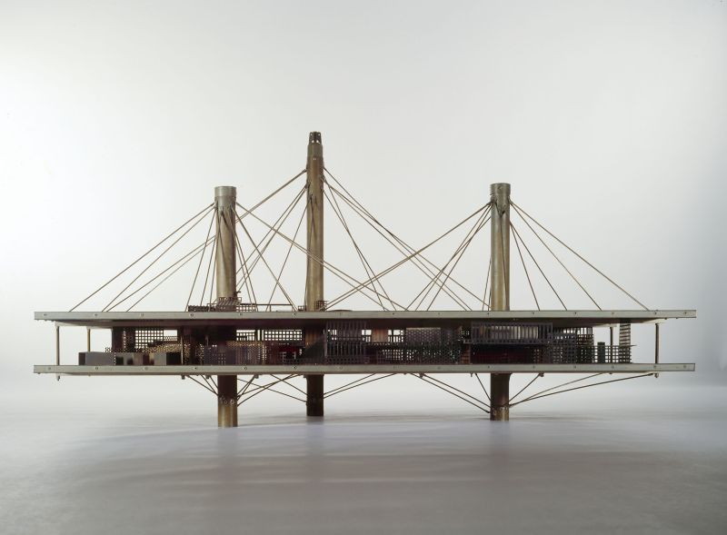
Constant Nieuwenhuys
New Babylon (1959 – 74)
Notes:
It was designed over a decade and a half, and so went through various stages and appearances.

Slide 24
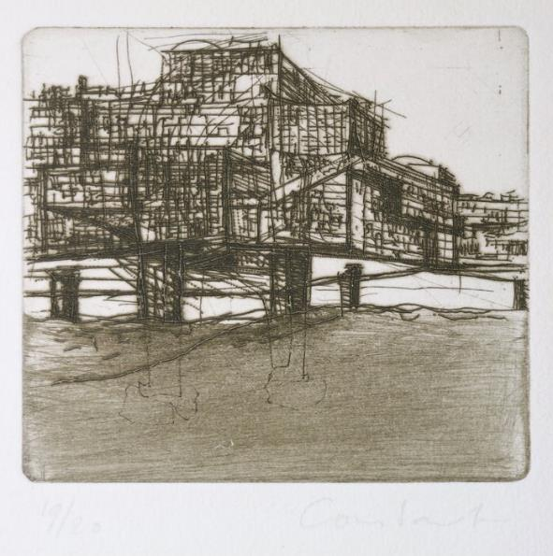
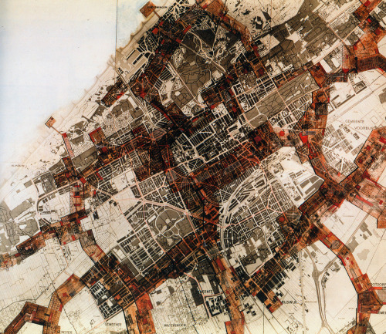
Constant Nieuwenhuys
New Babylon (1959 – 74)
Notes:
But the basic idea was the he was proposing a network of structures that hover above Paris.
The inhabitant, the citizen of New Babylon was called the Homo Ludens – the Man at Play
This man was freed from the shackles of the Capitalist model, and pursued their as they pleased, without prescription, driven only by self-fulfillment and self-satisfaction
A kind of hedonism as provocation against the contemporary consumerist life who is slave to products and lifestyles mandated by corporations and politicians far removed from the lives of most citizens.

Slide 25
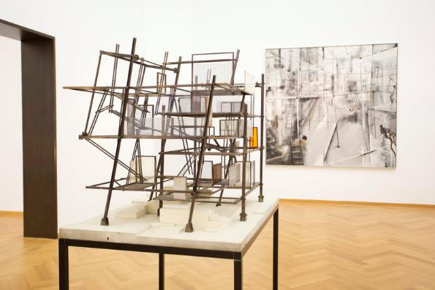
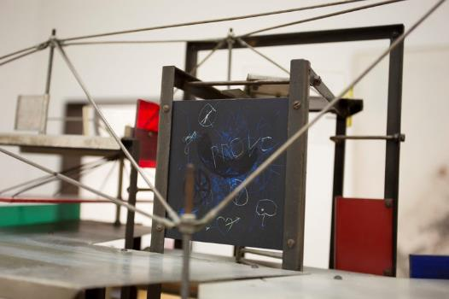
Constant Nieuwenhuys
Various Works
Notes:
New Bablyon was certainly his most well-known projects, and various other yet similar projects arose from that.
Notice the graffiti on his model – a shout-out to the Situationists and their guerilla art-as-protest

Slide 26
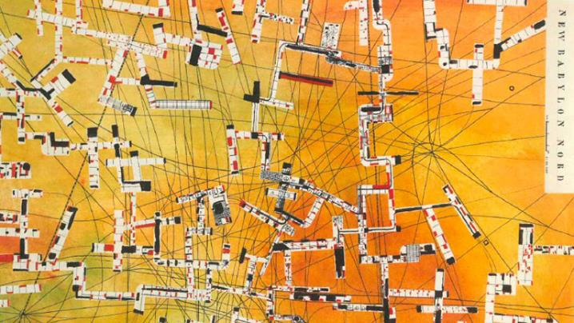
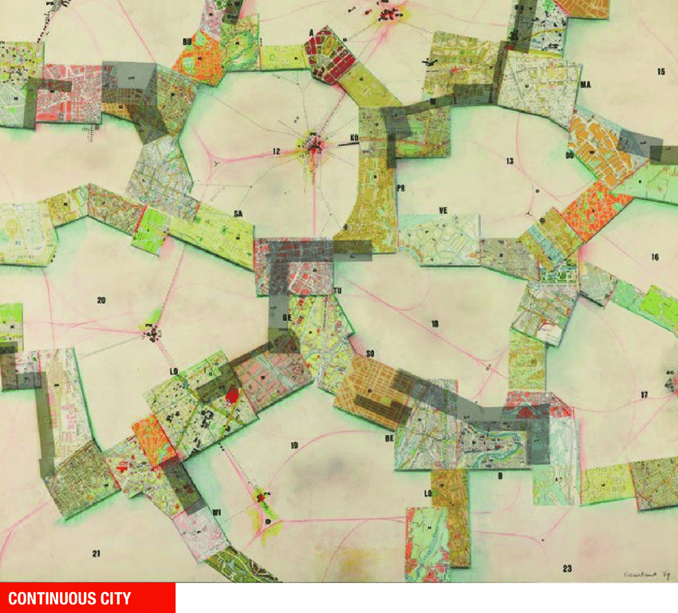
Constant Nieuwenhuys
New Babylon (1959 – 74)
Notes:
Various iterations of New Babylon.

Slide 27
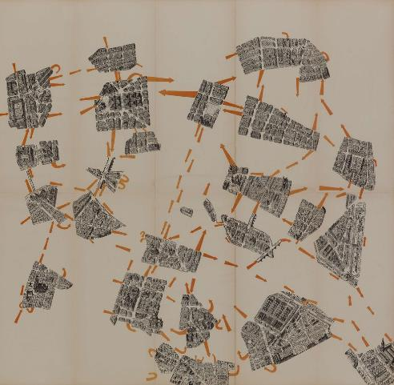
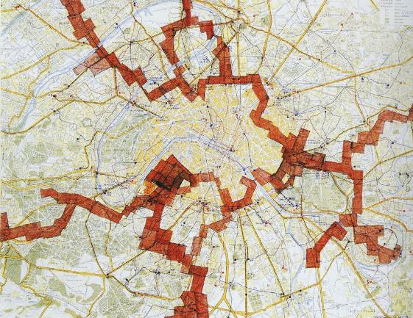
Left: Guy Debord
Right: Constant Nieuwenhuys
Notes:
- And of course, we can see the direct influence that the Situationists had on Nieuwenhuys.

Slide 28
DECONSTRUCTIVISM
Notes:
So now we shift to the movement of Deconstructivism
Not an inevitable progression from Situationism, but inherent shared connection of certain themes, and in terms of time periods, consecutive.
Like Situationism, heavy French influences

Slide 29
Left: Aleksandr Rodchenko, Knigi
Right: Cover for Novij Lef (New Left)
Notes:
The Deconstructivism is directly related to the arts/architecture movement of Constructivism, which was a Russian movement that immediately preceded the period of the Russian Revolution, so we’re talking about 1905-1920 roughly
This movement permeated all the arts
Strong Graphics examples

Slide 30
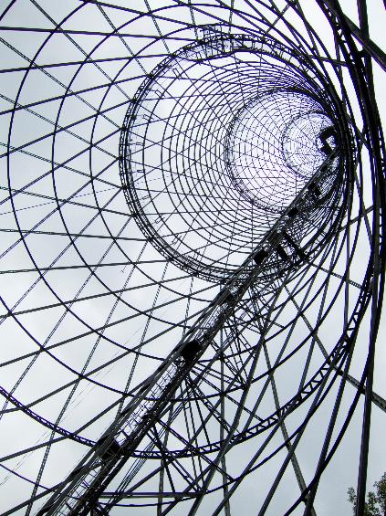
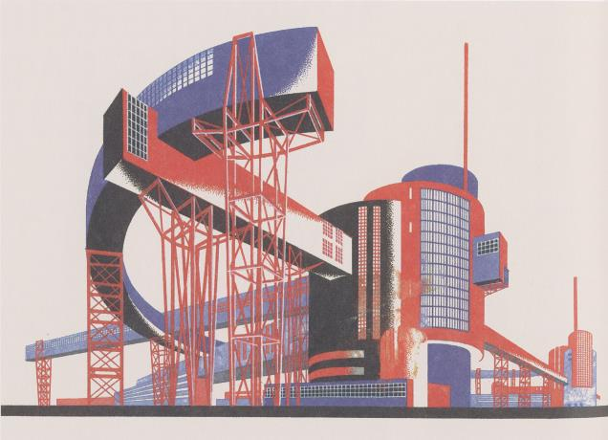
Left: Yakov Chernikhov, Architectural Fantasy (1933)
Right: Vladimir Shukhov, Shokhov Radio Tower (1920 – 22)
Notes:
Architecture and photography

Slide 31
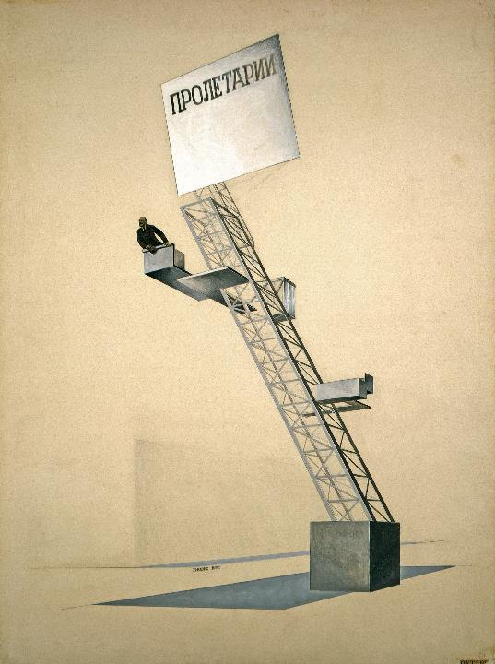
Left: El Lissitzky, The Lenin Tribune (1920-24)
Notes:
And of course, leading up to the Russian Revolution, was heavily inspired by two things:
The advent of machine and industrial technology-as-aesthetic
And politics, like by the working class, or in Russian, Proletariat

Slide 32
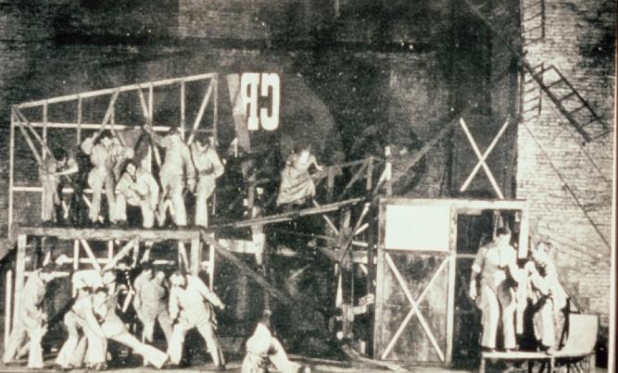
Left: El Lissitzky, The Lenin Tribune (1920-24)
Right: Liubov Popova, Set design for The Magnanimous Cuckold
Notes:
This merged idea permeated through to all forms of the creative fields
Here an example of set design

Slide 33
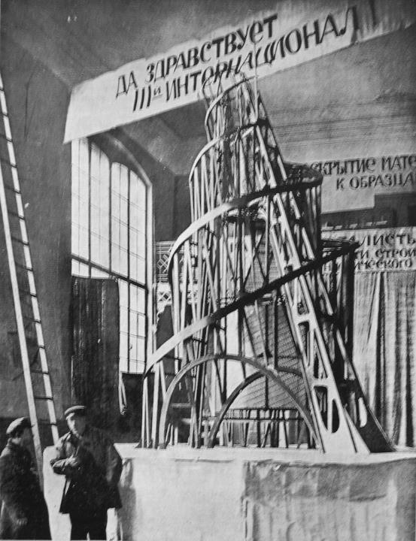
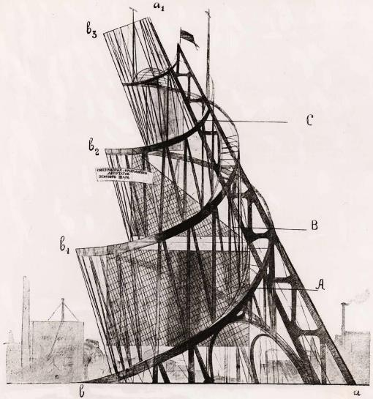
Vladimir Tatlin
Monument to the Third International (1919 – 20)
Notes:
And in terms of architecture, one of the most well-known examples is Vladimir Tatlin’s Monument to the Third International
The entire building as an architecture of propaganda
Was to be tantamount to the Eiffel Tower in its symbolism
400m in height (1200 feet)
Bottom
Cube
Lectures, venue, conference
Rotate a cycle once a year
Pyramid
Executive activities
Rotate once a month
Cylinder
Information centre, bulletins, manifestos, radio and loudspeaker
Rotate once a day
Hemisphere for radio equipment
So Russian Constructivism – an aesthetic, or stylistic source for Deconstructivism
Where was the philosophical/conceptual source?
Deconstructionism

Slide 34
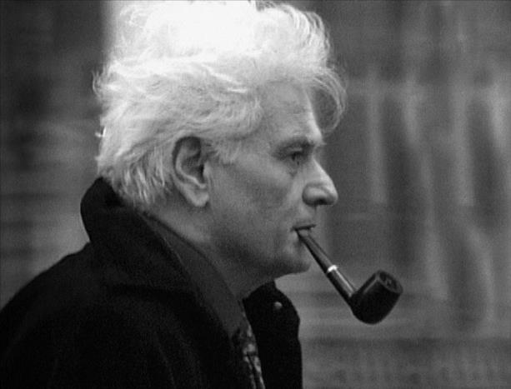
Jacques Derrida
French; 1930 - 2004
Notes:
‘Father’ of Deconstruction was the French philosopher, Jacques Derrida

Slide 35
DECONSTRUCTIVISM
≠
DECONSTRUCTION
Notes:
A bit confusing
Architecture → Deconstructivism
Philosophy → Deconstruction

Slide 36
DECONSTRUCTIVISM
≠
DECONSTRUCTION
STRUCTURALISM
POSTSTRUCTURALISM
Notes:
Deconstruction responding to Structuralism, Post-Structuralism
Details not all that important, except…
It’s about how the signs and meanings we use to communicate are settled on very shaky ground – nothing solid or permanent about them.

Slide 37
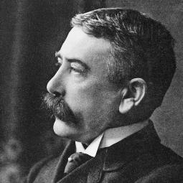
DECONSTRUCTIVISM
≠
DECONSTRUCTION
STRUCTURALISM
Ferdinand de Saussure
Swiss, 1857 - 1913
Linguistics
POSTSTRUCTURALISM
Notes:
If you remember Ferdinand de Saussure, the father of Structuralism…
One of his main ideas…

Slide 38
DECONSTRUCTIVISM
≠
DECONSTRUCTION
STRUCTURALISM
POSTSTRUCTURALISM
Notes:
Was the dichotomy Signified and Signifiers.
Signifier: Word / Medium
Signified: Meaning / Significance
Deconstruction argued against this, saying that this two-sidedness was somewhat arbitrary and conventional, and instead, things were far more complicated than this, and that there was a much more complicated network of meanings at play.

Slide 39
“no historical moment, body of thought, epoch or tradition, is ever wholly at one with itself because it inevitably contains the traces of what precedes and follows it.”
“there is not one single history, a general history, but rather histories.”
Notes:
From Of Grammatology (1967)

Slide 40
“The fact is that every text is the product of a logic of difference, relation or supplementarity that exceeds its author’s control.”
“language is born out of the process of its own degeneration.”

Slide 41
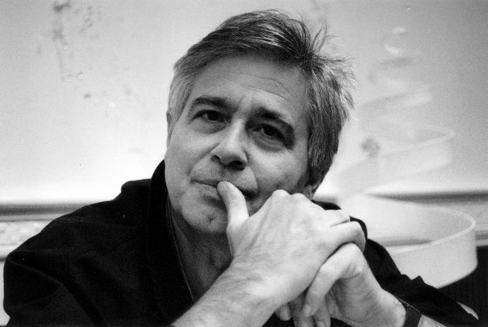
Bernard Tschumi
French; 1944 -
Notes:
So, with that HIGHLY abridged version of Deconstruction in Philosophy, we move on to an architect closely aligned with the Deconstructivist movement, Bernard Tschumi, who regularly conversed with Jacques Derrida.
French → AA → Columbia

Slide 42
DISJUNCTION
DEFAMILIARIZATION
EVENT
Notes:
3 Key Terms to understanding Tschumi’s works
DISJUNCTION
Juxtaposing things that don’t normally go together
DEFAMILIARIZATION
Seeing common things in a new light
EVENT
Like the ‘Situations’ of Guy Debord

Slide 43
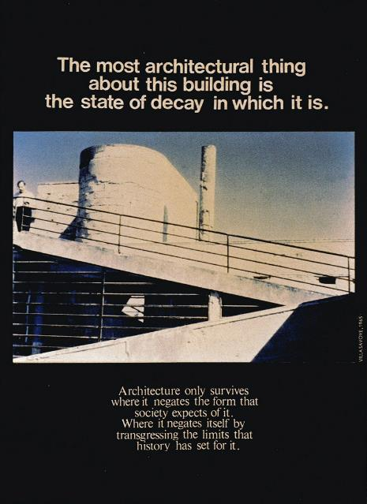
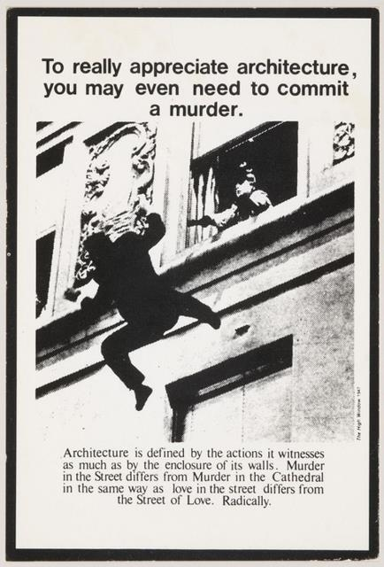
Advertisements for Architecture (1976 – 7)
Notes:
Early career, made these ‘Advertisements for Architecture’
Postcard sized images
An attempt to present architecture beyond its common presentation of space

Slide 44
“Architecture is not simply about space and form, but also about event, action, and what happens in space.”
Advertisements for Architecture (1976 – 7)

Slide 45
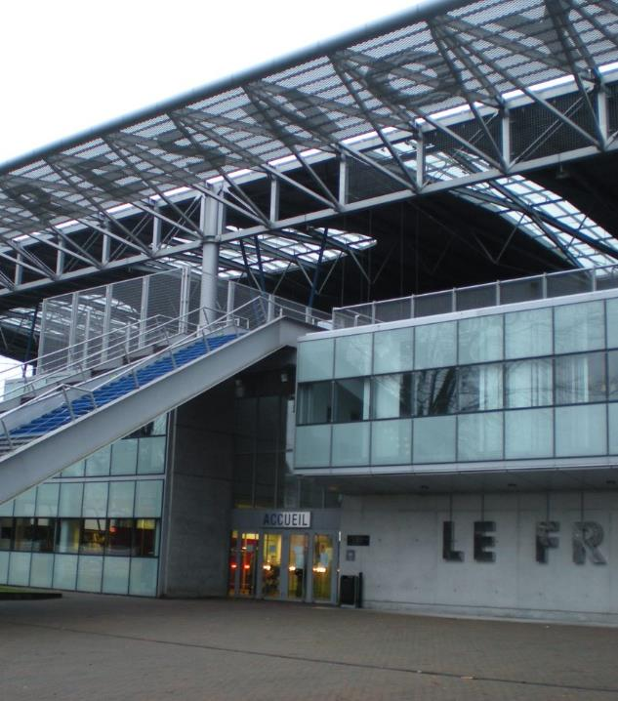
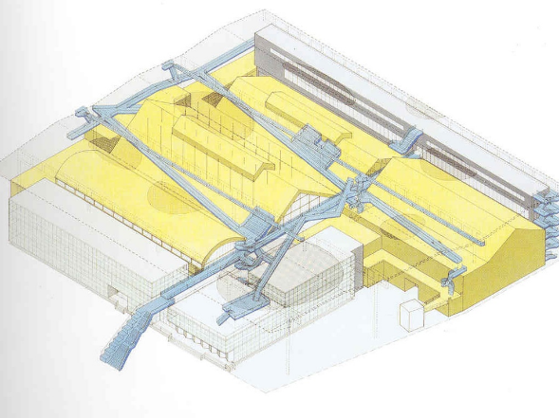
La Fresnoy Art Center, Tourcoing, France (1991 – 1997)
Notes:
But Tschumi has also tried to incorporate the ideas of DISJUNCTION, DEFAMILIARIZATION, and EVENT into his built works.
One of my favorites is his La Fresnoy Art Center
The original site was home to a number of buildings built in the 1920s, almost like warehouse spaces.

Slide 46
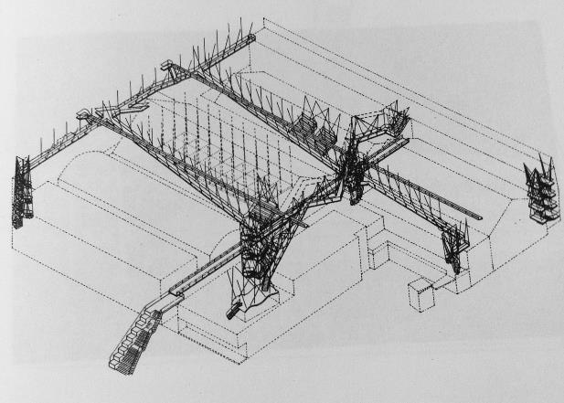
La Fresnoy Art Center, Tourcoing, France (1991 – 1997)
Notes:
What Tschumi did was built a massive roof above these buildings, making them into a single structure.
He called this the buildings’ ‘Common Denominator’

Slide 47
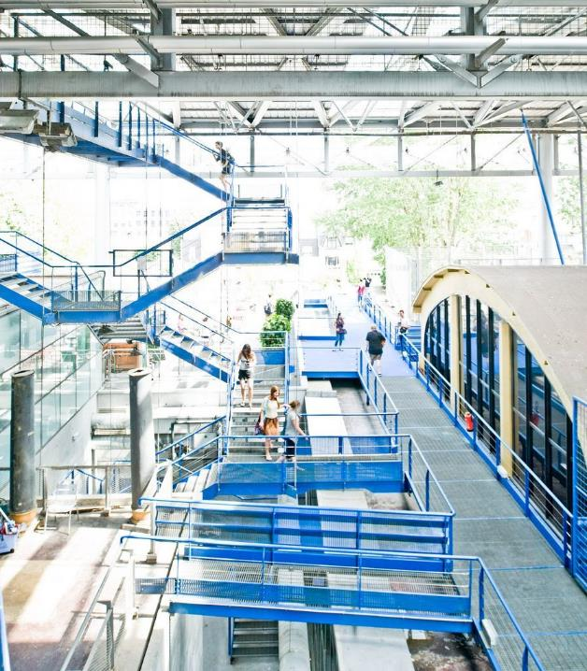
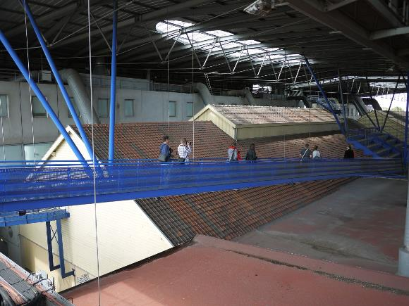
La Fresnoy Art Center, Tourcoing, France (1991 – 1997)
Notes:
Moreover, he then added a number of suspended walkways and services.
Other than the aesthetics of it, it was a physical manifestation of how building elements and program, that were not originally intended for each other, are juxtaposed, are forced into opposition.

Slide 48
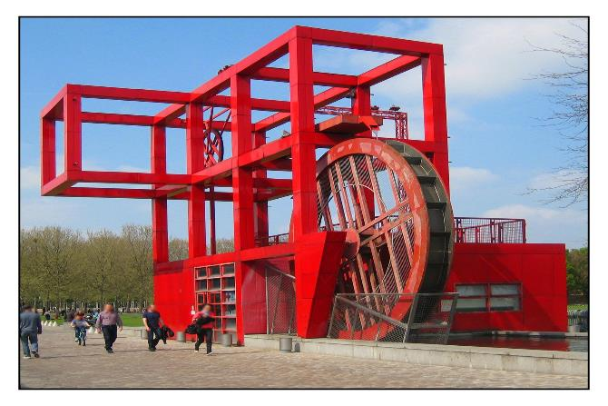
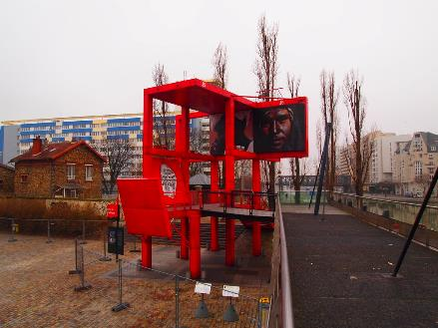
Parc de la Villette, Paris (1982 - 1998)
Notes:
Arguably his most famous built work is Parc de la Villette in Paris, France.
The ‘building’ is composed of multiple little structures, all painted in red, spread out through a park.

Slide 49
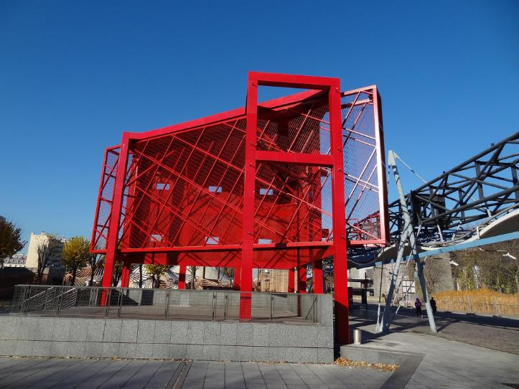
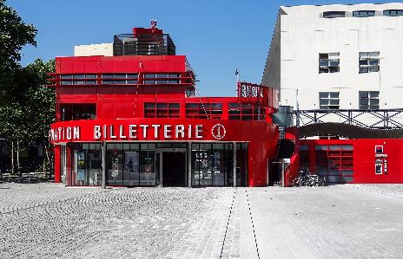
Parc de la Villette, Paris (1982 - 1998)
Notes:
Other than the color and the general aesthetic, these discreet structures – pavilions, can be understood as both autonomous (independent), but also held together as a single work, a single idea.
He called this pavilions ‘FOLIE’, or in English, ‘FOLLY’
Homophone (very Deconstructionist → the ‘loose’ tie b/w signified and signifier)
Folly (English) → Whimsical structure
Folie (French) → Madness, a break with sense
A structure that transcends its physical limits

Slide 50
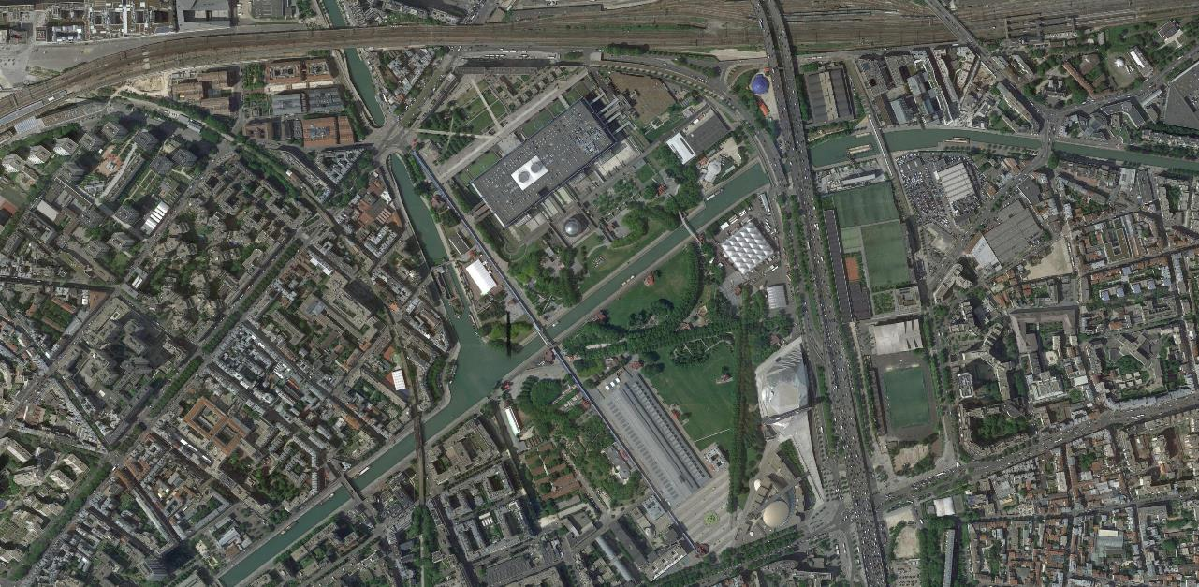
Parc de la Villette, Paris (1982 - 1998)
Notes:
In the aerial, located in North East of Paris
26 FOLIES

Slide 51
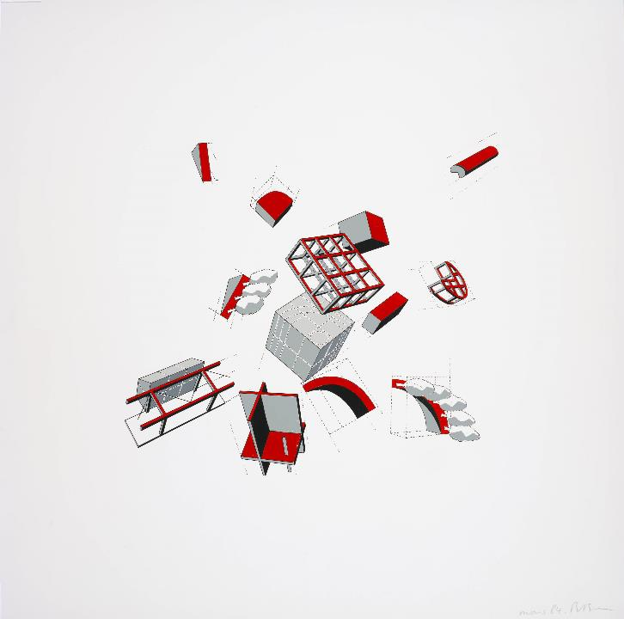
Parc de la Villette (folie explosée), Paris (1982 - 1998)
Notes:
Illustration of the concept of a folie, in which its construction is understood to be tenuous, in tension, and composed of a network of structures (Deconstruction)

Slide 52
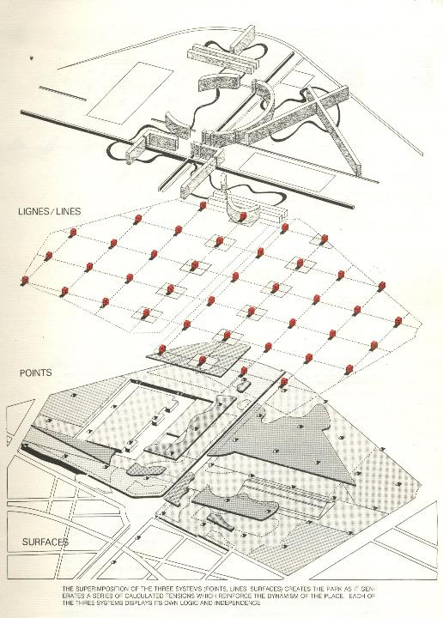
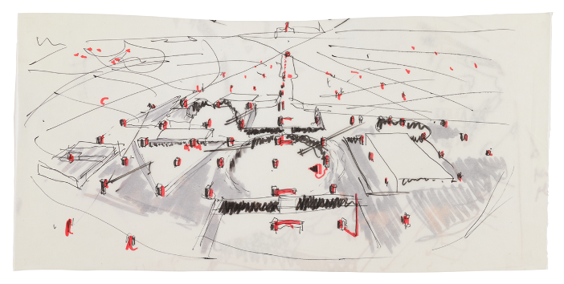
Parc de la Villette, Paris (1982 - 1998)
Notes:
The strategy is quite straightforward – a grid of folies, spread across the existing site

Slide 53
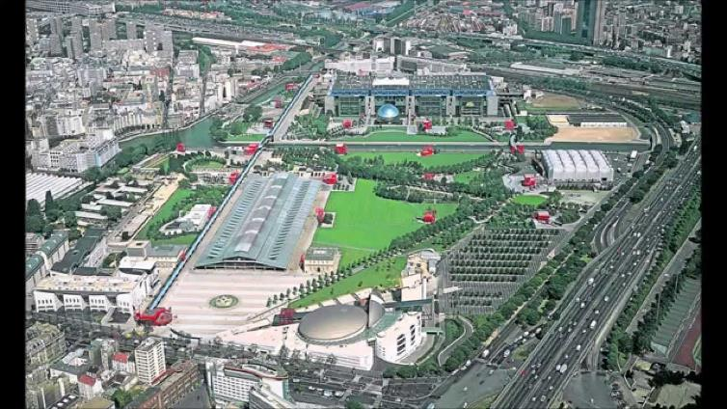
Parc de la Villette, Paris (1982 - 1998)
Notes:
Aerial photograph
Was meant to go on ad infinitum, depending on budget

Slide 54
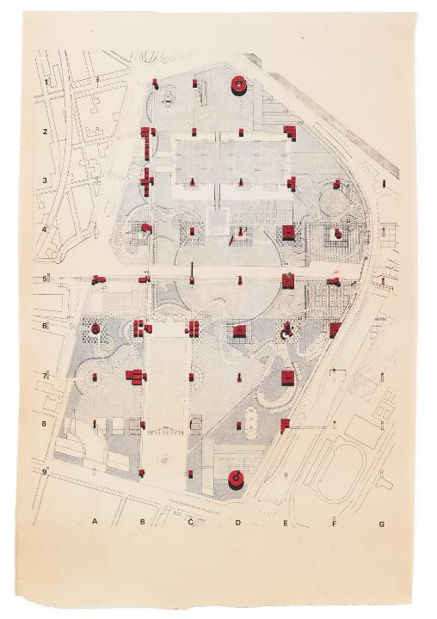
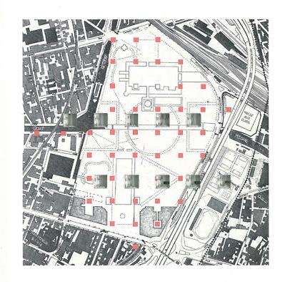
Parc de la Villette, Paris (1982 - 1998)
Notes:
Wonderful drawings accompanying this project

Slide 55
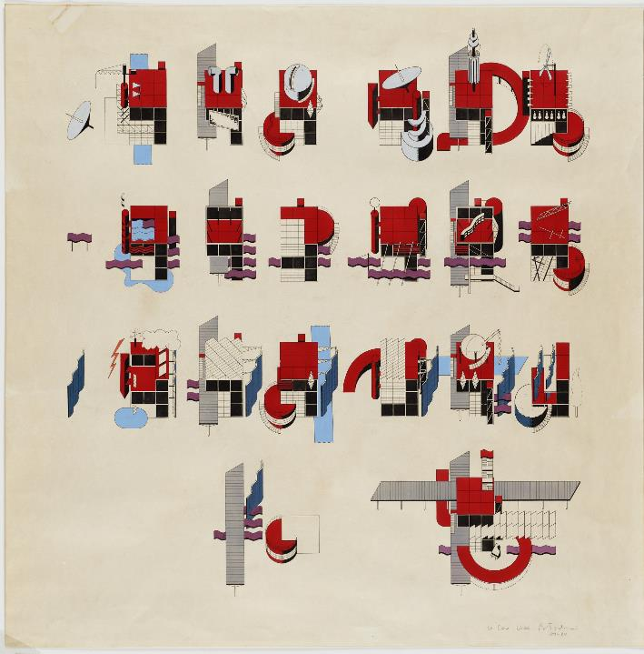
Parc de la Villette, Paris (1982 - 1998)
Notes:
Variations of folie
Again, not precious about the single folie, but about them working as a set
About the kind of responses, the events that they fostered in and around themselves

Slide 56
Parc de la Villette, Paris (1982 - 1998)
Notes:
Variations in model form

Slide 57
Notes:
Fireworks
Not about it being static (they could be aggregated ad infinitum)
Choreography of the park throughout, including the integration of choregraphed events, e.g. Fireworks
Diagram of fireworks in conjunction with their layout

Slide 58
Fireworks at the Parc de la Villette (1984)
Notes:
Photos of actual firework event (think SITUATIONS) within park.

Slide 59
Manhattan Transcripts (1984)
Notes:
Brings us to the last project of his, 1984 publication THE MANHATTAN TRANSCRIPTS
Can’t be considered apart from SITUATIONISM
Using the city as a canvas for architecture

Slide 60
“The Transcripts aimed to offer a different reading of architecture in which space, movement, and events are independent, yet stand in a new relation to one another, so that the conventional components of architecture are broken down and rebuilt along different axes.”
Manhattan Transcripts (1984)

Slide 61
Manhattan Transcripts (1984)
Notes:
Architecture not about a building, but about how the urban condition frames our understanding of space, and how the events that take place from our perception fundamentally transcends any Cartesian definition of space.
A major part of understanding this work is about interpretation, about interpreting meaning BETWEEN the Space of the images we see
So a common ‘technique’ that Tschumi uses throughout the Transcripts is the juxtaposition of images, as well as the juxtaposition of image types
For example, we see here some perspectives, some plans (that kind of look like diagrams, or if you’ve seen play strategies for sports), and some photographs.

Slide 62
Manhattan Transcripts (1984)
Notes:
Thought of Manhattan as a ‘STAGE SET’, in which events and their representation through architectural conventional drawings implied, or gave some kind of meaning to the stage.

Slide 63
The Park
The Street
The Tower
The Block
Manhattan Transcripts (1984)
Notes:
To make it even more layered, Tschumi narrates the Transcripts through a story, structured in 3 parts:
Part 1 – The Park
The murder
Part 2 – The Street
“He gets out of jail; they make love; she kills him; she is free”
Part 3 – The Tower
Lethal fall of an inmate
Part 4 – The Block
Acrobatics, extreme movements
Tried to subvert anti-Functionalism with extreme emotions and actions
Love, Death → Murder

Slide 64
Manhattan Transcripts (1984)
Notes:
Throughout the book, the chapters deal with various juxtapositions:
Type vs Program
Objects vs Events
Set and Script
Movement and Space, and Events

Slide 65
Manhattan Transcripts (1984)
Notes:
Even though there’s a narrative and a site (Murder + NYC), don’t try to approach it as a conventional book – treat them as a situationist would, that is, as discreet moments that allow us to see the city and architecture in different ways.
Understanding architecture through action, rather than the tired “function and form” dichotomy

Slide 66
Guy Debord, The Naked City (1957)
Notes:
Think of Debord’s The Naked City – in which the city is understood through a series of Situations, of discreet moments connected by the common denominator of a journey, a path.

Slide 67
Manhattan Transcripts (1984)
Notes:
In Tschumi’s case, we see how emotion affects the perception of space, and of how different architectural drawing conventions can reveal or complicate how we apply meaning to space.

Slide 68
Manhattan Transcripts (1984)
Notes:
The Manhattan Transcripts shouldn’t be thought of as a single publication, but as a kind of ongoing diary that tries to defamiliarize our understanding of architecture, to reveal how our discipline goes well beyond mere built structures.

Slide 69
Manhattan Transcripts (1984)
Notes:
Some original sketches for the Transcripts

Slide 70
Manhattan Transcripts (1984)
Notes:
And for Tschumi, he used this project to develop and redevelop some of his drawing personal drawing conventions.

Slide 71
Daniel Libeskind
Polish - American; 1946 -
Notes:
While Tschumi undoubtedly for me was the quintessential Deconstructivist, it’s important to remember that he wasn’t the only one, and in fact, Tschumi’s work was symptomatic of a larger conceptual-stylistic approach that really caught on in the 1980s up until today even.
Another preeminent architect that is associated with Deconstructivism is Daniel Libeskind – Polish/American, practices today.

Slide 72
Micromegas (1979)
Notes:
To start, we see his Micromegas project – series of drawings.

Slide 73
Micromegas (1979)
Notes:
Unlike Tschumi, Libeskind integration of philosophy into his architecture was a lot more opaque, quite dense integration of Derridean terms
It’s enough to read a kind of Deconstruction (philosophy) in these drawings
In which the stability of conventional architecture is undone, but architecture persists through the network of its manifold connections/associations.

Slide 74
Notes:
Project as series
Early in his career – developing his personal style, approach to understanding form.

Slide 75
Micromegas (1979)
Notes:
Quite intricate drawings – beautifully rendered.

Slide 76
Potsdamer Platz, Berlin (1991)
Notes:
It’s easy to see how Micromegas transitioned into his design of spaces, such as his proposal for Potsdamer Platz in Berlin, 1991.

Slide 77
Potsdamer Platz, Berlin (1991)
Notes:
Conceived of as a fracture of spaces that ‘float’ within a network over each other.

Slide 78
Potsdamer Platz, Berlin (1991)
Notes:
Designed as the intersection between 10 different shards, each one as a memory for a city that had a manifold and complicated history (Berlin)

Slide 79
Potsdamer Platz, Berlin (1991)
Notes:
His concept drawings and architectural renderings have to be understood in the same vein.
Influence of film (like Tschumi) – again, generational

Slide 80
Potsdamer Platz, Berlin (1991)
Notes:
The project proposed the area of Potsdamer Platz to be composed of these juxtapositions both in plan and in section.

Slide 81
Sonnets in Babylon, Venice Biennale (2014)
Notes:
More recent work for the Venice Biennale, Sonnets in Babylon
Installation of drawings

Slide 82
Sonnets in Babylon, Venice Biennale (2014)
Notes:
To this day, very much develops his architecture in both three-dimensions and in drawings
In fact has said a number of times that he considers himself an artist first, then an architect

Slide 83
Sonnets in Babylon, Venice Biennale (2014)
Notes:
Some details of the drawings
A series of narratives of personal importance
Not fully revealed, but I don’t think wholly relevant to understand the project
We can catch architectural moments (dome, staircase), but they float on unstable ground
Almost like Piranesi’s Carceri

Slide 84
Sonnets in Babylon, Venice Biennale (2014)
Notes:
The architectural form is the value itself
Meaning is found in the composition of works – not in its translation.

Slide 85
Three Lessons in Architecture, Cranbrook Academy of Art (1985)
Notes:
A project developed with his students at Cranbrook in 1985
Just showing range of Libeskind’s work

Slide 86
Extension to the Denver Art Museum (2006)
Notes:
But out of the early Deconstructivists, Libeskind is also quite prolific in his built work
Signature ‘shards’

Slide 87
Extension to the Denver Art Museum (2006)
Notes:
Extension to the Denver Art Museum of 2006.

Slide 88
Jewish Museum, Berlin (2001)
Notes:
Most celebrated project probably Jewish Museum in Berlin 2001.
Zig-zag in plan

Slide 89
Jewish Museum, Berlin (2001)
Notes:
In elevation, straight extrusion with these kind of ‘tears’ into the façade.
- Ruptures of an otherwise solid block

Slide 90
Jewish Museum, Berlin (2001)

Slide 91
Notes:
Throughout the zig-zag, going through various spaces that recount various aspects of the plight of Jews during World War II
Locational significance – in Berlin

Slide 92
Jewish Museum, Berlin (2001)
Notes:
Street level views
- Cold exterior breaking apart from the intensity of the subject matter within

Slide 93
Jewish Museum, Berlin (2001)
Notes:
Interior
Often described as quite cold, slanting planes make for a distortion of ‘normal’ space – in drama with the subject matter – solemn.
2. Intentionally ‘unpleasant’

Slide 94
World Trade Center Masterplan, New York City (2002 – 2010s)
Notes:
Masterplan for World Trade Center
His work spans both the conceptual and commercial
Regardless of style, appreciate that his conceptual work (Drawings) supplement his commercial work – unlike many of his contemporaries.

Slide 95
Zaha Hadid
British; 1950 - 2016
Notes:
Only a visual slideshow for Zaha
Primary reason is because I feel there was a strong break between her early work, and the work which she is perhaps best known for today
Hard sell considering her a ‘Deconstructivist,’ but her early period coincides both in time and in style to the work shown prior

Slide 96
Heydar Aliyev Center, Azerbaijan (2007)
Notes:
today, best known for projects like this

Slide 97
Vision for Madrid (1992)
Notes:
- But earlier work, primarily in painting…

Slide 98
Metropolis (1988)

Slide 99
The Peak (1983)

Slide 100
The Peak (1983)

Slide 101
The Peak (1983)

Slide 102
The Peak (1983)

Slide 103
Kurfuerstendamn 70 (1986)

Slide 104
Kurfuerstendamn 70 (1986)

Slide 105
Hafenstrasse Development (1989)

Slide 106
Hafenstrasse Development (1989)

Slide 107
Hafenstrasse Development (1989)

Slide 108
Hafenstrasse Development (1989)

Slide 109
Great Utopias (1992)

Slide 110
Great Utopias (1992)

Slide 112
Vitra Fire Station, Weil am Rhein, Germany (1993)

Slide 113
Vitra Fire Station, Weil am Rhein, Germany (1993)

Slide 114
Vitra Fire Station, Weil am Rhein, Germany (1993)

Slide 115
Vitra Fire Station, Weil am Rhein, Germany (1993)

Slide 116
Vitra Fire Station, Weil am Rhein, Germany (1993)

Slide 117
Vitra Fire Station, Weil am Rhein, Germany (1993)

