Slide 1
Postmodernism
Contemporary Architecture Theory
Eugene Han
Fall 2020, 11:15 – 12:30 pm
Online Instruction
Notes:
For the next session, we’ll be looking at the architectural movement called Postmodernism.
Like pretty much all other architectural movements, the source of Postmodernism existed outside of architecture, and studies such as philosophy and sociology.
But I won’t get into that, as unlike Phenomenology, it strays too far from problems of the built environment.
No single definition of Postmodernism (though often misused today)
Inherently a sloppy term, and it’s very difficult if not impossible to clarify what is meant exactly by Postmodernists
By definition, a part of it still clings on to Modernism
Nevertheless, some shared tendencies from self-defined Postmodernists…

Slide 2
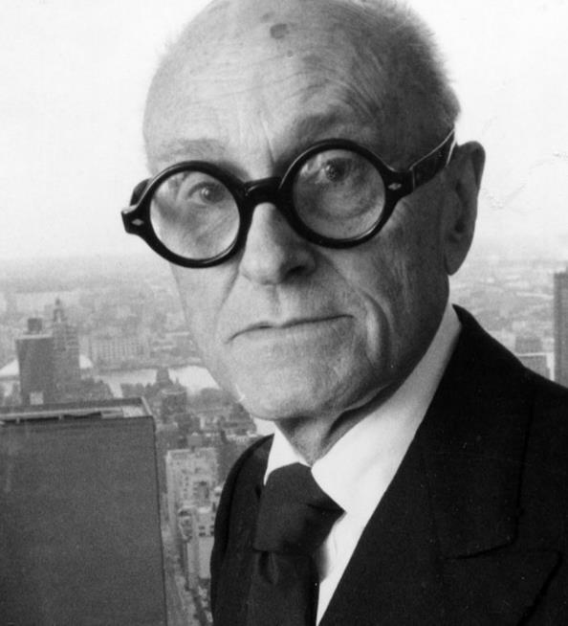
Notes:
Before we get into Postmodernism proper, let’s begin with this fellow…

Slide 3
Philip Johnson
American; 1906 - 2005
Notes:
A Corbusier lookalike – Philip Johnson.
Johnson was an architect in his own right, but he’s probably best known for his stuff outside of building.
He was essentially an architectural socialite – someone that at the center of the architectural world, without having building at the core of his practice.

Slide 4
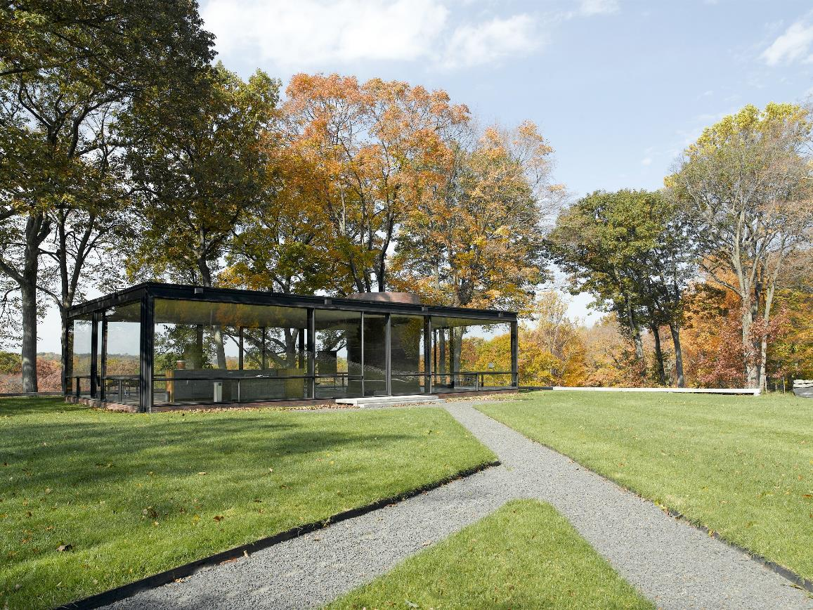
Glass House
New Canaan, CT (1955)
Notes:
He did build however, but even he considered himself an aficionado of sorts, who used his own buildings to learn about others.
Does this building look like anyone’s work?... Mies!

Slide 5
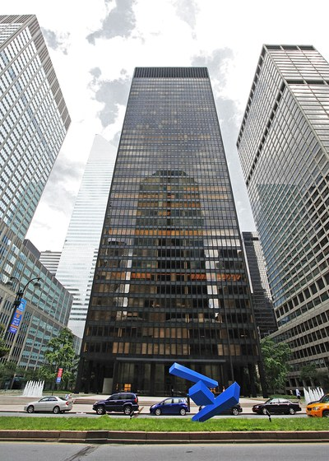
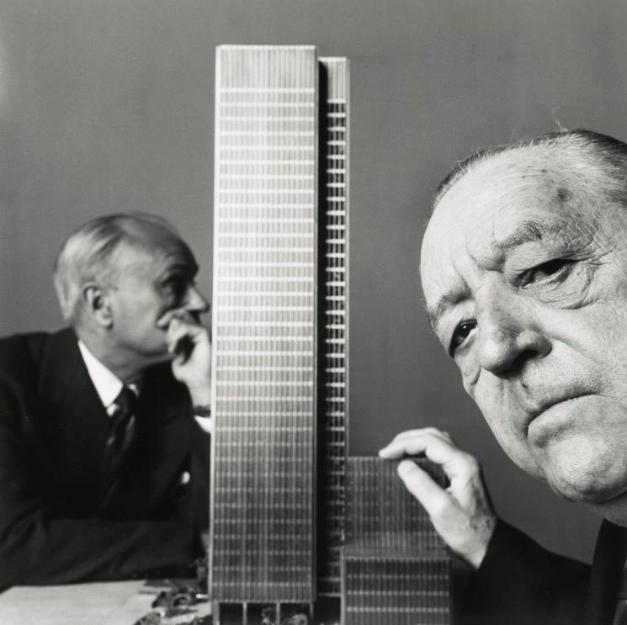
With Mies van der Rohe, Seagram Building
New York City, NY (1958)
Notes:
He was quite close to Mies, and actually worked in partnership with him for the Seagram Building – largely because he helped secure the commission for Mies.

Slide 6
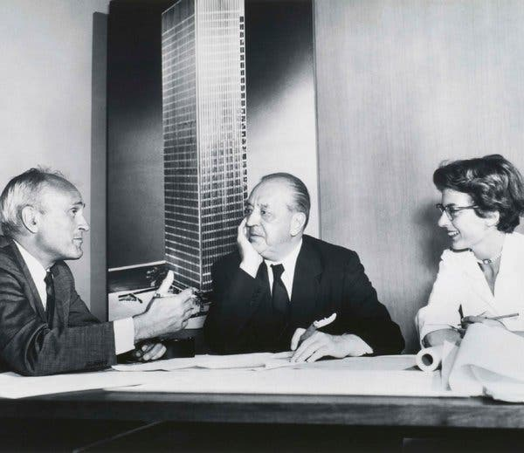
With Mies van der Rohe, Seagram Building
Philip Johnson, Mies van der Rohe, and Phyllis Lambert in 1955
Notes:
Here we see a photo of the three main ‘designers’ (Phyllis Lambert, daughter and heir to the Seagram fortune, patron of architecture and design).

Slide 7
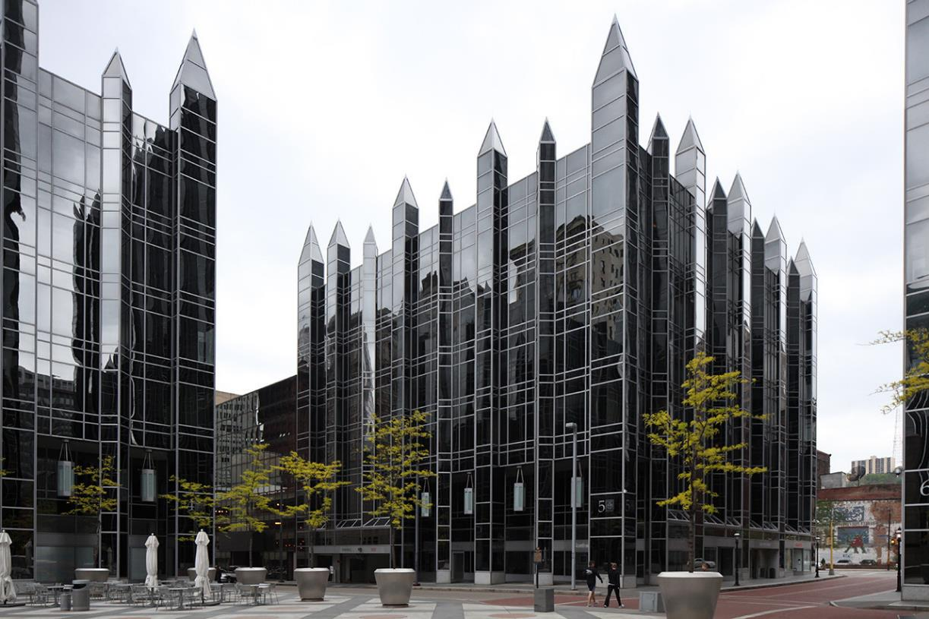
John Burgee Architects w/ Philip Johnson, PPG Place
Pittsburgh, PA (1984)
Notes:
But Johnson, as an architectural aficionado, was quite promiscuous with his design.
He didn’t have a single style, but had the connections and means to try out a few styles, oftentimes building in partnership with others that had either a stronger design vision, or better technical know-how.

Slide 8
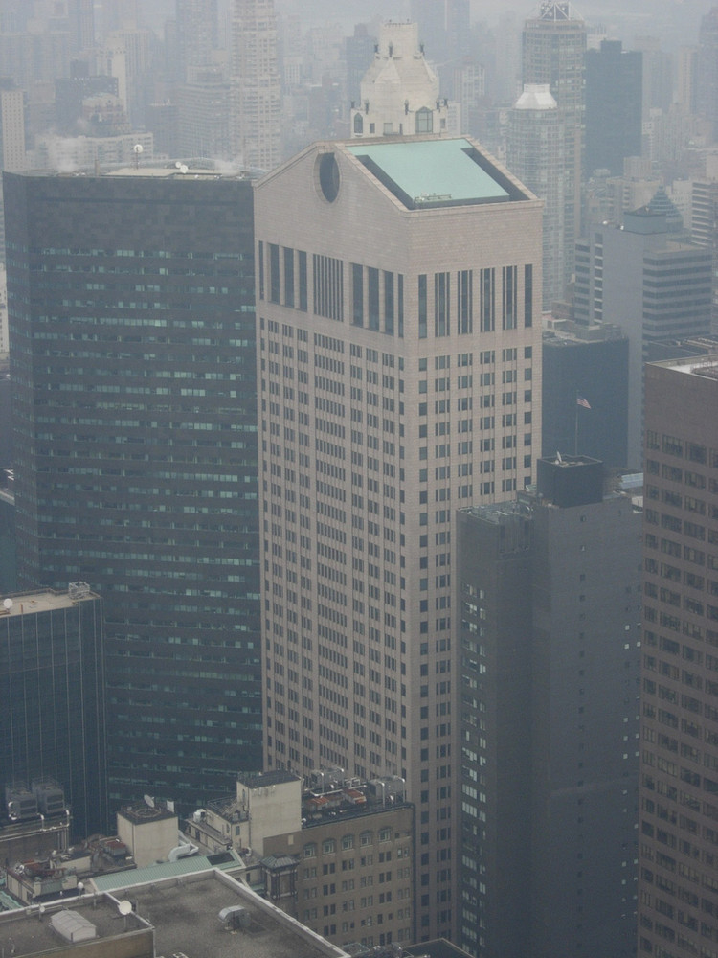
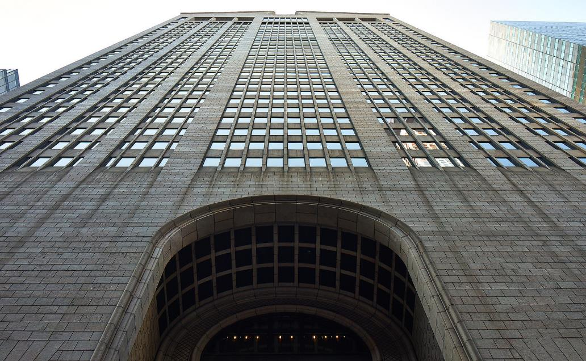
550 Madison Ave (AT&T Building)
New York City, NY (1984)
Notes:
This is arguably Johnson’s most well-known work, the AT&T building in Manhattan.
Conspicuous ‘pitched roof’… on a skyscraper.
Zero functional element, purely symbolic
Stonework cladding… on a skyscraper.

Slide 9
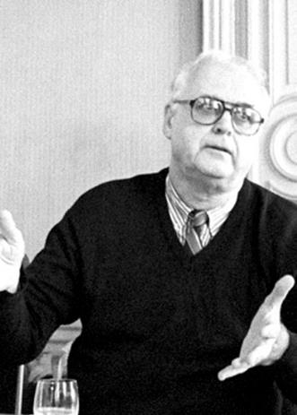
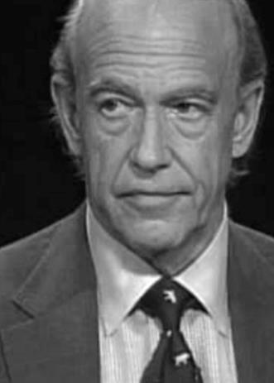
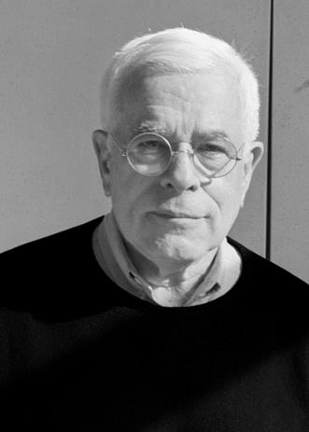
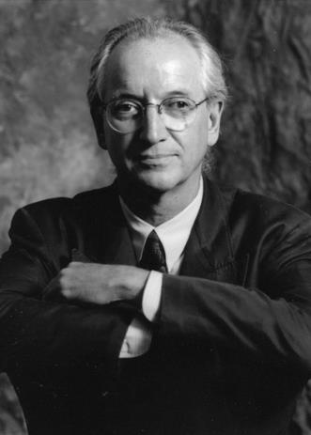
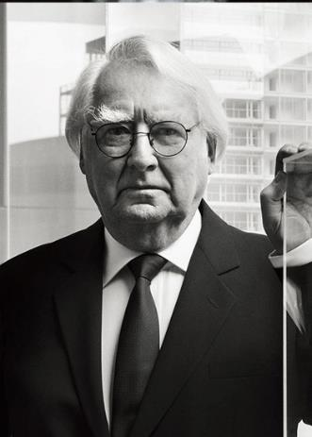
John Hejduk
1929 - 2000
Charles Gwathmey
1938 - 2009
Peter Eisenman
1932 -
Michael Graves
1934 - 2015
Richard Meier
1934 -
The New York Five (The Whites)
Notes:
But we started with Philip Johnson because it was he who coined the term, “The New York 5” to describe these 5 architects.
These 5 architects were featured in a publication called Five Architects (1972) produced by CASE (Committee of Architects for the Study of the Environment) at MOMA.
Also known as “The Whites” – unknown origin
Not about race, but about their admiration of Le Corbusier and Modernism
Think White as abstract (white paper)
John Hejduk, Charles Gwathmey, Peter Eisenman, Michael Graves, and Richard Meier.
We’ll cover Eiseneman in a bit more detail later on.

Slide 10
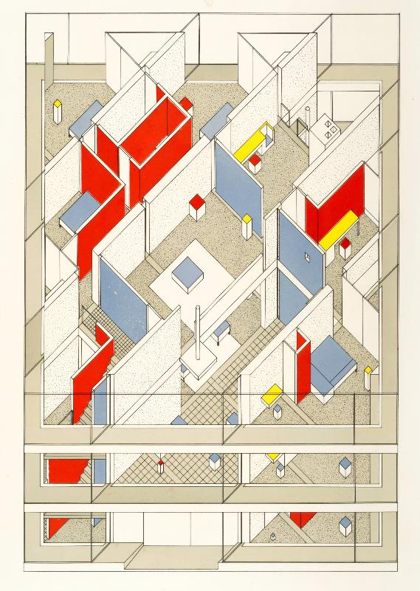
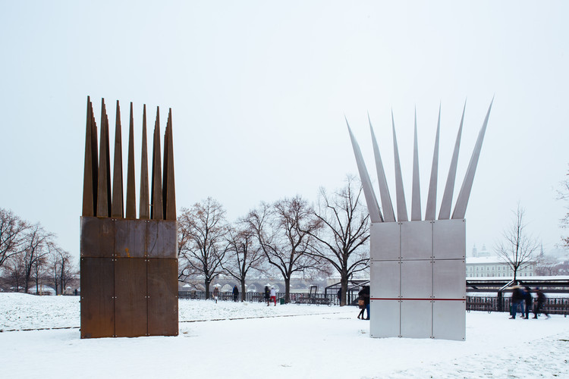
John Hejduk
1929 - 2000
The New York Five (The Whites)
John Hejduk, Charles Gwathmey, Peter Eisenman, Michael Graves, Richard Meier
Notes:
Hejduk
While certainly a designer, very much into the poetry of architecture
To the extent that many of his publications were half building sketches, half poems

Slide 11
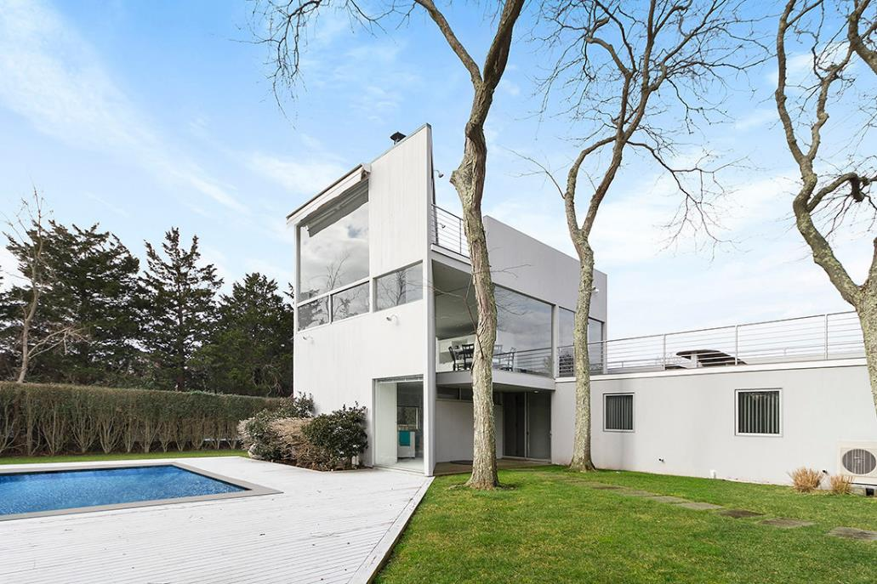
Charles Gwathmey
1938 - 2009
The New York Five (The Whites)
John Hejduk, Charles Gwathmey, Peter Eisenman, Michael Graves, Richard Meier
Notes:
Gwathmey
Coroprate model for Modernist aesthetic

Slide 12
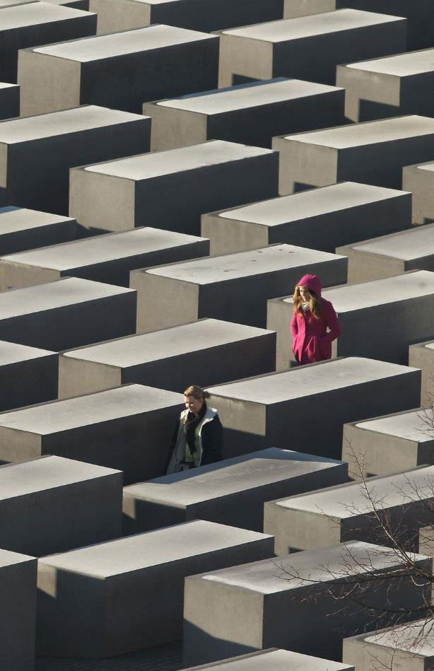
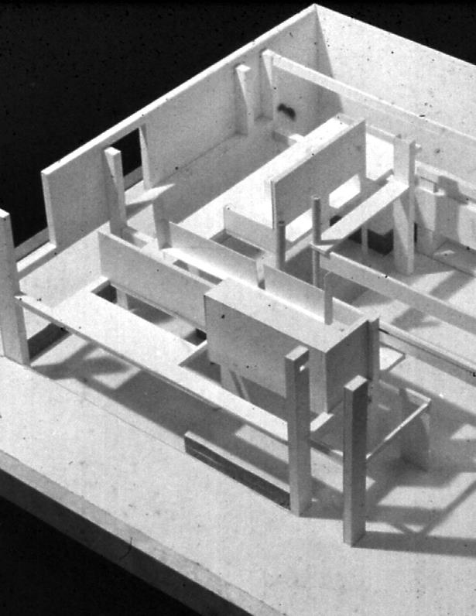
Peter Eisenman
1932 -
The New York Five (The Whites)
John Hejduk, Charles Gwathmey, Peter Eisenman, Michael Graves, Richard Meier
Notes:
Eisenman
Diagrams, a vast range of project types
One of the main architects in the Deconstructivist period

Slide 13
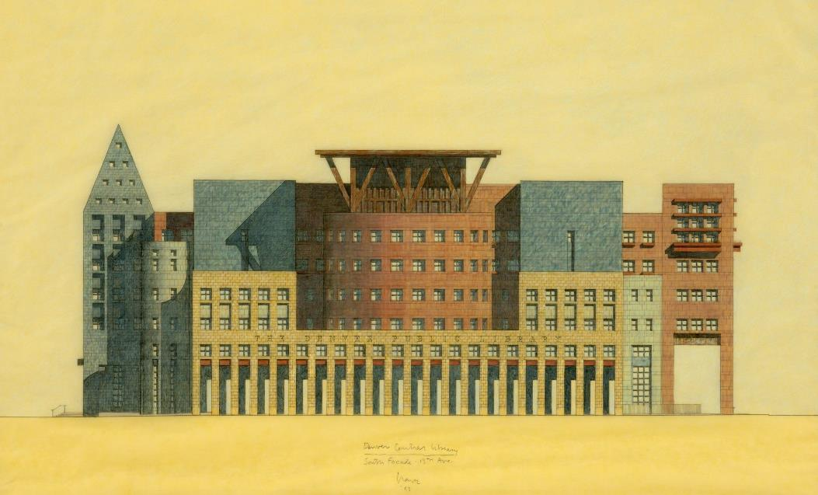
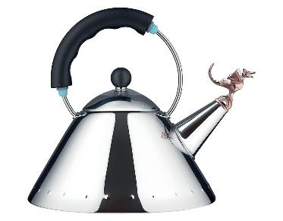
Michael Graves
1934 - 2015
The New York Five (The Whites)
John Hejduk, Charles Gwathmey, Peter Eisenman, Michael Graves, Richard Meier
Notes:
Michael Graves
Aesthetics of juxtaposition, whimsical forms
While he was part of ‘The Whites’, he’d eventually become one of the most famous Postmodernists

Slide 14
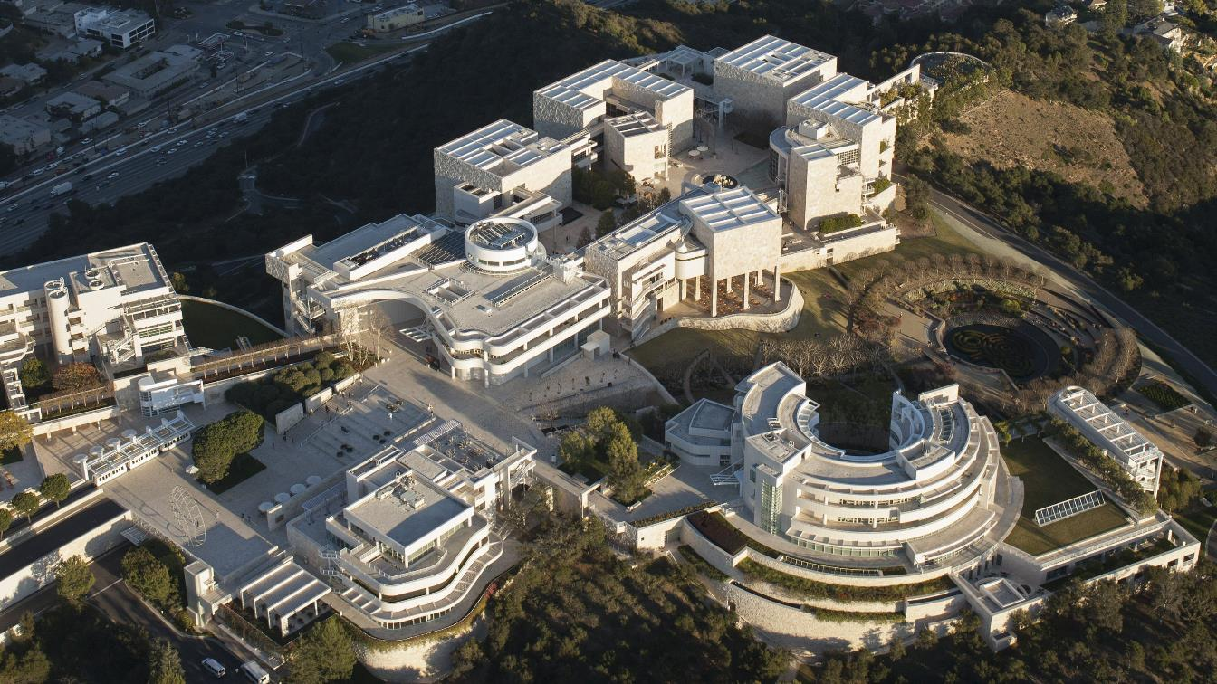
Richard Meier
1934 -
The New York Five (The Whites)
John Hejduk, Charles Gwathmey, Peter Eisenman, Michael Graves, Richard Meier
Notes:
Richard Meier
White grids, geometric collages
Getty Center, one of his most famous projects

Slide 15
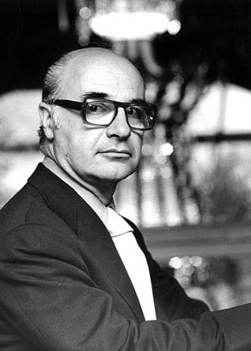
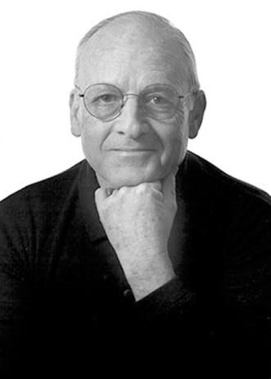
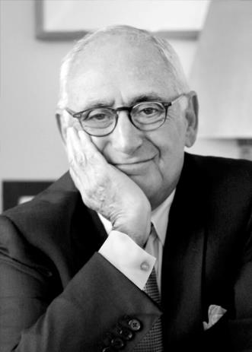
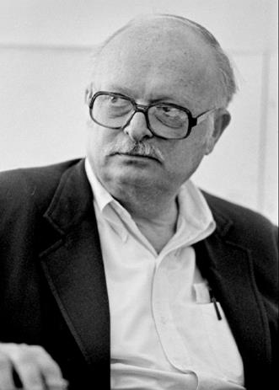
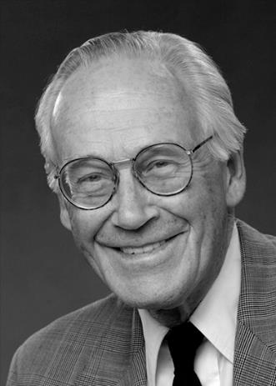
Romaldo Giurgola
1920 - 2016
Allan Greenberg
1938 -
Robert AM Stern
1939 -
Charles Moore
1925 - 1993
Jaquelin T. Robertson
1933 -
The Grays
Notes:
The label of the New York 5 gained a lot of notoriety, but there was some disciplinary tension with those that had a fundamentally different outlook than The Whites... led by Robert AM Stern, they called themsleves "The Greys“
In response, Robert Stern organized a forum called “Five on Five”, published in 1973
Robert AM Stern, Romaldo Giurgola, Allan Greenberg, Charles Moore, and Jaquelin T. Robertson
Unlike the ‘purity of the whites,’ the Greys sought to acknowledge the complexity of history, and that reality was more complicated than textbook theory.
Going to cycle through some of their projects, and won’t say much about each of them – pay attention to difference with Whites…

Slide 16
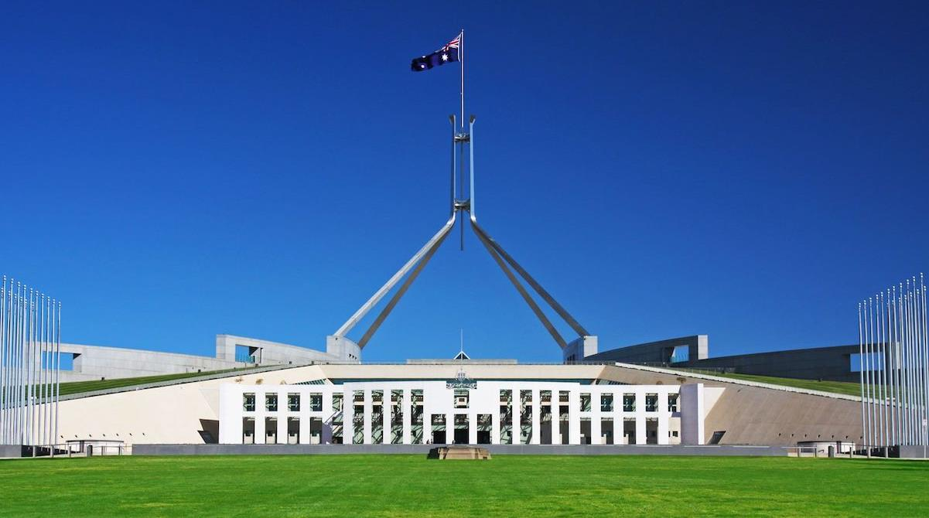
Romaldo Giurgola
1920 - 2016
The Grays
Romaldo Giurgola, Parliament House, Canberra, Australia (1981)
Notes:
Romaldo Giurgola

Slide 17
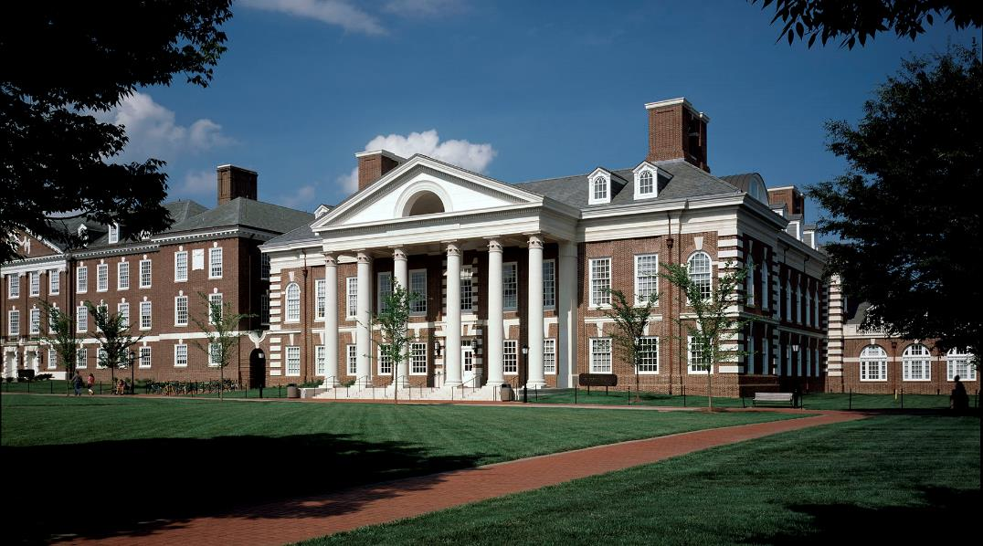
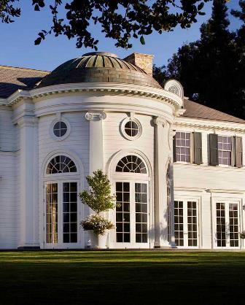
Allan Greenberg
1938 -
The Grays
Allan Greenberg, (right) Unicorn Mining Headquarters (1999)
Notes:
Allan Greenberg

Slide 18
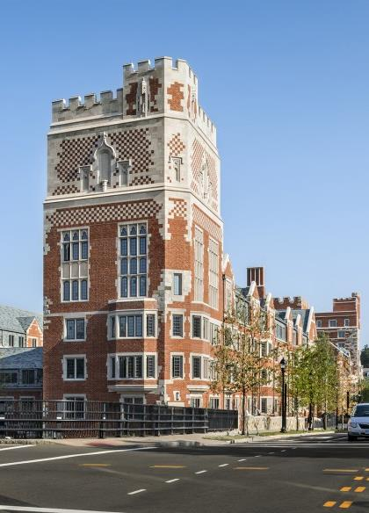
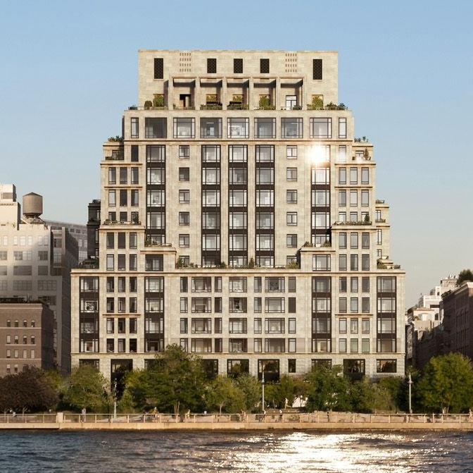
Robert AM Stern
1939 -
The Grays
Notes:
Robert AM Stern

Slide 19
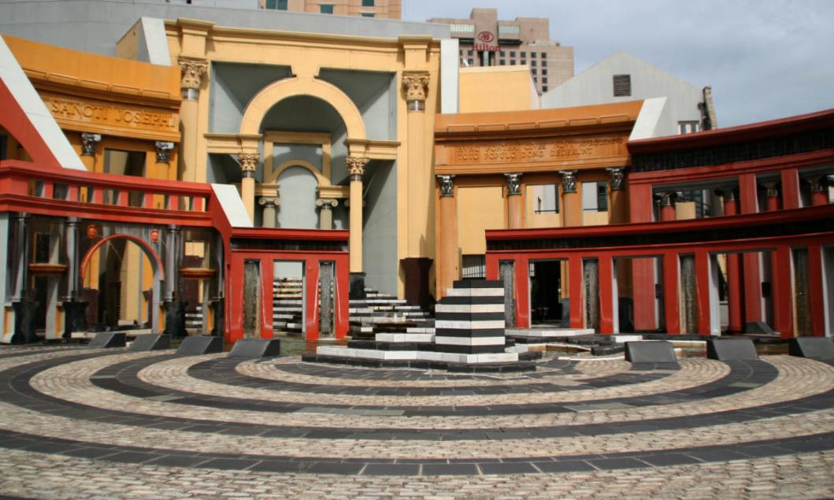
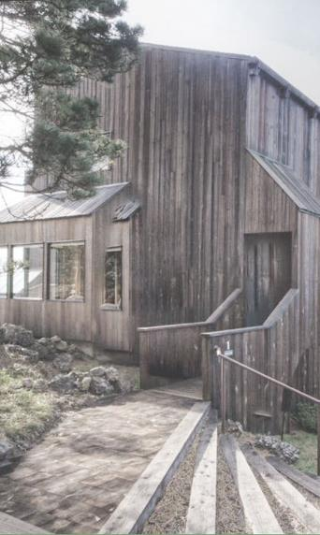
Charles Moore
1925 - 1993
The Grays
Notes:
Charles Moore

Slide 20
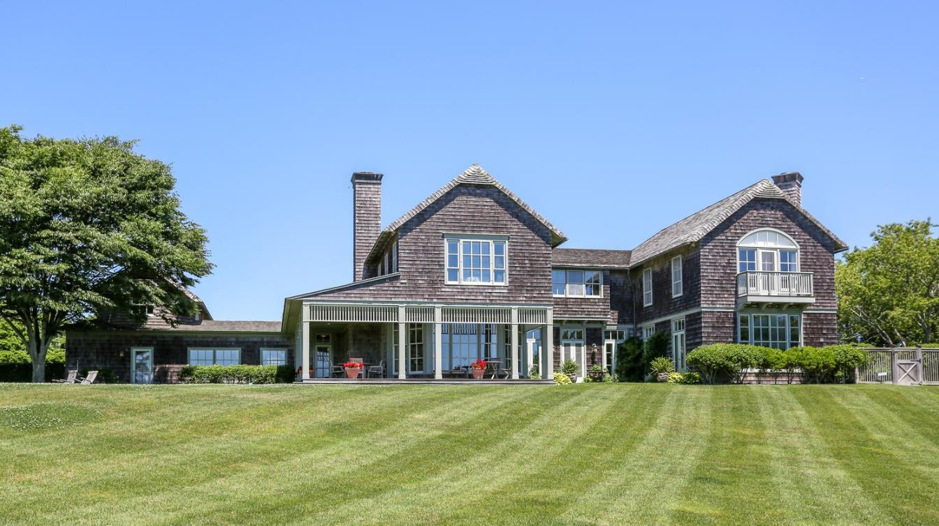
Jaquelin T. Robertson
1954 -
The Grays
Jaquelin Robertson, Hamptons Residential Project
Notes:
Jaquelin Robertson
Any differences with the Whites?
So, it’s accurate to say that the Grays were aiming towards a kind of architecture reliant on the ‘mixed’, less pure in favor of the actual.

Slide 21
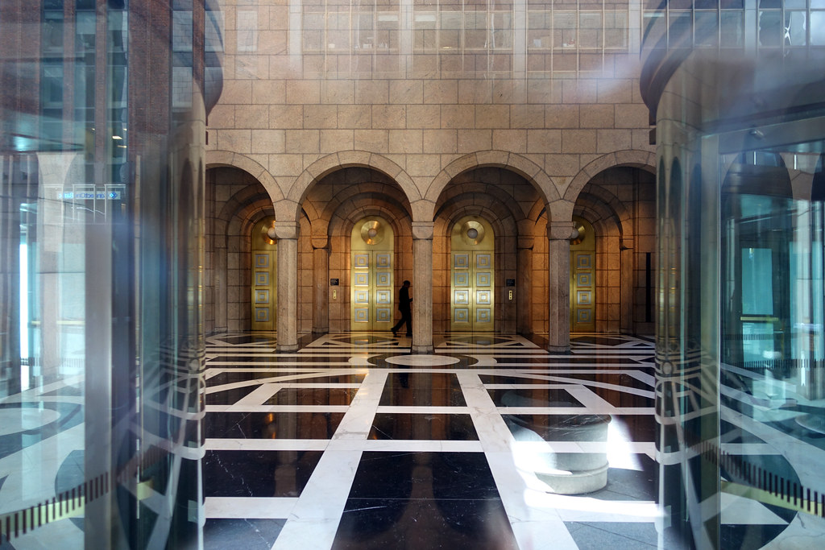
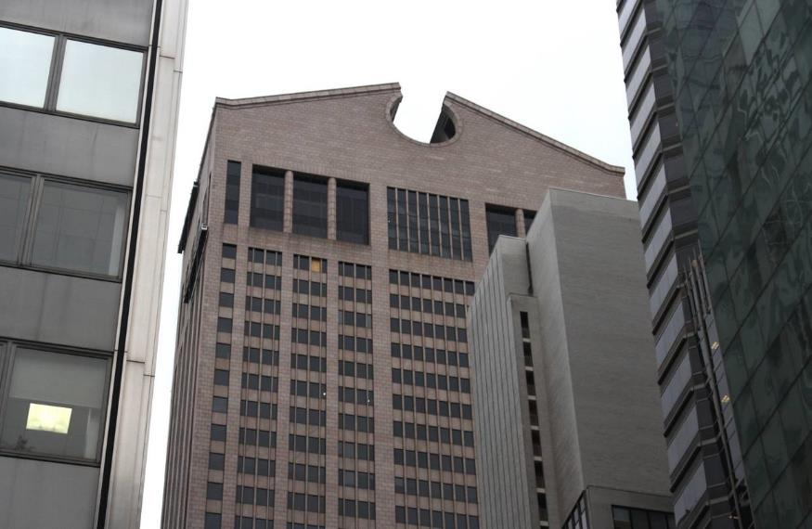
Philip Johnson, 550 Madison Ave (AT&T Building)
New York City, NY (1984)
Notes:
Going to show a series of buildings that are quintessentially Postmodern… try to articulate any stylistic tendencies
Philip Johnson’s AT&T Building

Slide 22
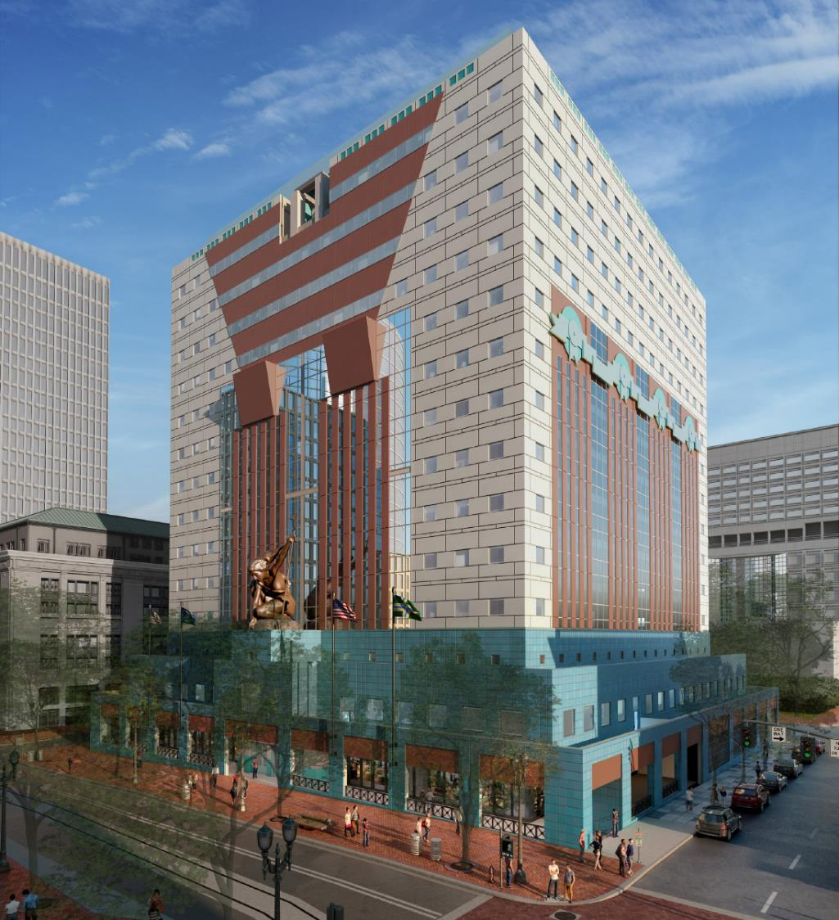
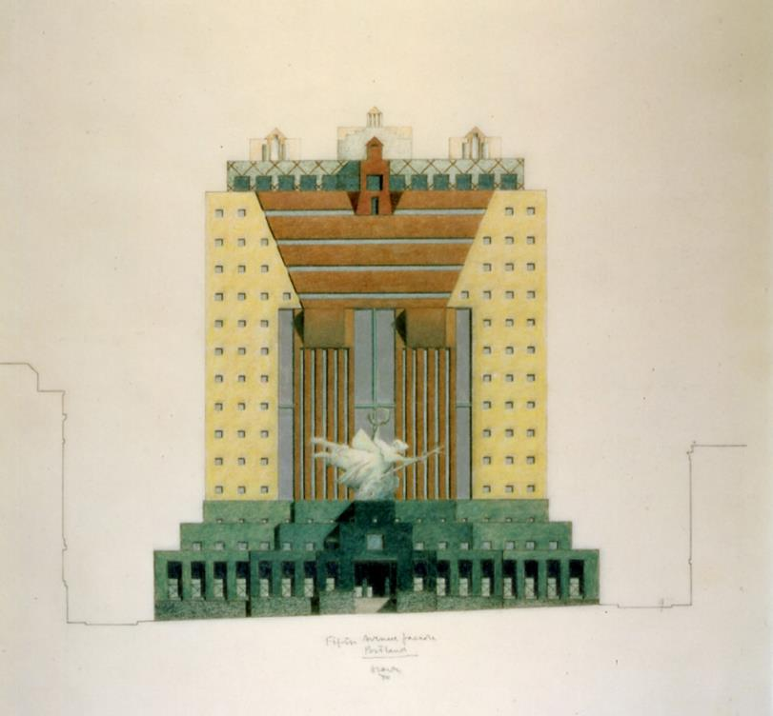
Michael Graves, Portland Building
Portland, OR (1982)
Notes:
Michael Graves
Remember, he was part of the Whites
So part of the difficulty of the term Whites/Greys
Actually more mixed in reality than on opposite teams

Slide 23
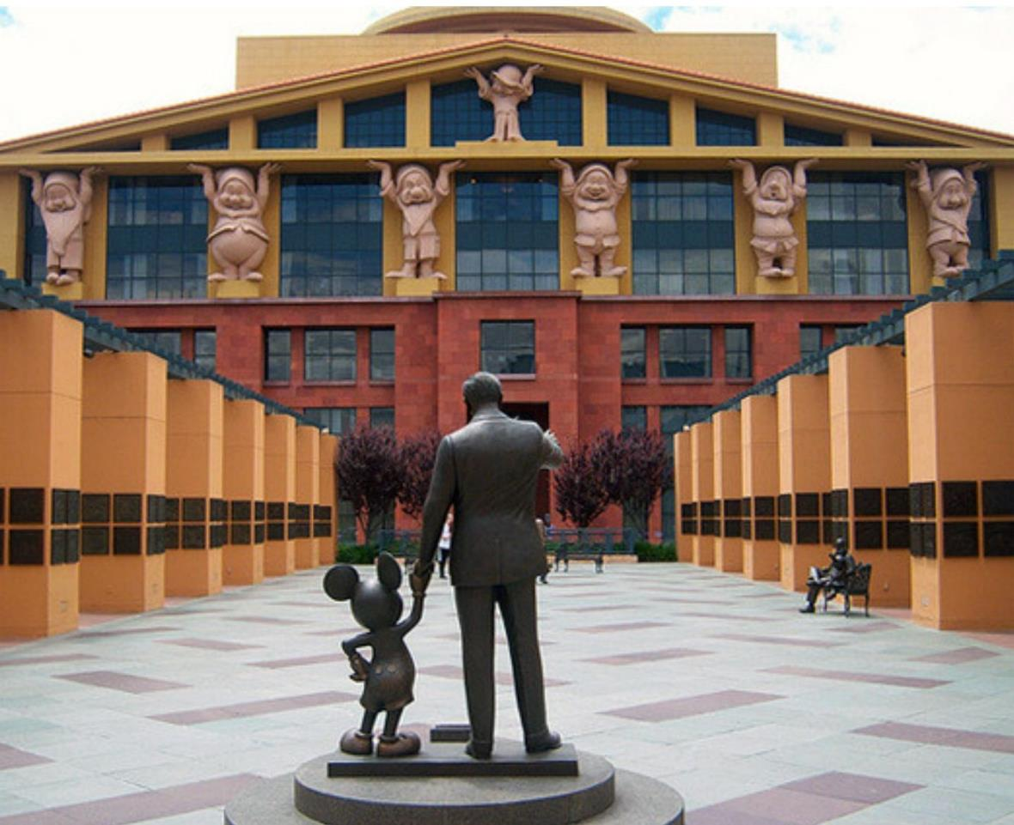
Michael Graves, Walt Disney Studios
Burbank, CA (1990)
Notes:
Another one of Graves
Disney Studios in Burbank
Snow White’s 7 dwarves serving as the caryatids of the front facade

Slide 24
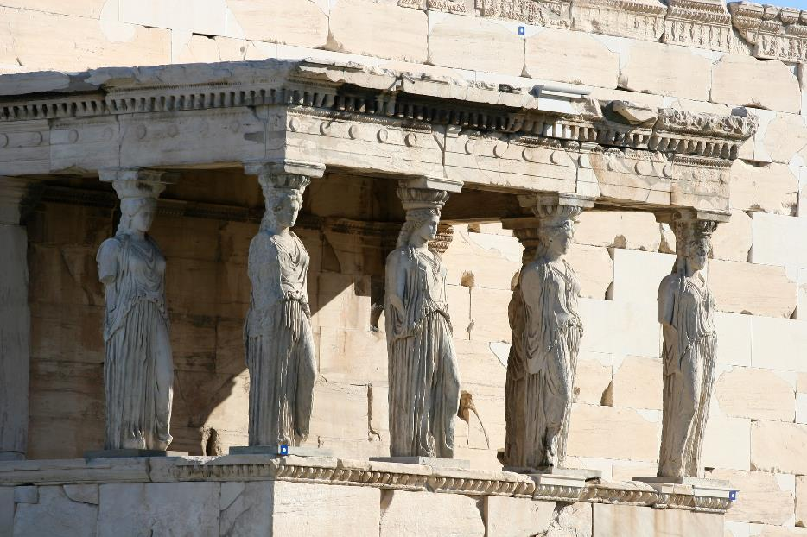
Michael Graves, Walt Disney Studios
Burbank, CA (1990)
Right: Erechtheion, The Acropolis, Greece (421 BC)
Notes:
An important exemplar to Postmodernism
Architecture as a conversation, where the history of the discipline supplies the practicing architect with a language, laden with symbolic value
A nod to the origins of Architecture
But light, for a building for an animation company

Slide 25
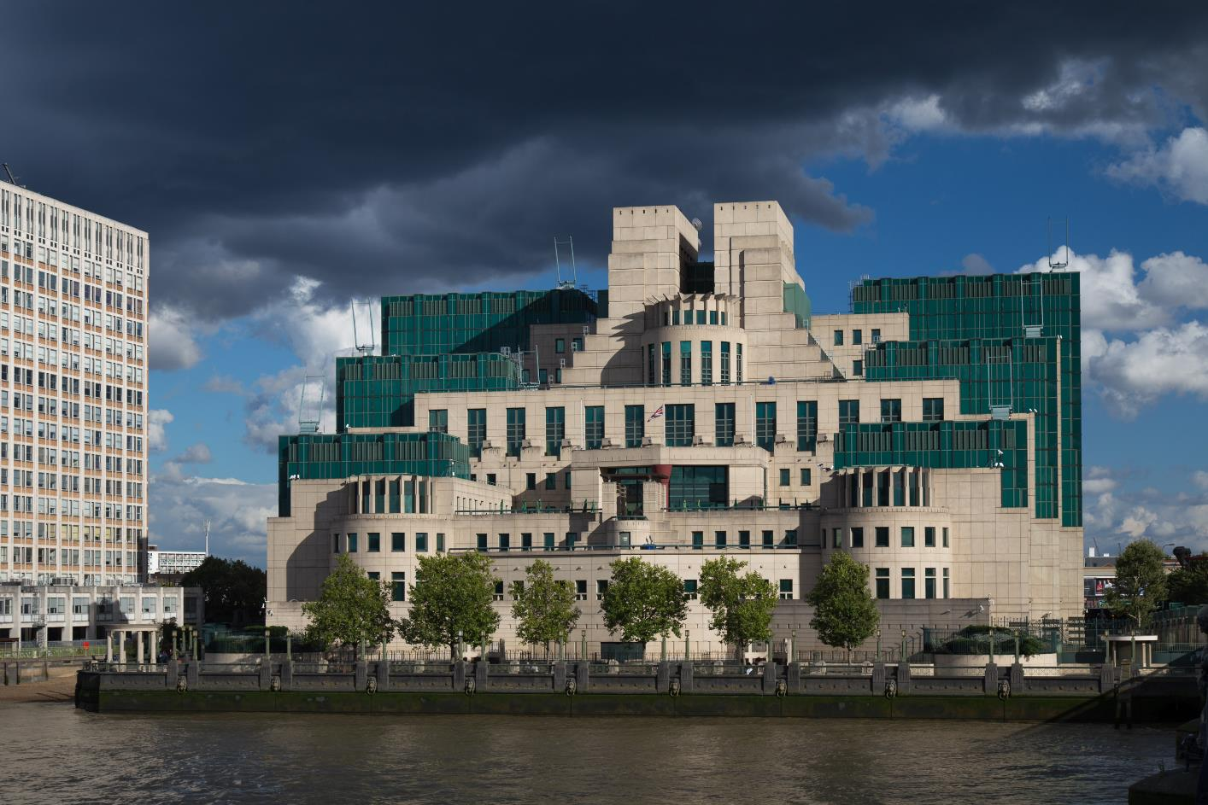
Terry Ferrell, MI6 Building
London, UK (1994)
Notes:
Terry Ferrel MI6 building in London
Ziggurat form for a governmental organization
Pyramidal
Though the actual MI6 is located in another building behind

Slide 26
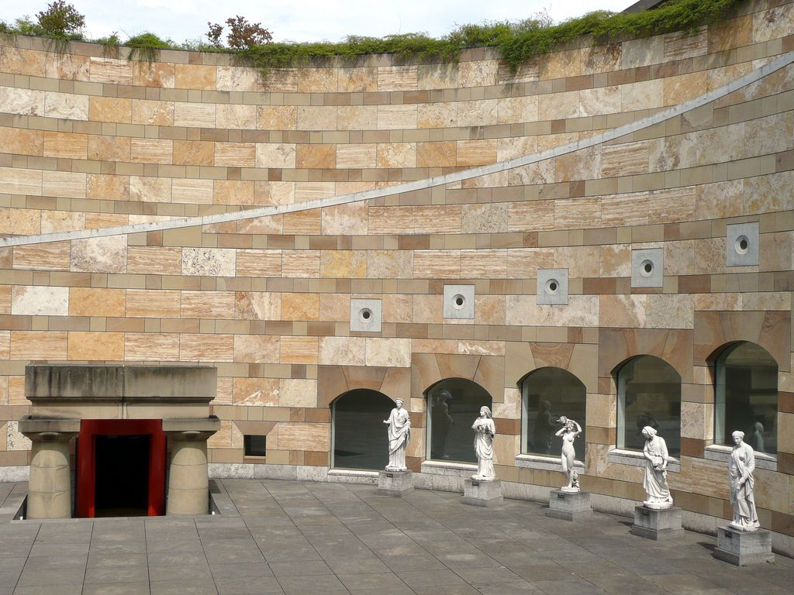
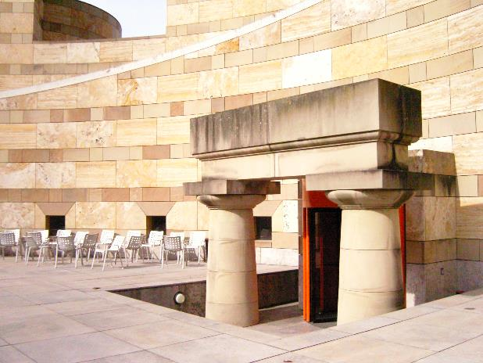
James Stirling, Neue Staatsgalerie
Stuttgart, Germany (1984)
Notes:
James Stirling’s Neue Staatsgalerie
A connection with the original Staatsgalerie of 1843
So the design intentionally collides the modern with the classical
Not only forms, but also materials
Celebration of the many, the mixed, rather than the homogenous

Slide 27
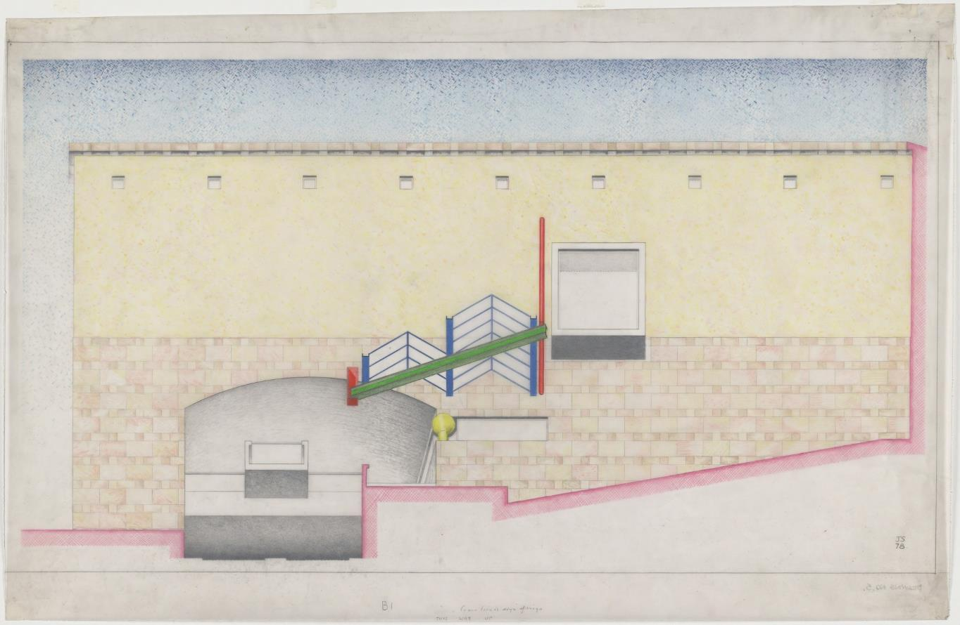
James Stirling, Neue Staatsgalerie
Stuttgart, Germany (1984)
Notes:
Elevation of the art gallery
Intentional combination, rather than integration with the preexisting classical style
Series of contrasts

Slide 28
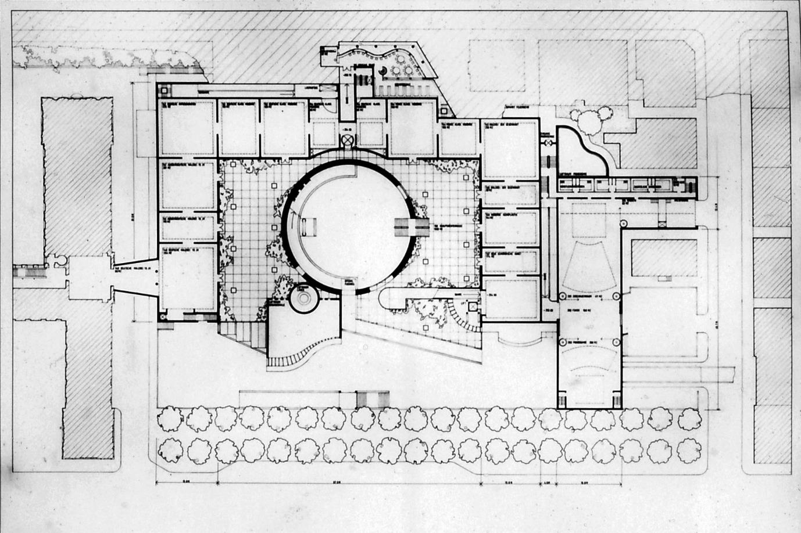
James Stirling, Neue Staatsgalerie
Stuttgart, Germany (1984)
Notes:
And plan
Reminder? Collage?

Slide 29
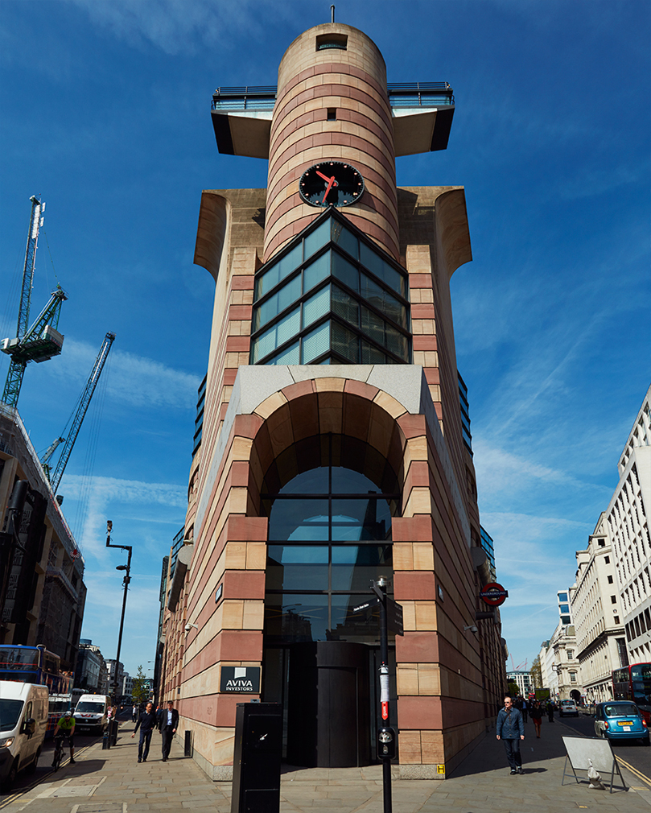
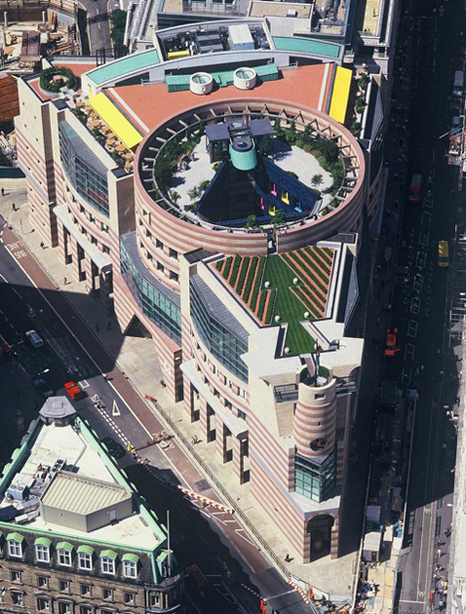
James Stirling, No. 1 Poultry
London, UK (1994)
Notes:
Another Stirling, No. 1 Poultry building
Wedge-shaped site in London
Clear combination of basic shapes
Not only collision of shapes, but aesthetics
Modern materials in steel and glass
Juxtaposed with masonry rendered in a kind of Medieval striping

Slide 30
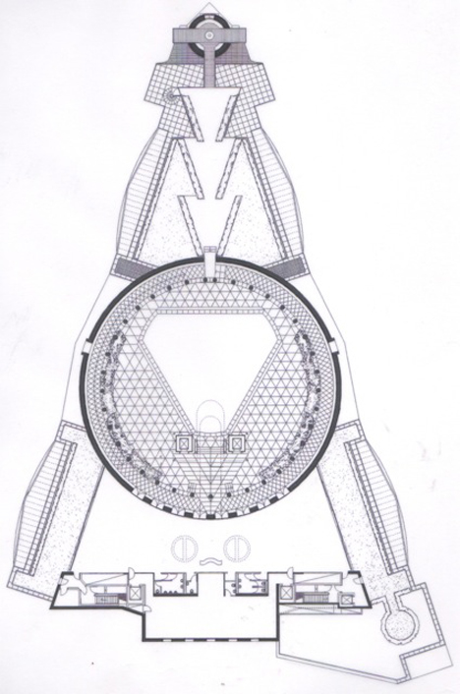
James Stirling, No. 1 Poultry
London, UK (1994)
Notes:
Another Stirling, No. 1 Poultry building
- Wedge-shaped site in London

Slide 31
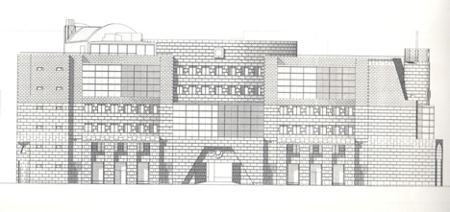
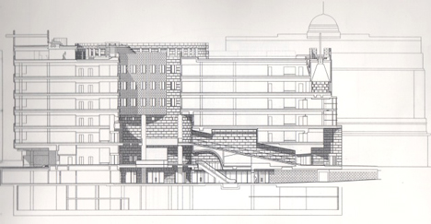
James Stirling, No. 1 Poultry
London, UK (1994)
Notes:
Another Stirling, No. 1 Poultry building
- Wedge-shaped site in London

Slide 32
James Stirling, No. 1 Poultry
London, UK (1994)
Notes:
Another Stirling, No. 1 Poultry building
- Wedge-shaped site in London

Slide 33
James Stirling, No. 1 Poultry
London, UK (1994)
Notes:
Another Stirling, No. 1 Poultry building
- Wedge-shaped site in London

Slide 34
James Stirling, No. 1 Poultry
London, UK (1994)
Notes:
Another Stirling, No. 1 Poultry building
- Wedge-shaped site in London

Slide 35
Mario Botta, SFMOMA
San Francisco, CA (1991)
Notes:
And finally Mario Botta’s SF MOMA
Visual tendency seems to be about Collage
Juxtaposition, Collision, of styles, materials, colors, etc.
Same Medieval striping on the truncated silo (Cathedral Siena)

Slide 36
Mario Botta, SFMOMA
San Francisco, CA (1991)
Notes:
► The ‘cheap’ explanation of Postmodernism – highly visual, and accurate at that
But there’s a more intellectual mandate behind the visual chaos

Slide 37
Robert Venturi
American; 1906 - 2018
Notes:
For the reading, I assigned Complexity and Contradiction in Architecture by Robert Venturi, published in 1966.
Key texts of the 20th century – strongly encourage you to read entirety.

Slide 38
Denise Scott Brown
American; 1931 -
Notes:
Before I go on, it’s important to note that Venturi is often associated Denise Scott Brown – personal and professional partner.
For majority of his career, was partnered with Scott Brown.

Slide 39
Complexity and Contradiction
1966
Learning from Las Vegas
1971
Venturi and Short (1960 – 1964) → Venturi and Rauch (1964 – 1969) → Venturi, Rauch and Scott Brown (1969 – 1989)
Venturi, Scott Brown and Associates (1989 – Present)
Notes:
There are 2 major works by Venturi, with one with Scott Brown – gets complicated
Timeline of partnership

Slide 40
‘ambiguity’
Notes:
A few key words/phrases that really summarize Venturi’s ideas… think about the buildings we originally looked at.
Ambiguity

Slide 41
‘ambiguity’
‘contradictory’
Notes:
Contradictory

Slide 42
‘ambiguity’
‘contradictory’
‘juxtaposition’
Notes:
Juxtaposition

Slide 43
‘ambiguity’
‘contradictory’
‘juxtaposition’
‘the difficult whole’
Notes:
The Difficult Whole

Slide 44
‘ambiguity’
‘contradictory’
‘juxtaposition’
‘the difficult whole’
‘anomalies and uncertainties give validity to architecture’
Notes:
Anomalies and Uncertainties give validity to architecture

Slide 45
‘ambiguity’
‘contradictory’
‘juxtaposition’
‘the difficult whole’
‘anomalies and uncertainties give validity to architecture’
‘seeing familiar things in an unfamiliar way and from unexpected points of view
Notes:
Seeing familiar things in an unfamiliar way and from unexpected points of view

Slide 46
“Both-And”
“Either-Or”
Notes:
Both-And vs Either-Or

Slide 47
“Both-And”
Notes:
Rather than saying that proper architecture has to be EITHER this or THAT, why not both?
Because in reality, the world is complex, and made up of many social/cultural/economic orders
The lesson from Modernism? - These things are complicated, and there’s never one solution
Buildings should take a BOTH-AND strategy to their form.

Slide 48
“Orthodox Modern architects have tended to recognize complexity insufficiently or inconsistently. In their attempt to break with tradition and start all over again, they idealized the primitive and elementary at the expense of the diverse and the sophisticated.” [16]
Notes:
- ‘Primitive’ – think of Collage City, the Primitive Man

Slide 49
“Mies, for instance, makes wonderful buildings only because he ignores many aspects of a building. If he solved more problems, his buildings would be far less potent.” [16]

Slide 50
Robert Venturi
Drawing for House, New Castle, Delaware (1978)
Notes:
An idea of Venturi Scott Brown’s approach, Residence in New Castle, Delaware

Slide 51
Robert Venturi
Private Residence, New Castle, Delaware (1978)
Notes:
Intentional misuse and combination of architectural orders

Slide 52
Robert Venturi
Private Residence, New Castle, Delaware (1978)
Notes:
Even the forms are almost paper thin – not masking their iconographic nature
But more than ‘icon’, about ‘symbols’

Slide 53
Robert Venturi
Private Residence, New Castle, Delaware (1978)
Notes:
Stark contrast to a building like Villa Savoye
Rather than use of ‘pure forms’, intentionally using forms ‘tainted’ with history, with semantic association.
Venturi believed that when forms with meaning were pitted against each other, new readings of those forms would emerge, and so it was the architect’s task to choreograph
“Common elements made uncommon by their distortion, scale”

Slide 54
Vanna Venturi House
Chestnut Hill (Philadelphia), PA 1964
Notes:
One of his most well-known projects was built in 1964, before Scott Brown
A house for his mother
Remains as one of his most well-regarded projects.

Slide 55
Vanna Venturi House
Chestnut Hill (Philadelphia), PA 1964
Notes:
Development of a vocabulary that he would use for the rest of his career.
Not about a single, ‘pure’ idea, but a playfulness of space, collision of geometries, and unexpected formal references
Staircase that doesn’t go all the way (pitched roof silhouette, but just 6 inches thick).

Slide 56
Left: Guild House, Philadelphia, PA (1963)
Right: Goffe Street Fire House, New Haven, CT (1974)
Notes:
Guild House – arguably most well-known project
Housing block in Philadelphia – lower-middle income housing (important, not just building for the wealthy)
Here, beginning to develop a language of ‘VERNACULAR’
Notice signage, oftentimes hidden in the clean lines of Modernist-style buildings
Can’t see, but satellite dishes are visible on roofline
Likewise, Goffe Street Fire House in New Haven
Heavily into ‘direct’ signage, that graphics was part of a cultural phenomena, that should be embraced by architects
Common Language of building.

Slide 57
National Collegiate Football Hall of Fame
New Brunswick, NJ (1967)
Notes:
National Collegiate Football Hall of Fame
Competition entry
Massive building acting as signage alongside the museum proper
Signage becomes building element – about communication, a long tradition of ‘Architecture Parlante’… that architecture speaks

Slide 58
National Collegiate Football Hall of Fame
New Brunswick, NJ (1967)
Notes:
Another view
- No hiding the tacked on nature of the billboard-as-facade

Slide 59
Allentown Art Museum
Allentown, PA (2012)
Notes:
More recently and more locally, ALLENTOWN ART MUSEUM
Notice columns, mixed with modern fenestration
Also conspicuous signage

Slide 60
“If the source of both-and phenomenon is contradiction, its basis is hierarchy, which yields several levels of meanings among elements with varying values. It can include elements that are both good and awkward, big and little, closed and open, continuous and articulated, round and square, structural and spatial. An architecture which includes varying levels of meaning breeds ambiguity and tension.” [23]

Slide 61
“A play of order and compromise also supports the idea of renovation in building, and of evolution in city planning.” [42]
Notes:
So for him, a more responsible way of design that acknowledges the complexity of real-life was towards

Slide 62
Notes:
So, from Complexity and Contradiction, we move on to his other book, Learning From Las Vegas (1972), which was very much produced with Denise Scott Brown, and Steven Izenour
- Venturi stated that Scott Brown’s major contribution was introducing him to the value of the ‘Pop’, the ordinary

Slide 63
Notes:
Taking the idea of vernacular, the entire book is essentially a lesson of subversiveness
Not taking cues from ‘high’ philosophy and intellectual esotericism, but about learning from popular culture
They looked at the city of Las Vegas to draw lessons in culture should inform architecture
To underscore the point, not looking at Rome, Athens, or even Paris, but Las Vegas
That’s like a chef looking at Burger King for inspiration

Slide 64
Notes:
A series of ‘lessons’ compiled in a kind of field journal
Among the key takeaways – important distinction
DUCK vs DECORATED SHED

Slide 65
Big Duck
Long Island, New York
Notes:
They defined a duck as…

Slide 66
“[Ducks are] Where the architectural systems of space, structure, and program are submerged and distorted by an overall symbolic form.”
Notes:
Contrasted to the Duck is the Decorated Shed

Slide 67
Longaberger Basket Building
Newark, Ohio (1997)
Notes:
Example of where the idea of the building extends throughout
An idea of reductiveness – simplicity (in a bad sense)

Slide 68
Randy’s Donuts
Inglewood, CA
Notes:
Many examples – some more or less open to interpretation

Slide 69
“[Decorated Sheds are] Where systems of space and structure are directly at the service of program, and ornament is applied independently.”
Notes:
Decorated sheds on the other hand … <<Quote… >>

Slide 70
The ‘Decorated Shed’
Notes:
At its basis – we can think of big box stores… again, learning from popular culture.

Slide 71
The ‘Decorated Shed’
Notes:
Quintessentially an American invention.
- Quintessentially ‘low brow’

Slide 72
“we shall argue for the symbolism of the ugly and ordinary in architecture and for the particular significance of the decorated shed with a rhetorical front and conventional behind: for architecture as shelter with symbols on it.” [LVL, 90]
Notes:
So what’s their point? Which is better?
<<Quote… >>
2. Why? Because the Decorated Shed actively invites many voices

Slide 73
“Our other point is that the content of the unacknowledged symbolism of current Modern architecture is silly. We have been designing dead ducks.” [LVL, 162]
Notes:
Arguing that even though they’re stylistically different, the Modern movement has been producing ducks – simplicity to a fault, without acknowledging the complexity inherent in architectural a system of form and communication.

Slide 74
“When Modern architects righteously abandoned ornament on buildings, they unconsciously designed buildings that were ornament. In promoting Space and Articulation over symbolism and ornament, they distorted the whole building into a duck.” [LLV, 163]
Notes:
A pretty good point
Venturi highlighted the point that Mies’ aesthetic (a largely Modernist one), was like a duck for the Industrial Warehouses from which Modernism took inspiration

Slide 75
Le Corbusier, Convent Sainte Marie de la Tourette
Lyon, France (1961)
Notes:
Example

Slide 76
Moshe Safdie, Habitat 67
Montreal, Canada (1967)
Notes:
Example

Slide 77
Kallmann, MicKinnell & Knowles, Boston City Hall
Boston, MA (1968)
Notes:
“MINIMEGASTRUCTURES”

Slide 78
Ducks
“Minimegastructures”

Slide 79
Notes:
In terms of their approach, they looked at what really mattered in Las Vegas as it was, rather than resorting to academic ideals
Churches, Food Stores, Wedding Chapels, Automobile Rentals
Clear reaction against the Urbanism of Corbusier

Slide 80
Notes:
They took conventional architectural mapping and diagram techniques, applied to popular content
Nolli plan of Las Vegas – not about public/Private, but about Ceremonial Space (Chapels)

Slide 81
Notes:
Likewise, they acknowledged that much of the American city was contingent upon its perception in the car (rather than pedestrian European cities)
3MPH to 50MPH
Signage / Word / Architecture

Slide 82
Notes:
Versailles

Slide 83
Notes:
English Garden

Slide 84
Notes:
Broadacre City (Architect? FLW)
- Devoid of signage and symbol (just form)

Slide 85
Notes:
Ville Radieuse (Architect? Le Corbusier!)
- Devoid of signage and symbol (just form)

Slide 86
Notes:
Highway
- Purely about the sign

Slide 87
Notes:
The Strip
The ultimate paradigm for their study
Incredibly subversive, original, unconventional

Slide 88
Notes:
Various analyses, trying to acknowledge the complexity of things that may otherwise appear to be tacky, popular art – but in fact had resonance for a populace, more so than architectures designed in a ivory tower, ignorant of the common language of design that actually affected people.
- Embedded complexity of reality

Slide 89
Notes:
Sample of their form of analysis

Slide 90
The Children’s Museum
Houston, TX (1984)
Notes:
And again, their point was the decorated shed
That architecture shouldn’t shy away from direct communication
This is not a compromise of form, but an engagement with architecture’s potential for communication.
2. Importance of “Form and Symbol”, not just “Form and Form”

Slide 91
“learning from popular culture does not remove the architect from his or her status in high culture. But it may alter high culture to make it more sympathetic to current needs and issues.” [161]

Slide 92
“Social classes rarely come together, but if they can make temporary alliances in the designing and building of multivalued community architecture, a sense of paradox and some irony and wit will be needed on all sides.” [161]

