Slide 1
Phenomenology
Christian Norberg-Schulz, Martin Heidegger
Contemporary Architecture Theory
Eugene Han
Fall 2020, 11:15 – 12:30 pm
Online Instruction

Slide 2
PHENOMENOLOGY
ARCHITECTURE
Notes:
it should be clear that architecture often feeds off of theories and movements that are happening outside of building proper.
Following this trend, phenomenology was first and foremost a philosophical movement.
And it would be meaningless to describe its effects in architecture without first covering its very basic foundation.

Slide 3
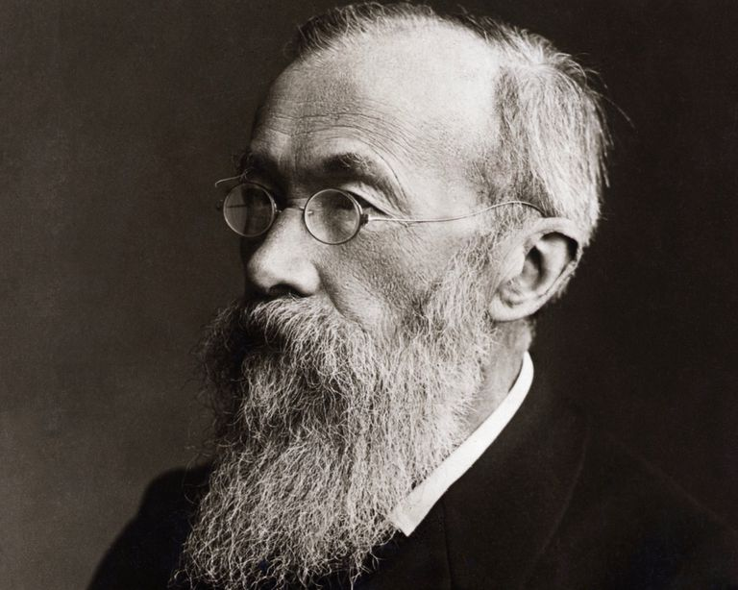
Wilhelm Wundt
German; 1832 - 1920
Notes:
Phenomenology was formed as a direct response to what was happening elsewhere – in particular with the sciences, and more specifically, with the emergence of experimental psychology.
For literally millennia, philosophy was the discipline in which the study of the human and mind and behavior was investigated.
But with the rapid spread of science and of the scientific method, it was inevitable that the study of mind would eventually become an object of science.
And this person, Wilhelm Wundt, was quite important in that history – namely because he was the first to establish an experimental psychology laboratory at the University of Leipzig in Germany.

Slide 4
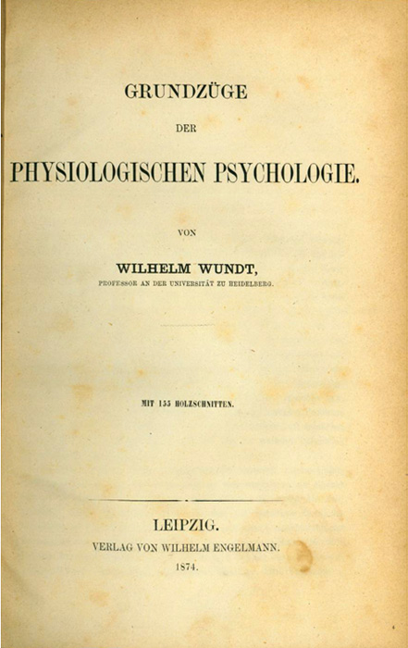
Notes:
One of his major works was the Principles of Physiological Psychology published in 1874.
It’s important to realize that up to this point, all psychologists were initially trained in philosophy, and only in their upper years, did they transition towards a scientific method.

Slide 5
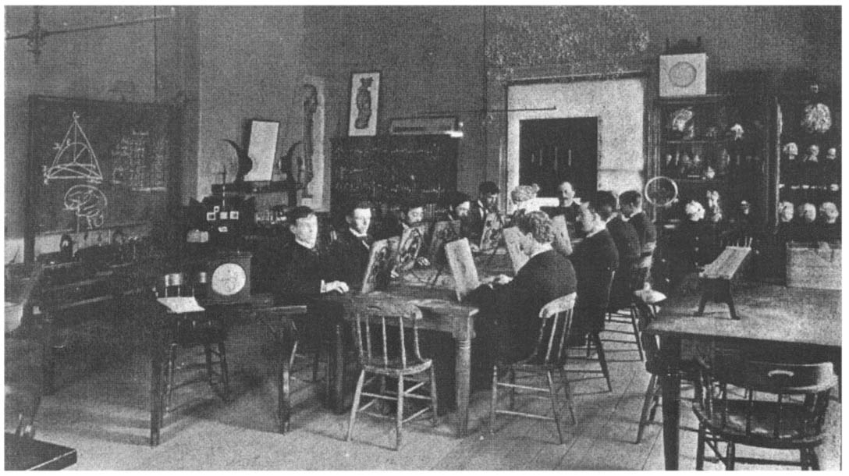
University of Leipzig, Germany. Psychology Laboratory – Wilhelm Wundt, 1879.
Notes:
Wundt’s work was important because the experimental aspect was never part of the philosophical tradition.
So, phenomenology was really a philosophical reaction to what quickly became the domination of the scientific method over philosophy as regards the mind, behavior, and our perception of the world.
This sets the intellectual stage of phenomenology, and was really the philosophers’ target – reclaiming knowledge of the mind through philosophical, rather than scientific means

Slide 6
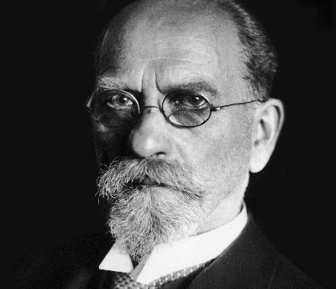
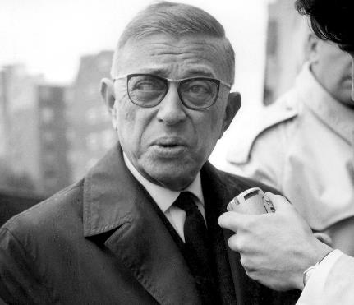
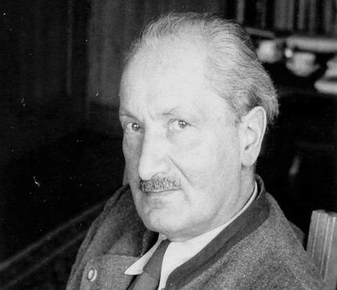
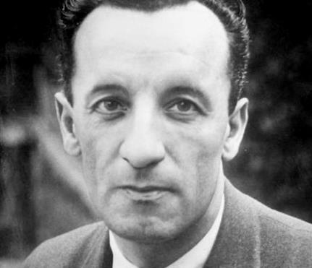
Edmund Husserl
German; 1859 - 1938
Jean-Paul Sartre
French; 1905 - 1980
Martin Heidegger
German; 1889 - 1976
Maurice Merleau-Ponty
French; 1908 - 1961
Notes:
These are perhaps the most well-known phenomenologists.
You’ll notice two overarching trends:
German | French
German:
Original
Deeper, heavier, academic
French:
Newer
More geared towards the populace
The mid-20th French milieu was quite intellectual
The writings of Jean-Paul Sartre were popular, even outside of academia
Maurice Merleau-Ponty regularly broadcast his philosophy to a wide general audience over the radio.
We won’t have time to cover the French, but I strongly encourage you to pursue them, namely b/c they’re much easier to read
Instead, we’ll be spending the most time today with Martin Heidegger
His work has been largely quoted with regards to architecture

Slide 7
PHENOMENOLOGY
Notes:
So to begin, let’s have a look at the word Phenomenology
According to Heidegger’s deconstruction of the term, he first looked at the Greek root, ‘Phenomenon’

Slide 8
PHENOMENOLOGY
PHENOMENO(N)
φαινόμενον
Notes:
This is important, and will come up regularly today
Heidegger noted that phenomenon meant a self-showing, an unconcealing

Slide 9
PHENOMENOLOGY
PHENOMENO(N)
φαινόμενον
Self-showing
≠ representing
Notes:
It was not about re-presenting… not a simulacrum, but a showing of the self.

Slide 10
PHENOMENOLOGY
PHENOMENO(N)
φαινόμενον
-LOGY
λογια
Self-showing
≠ representing
Notes:
The second term, or the suffix, is ‘logy’ (logia)

Slide 11
PHENOMENOLOGY
PHENOMENO(N)
φαινόμενον
-LOGY
λογια
Self-showing
≠ representing
Communicating the apprehension of a subject matter
Notes:
Which denotes communicating the apprehension of a subject matter.

Slide 12
PHENOMENOLOGY
PHENOMENO(N)
φαινόμενον
-LOGY
λογια
“letting the manifest in itself be seen from itself.”
Notes:
In short, Heidegger defined Phenomenology as:
“letting the manifest in itself be seen from itself.”

Slide 13
PHENOMENOLOGY
PHENOMENO(N)
φαινόμενον
-LOGY
λογια
“letting the manifest in itself be seen from itself.”
“a way of encountering something.”
Notes:
Similarly, it meant “a way of encountering something.”
It’s not about relatively, not about how I see something, but about how I see the essence (truth) of something.
It’s about how our perception can reveal the truth of the world.

Slide 14
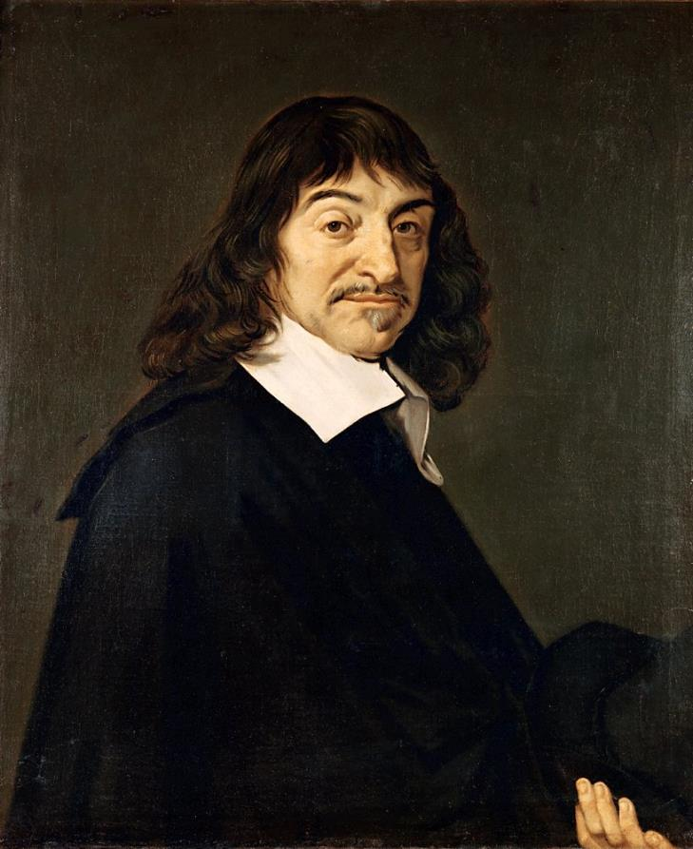
René Descartes
French; 1596 - 1650
Notes:
Now, I mentioned that phenomenology formed as a direct reaction against the emergence of experimental psychology
But its root was also a reaction against the scientific worldview (Weltanschauung)
Particularly with one of the consequences of approaching the world scientifically, and this approach was ushered by Rene Descartes, who by most accounts, initiated what is generally understood as Modernism (late 17th century).

Slide 15
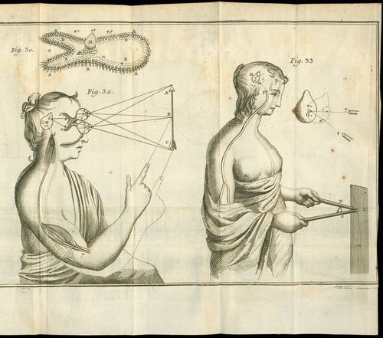
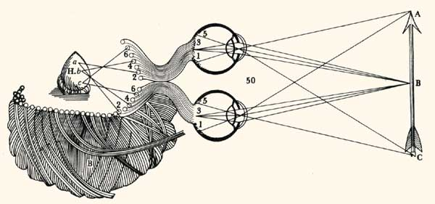
Pineal gland – ‘The Ghost in the Machine’
Notes:
One of his principle contentions was that we, the “I” in “I think therefore I am,” (“Cogito ergo sum”) is separate from the body that we occupy.
He believed our bodies are like a machine.
And that the true ‘I’ is a spirit
He wasn’t sure how the interface between a spirit and the body took place, but he speculated that the spirit was located in the brain, in an organ called the Pineal Gland.
This separation between the spirit and the body is known generally as Mind Body Dualism <WOB>
Gilbert Ryle – ‘Ghost in the Machine’
So the famous quote “I think therefore I am” places the existence in the spirit, because it is the mind that thinks, and because the mind can acknowledge that it does indeed think, it exists – it’s not about the body – body as mere vessel

Slide 16
SUBJECT | OBJECT
René Descartes, 1596 - 1650
Notes:
Another way to describe this separation is that of SUBJECT | OBJECT
Phenomenology fundamentally against the separation between SUBJECT | OBJECT
Criticism of language – the Subject/Object dichotic
This influences our thinking of the world as fundamentally split/splittable
Instead, what we are, what the world is, fundamentally integrated

Slide 17
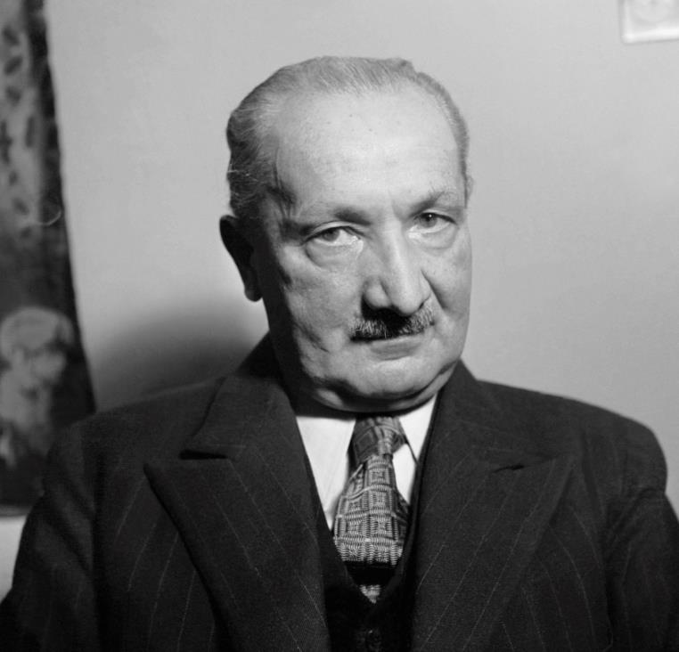
Martin Heidegger
German; 1889 - 1976
Notes:
So now that we have the outline of the phenomenological project, let’s drill down a little deeper, particularly with the ideas of Martin Heidegger
Heidegger was himself a student of Edmund Husserl, though as they both progressed in their careers, their views increasingly diverged – but fair to say that both were career phenomenologists

Slide 18
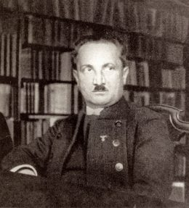
Notes:
Covering Heidegger is somewhat regrettable
One of the most important thinkers of the 20th century, but he was also very openly involved with the Nationalist Socialism Party – in other words, he was a Nazi
To be clear, he was a supporter of the political movement – he didn’t fight, nor was he associated with any fighting regime, nevertheless, you can see clear resonance between his ideas and that of the National Socialist Party.
Moreover, even after the war, he never explicitly apologized or expressed his regret with his association – the most he said was that it was a silly mistake to be part of that party, without further elaboration.
On this account, philosophers throughout the 20th century are very much split on him.
Some say that his philosophy is separate from his political associations, while others say the very opposite – that his philosophy and his politics were of the same stream, so his actions were evidence of the faults in his philosophy.
Why do I cover him then?
Phenomenology in architecture would not even exist with reference to Heidegger.

Slide 19
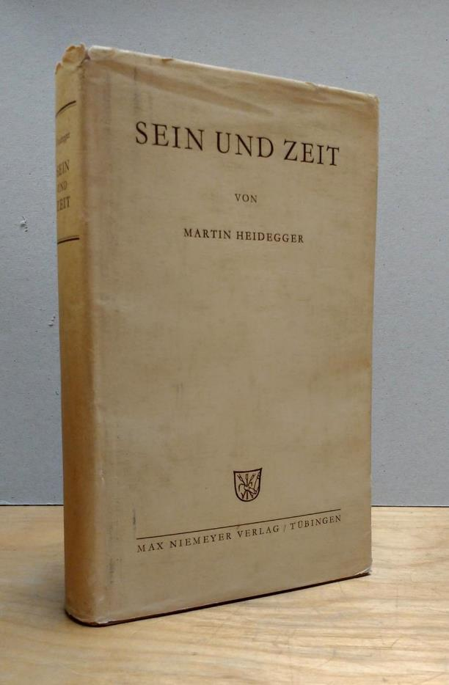
Being and Time (1927)
Notes:
So rather than dwelling on Heidegger the man – I want to explain some of his key concepts, and how they relate to the built the environment.
His major work is Sein und Zeit, Being and Time, published in 1927.
Felt something was wrong with so-called modern ‘progress’
War
Environmental devastation
Technology was separating us from a fundamental understanding of Being

Slide 20
DASEIN
Being and Time (1927)
Notes:
Without doubt, the most important word and concept throughout Heidegger’s phenomenology is DASEIN, generally translated as BEING

Slide 21
We are always situated in a place, interacting with things, and part of something larger
DASEIN
Being and Time (1927)

Slide 22
We are always situated in a place, interacting with things, and part of something larger
The interconnectedness of Being
DASEIN
Being and Time (1927)
Being and Time (1927)

Slide 23
We are always situated in a place, interacting with things, and part of something larger
The interconnectedness of Being
Meaningful things are meaningful through connection
DASEIN
Being and Time (1927)

Slide 24
We are always situated in a place, interacting with things, and part of something larger
The interconnectedness of Being
Meaningful things are meaningful through connection
We’re never ‘in the world’ in a neutral, disinterested way
DASEIN
Being and Time (1927)

Slide 25
We are always situated in a place, interacting with things, and part of something larger
The interconnectedness of Being
Meaningful things are meaningful through connection
We’re never ‘in the world’ in a neutral, disinterested way
We are always involved, we ‘have care’
DASEIN
Being and Time (1927)

Slide 26
Care
Being and Time (1927)
Notes:
Care: Take it as a ‘personal experience’ of the world – how we can’t really be truly objective with anything – everything we know has personalization embedded within it.
Composed of 2 aspects

Slide 27
FACTICITY
The ‘given’ of our existence
‘Thrownness’ (geworfen)
Care
Being and Time (1927)
Notes:
FACTICITY – the fact of things, as a material fact.
Our existence is given – we have a body, and that body is part of the reality of our existence – cannot rend it from our mind.
More importantly, we’ve been given this body. We didn’t design it ourselves, we only respond to it.
Thrownness, We’re dropped into this world, we just have to deal with it.

Slide 28
FACTICITY
The ‘given’ of our existence
‘Thrownness’ (geworfen)
FALLENNESS
‘Das Man’ → ‘They-self’
We fall away from our own potential
Care
Being and Time (1927)
Notes:
FALLENNESS – In living life, we generally fall away from ourselves
Rather than living according to our own potential, we fall into the expectations of convention
We judge our self worth according to metric designed by others, oftentimes for outcomes that have no bearing on our own growth and realization of potential.
DAS MAN – ‘Theyself,’ as opposed to ‘oneself’ – we live our lives according to das man: “The Man”
Not about becoming a hermit, a recluse, but about understanding the world to better understand yourself and live according to YOURSELF.
Only when everyone lives according, can society as a whole improve.

Slide 29
“the world is always the one that I share with others.”
Being and Time (1927)
Notes:
So phenomenological connectedness is not just a touchy-feely ‘let’s get along,’ but addresses the constant dynamic between self-worth and the worth conventionalized by the world, by Das Man

Slide 30
DAS DING
THE THING-IN-ITSELF
Being and Time (1927)
Notes:
Sticking with Interconnectedness, it’s important to address another one of Heidegger’s terms: Das Ding
Directly translated, it just means THE THING, but in context, it’s usually translated as THE THING-IN-ITSELF.
In a nutshell, it means that nothing, no object, nothing, exists in isolation.
The essence of every single thing is that it is connected with everything else.

Slide 31
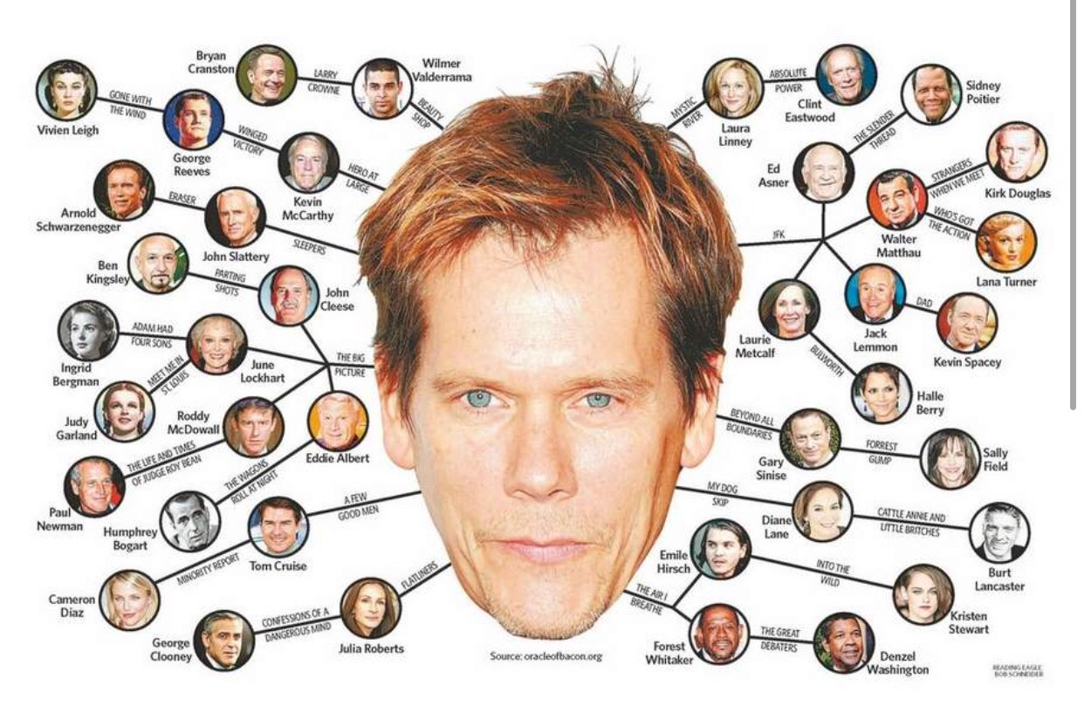
Notes:
The concept isn’t all that difficult, but it has repercussions, especially when we think of architecture.
Let’s take an example of a game called 6 Degrees of Separation.
The game is simply that you take 2 people, and that everyone is ‘connected’ through no more than 6 steps.
For example, everyone here in class is connected by a single step – 0 degrees of separation.
I am connected to XXX because they are my student.
Likewise, XXX’s friend YYY and I are connected through 1 degree of separation.
While a silly game, this was actually theorized by someone in 1929, and essentially implies that we’re all connected on this earth – and that even though the population of the world is growing exponentially, because we’re a society with a biological mechanism for reproduction, the idea of 6 degrees will always hold true.
Facebook users are on average 2.9 – 4.2 degrees separated.
Has repercussions on digital data mining, logarithmic functions, and social studies.

Slide 32
DAS DING
THE THING-IN-ITSELF
Notes:
So reiterating Heidegger’s point, we’re all connected.
But not just people – everything is connected.

Slide 33
PRESENT-AT-HAND
READY-TO-HAND
Notes:
To illustrate this point, he sets up a dichotic – two different worldviews.
Present-At-Hand
Ready-To-Hand

Slide 34
PRESENT-AT-HAND
Notes:
Present-at-hand describes the scientific, modern approach
It’s important to see an object in its objectivity – completely separated from our personal associations with it.
Scientist – it’s important than scientific scrutiny not involve opinion, impressions, etc.
The object is supposed to be disconnected from any person.

Slide 35
READY-TO-HAND
Notes:
Contrary to that, we have, READY-TO-HAND
It’s not that the object is now personalized, but it’s about that we use the object.
More importantly, in using the object, we don’t think about the object as a disconnected thing from our own actions.
Think about a car – there a lot of mechanisms at play in driving a car, yet you don’t have to consider every single mechanical and digital connection that happening when going from first to fifth gear, or when making a simple turn.
The is an extension of yourself.
I put this image of Ron Swanson on purpose, because to demonstrate his distinction between Present-At-Hand and Ready-To-Hand, he uses the example of a hammer.
Using a hammer – we don’t think of the complex physics and geometry at work
We see a nail, we hit the nail.
The more nails we hit, the better we get at it, the less we think of the hammer itself.
Hammer breaks!
We look at the hammer no longer as an extension of our own arm, but as an object that has malfunctioned.
The hammer looks foreign to us.
So for Heidegger, the truth of things is that objects are tools for our use (figuratively).
We connect with them, we understand the world through them.
We have to force ourselves to create distance between them and us (through science).
To know the hammer in this way is to know the truth of the hammer.
The hammer is not a foreign object, but an extension, a connection, of our own being.

Slide 36
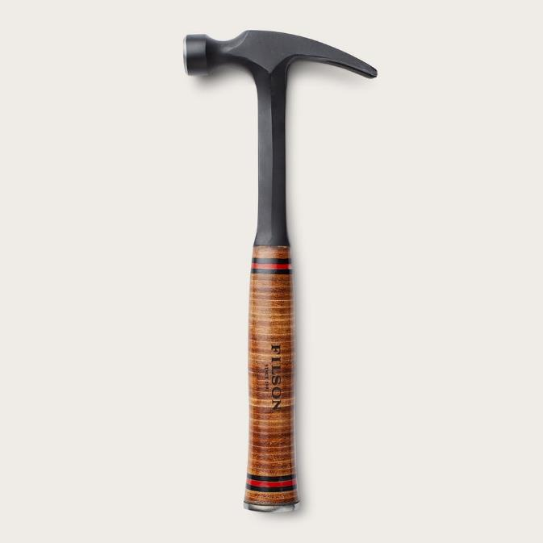
Notes:
Now, this is where it get a little trippy
Let’s think of Ron Swanson’s hammer in isolation… just the hammer.
Heidegger says that we shouldn’t think of it as an inanimate thing waiting for us to use.
It’s almost as if the hammer is using us to get nail down nails.
So rather than thinking of it as Ron Swanson’s hammer, it’s more like the hammer…

Slide 37
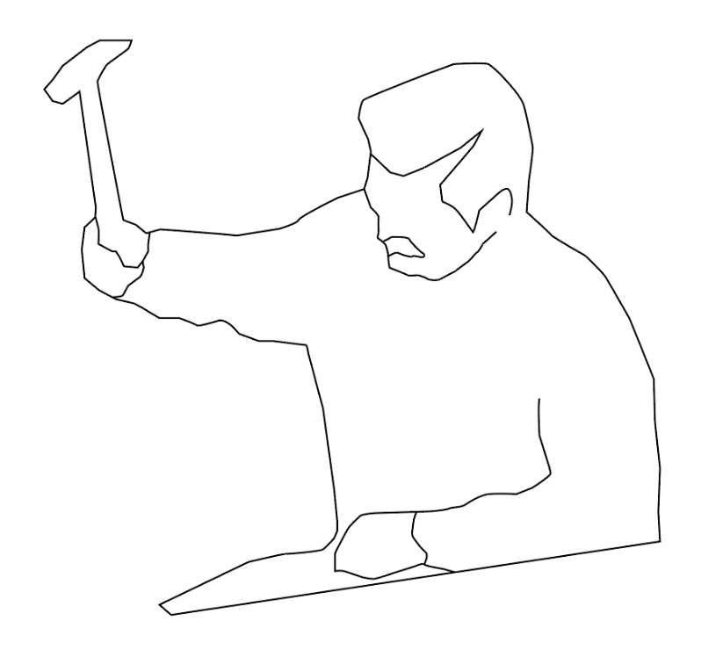
Notes:
That allowed Ron Swanson to use it.
In more Heideggarian terms, the hammer gathers the world around it, and so in the previous gif, it has gathered Ron and the cell phone and the desk, so that it could achieve the action of hammering.
So rather than thinking of it like objects are free-floating things waiting for our use of them, we have to understand them as absorbing, or enabling, their environments to achieve their own potential.

Slide 38
UNCONCEALMENT
“letting the manifest in itself be seen from itself.”
Notes:
This process of recognizing the interconnected truth of things, Heidegger calls UNCONCEALMENT
<Re-Quote… >

Slide 39
DAS DING – The Thing-In-Itself
‘gathering a world’
Notes:
Returning to Das Ding, let’s apply Heidegger’s concept to a more familiar situation

Slide 40
Notes:
Heidegger often referred to architecture simply as art, because he didn’t make a distinction between architectural works with paintings or music.
In one of our readings, Building Dwelling Thinking, he refers to a bridge.
Now, imagine this stream before the bridge – just a regular stream w/o particular features
Once the bridge comes in, once it’s realized, other things emerge.
We begin to see certain potentialities within the site supporting the concept of ‘bridgeness’
These things predated the bridge, but their potentiality was only realized once the bridge was put in.
The bridge, by the fact that it connects, manifests a number of latent connections that were not explicit before its construction.

Slide 41
LOCALES
Notes:
So his term for condensation of a landscape’s potential is LOCALE

Slide 42
“spaces receive their essential being from locales and not from “space.”” [356]
Building Dwelling Thinking
Notes:
He stated that <Quote… “spaces receive their essential being from locales and not from “space.””>
SPACE (second instance) – geometric, abstracted, universal
Locales make space specific by extracting and enabling an existing site’s potentiality.
Distinction between an insignificant coordinate, a space with meaning

Slide 43
“This is why building, by virtue of constructing locales, is a founding and joining of spaces. Because building produces locales, the joining of the spaces of these locales necessarily brings with it space, as spatium and as extensio, into the thingly structure of buildings.” [360]
Building Dwelling Thinking
Notes:
Further elaborating, <Quote…>
This is why Heidegger prized architecture so much – he felt that good architecture recognized the interconnections of everything, namely from space to locales.
‘Thingly’ – read as Das Ding

Slide 44
“because [building] produces things as locales, building is closer to the essence of spaces and to the essential origins of “space” than any geometry and mathematics.” [360]
Building Dwelling Thinking
Notes:
<Quote… >
Heidegger believes architecture deals with the importance of space, so that we design using locales rather than space considered merely as objective and scientific metrics.

Slide 45
DAS DING – The Thing-In-Itself
‘gathering a world’
“Works of architecture are things, and their “meaning” consists in what they gather, that is, their world.” [CNS, 37]
Christian Norberg-Schulz, referencing Heidegger
Notes:
Going back to the concept of The Thing In Itself, together with gathering, but applied to architecture, he stated that <Quote… >
<<Draw… Worlds inside World>>

Slide 46
“When I go toward the door of the lecture hall, I am already there, and I could not go to it at all if I were not such that I am there. I am never here only, as this encapsulated body; rather, I am there, that, I already pervade the space of the room, and only thus can I go through it.” [359]
Building Dwelling Thinking
Notes:
Another example of how locals affect our conception of space, outlining the pan-temporal natural resulting from connectedness

Slide 47
DWELL
Being and Time
Notes:
So, the final major term that Heidegger uses is DWELL, and this concept is pretty simply once we understand DASEIN (Being)
To dwell simply means that we exist with the THINGS around us, knowing that we’re part of them, and that they are part of us.
It’s like saying we exist in an enlightened, aware state

Slide 48
DWELL
BUILDING
Being and Time
Notes:
For Heidegger - and this is why architects have often referred to him – he made no distinction between Dwelling and Building
They are for him, one and the same thing
To build, you understand the connection of things, and so you are also dwelling.

Slide 49
“The essence of building is letting dwell.”
Building Dwelling Thinking
Notes:
Unequivocal statement regarding the relationship between Building and Dwelling

Slide 50
“Man dwells in that he builds.”
Heidegger, The Origin of the Work of Art

Slide 51
Inhabitating ≠ Dwelling
Building Dwelling Thinking
Notes:
Like Space ≠ Locale…
He made the distinction that Dwelling is not Simply Inhabiting
Inhabiting is simply occupying – being inside of – using
Dwelling is existing, or in his terms Being (capital B)

Slide 52
Building
buan
bauen
Nachgebauer
Dwell
neighbor
‘he who dwells nearby’
‘to remain, to stay in a place’
Building Dwelling Thinking
Notes:
Heidegger outlines complex etymology to demonstrate that the word Building and Being are historically related.
This is not just an academic exercise, but to show that like the interconnection of things, the words we use are intertwined with one another.
And our continuation of language demonstrates for Heidegger, that we’re also connected to the past… everything is connected – historical lineage.
Meaning is gained through previous connections.

Slide 53
“Building in the sense of preserving and nurturing is not making anything. Shipbuilding and temple-building, on the other hand, do in a certain way make their own works.” [349]
Building Dwelling Thinking
Notes:
This idea of the connection with the past through building is explicit in this sentiment… <Quote…>
Interconnectedness is not just spatial, but also temporal

Slide 54
“Building in the sense of preserving and nurturing is not making anything. Shipbuilding and temple-building, on the other hand, do in a certain way make their own works.” [349]
“dwelling itself is always a staying with things. Dwelling, as preserving, keeps the fourfold in that with which mortals stay: in things.” [353]
Building Dwelling Thinking

Slide 55
“Building in the sense of preserving and nurturing is not making anything. Shipbuilding and temple-building, on the other hand, do in a certain way make their own works.” [349]
“dwelling itself is always a staying with things. Dwelling, as preserving, keeps the fourfold in that with which mortals stay: in things.” [353]
“Only if we are capable of dwelling, only then can we build.” [360]
Building Dwelling Thinking

Slide 56
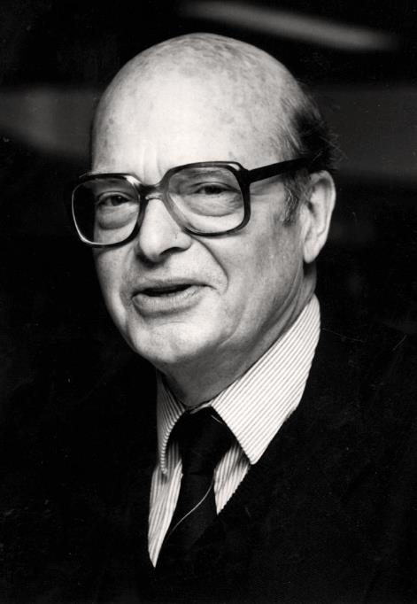
Christian Norberg-Schulz
Norwegian; 1926 - 2000
Notes:
Switching over to architecture proper, there’s perhaps no more name associated with phenomenology than the Norwegian theorist Christian Norberg-Schulz.

Slide 57
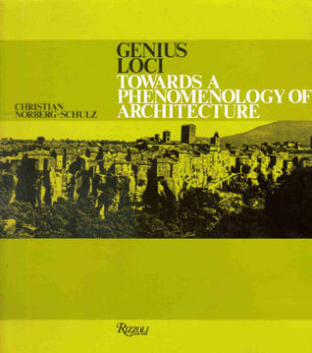
Christian Norberg-Schulz, Towards a Phenomenology of Architecture (1979)
Notes:
His most well-known work was Genius Loci – Towards a Phenomenology of Architecture published in 1979.
‘Genius Loci’ – ‘Spirit of a place’
Written at a time when scientific methods were really being adopted by the general architectural discipline, he believed, like Heidegger, than a certain objectification of the built environment was taking place, and that we were losing our hold on the truth of buildings.

Slide 58
“he [Corbusier] regards pilotis, roof-gardens, strip-windows etc., as being universally valid, so confirming the attitude which was typical of early functionalism of complete detachment from place. Today we understand that an international style can never ensure places in which dwelling in the full sense of the word is possible and that traditional forms often express a profound understanding of the genius loci.”
Christian Norberg-Schulz, Genius Loci [65]
Notes:
In very Heideggerian-esque fashion, he wrote, <Quote… >

Slide 59
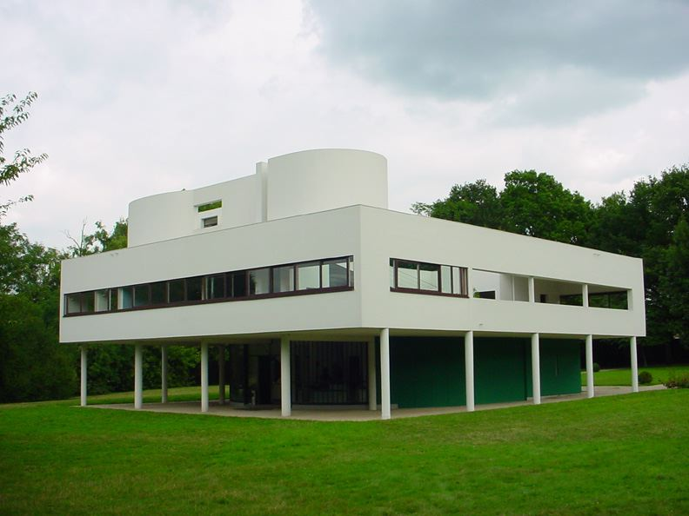
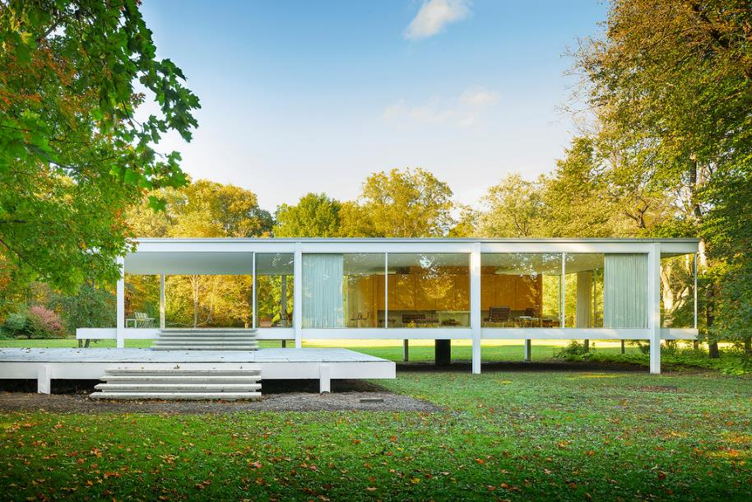
The International Style
Notes:
The International Style of course referring to architectural approaches that assumed the possibility of universality, regardless of place or time.

Slide 60
“When a person identifies himself with a place we say that he dwells.” [CNS, Genius Loci, 59]
Notes:
Sounding like it came straight from Building, Dwelling, Thinking, Norberg-Schulz wrote <Quote… “When a person identifies himself with a place we say that he dwells.”>

Slide 61
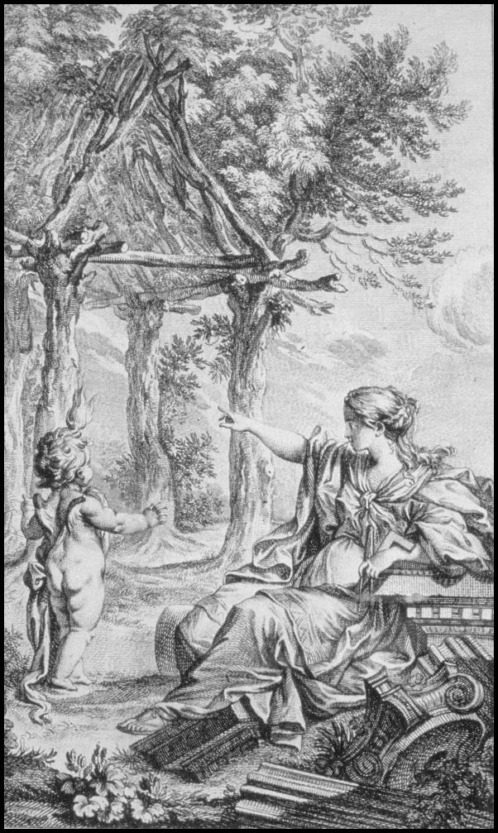

Slide 62
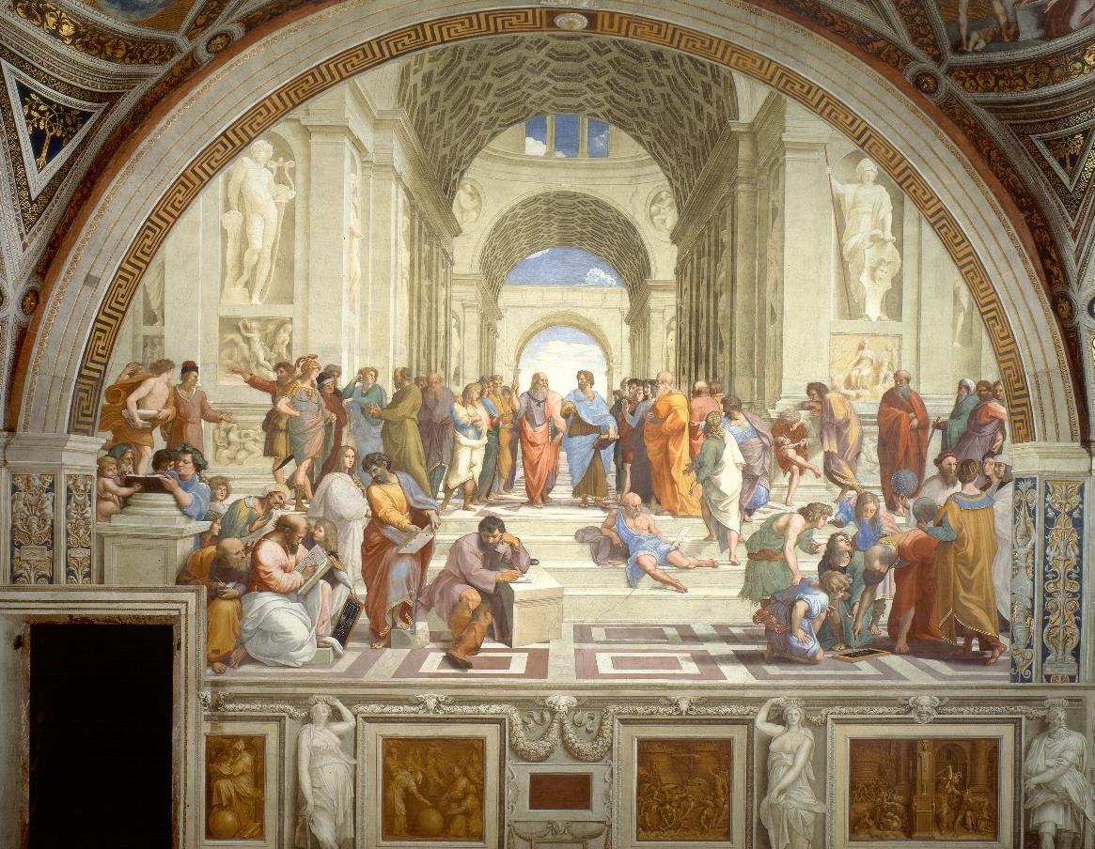

Slide 63
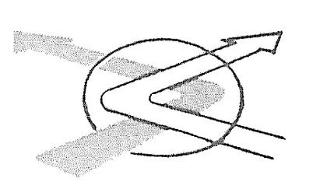
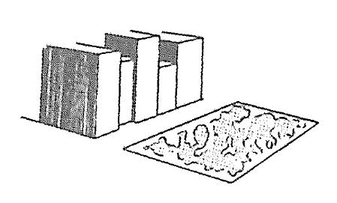
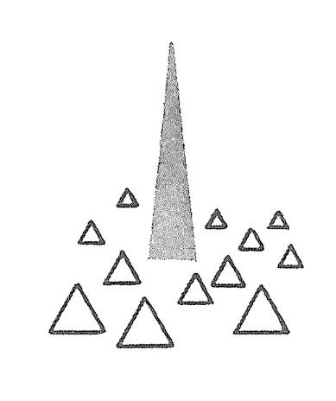
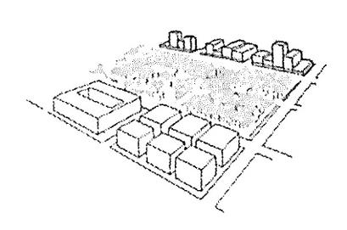
Lanmarks

Slide 64
Paths
Nodes
Edges
Landmarks
Districts

Slide 65
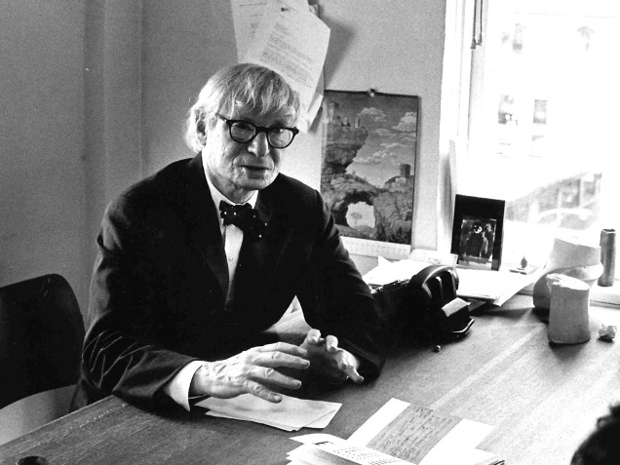
Louis Kahn
Estonian → American; 1901 - 1974
Notes:
Now, CNS wasn’t a builder so much as a theorist, and the single architect he used most to demonstrate his phenomenological approach was Louis Kahn.
What I personally like about Kahn was that he was known as a ‘slow developer’
Barely gained traction at 40, and even then, churned projects out at his own pace
Was not at all concerned with financial growth of his practice – constantly in bankruptcy, always over budget, yet while clients knew this of him, still chose him.
2. Known for buildings that expressed a sense of monumentality – that’s the key word for Kahn

Slide 66
“What does the building want to be?”

Slide 67
“If I were to define architecture in a word, I would say that architecture is a thoughtful making of spaces.”
“It [architecture] is a creating of spaces that evoke a feeling of use”

Slide 68
“A great building, in my opinion, must begin with the unmeasurable, must go through measurable means when it is being designed and in the end must be unmeasurable. The design, the making of things is a measurable act.”
Form and Design
Notes:
The distinction to be between ‘FORM’ and ‘DESIGN
For Kahn, Form was intangible, abstract, prior to anything built
While Design referred to a thing-as-built. It was the result of form, and so is the material currency available to the architect.
“Form is what, Design is how”
Design is the actualization of Form.

Slide 69
“A great building, in my opinion, must begin with the unmeasurable, must go through measurable means when it is being designed and in the end must be unmeasurable. The design, the making of things is a measurable act.”
Form and Design
unmeasurable → measurable → unmeasurable

Slide 70
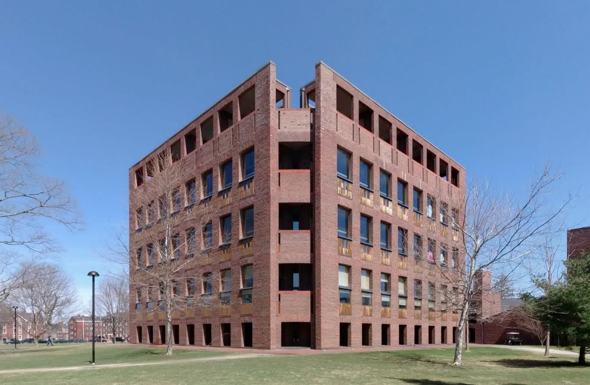
Library at Phillips Exeter Academy, Exeter, New Hampshire (1972)
Notes:
Phillips Exeter Academy wanted a library whose exterior matched the Georgian buildings of the extant campus
Enter through the ground floor, seemingly going under the building

Slide 71
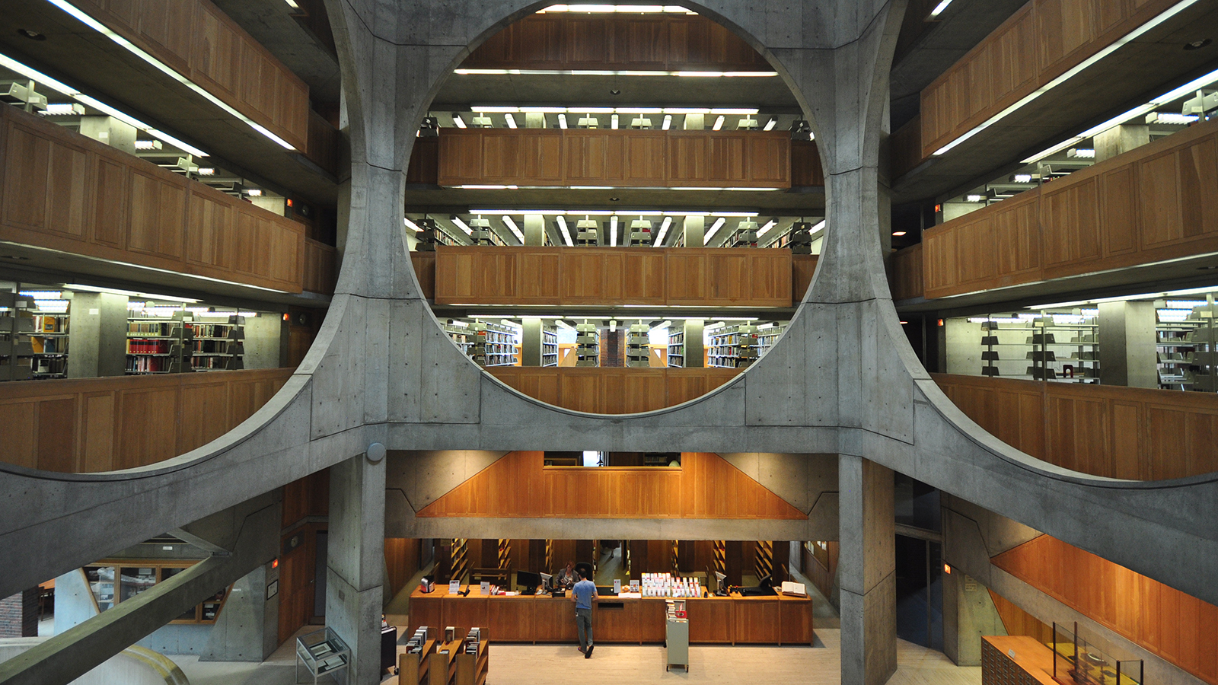
Library at Phillips Exeter Academy, Exeter, New Hampshire (1972)
Notes:
Immediately entering the central void
Atrium 52’ in height
32’ square lobby space
Height and width follow golden ratio of 1.618
About ‘eternal’ truths

Slide 72
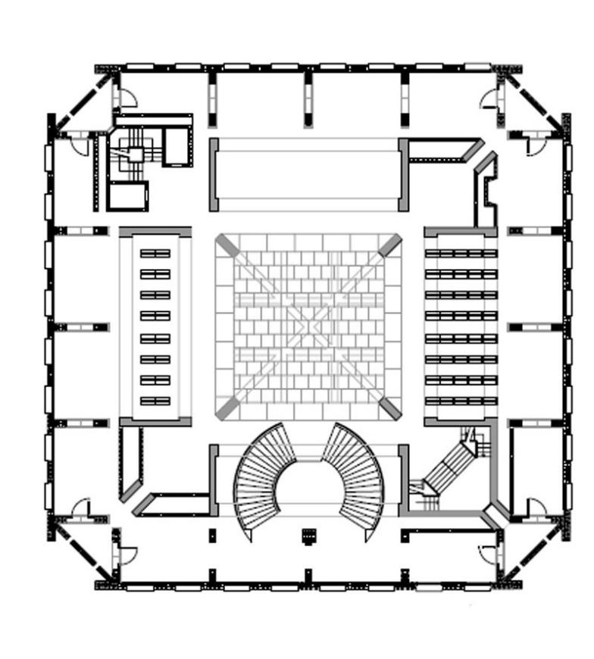
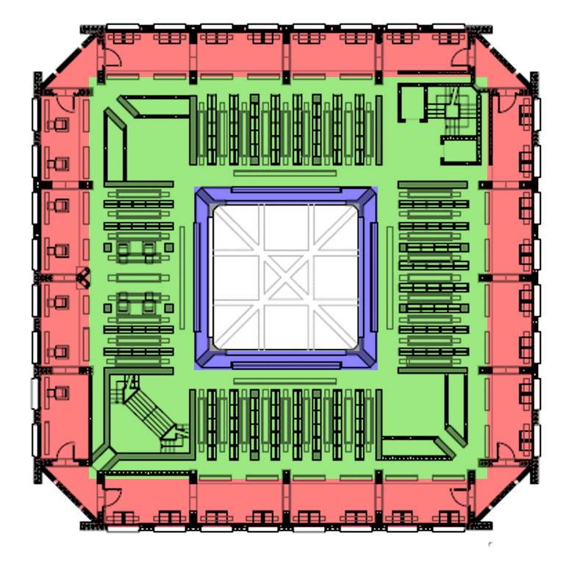
Library at Phillips Exeter Academy, Exeter, New Hampshire (1972)
Notes:
The plan is structured as 3 concentric rings
These 3 rings were considered ‘buildings within buildings’
Avoided hallways at all costs, and instead opted for open spaces with implied directionality

Slide 73
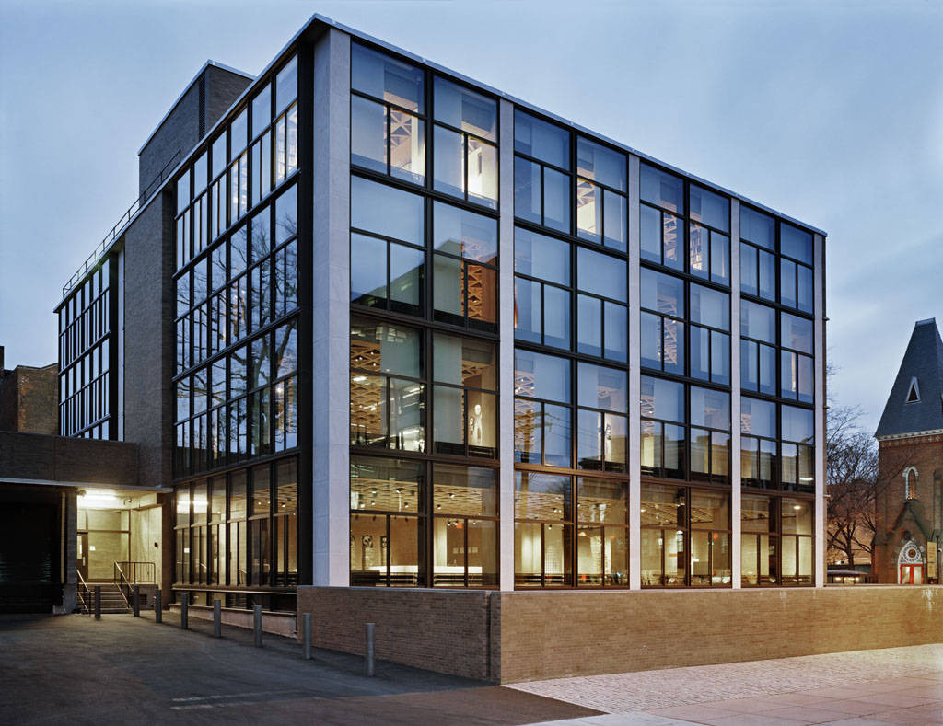
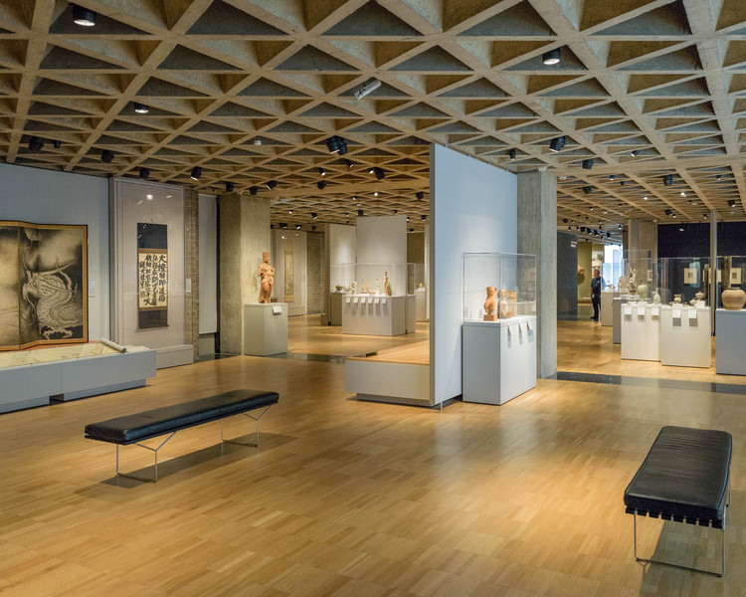
Yale University Art Gallery, New Haven, CT (1953)
Notes:
Sits directly across Yale University Art Gallery, Kahn’s first major public building completed in 1953

Slide 74
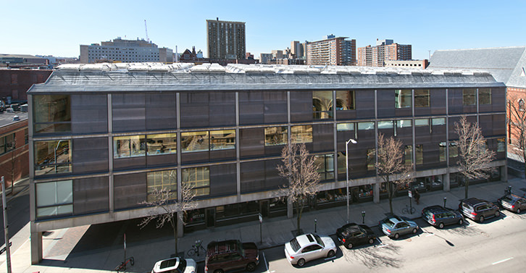
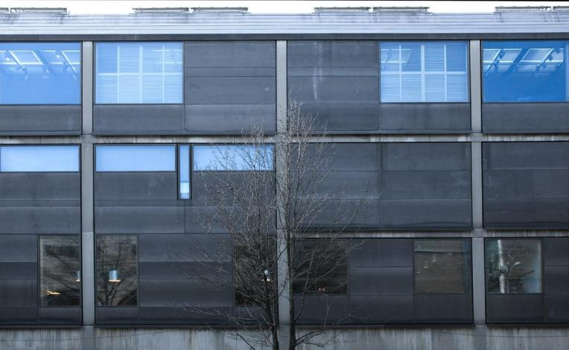
Yale Center for British Art, New Haven, CT (1966)
Notes:
YCBA
Exterior is clad with matte steel
Interior is lined with travertine marble

Slide 75
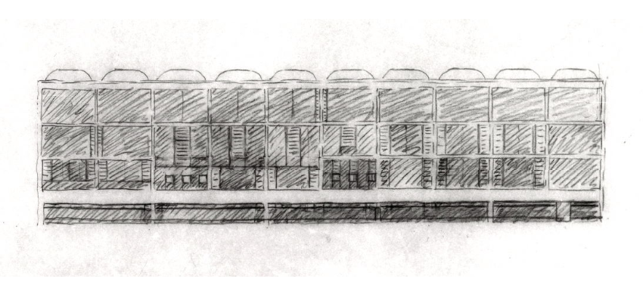
Yale University Art Gallery, New Haven, CT (1953)
Notes:
The interior organization can be thought of as subdivided into regular square bays (at 20’ feet square), with clusters of bays that extend spaces horizontally and vertically
A museum composed of a series of ‘rooms’
Said that Kahn got this idea after visiting Paul Mellon’s home to view the works

Slide 76
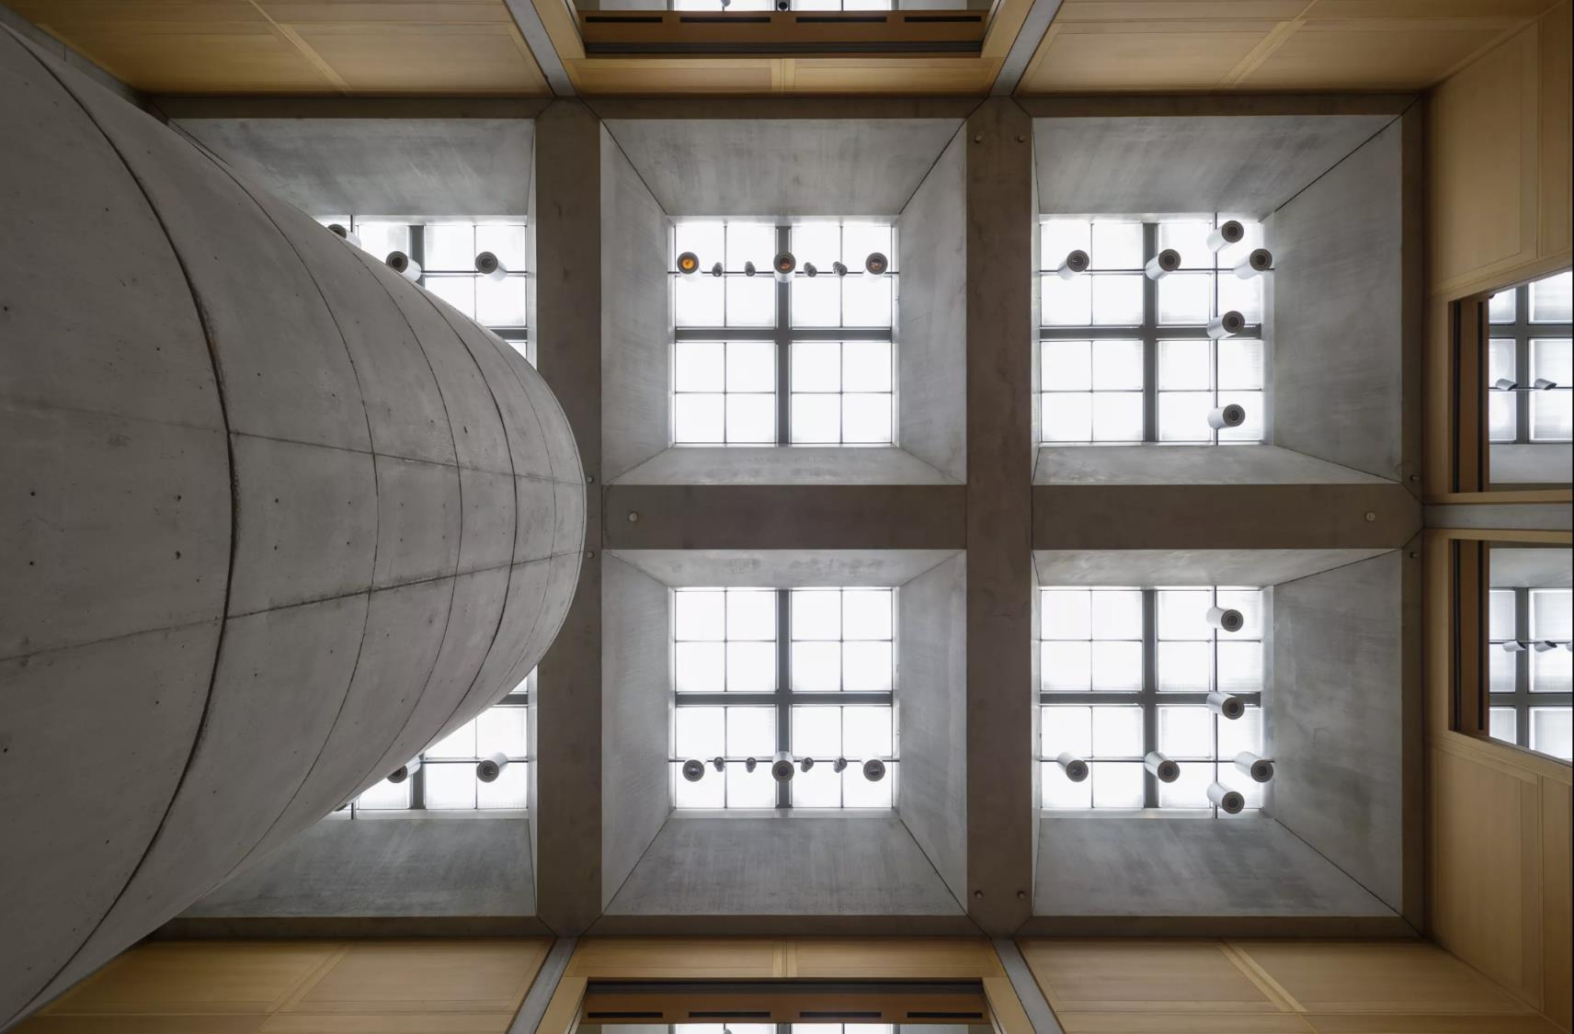
Yale Center for British Art, New Haven, CT (1966)
Notes:
Maximum daylight entry, as provided by the coffered ceiling, each with skylighting
Central elevated atrium (w/ drum) allowed for light to enter into the gallery spaces from within the perimeter, allowing for many of the discreet spaces to have natural daylight coming in from both sides, reducing harsh lighting conditings

Slide 77
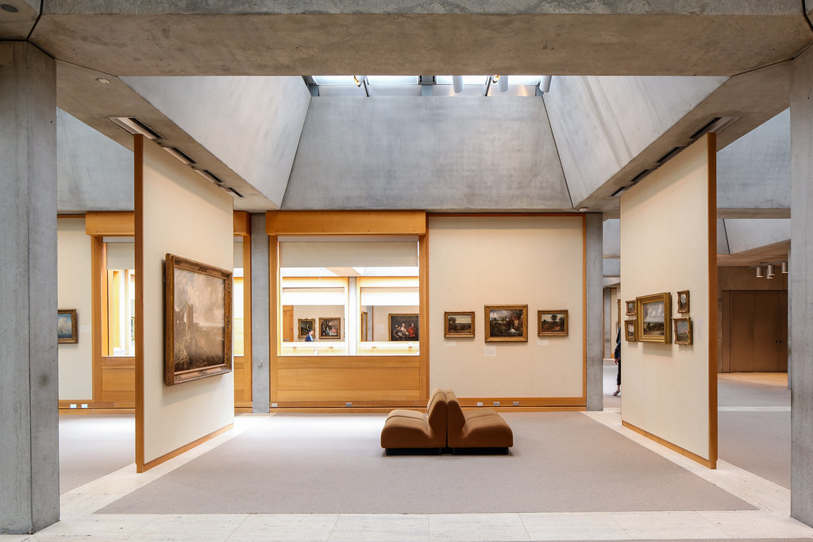
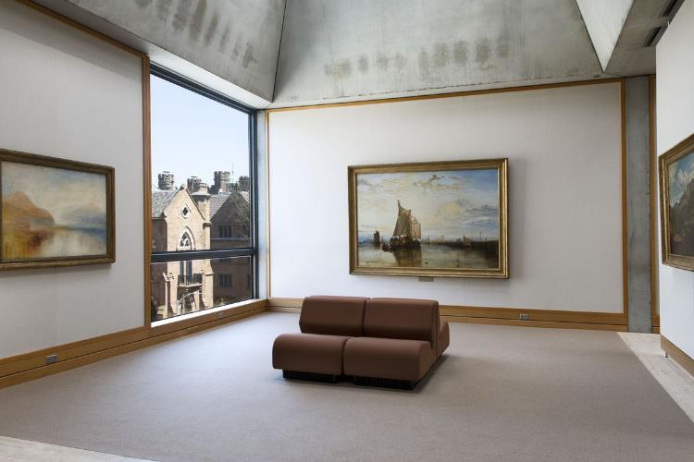
Yale Center for British Art, New Haven, CT (1966)
Notes:
Series of rooms, illuminated from above
Typical of Kahn – simple shapes (squares, circles), complex and open layouts

Slide 78
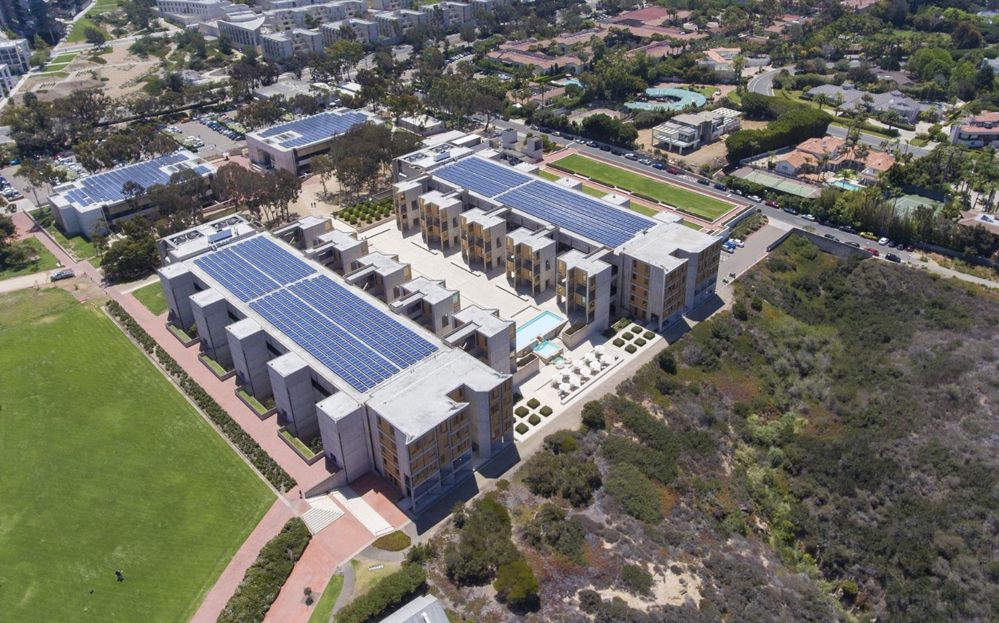
Salk Institute for Biological Studies, La Jolla (San Diego), CA (1959 – 65)
Notes:
The Salk Institute, from Jonas Salk, the man who discovered the vaccine for polio
The brief was a center of scientific research for the benefit of humanity

Slide 79
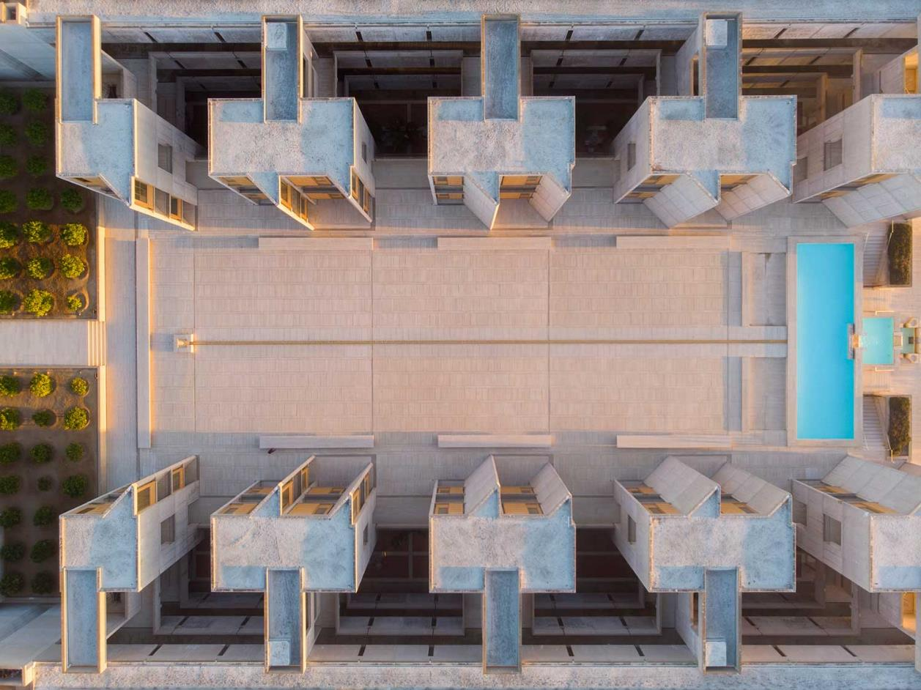
Salk Institute for Biological Studies, La Jolla, CA (1959 – 65)
‘Servant’ and ‘Served’ spaces
Notes:
Two ‘wings’, separated by a courtyard
Often described as modeled off a monastery, but for this, an isolated intellectual rather than a religious community
Symmetrical, 6 stories tall
Travertine courtyard
Initially Kahn was going to line the courtyard with greenery (sketches)

Slide 80
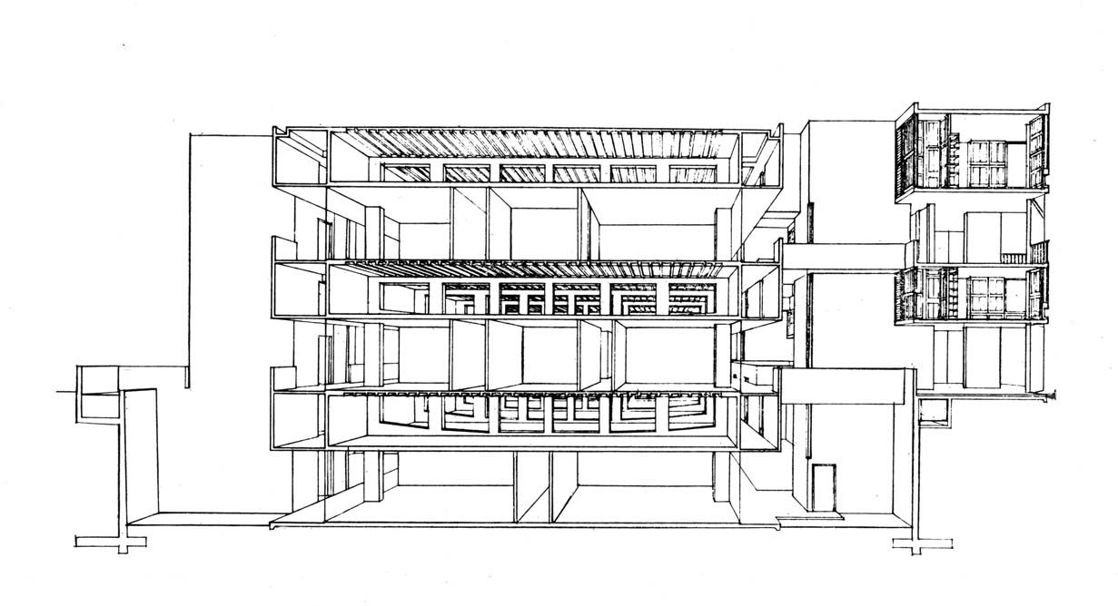
Salk Institute for Biological Studies, La Jolla, CA (1959 – 65)
Vierendeel structure through ‘Servant’ spaces
Notes:
While most of the talk revolves around the courtyard, many interpret the resolution of floor design to be even more significant
Laboratories had to be open, spacious, and allow for reconfiguration
‘Servant’ and ‘Served’ spaces
Allowing for unobstructed occupied spaces
No need to dedicate significant part of volume to utilities
On a practical level, building maintenance could occur without disrupting work
Allows for thick floors, which in turn act as Vierendeel trusses, allowing for greater spans, larger clear floors
The pipe space was just as important/integral to Kahn as that of the laboratory spaces
By separating utilities, dust could be reduced in labs

Slide 81
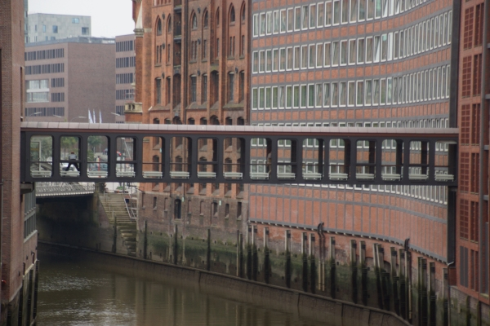
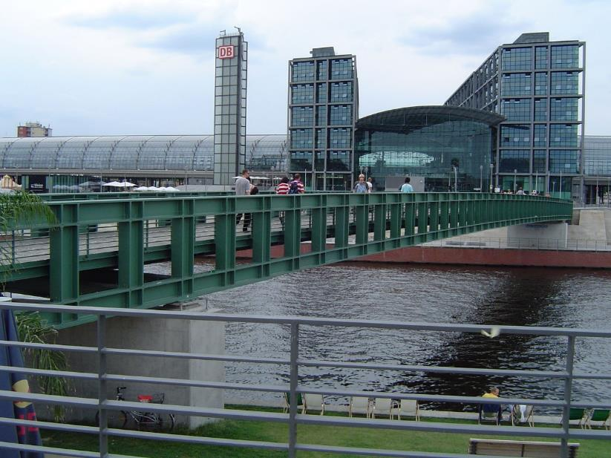
Brooksfleet Footbridge, Hamburg, Germany
Gustav Heinemann Bridge, Nürnberg, Germany

Slide 82
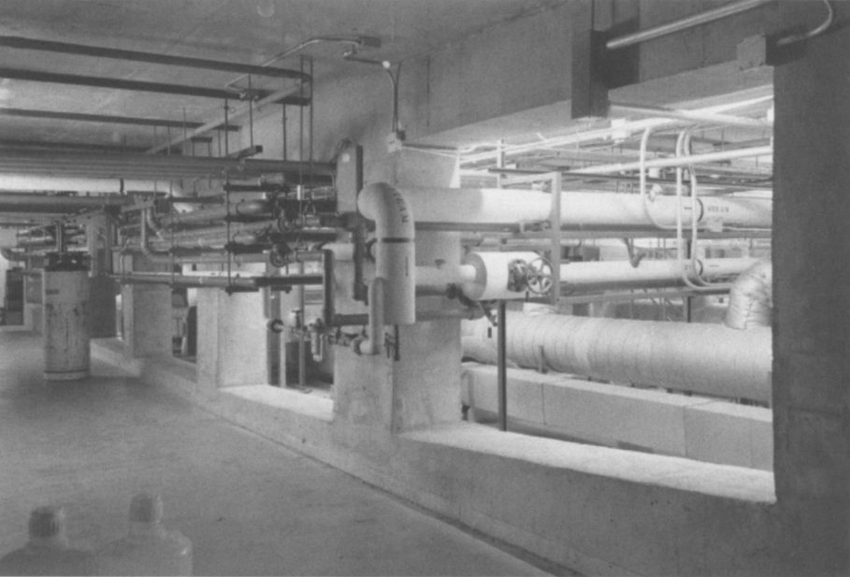
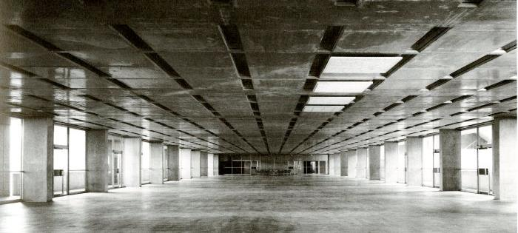
Salk Institute for Biological Studies, La Jolla, CA (1959 – 65)
Vierendeel structure through ‘Servant’ spaces

Slide 83
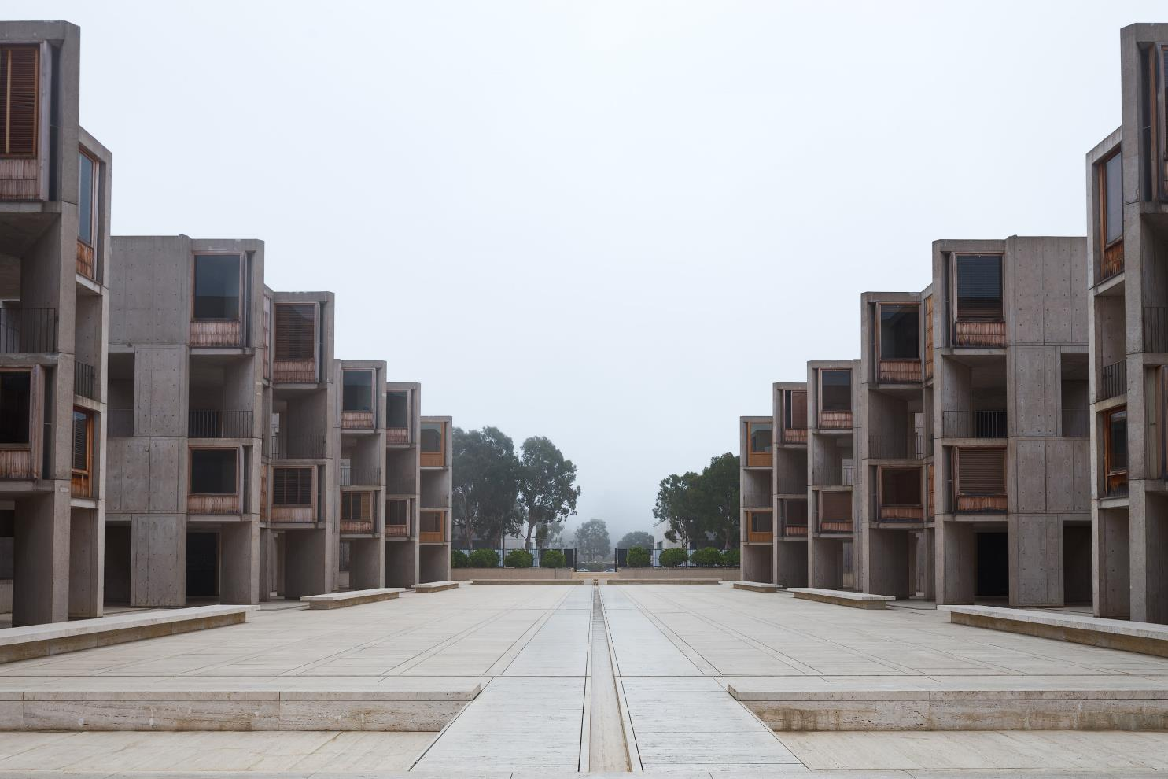
Salk Institute for Biological Studies, La Jolla, CA (1959 – 65)
Notes:
Courtyard a place for creative collaboration

Slide 84
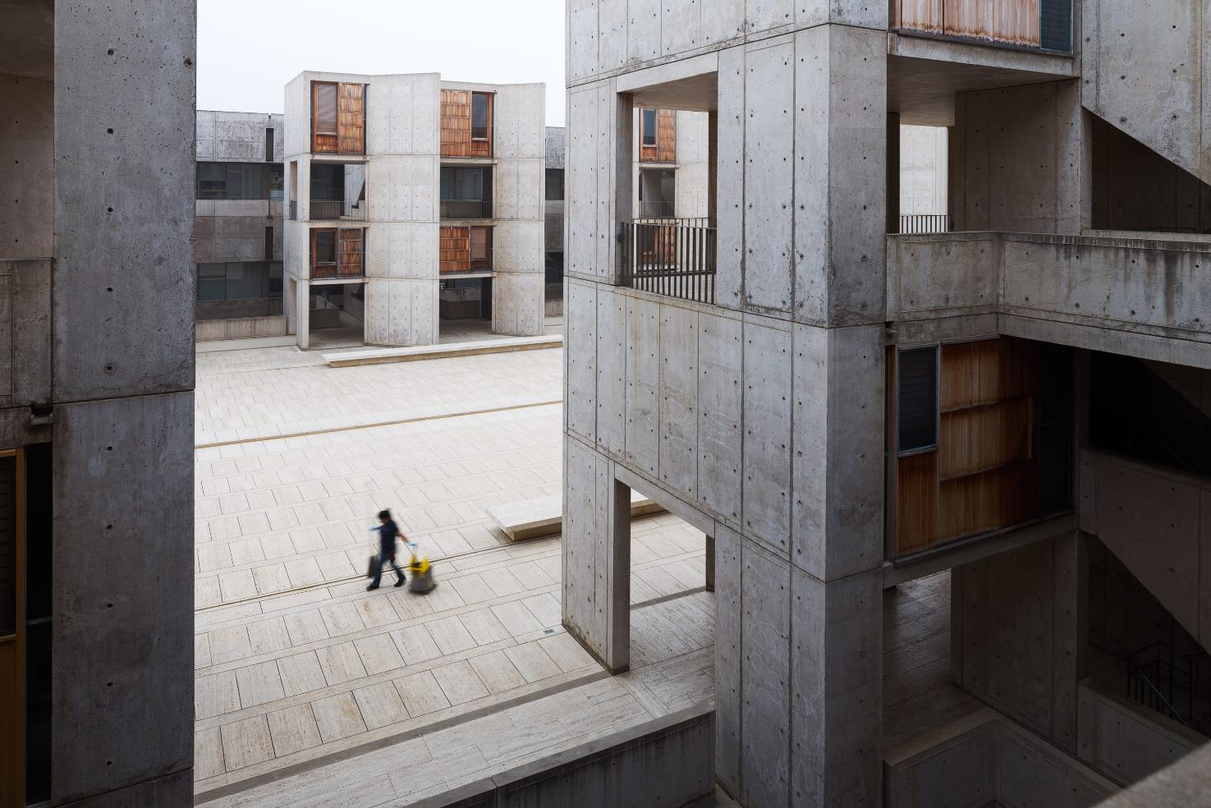
Salk Institute for Biological Studies, La Jolla, CA (1959 – 65)

Slide 85
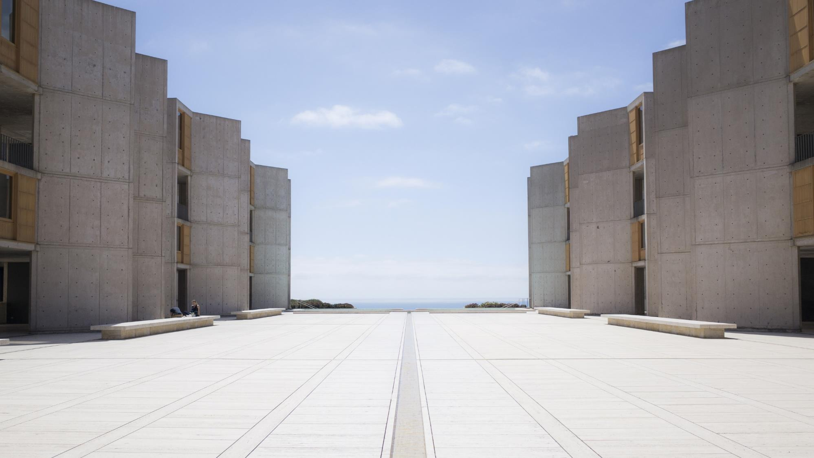
Salk Institute for Biological Studies, La Jolla, CA (1959 – 65)

Slide 86
Salk Institute for Biological Studies, La Jolla, CA (1959 – 65)
Alignment with the sun at vernal equinox (beginning of spring)

Slide 87
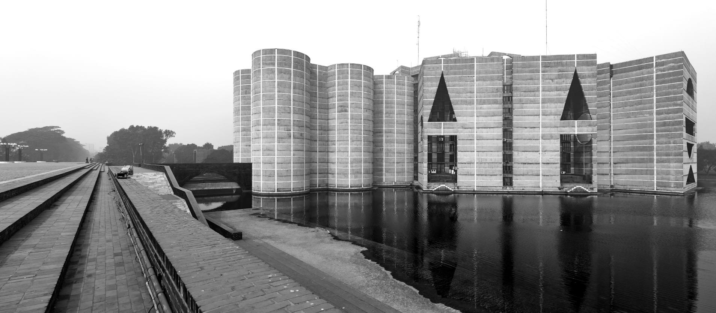
Jatiya Sangsad Bhaban (National Parliament House), Dhaka, Bangladesh (1982)
Notes:
Perhaps does not get as much coverage, given its site in Dhaka, Bangladesh
Symbolic diagram of the state
Situated in artificial lake

Slide 88
Jatiya Sangsad Bhaban (National Parliament House), Dhaka, Bangladesh (1982)
Notes:
Parliament at center, therefore central to the social order
Government as an idealized order

Slide 89
Jatiya Sangsad Bhaban (National Parliament House), Dhaka, Bangladesh (1982)
Notes:
The exterior is solid, fortress-like
The interior the opposite, porous, but through geometrical apertures

Slide 90
Jatiya Sangsad Bhaban (National Parliament House), Dhaka, Bangladesh (1982)
Notes:
Use of basic geometries, allowing light to create cavernous volumes

Slide 91
Kimbell Art Museum, Fort Worth, Texas (1972)
Notes:
A total of 16 vaults
100’ long, 20’ high, 20’ wide

Slide 92
Kimbell Art Museum, Fort Worth, Texas (1972)
Notes:
Like his other projects, simple shapes, and almost fortress-like appearance
Notice the seam on the end of the barrels

Slide 93
Kimbell Art Museum, Fort Worth, Texas (1972)
Notes:
Well-known for its use of light
Indirect, reflected light through skylights
Practical reason – art work to protect

Slide 94
Kimbell Art Museum, Fort Worth, Texas (1972)
Notes:
The precise curvature is neither circular nor ovoidal, but ‘cycloidal’
Important for spreading (diffusing) the indirect natural light

Slide 95
Kimbell Art Museum, Fort Worth, Texas (1972)
Notes:
View from the interior
Like YCBA, a series, or rows, of rooms with lighting from above
Like all his projects, resistance to hallways, strict circulation

Slide 96
“I am trying to find new expressions of old institutions.” Kahn [32]
Kimbell Art Museum, Fort Worth, Texas (1972)

Slide 97
INSTITUTIONS
“Institutions are thus dis-covered and re-discovered, but as such they are based on and stem from the timeless structure of the world.” [CNS, 32]
Notes:
CNS defined according, <Quote…>
Not about programs, not about functions, but about events, events that address immutable aspects of the relationship between our humanity and the built environment.

Slide 98
INSTITUTIONS
To learn
To live
To work
To meet
To question
To express
“Institutions are thus dis-covered and re-discovered, but as such they are based on and stem from the timeless structure of the world.” [CNS, 32]
Notes:
Kahn’s approach was not an application of what the architect wanted, but the architect was supposed to identify, to UNCONCEAL, the things that a given site possessed in its potentia.

Slide 99
INSTITUTIONS
To learn
To live
To work
To meet
To question
To express
“It is not what you want, it is what you sense in the order of things which tells you what to design.” [31]
Notes:
By identifying INSTITUTIONS instead of PROGRAMS, CNS believed that Kahn was working with the interconnectedness of being that architecture realizes so well.

Slide 100
The Street
The first institution of man
A meeting-hall without a roof
Notes:
Examples of how Kahn approached his works:
A street
The first institution of man
A meeting-hall without a roof
The School
A realm of spaces where it is good to learn
The City
The place of assembled institutions

Slide 101
The Street
A meeting-hall without a roof
The School
A realm of spaces where it is good to learn
The City
The place of assembled institutions
Notes:
Generalized understanding, such that the uses of buildings are not programmatic nor functional, but highly generalized, basic

