Slide 1
ACTIVE vs CLASSICAL
UTOPIA

Slide 2
ETYMOLOGY of UTOPIA

Slide 3
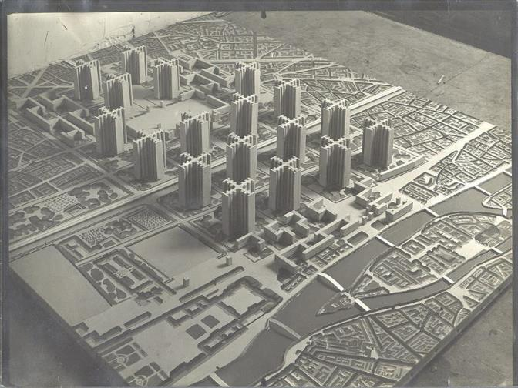
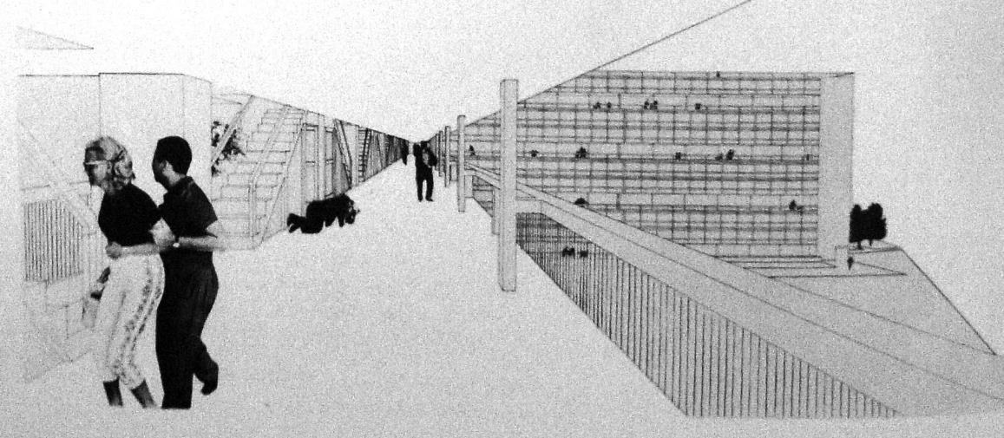
According to Rowe/Koetter, what’s the comparison?

Slide 4
The City
Part 2 of 3 (Rowe/Koetter)
Contemporary Architecture Theory
Eugene Han
Fall 2020, 11:15 – 12:30 pm
Online Instruction
Notes:
Now we move on to the second part of ‘The City’ section, which I stated, is much more theoretical
The fancy name for that is ‘Discourse’
That simply means we’re talking about how we talk about architecture
Shared conversation between periods and theorists

Slide 5
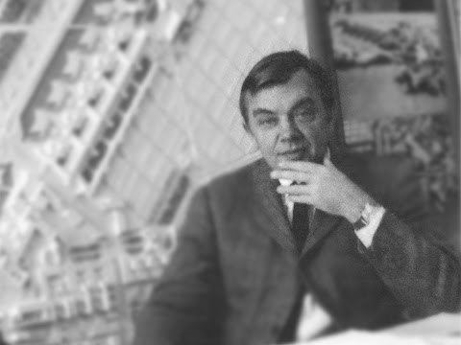
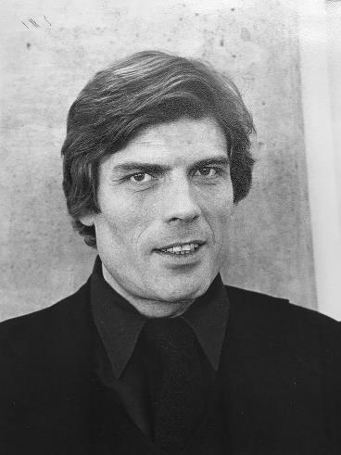
Colin Rowe
British / American; 1920 - 1999
Fred Koetter
American; 1938 - 2017
Notes:
For the first work, we’ll be looking at a seminal publication titled Collage City by Colin Rowe and Fred Koetter
Rowe was incredibly well-regarded architectural historian and theorist, and was noted as a teacher at Cornell
Koetter was his junior – while an academic, he was also involved in practice, dedicated most of his teaching at Yale

Slide 6
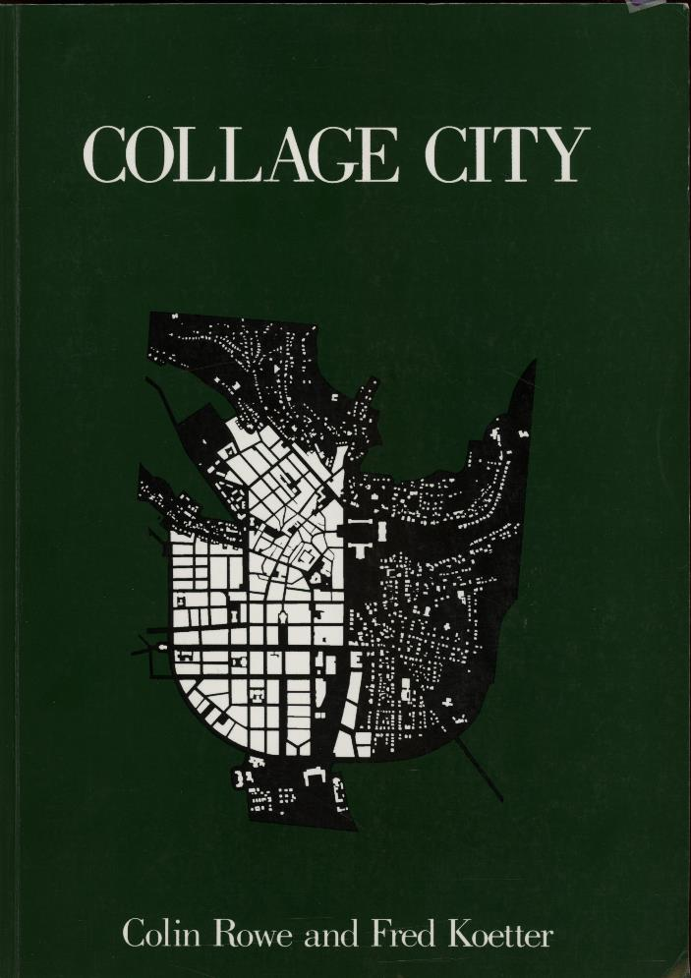
Introduction
Utopia: Decline and Fall?
After the Millennium
Crisis of the Object
Collision City and the Politics of ‘Bricolage’
Collage City and the Reconquest of Time
Collage City (1978)
Notes:
For this section, we’ll essentially be going through the book in summary, chapter-by-chapter
I’ll be leaving out some important parts because they go into detail, but I do encourage everyone to read this book in its entirety – it’s a REALLY important book in 20th century architecture, and I think summarizes quite well most of the century.
In short, it’s a book that reflects on where architecture is, why it is where it is, and where it should go.
On the right are the headings for each chapter, and you’ll see that the goal, the end, is to propose an idea of a ‘Collage City’
So, to quickly go over the content of each chapter…

Slide 7
“The new architecture represented the overcoming of history”
Introduction
Utopia: Decline and Fall?
After the Millennium
Crisis of the Object
Collision City and the Politics of ‘Bricolage’
Collage City and the Reconquest of Time
Collage City (1978)
Notes:
They start by setting the stage of their critique by reflecting on the Results of Modernism
In describing the Modernist project, they stated that “The new architecture represented the overcoming of history”
This overcoming of history was to take place by introducing the science of architecture-making
Method would overcome History.

Slide 8
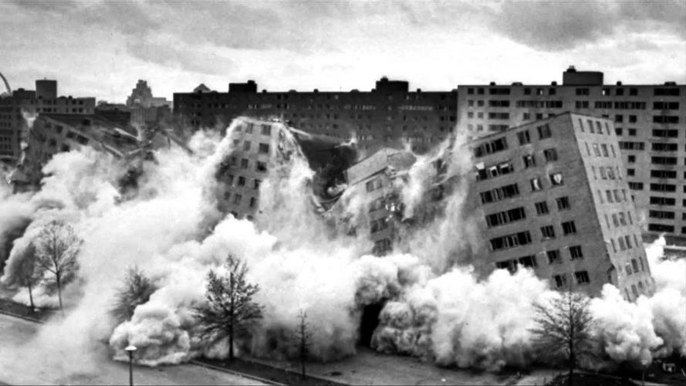
Introduction
Utopia: Decline and Fall?
After the Millennium
Crisis of the Object
Collision City and the Politics of ‘Bricolage’
Collage City and the Reconquest of Time
Pruitt-Igoe demolition, St. Louis (1972)
Notes:
But as we know, the promise of Modernism was only short-lived
Demolition of Pruitt-Igoe (1954 – 1972 – phased demolition), which they included to typify the failure of Modernism
33 building complex
Absolutely critical to understand that Collage was written 6 years after Pruitt-Igoe
Why start with Pruitt-Igoe?...
RK saying ‘hold up, we Modernism wasn’t perfect, but let’s take stock of things before jettisoning its contributions wholesale’

Slide 9
UTOPIA
Introduction
Utopia: Decline and Fall?
After the Millennium
Crisis of the Object
Collision City and the Politics of ‘Bricolage’
Collage City and the Reconquest of Time
Collage City (1978)
Notes:
Utopia: Decline and Fall?
Ou (not) + Topos (place) = Nowhere
An excursus on the history of Utopias
Setting up the mindset of why past City projects have failed
B/c they used as an ideal the concept of Utopia
Showing that while over-idealistic, they form the basis of architectural knowledge and history

Slide 10
UTOPIA
Introduction
Utopia: Decline and Fall?
After the Millennium
Crisis of the Object
Collision City and the Politics of ‘Bricolage’
Collage City and the Reconquest of Time
ou
(not)
Collage City (1978)

Slide 11
UTOPIA
Introduction
Utopia: Decline and Fall?
After the Millennium
Crisis of the Object
Collision City and the Politics of ‘Bricolage’
Collage City and the Reconquest of Time
ou
(not)
topos
(place)
Collage City (1978)

Slide 12
UTOPIA
Introduction
Utopia: Decline and Fall?
After the Millennium
Crisis of the Object
Collision City and the Politics of ‘Bricolage’
Collage City and the Reconquest of Time
ou
(not)
topos
(place)
‘nowhere’
Collage City (1978)

Slide 13
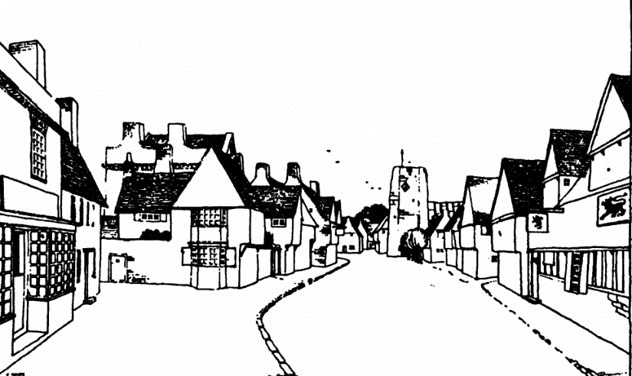
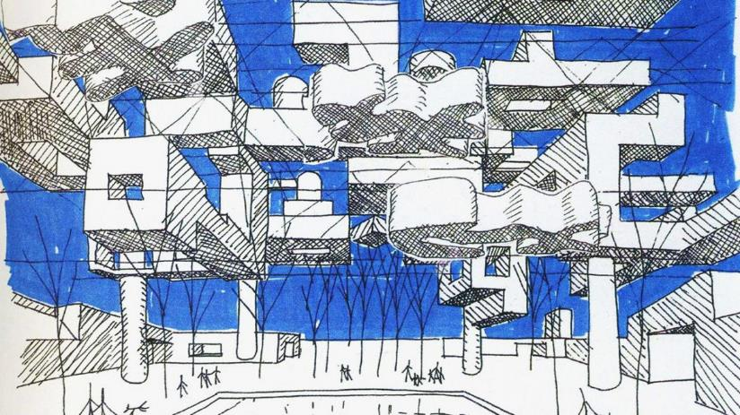
Introduction
Utopia: Decline and Fall?
After the Millennium
Crisis of the Object
Collision City and the Politics of ‘Bricolage’
Collage City and the Reconquest of Time
Top: Raymond Unwin, Study for fictional town
Bottom: Yona Friedman, from Mobile Architecture studies (1950-60s)
Notes:
After the Millennium
Extant issues in the city (during the time immediately preceding and concurrent with Collage City)
Either a regression back to the British Picturesque /Townscape ‘good ole days’ or ‘hyper-futurism’ of Metabolism, Futurism, and even Team X

Slide 14
“the presumption here inferred that only the middle ground of an argument is of use, that its extremities are likely always to be absurd, is now positively introduced, not from any passion for compromise, but as an intuition which might assist some kind of alert and workable détente.”
Introduction
Utopia: Decline and Fall?
After the Millennium
Crisis of the Object
Collision City and the Politics of ‘Bricolage’
Collage City and the Reconquest of Time
Collage City (1978)
Notes:
<<Quote>>

Slide 15
TEXTURE
Introduction
Utopia: Decline and Fall?
After the Millennium
Crisis of the Object
Collision City and the Politics of ‘Bricolage’
Collage City and the Reconquest of Time
Collage City (1978)
Notes:
Crisis of the Object
The idea of ‘texture’ as a way to read architecture
Setting up a formal lexicon to put forward their own message
But before delivering their message, now that they have an alphabet, they have to argue for a grammar

Slide 16
TEXTURE
Introduction
Utopia: Decline and Fall?
After the Millennium
Crisis of the Object
Collision City and the Politics of ‘Bricolage’
Collage City and the Reconquest of Time
“[texture] is a matter of how much the mind and eye can absorb or comprehend.”
Collage City (1978)
Notes:
<<Quote>>

Slide 17
Introduction
Utopia: Decline and Fall?
After the Millennium
Crisis of the Object
Collision City and the Politics of ‘Bricolage’
Collage City and the Reconquest of Time
Top-Down
Bottom-Up
Collage City (1978)
Notes:
Collision City
Back to the distinction b/w Top-Down and Bottom-Up <<Review>>

Slide 18
Introduction
Utopia: Decline and Fall?
After the Millennium
Crisis of the Object
Collision City and the Politics of ‘Bricolage’
Collage City and the Reconquest of Time
‘Open Society’
Collage City (1978)
Notes:
‘Open Society’
Encourages a system in which evolution is neither restrained nor forced, but reflects a city’s natural development
A renewed idea of civic equity and democracy as it relates to organized forms of living – in other words, the city

Slide 19
COLLAGE
Introduction
Utopia: Decline and Fall?
After the Millennium
Crisis of the Object
Collision City and the Politics of ‘Bricolage’
Collage City and the Reconquest of Time
Collage City (1978)
Notes:
Collage City
Hone in on the definition of Collage and its relevance to architecture
Differentiates between collage as technique of montaging different elements together, and collage as a state of mind, in which difference is celebrated, differences and opposition become the effective tool for design.

Slide 20
COLLAGE
Introduction
Utopia: Decline and Fall?
After the Millennium
Crisis of the Object
Collision City and the Politics of ‘Bricolage’
Collage City and the Reconquest of Time
“Disparate objects held together by various means, ‘physical, optical, psychological’”
Collage City (1978)
Notes:
<<Quote>>

Slide 21
Introduction
Utopia: Decline and Fall?
After the Millennium
Crisis of the Object
Collision City and the Politics of ‘Bricolage’
Collage City and the Reconquest of Time

Slide 22
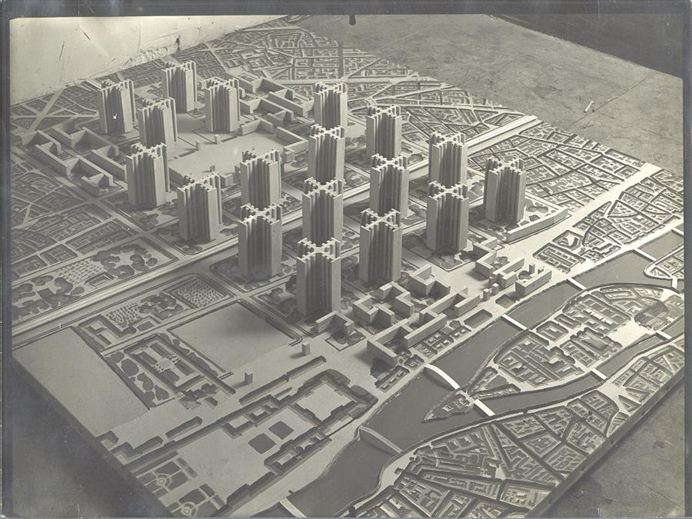
Le Corbusier, Plan Voisin, Paris (1925)
Notes:
To begin their argument, they had to take stock of the current state of architecture and the city (1978)
Rowe and Koetter take a very nuanced stance when it came to assessing the successes of Modernism
On the one hand, there was no denying the failure of the Modernist project, that of developing a science of architecture that could improve the world, particularly in relation to how we live in the city
However, they also acknowledged the inherent goodwill of the Modernists
For Rowe and Koetter, it was fundamentally important that there was a ‘spirit of the age,’ a common ambition by a wide group of architects
This common ambition was about the improvement of living through embracing new technologies.
The Modernist project (from early 20th century up to roughly Team X) created a false choice between…

Slide 23
SCIENCE

Slide 24
PEOPLE

Slide 25
“Nor should it be necessary to say that these alternatives – Let science build the town and Let people build the town – are both of them profoundly neurotic.”
Notes:
But for RK, the decision for the architect is NOT BINARY – Not Science OR People
There can be moments for one, moments for the other, moments in which they blend, and moments in which of opposition.
A common thread that you’ll see throughout this work is that they resist the concession towards on extreme or another, or even an average between the two, and instead, endorse a kind of ‘constructive dis-illusion’
Also resist ‘averaging’ in favor of ‘mixture’
<<Quote…>>

Slide 26
“A proposal for constructive dis-illusion, it is simultaneously an appeal for order and disorder, for the simple and the complex, for the joint existence of permanent reference and random happening, of the private and the public, of innovation and tradition, of both the retrospective and the prophetic gesture.”
Rowe / Koetter, Collage City

Slide 27
Introduction
Utopia: Decline and Fall?
After the Millennium
Crisis of the Object
Collision City and the Politics of ‘Bricolage’
Collage City and the Reconquest of Time

Slide 28
UTOPIA
‘Classical Utopia’
‘nowhere’
‘Active Utopia’
Notes:
RK make a distinction between 2 different types of Utopia
As a way to legitimate its use in architecture

Slide 29
‘Classical Utopia’
Pre-Enlightenment (pre~1700)
Intellectual exercise
For learned class
Often schemes designed for the recommendation to ruling classes
Inspired by universal rationality / morality
Platonic inheritance
Fundamentally hypothetical – intellectual
Francesco di Giorgio Martini: studies for ideal cities

Slide 30
‘Classical Utopia’
Pre-Enlightenment (pre~1700)
Intellectual exercise
For learned class
Often schemes designed for the recommendation to ruling classes
Inspired by universal rationality / morality
Platonic inheritance
Fundamentally hypothetical – intellectual
André: mid-19th century project for ideal community

Slide 31
From ‘Classical’ to
‘Active’ Utopia
“Simply the manager has pre-empted the place of the prince; and, if it is now not the law-giver but le directeur who is the informing power of the city, it is just possible that we are here, very incipiently, presented with a new idea for the constitution of the state.”
Claude-Nicolas Ledoux: La Saline de Chaux (1776)

Slide 32
‘Active Utopia’
“The need is evident and hence the attempt must be made to establish science as the foundation of morals, to turn politics into a branch of physics and, ultimately, to enjoin the replacement of arbitrary government by the rule of rational administration.”
Claude-Nicolas Ledoux: La Saline de Chaux (1776)

Slide 33
‘Active Utopia’
Enlightenment (post~1700)
Utopia as ‘a blueprint for the future’
For the masses
Inspired by science
Platonic inheritance
Fundamentally pragmatic
Claude-Nicolas Ledoux: La Saline de Chaux (1776)

Slide 34
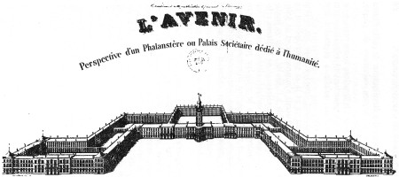
‘Active Utopia’
Enlightenment (post~1700)
Utopia as ‘a blueprint for the future’
For the masses
Inspired by science
Platonic inheritance
Fundamentally pragmatic
Charles Fourier, Phalanstery (1829)

Slide 35
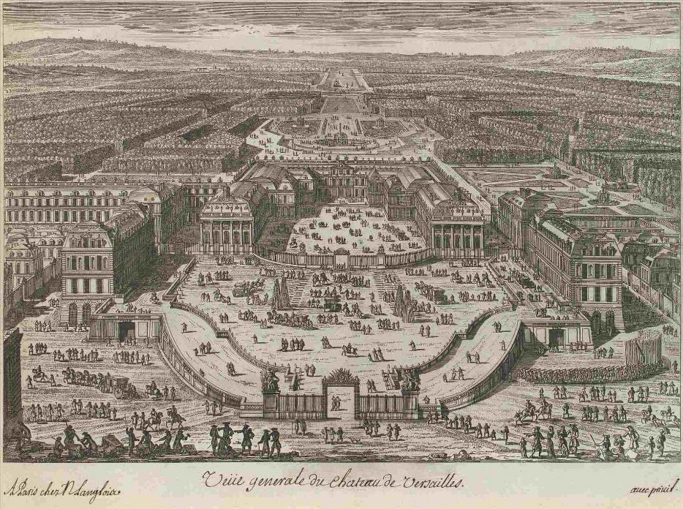
‘Active Utopia’
Enlightenment (post~1700)
Utopia as ‘a blueprint for the future’
For the masses
Inspired by science
Platonic inheritance
Fundamentally pragmatic
Palace of Versailles, Louis XIV (1634)

Slide 36
‘Active Utopia’
Enlightenment (post~1700)
Utopia as ‘a blueprint for the future’
For the masses
Inspired by science
Platonic inheritance
Fundamentally pragmatic
Le Corbusier, Sketch of an ideal modern living unit

Slide 37
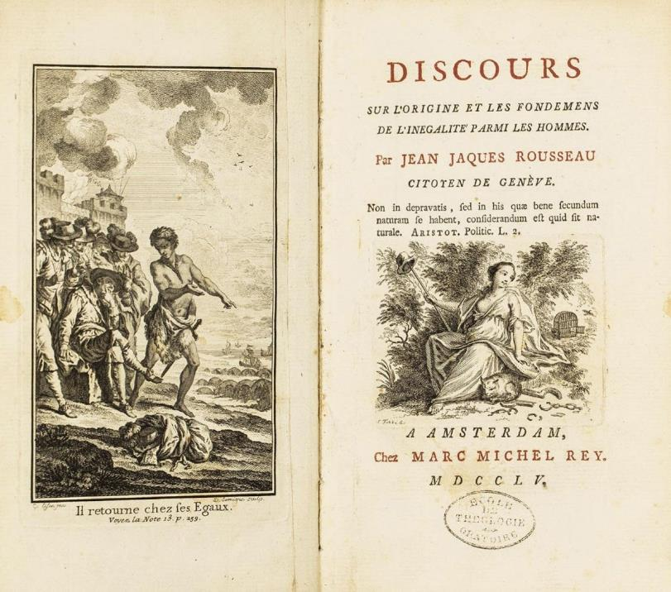
Le Corbusier, Sketch of an ideal modern living unit
Right: Jean Jacque Rousseau, Discourse on the Origin and Basis of Inequality Among Men (1754)
Notes:
RK discuss the Noble Savage as a curiousity that seems to repeat itself throughout ‘learned’ Western narratives
To better understand, quick history:
Best known to appear from Jean Jacque Rousseau’s Discourse on the Origin and Basis of Inequality Among Men (1754)… though Rousseau never mentions the phrase

Slide 38
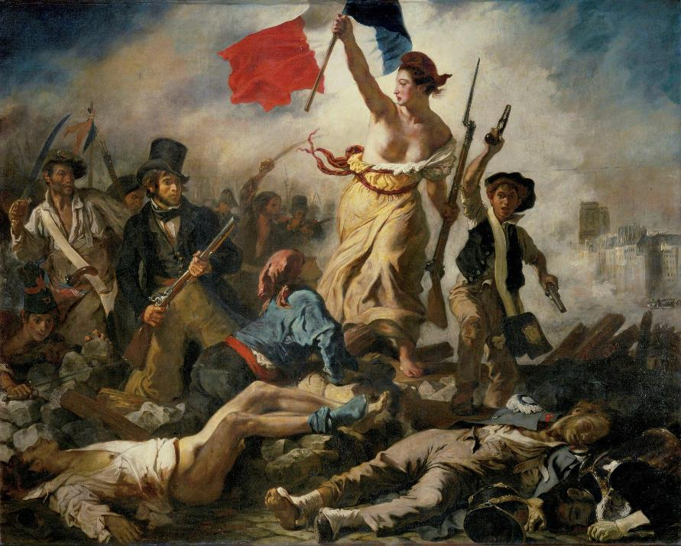
Eugéne Delcroix, Liberty Leading the People (1830)
Right: Jean Jacque Rousseau, Discourse on the Origin and Basis of Inequality Among Men (1754)
Notes:
Remember, French Revolution 1789 – freedom among all individuals
An attempt to underline our common humanity: what we all have in common is our desire for freedom
The tricolor of France, not official, but often interpreted as: Liberté, égalité, fraternité
Il retourne chez Ses égaux = He returns to his equals
For RK, Noble Savage – a misguided conviction on the reducibility of humanity to a romantic and fundamentally flawed notion of ‘primitive’
A romantic view that modern society (note 18th century) corrupts, and that as ‘scientists,’ if we can return to a purer state, we can design ideal cities
But critically, this isn’t a modern idea, but the idea of a Noble Savage has been documented all the way back to 1 AD, in reference Ancient Rome and the tribes that dominated present-day Germany
The racism is clear, but it’s important to recognize its universality in Western thought (if not wider than that)
20th century, increased use of term ‘Natural Man’, but today, even that term would be heavily criticized

Slide 39
Introduction
Utopia: Decline and Fall?
After the Millennium
Crisis of the Object
Collision City and the Politics of ‘Bricolage’
Collage City and the Reconquest of Time

Slide 40
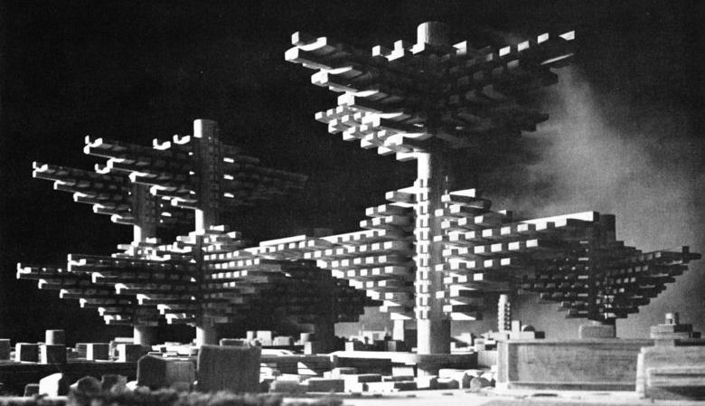
Left: Arata Isozaki, Clusters in the Air (1962)
Right: Gordon Cullen, Townscape Model (1961)

Slide 41
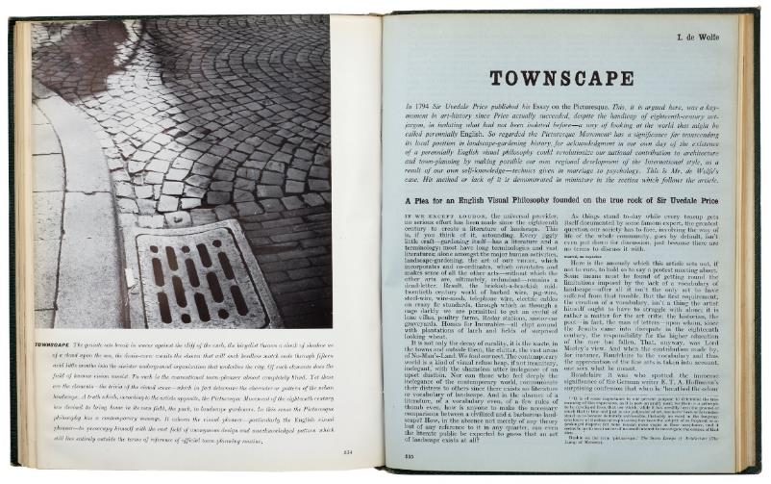
Gordon Cullen, Townscape Model (1961)
Notes:
Counter to movements like Team X, Structuralism, or Metabolism (think of these as progressive movements), there was a contemporaneous and heightened interest in nostalgic movements
Among these, Townscape (or British Townscape) sought to break down the fabric of small villages, and apply that design DNA to larger communities
Think of Christopher Alexander
Unquestionable conservative, a clear reaction to groups including both CIAM and Team X
Still going on – Prince Charles for example is a massive proponent of Townscape

Slide 42
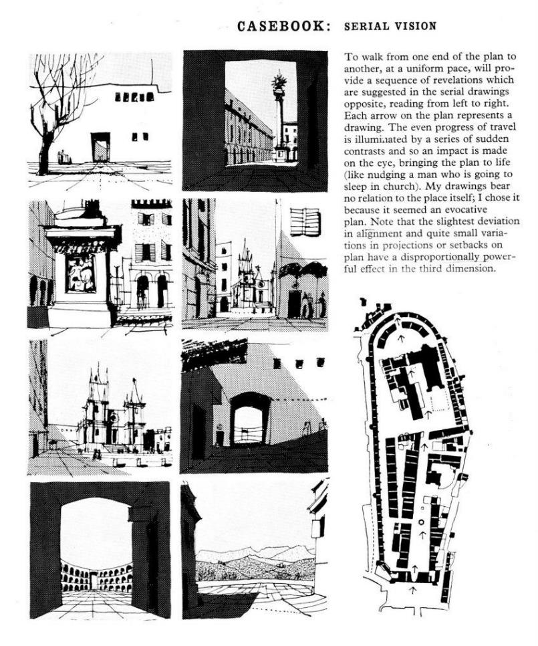
Gordon Cullen, Townscape Model (1961)
Notes:
- Example of Townscape tenets – frame views, ‘get lost’, establish modest landmarks

Slide 43
“but, in practice, townscape seems to have lacked any ideal referent for the always engaging ‘accidents’ which it sought to promote; and, as a result, its tendency has been to provide sensation without plan, to appeal to the eye and not to the mind and, while usefully sponsoring a perceptual world, to devalue a world of concepts.
Gordon Cullen, Townscape Model (1961)

Slide 44
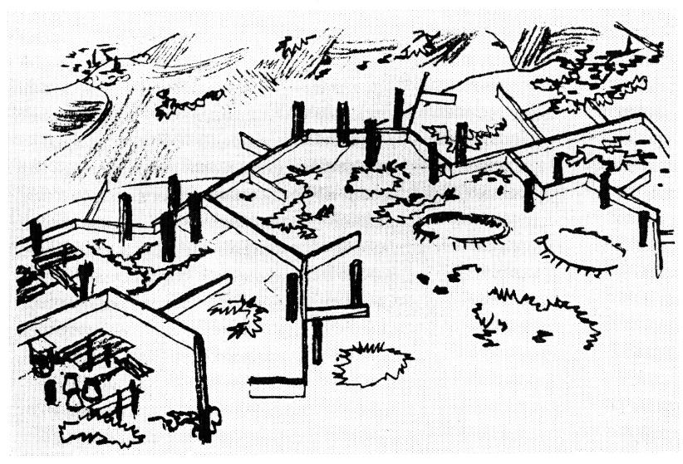
Alison and Peter Smithson, Golden Lane Housing Competition (1952)
Notes:
- As we know, the converse of Townscape came from ‘second generation’ Modernists

Slide 45
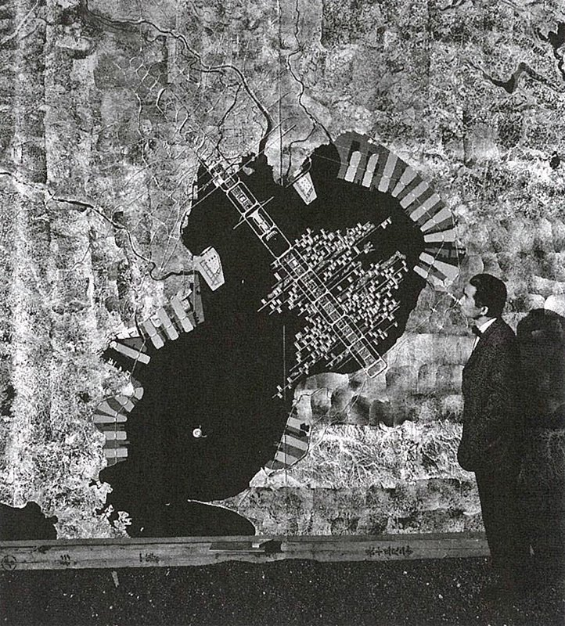
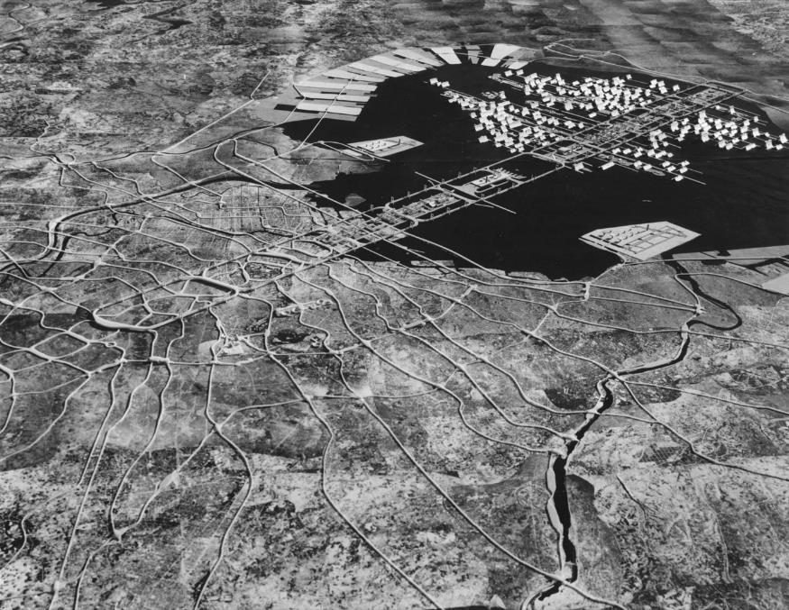
Kenzo Tange, Tokyo Bay Masterplan, Tokyo (1960)

Slide 46
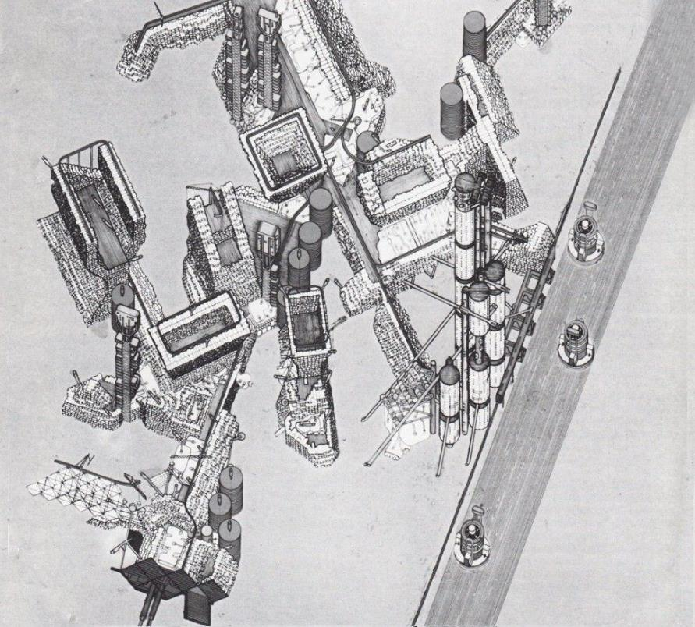
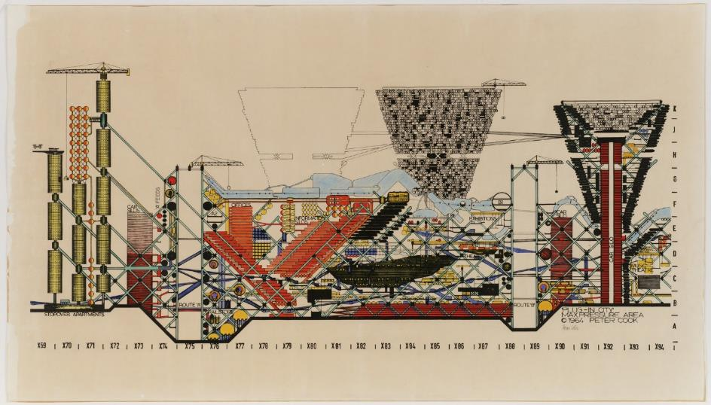
Archigram, Plug-In City (1964)
Notes:
- Examples in extreme

Slide 47
“Archigram would seem to be making picturesque images of the future. For, all of the unplanned randomness, the happy jerkiness, the obviously high-pitched tonality, the aggressive syncopation, all of the famous ingredients of Englishness in action are now given a space-age gloss.”
Archigram, Plug-In City (1964)
Notes:
- But these ostensibly polar extremes were actually working with the same approach

Slide 48
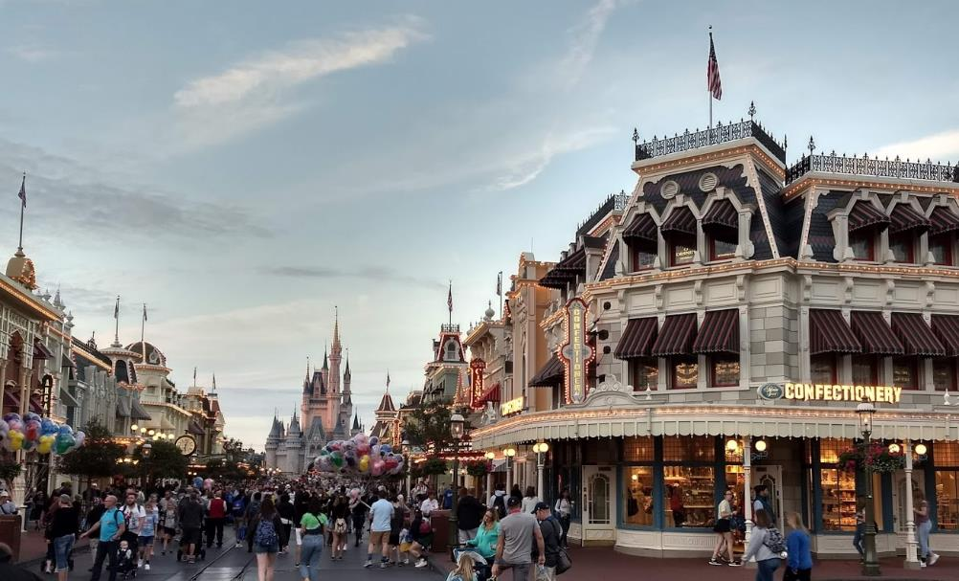
“Disney World’s Main Street is not so much an idealization of the real thing as it is a filtering and packaging operation, involving the elimination of unpleasantness, of tragedy, of time and of blemish.”
Disneyland, Main Street
Notes:
- But these ostensibly polar extremes were actually working with the same approach

Slide 49
Introduction
Utopia: Decline and Fall?
After the Millennium
Crisis of the Object
Collision City and the Politics of ‘Bricolage’
Collage City and the Reconquest of Time

Slide 50
TEXTURE
OBJECT
Notes:
- To set up the beginning of their approach, RK make a distinction between the terms ‘Texture’ and ‘Object’ in reading the city

Slide 51
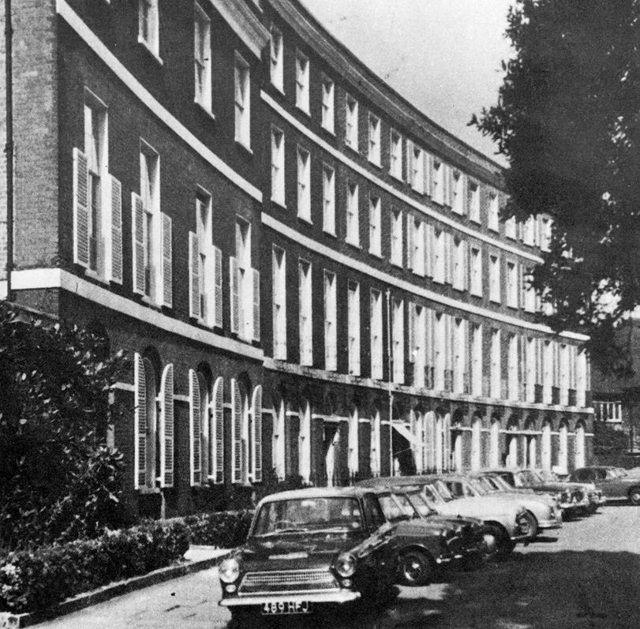
TEXTURE
Exeter, UK, Barnfield Crescent
Notes:
- In terms of texture, the key is to read general patterns that don’t pertain to a single building, monument, feature, but forms of organization that tend to cluster various city functions

Slide 52
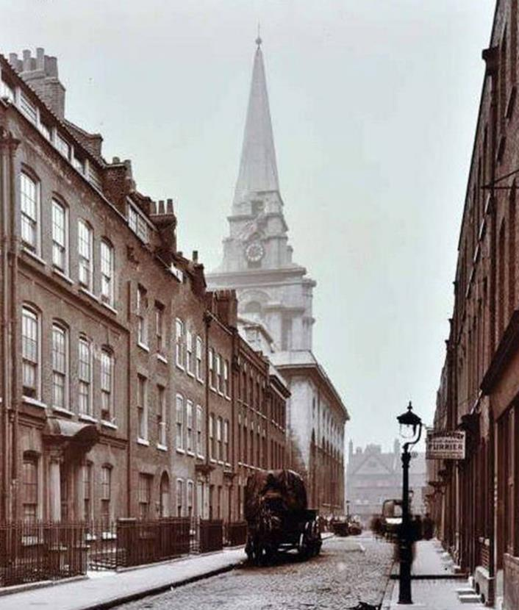
OBJECT
Nicholas Hawksmoor, Christ Church, London, UK (1729)
Notes:
Contrarily, Objects are those that are clearly distinguishable from the context
Here we can read texture overlaid onto an object

Slide 53
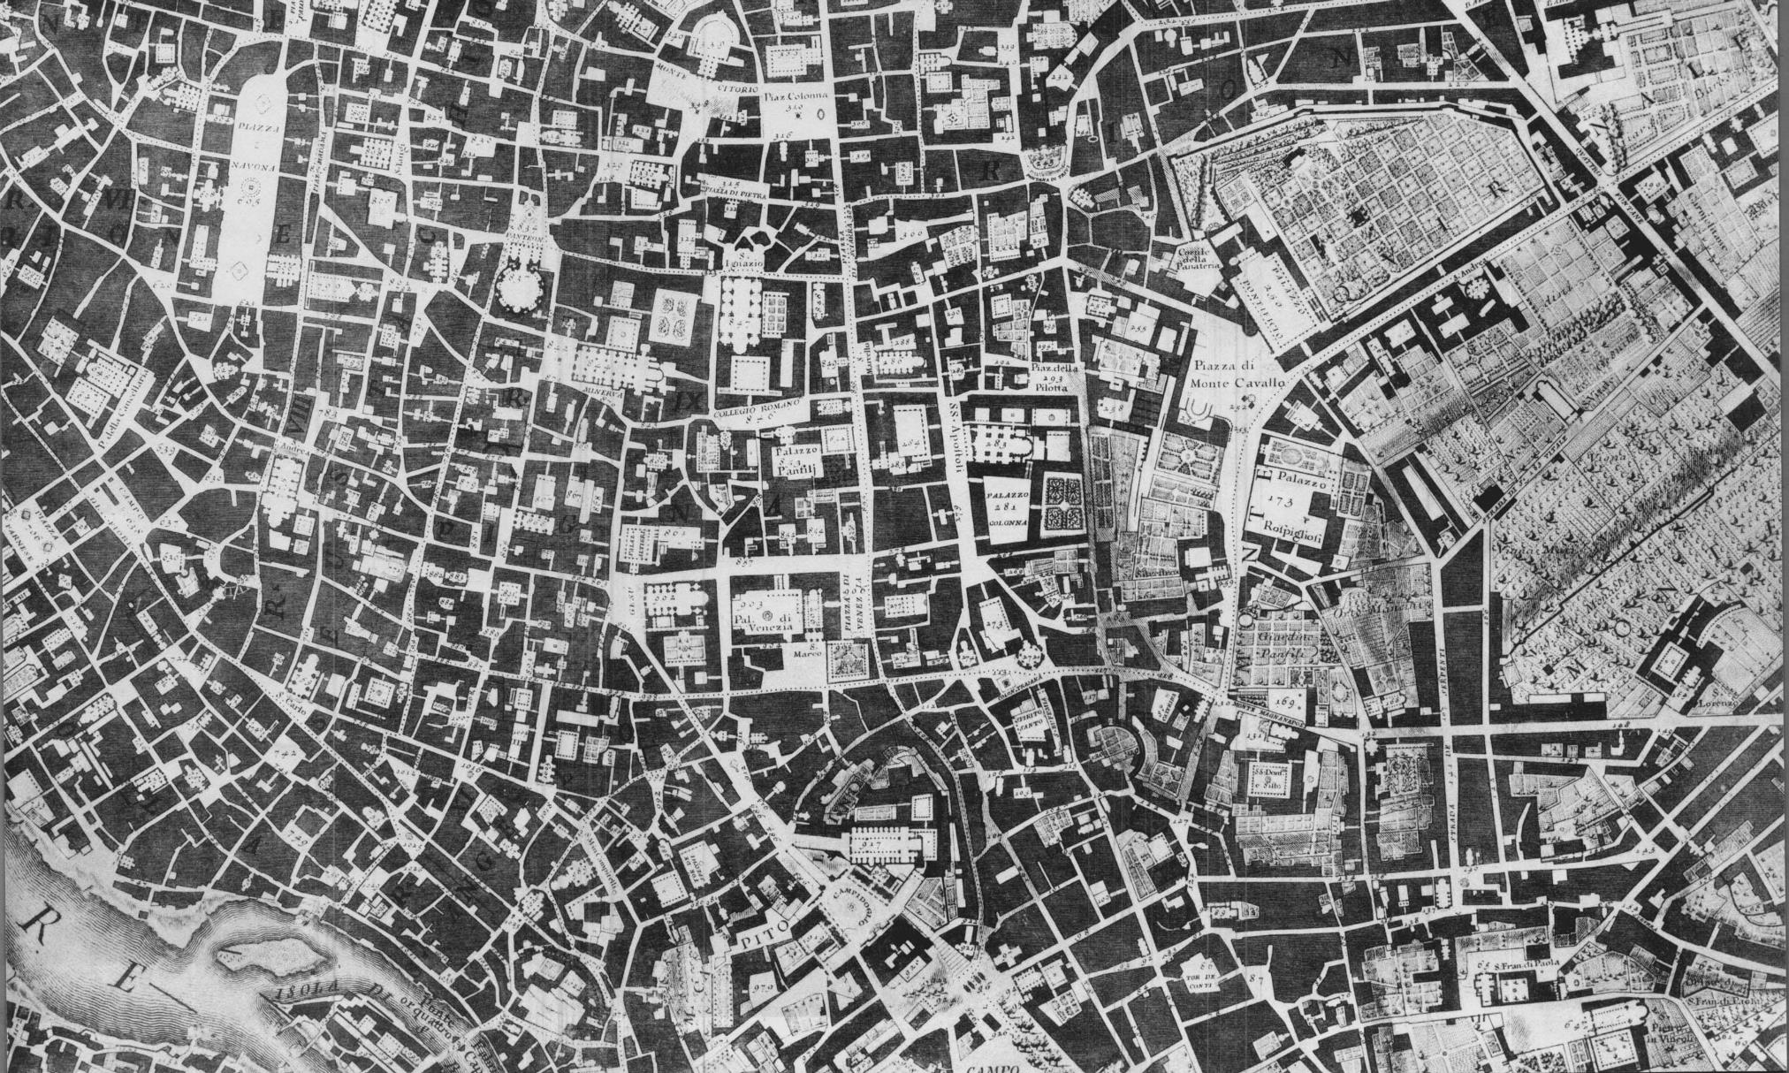
Notes:
Given that RK’s thesis pertained to the city, drawings like this, in which we can see the plans of many buildings, were really the key way to understand RK’s approach
Texture of ‘common’ buildings, punctuated by Objects (piazza, squares, cathedrals)

Slide 54
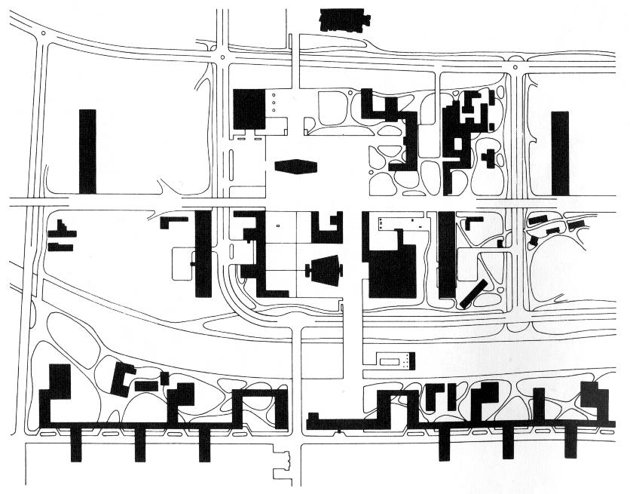
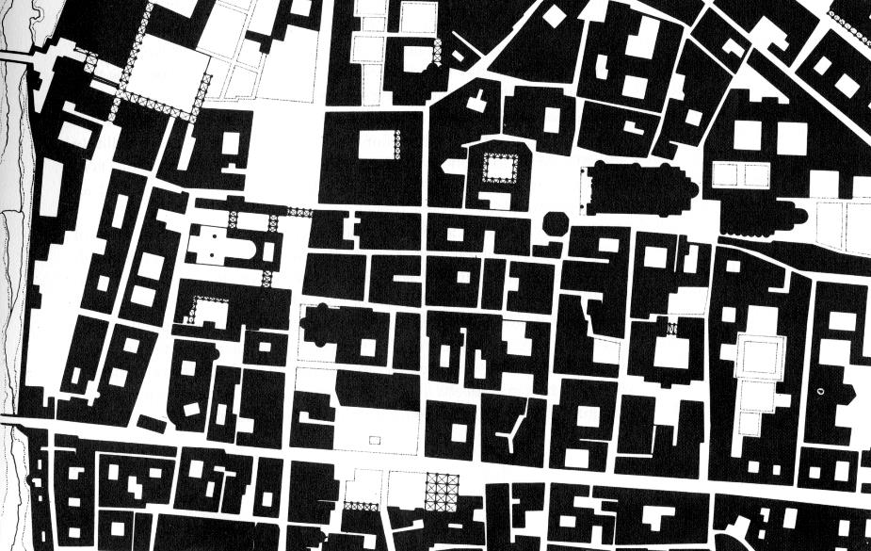
Left: Le Corbusier, Saint-Dié
Right: Parma
Notes:
- Left: a ‘city’ formed purely by objects, Right: a city composed of both

Slide 55
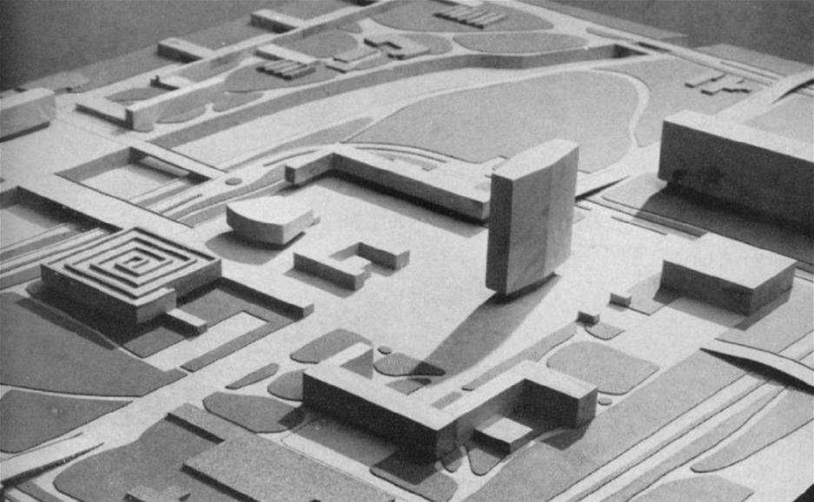
Le Corbusier, Saint-Dié

Slide 56
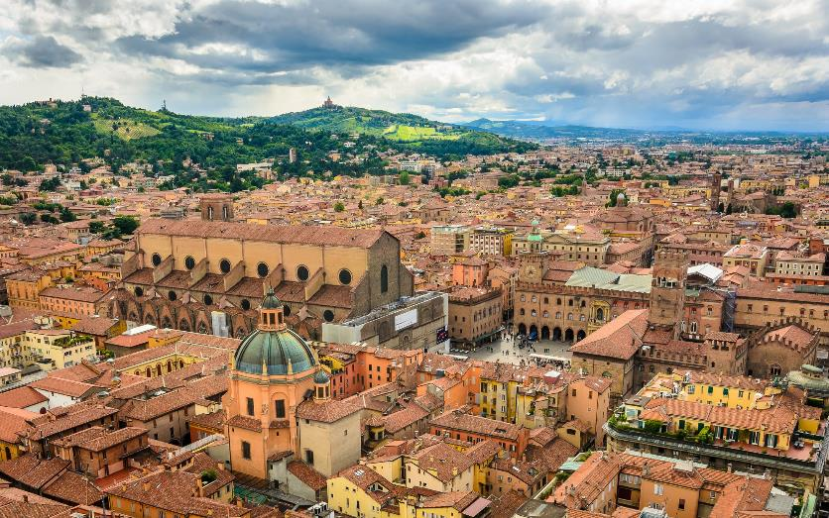
Parma
Notes:
- RK were trying to abstract the significance inherent in older cities, but in a way that architects could apply its lessons to today

Slide 57
Introduction
Utopia: Decline and Fall?
After the Millennium
Crisis of the Object
Collision City and the Politics of ‘Bricolage’
Collage City and the Reconquest of Time

Slide 58
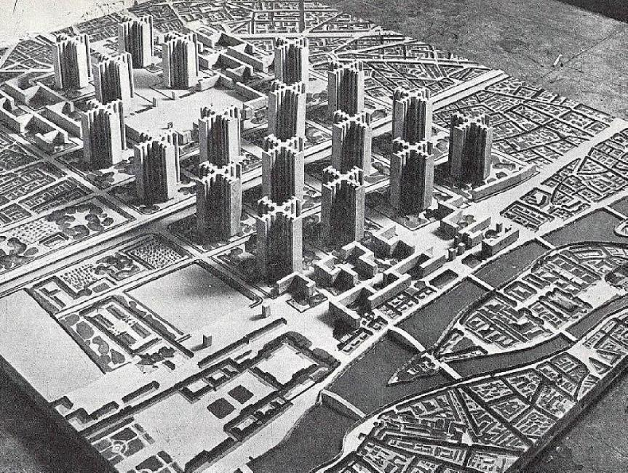
“… in a particularly extreme form, a way in which exclusion may gratify the imagination… Which is quite simply to say that the absolute spatial freedoms of the ville radieuse and its more recent derivatives are without interest: and that, rather than being empowered to walk everywhere – everywhere being always the same – almost certainly it would be more satisfying to be presented with exclusion – wall, railings, fences, gates, barriers – of a reasonably constructed ground plane.”
Rowe and Koetter, Collage City

Slide 59
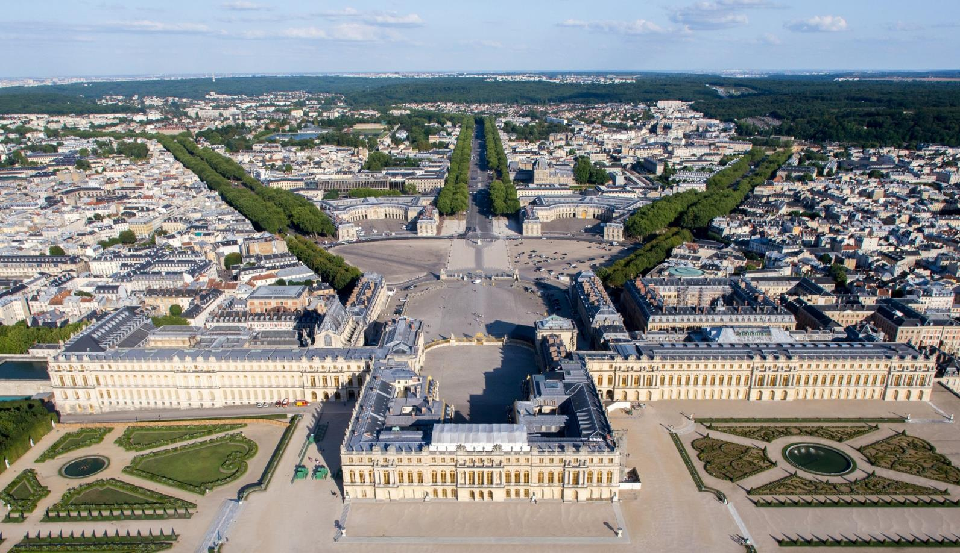
Palace of Versailles, France (1634)
Notes:
A prime example of a ‘city’ made by objects: Palace of Versailles
A rigid top-down order

Slide 60
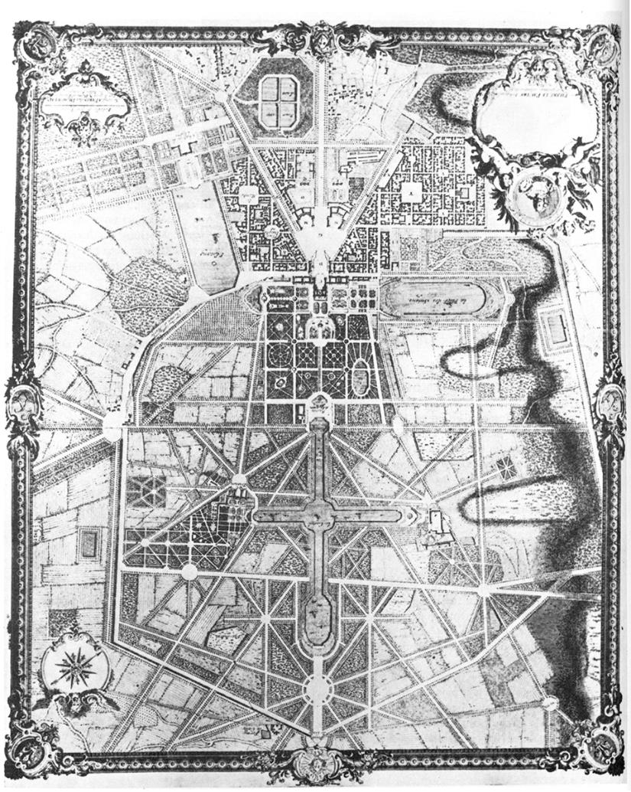
“It is the triumph of generality, the prevalence of the overwhelming idea and the refusal of the exception.”
Palace of Versailles, France (1634)

Slide 61
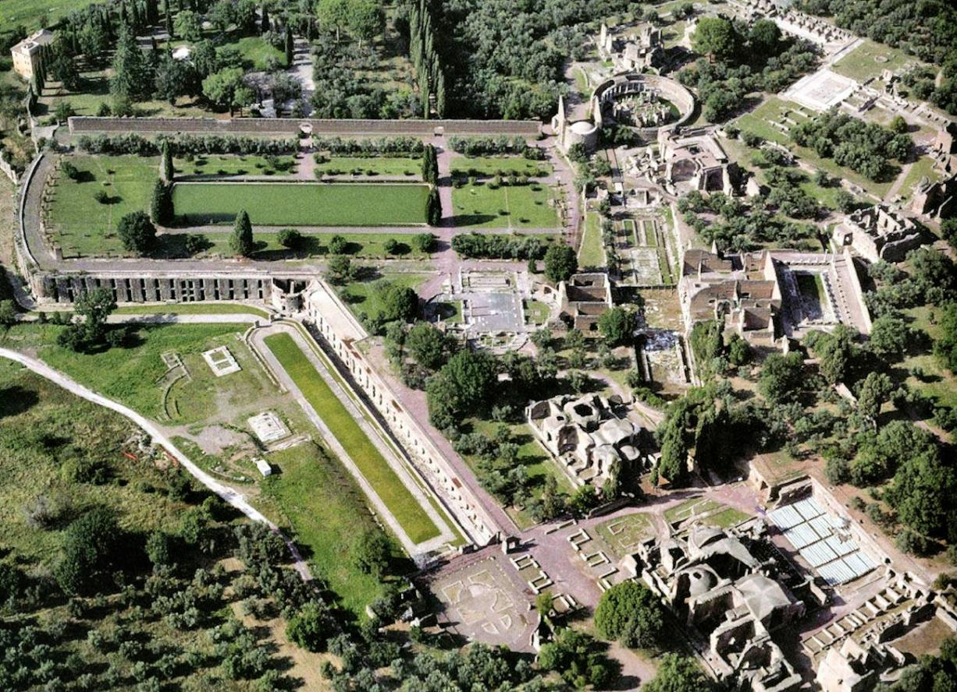
Hadrian’s Villa, Tivoli (Rome), Italy (2nd century AD)
Notes:
The counterpoint to Versailles: Hadrian’s Villa in Rome
A community of buildings, initiated as retreat for the Emperor (Hadrian) towards the beginning of the 2nd century AD
A seeming ‘planless’ complex, predicated on various functions rather than their overall structure

Slide 62
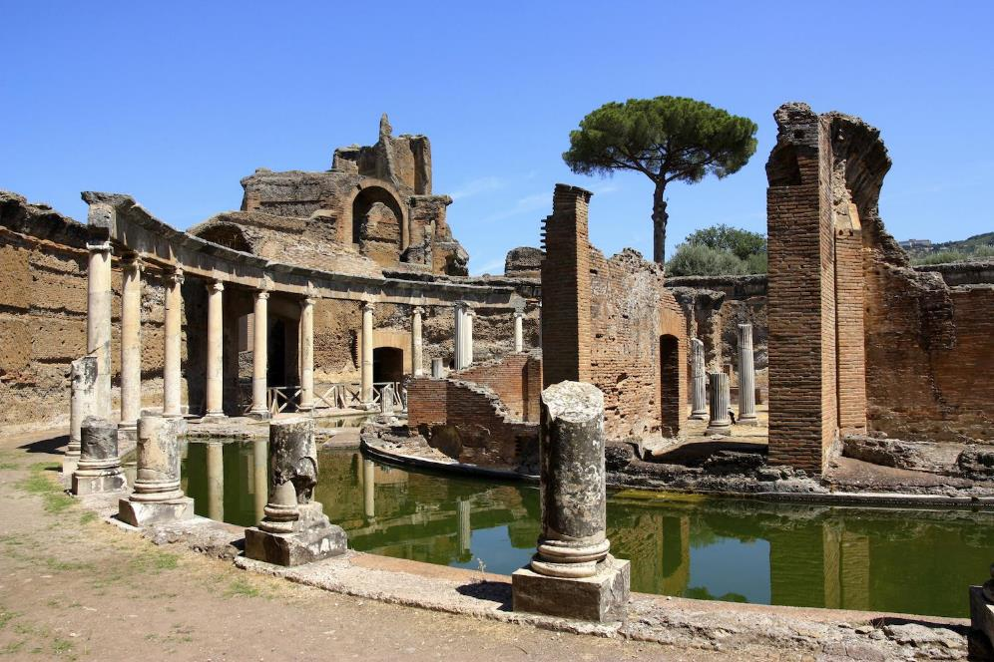
“we have the curiosity of Hadrian – of Hadrian who is, apparently, so disorganized and casual, who proposed the reverse of any ‘totality’, who seems to need only an accumulation of disparate ideal fragments…”
Hadrian’s Villa, Tivoli (Rome), Italy (2nd century AD)

Slide 63
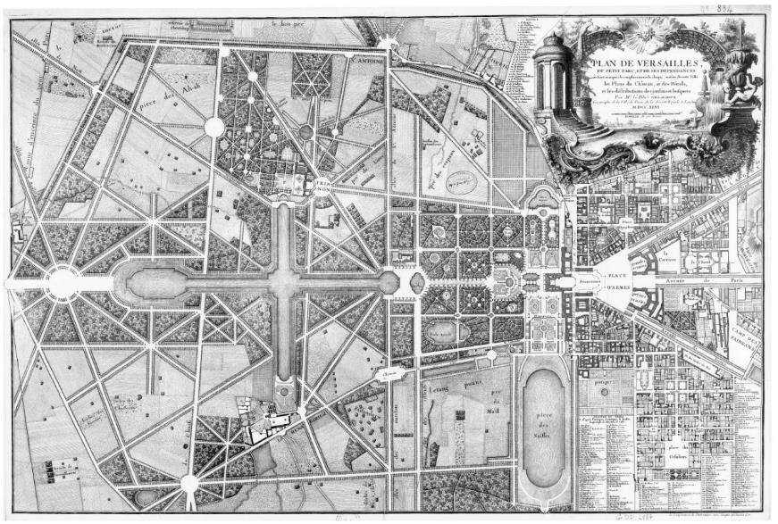
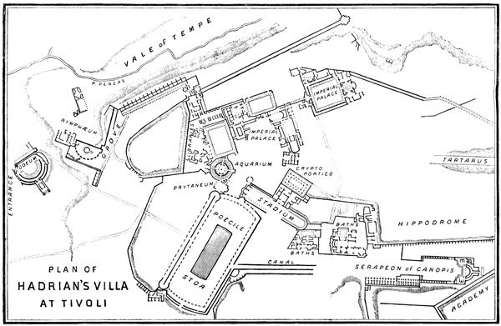
Left: Palace of Versailles, France (1634)
Right: Hadrian’s Villa, Tivoli (Rome), Italy (2nd century AD)
Notes:
- Contrasting the two schemes

Slide 64
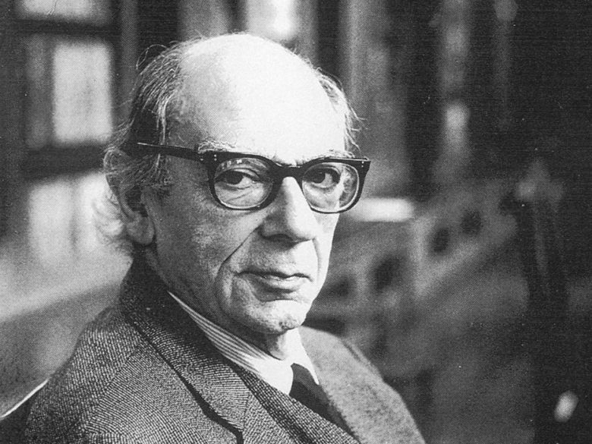
Isaiah Berlin, “The Hedgehog and the Fox” (1953)
Notes:
At this stage, RK shift the conversation for a bit, to describe a corollary to the comparison we’re seeing between Versailles and Hadrian’s Villa
Discussion of a popular book at the time, by Isaiah Berlin

Slide 65
Hedgehog
Fox
Isaiah Berlin, “The Hedgehog and the Fox” (1953)
Notes:
In short, Berlin contrasts how the hedgehog and the fox go about solving problems
Hedgehogs – see the world through a single lens. Tackle problems head-on, through the most direct path. Accordingly, their basic point is generally easily understood.
The approach is to identify the root of problem and resolve it.
Foxes – see the world through multiple lenses, without reducing a problem to a single idea. Complex approach, often frustratingly difficult to understand.
The approach is to identify the manifold of related problems that inform the central problem under consideration… may not have a ‘solution.’
Berlin used well-known individuals to illustrate his point
Hedgehogs – Plato , Nietzsche
Foxes – Aristotle, Goethe, Shakespeare

Slide 66
Hedgehog
Fox
Left: Palace of Versailles, France (1634)
Right: Hadrian’s Villa, Tivoli (Rome), Italy (2nd century AD)
Notes:
Back to architecture
Versailles: Hedgehog
Hadrian’s Villa: Fox

Slide 67
“the open society depends upon the complexity of its parts, upon competing group-centred interests which need not be logical but which, collectively, may not only check each other but may, sometimes, also serve as protective membrane between the individual and the form of collective authority.”

Slide 68
“the open society depends upon the complexity of its parts, upon competing group-centred interests which need not be logical but which, collectively, may not only check each other but may, sometimes, also serve as protective membrane between the individual and the form of collective authority.”
“But it [collision] does not suppose that, in the absence of total design merely random procedures can be expected to flourish. Instead, whatever may be the empirical and whatever may be the ideal (and both positions can be distorted by intellectual passion or self-interest to appear their opposites), the ongoing thesis presumes the possibility and the need for a two-way argument between these polar extremes.”

Slide 69
Introduction
Utopia: Decline and Fall?
After the Millennium
Crisis of the Object
Collision City and the Politics of ‘Bricolage’
Collage City and the Reconquest of Time

Slide 70
Bricolage
Notes:
This chapter focused around the term Bricolage
Bricolage, in short, is a conceptual model for ‘Collage’… “Collage City”

Slide 71
STRATEGIES OF BRICOLAGE
Cross-breeding
Assimilation
Distortion
Challenge
Response
Imposition
Superimposition
Conciliation

Slide 72
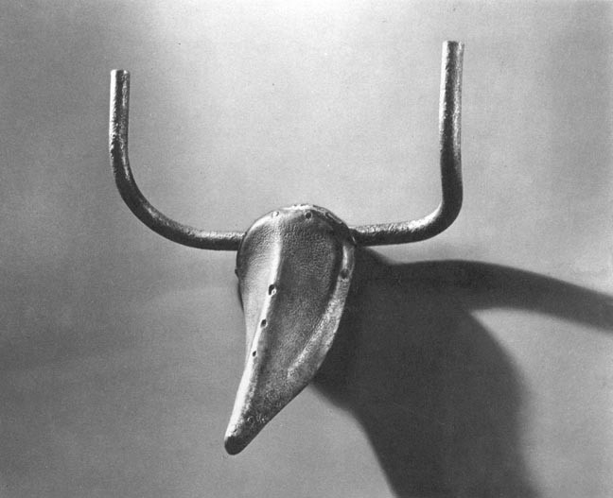
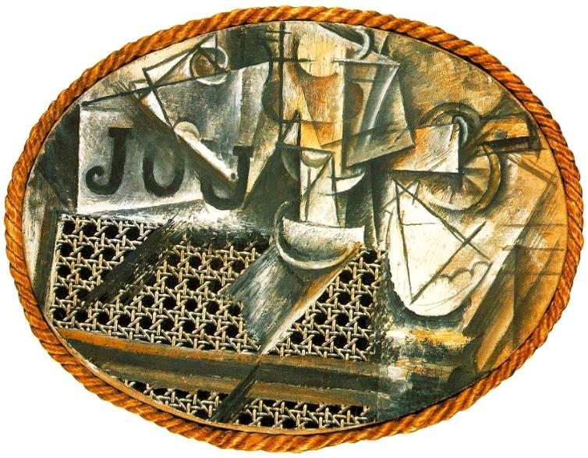
Left: Pablo Picasso, Bull’s Head (1944)
Right: Pablo Picasso, Still Life with Chair Caning (1911-12)
Notes:
Examples of bricolage
Misuse of parts to create another whole

Slide 73
“Disparate objects held together by various means, ‘physical, optical, psychological.”
Left: Pablo Picasso, Bull’s Head (1944)
Right: Pablo Picasso, Still Life with Chair Caning (1911-12)

Slide 74
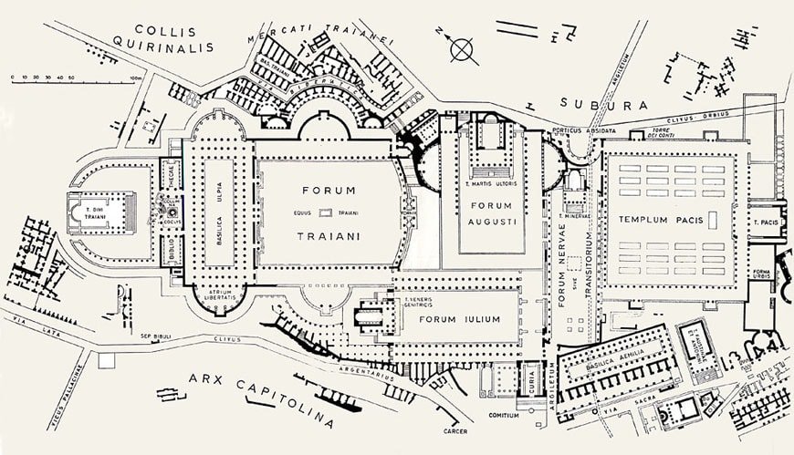
Left: The Imperial Fora, Rome
Right: Hadrian’s Villa, Tivoli (Rome)
Notes:
Return to Hadrian’s Villa
The accumulation of “disparate objects”

Slide 75
Left: Wiesbaden, Germany (plan c. 1900)
Right: Hadrian’s Villa, Tivoli (Rome)
Notes:
- Figure/Ground representation of bricolage applied to the city

Slide 76
“the idea that collage technique, by accommodating a whole range of axes mundi […] might be a means of permitting us the enjoyment of utopian poetics without our being obliged to suffer the embarrassment of utopian politics.”

Slide 77
“because collage is a method deriving its virtue from its irony, because it seems to be a technique for using things and simultaneously disbelieving in them, it is also a strategy which can allow utopia to be dealt with as image, to be dealt with in fragments without our having to accept it in toto, which is further to suggest that collage could even be a strategy which, by supporting the utopian illusion of changelessness and finality, might even fuel a reality of change, motion, action and history.”

Slide 78
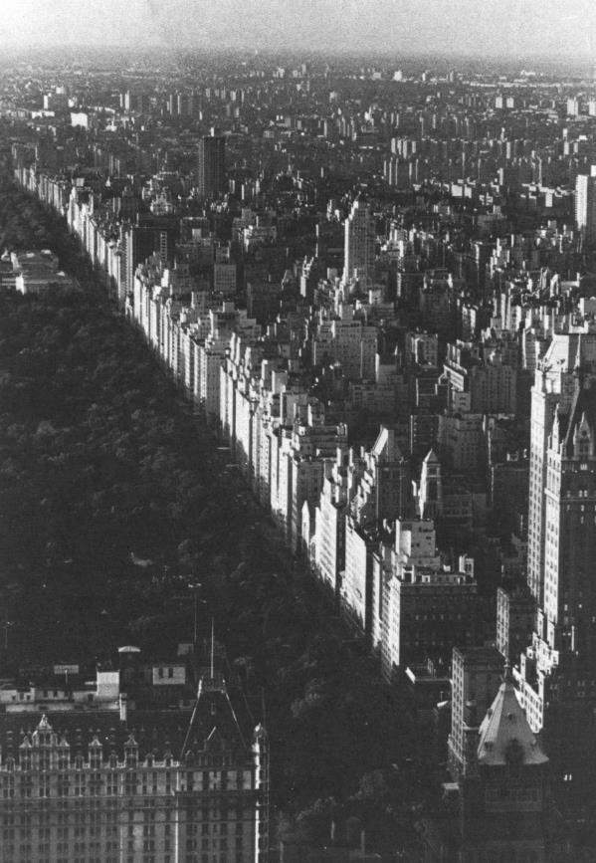
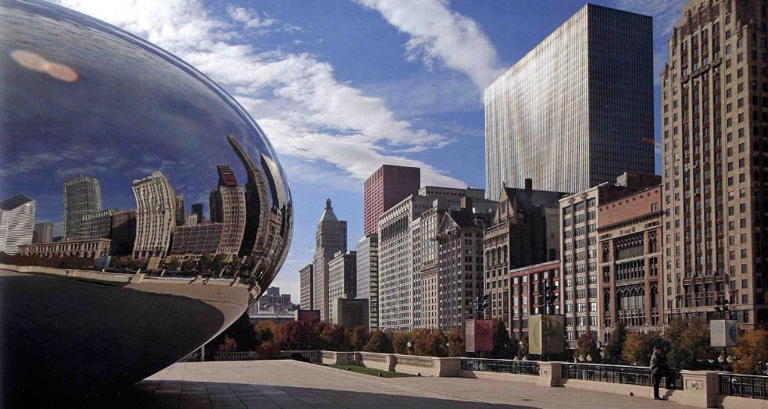
Memorable Streets
Left: 5th Ave facing Central Park, NYC
Right: Michigan Ave, Chicago

Slide 79
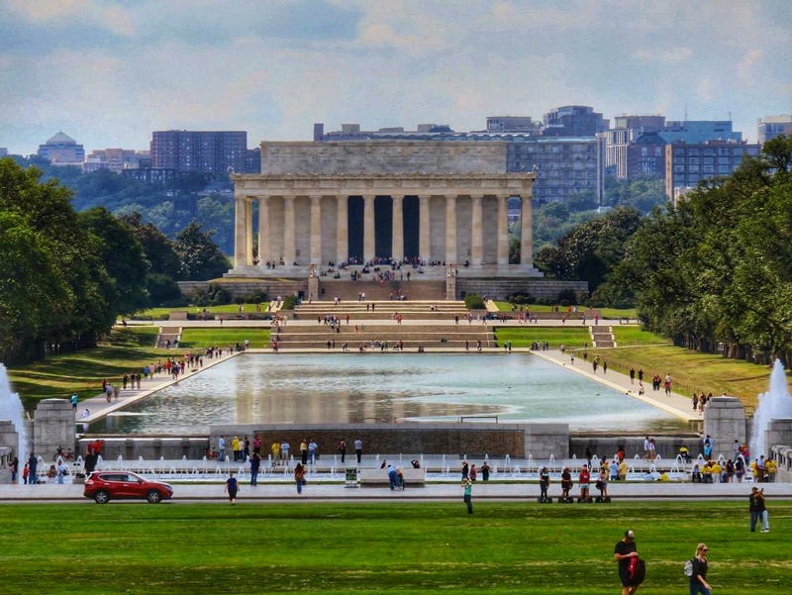
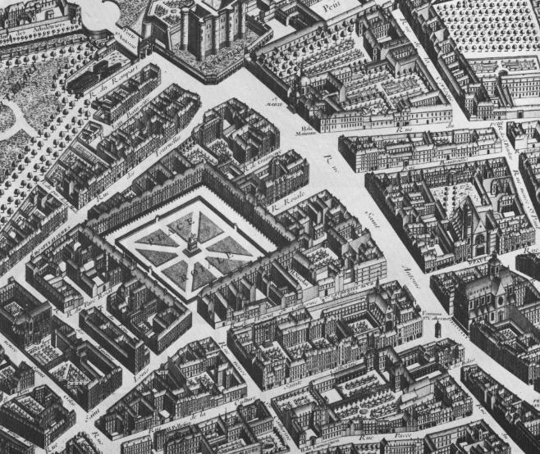
Stabilizers
Left: Place des Vosges, Paris
Right: National Mall, Washington DC

Slide 80
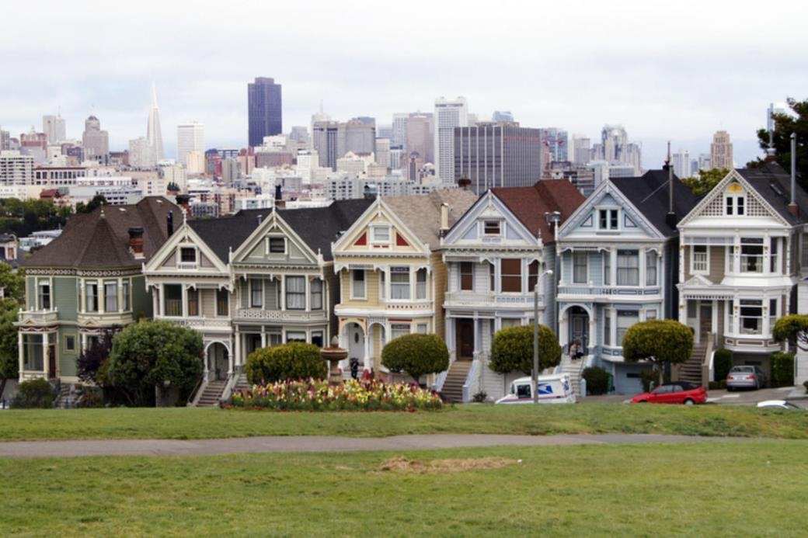
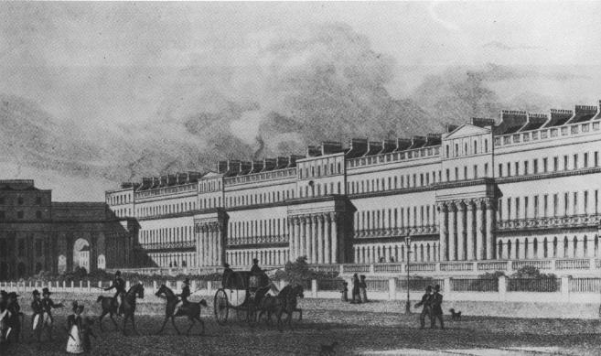
Potentially Interminable Set Pieces
Left: Chester Terrace, London
Right: San Francisco

Slide 81
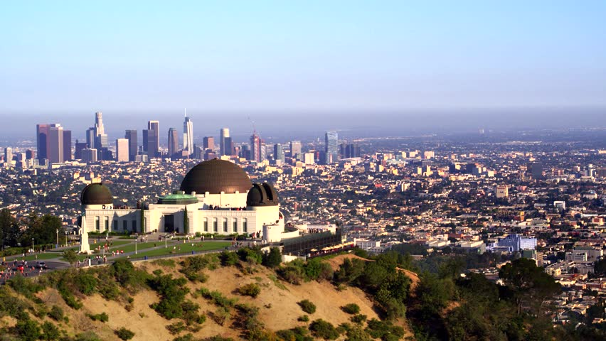
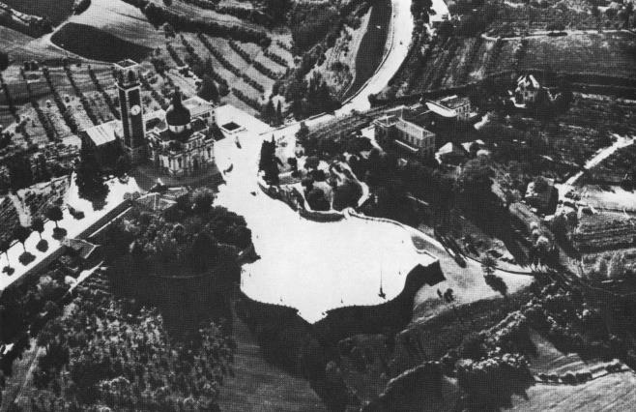
Splendid Public Terraces
Left: Vicenza, Piazzale Monte Berico
Right: Griffith Park Observatory, Los Angeles

Slide 82
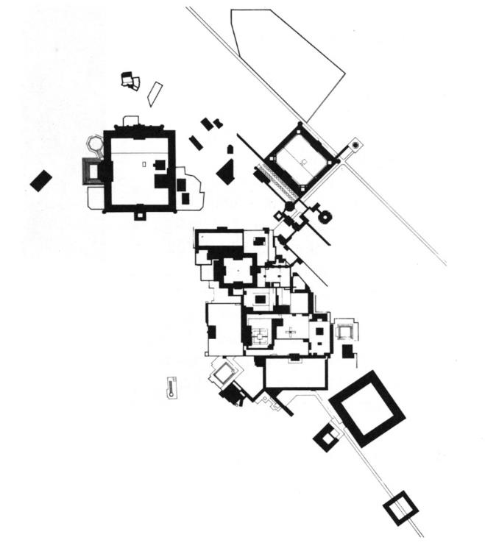
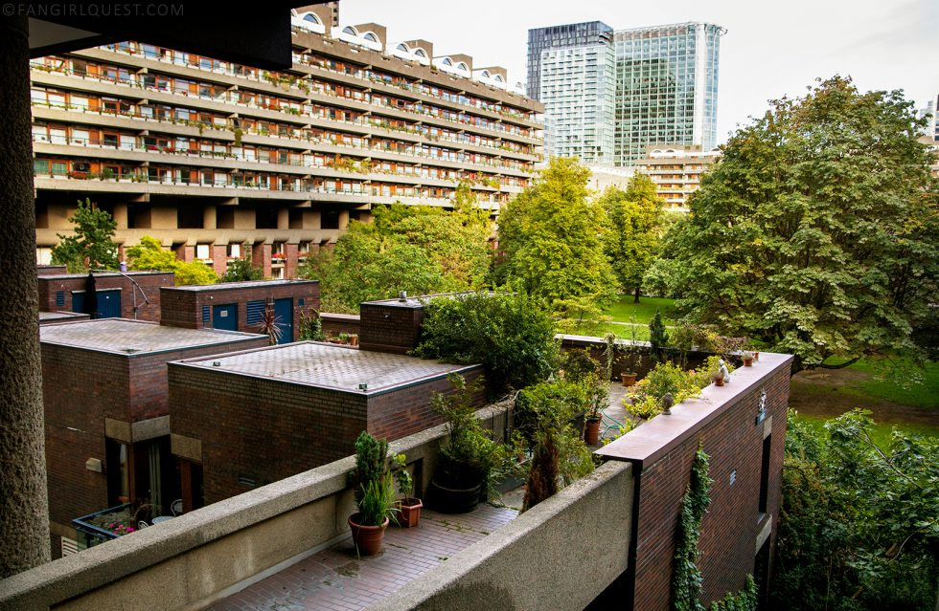
Ambiguous and Composite Buildings
Left: Fatephur Sikri, India
Right: The Barbican Development, London

Slide 83
Nostalgia-Producing Instruments
Left: Pyramid of Caius Cestius, Rome
Right: Steel Stacks, Bethelehem, PA

Slide 84
The Garden
Left: Chateau of the Bishops of Langres, France
Right: Central Park, NYC

