Slide 1
The City
Part 3 of 3 (Rossi)
Contemporary Architecture Theory
Eugene Han
Fall 2020, 11:15 – 12:30 pm
Online Instruction
Notes:
Last part of the City

Slide 2
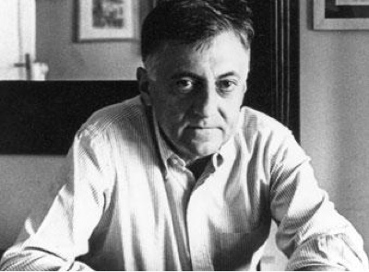
Aldo Rossi
Italian; 1931 - 1997
Notes:
Heavily theoretical, although he did build
In a broad stroke, his theory was about how architectural was necessarily historical

Slide 3
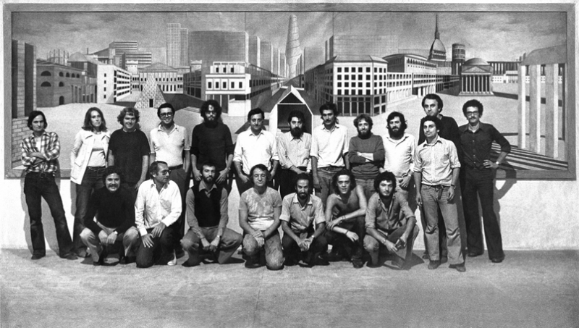
‘La Tendenza’ Group (1965 – 85)
Notes:
1. Represented a group called ‘La Tendenza’ (the tendency – the trend) [1965 -85]
La Tendenza arose from post-war Italy
Strongest Italian architectural movement from after WWII
Rejected the idea of utopia
Favored political/critical architecture based on reality
Role of the city in relation to architecture (inseparable)
To speak of architecture was to speak of buildings AND city
Venice was its epicenter
Also known as ‘The Venice School’
IUAV – Aldo Rossi, Carlo Scarpa, Manfredo Tafuri, Giancarlo De Carlo

Slide 4
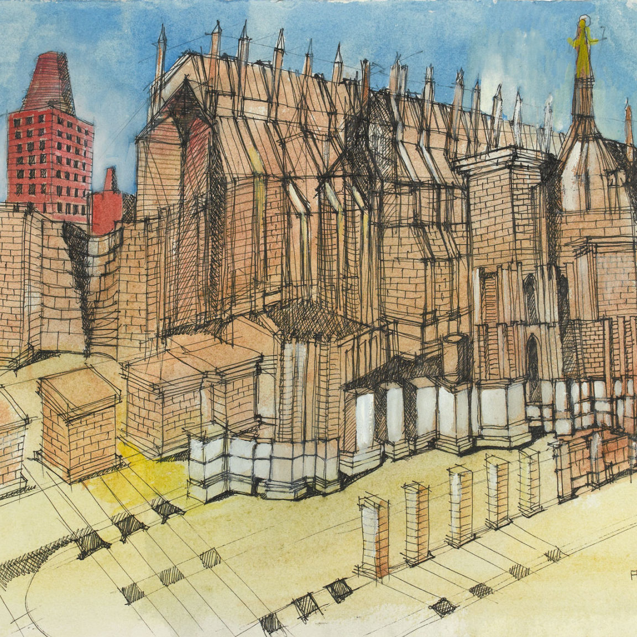
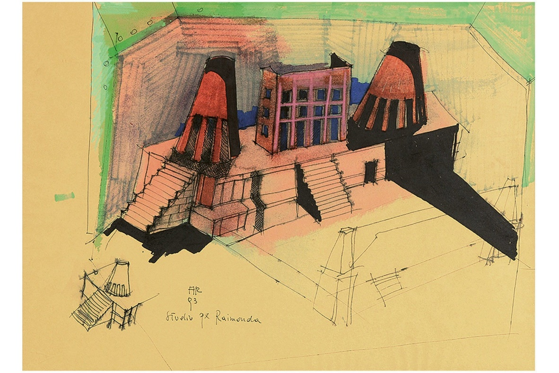
Aldo Rossi, untitled sketch (left: 1994, right: 1993)
Notes:
While his written work forms the major part of his legacy, he developed a rich drawing portfolio

Slide 5
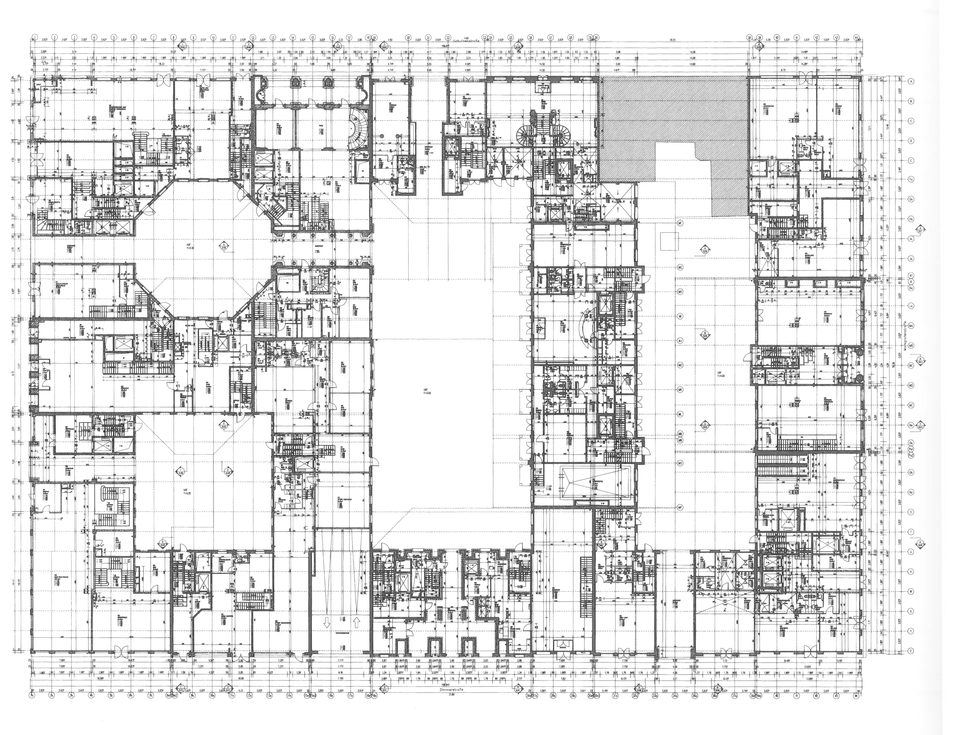
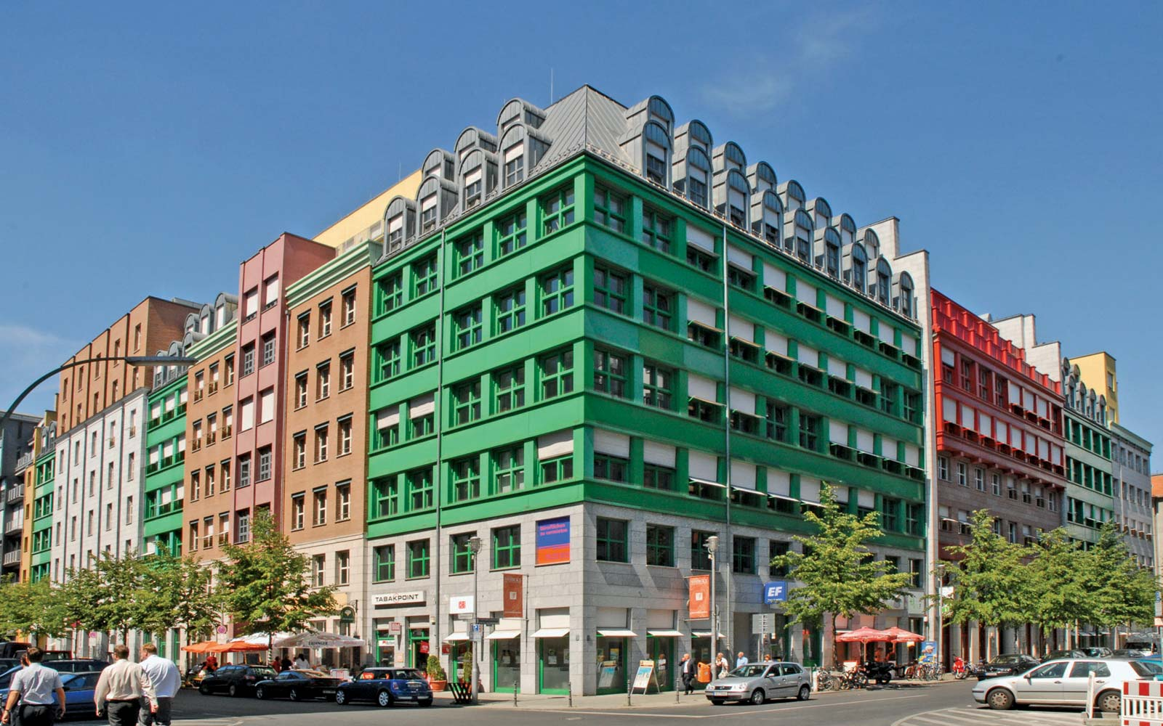
Aldo Rossi, Quartier Schützenstrasse, Berlin, Germany (1981-88)
Notes:
And builder, though much more strongly present in Europe

Slide 6
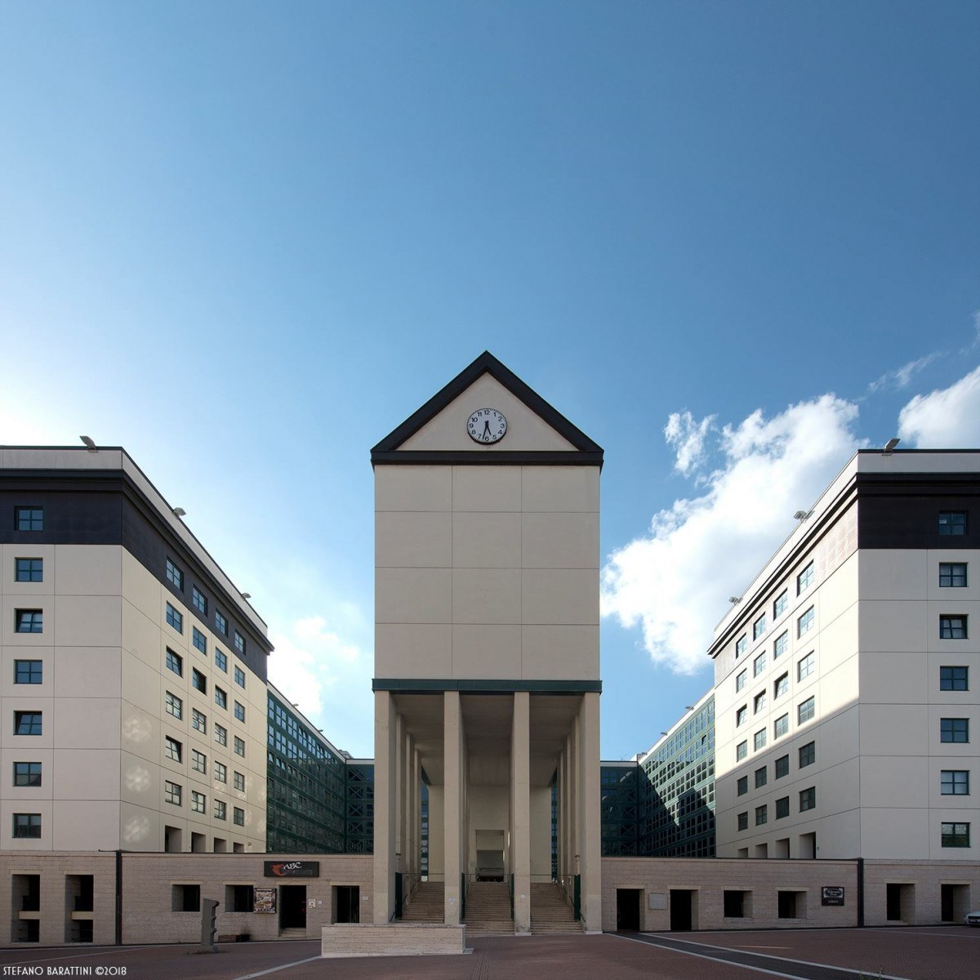
Aldo Rossi, Centro Direzionale e commerciale Fontivegge, Modena, Italy (1971)
Notes:
Buildings were often devoted to larger works, such as office complexes, residential blocks…

Slide 7
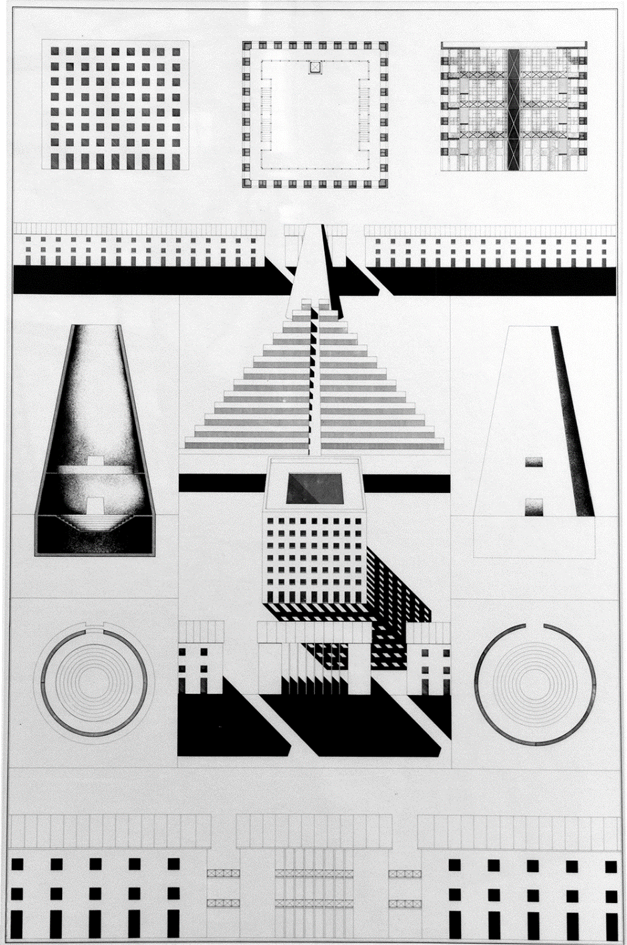
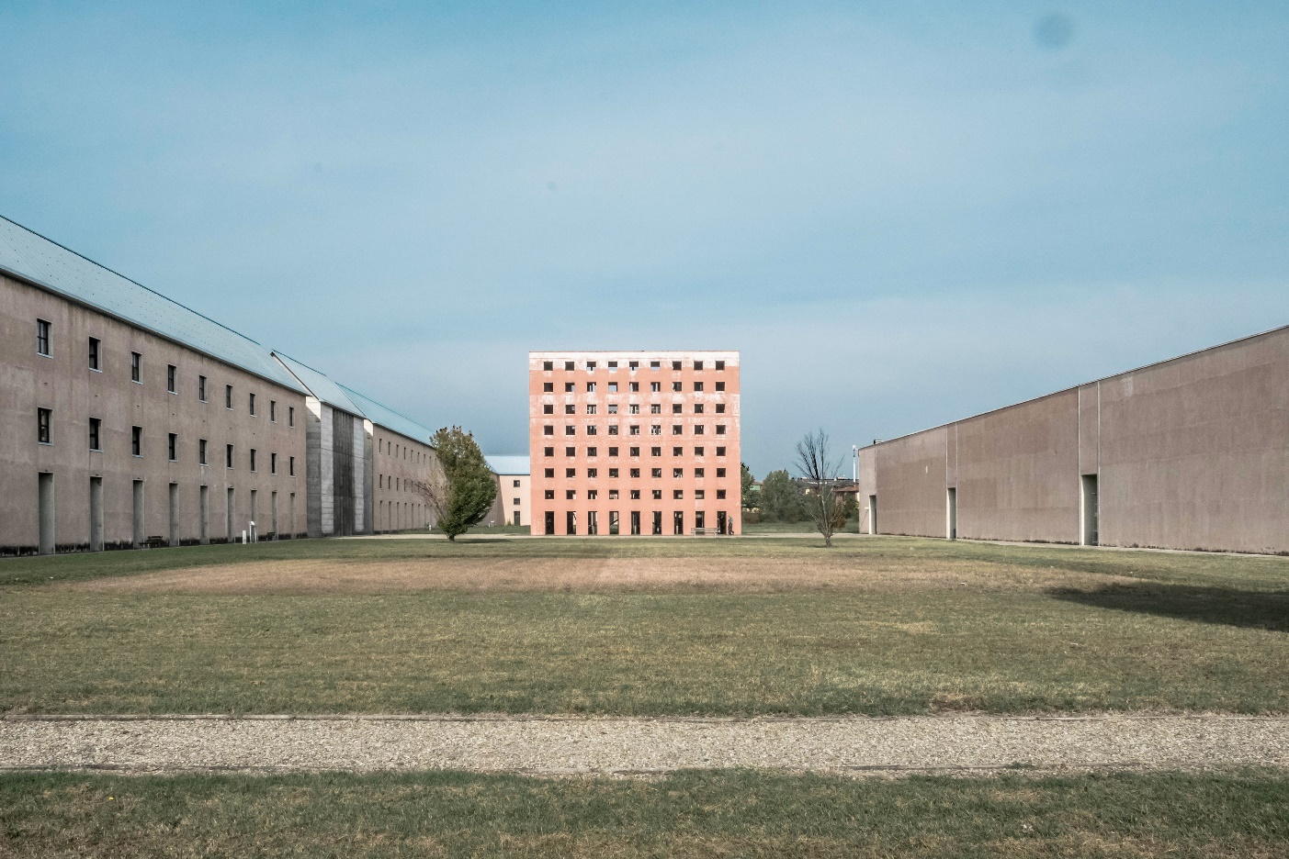
Aldo Rossi, San Cataldo Cemetery, Modena, Italy (1971)
Notes:
And one of his most famous projects, a cemetery in Modena
So, like all the architects that we studied in ‘The City’ section, Rossi’s theory is predicated on a reaction to Modernism
But closer to Rowe/Koetter, Rossi recognized Modernism’s overall contribution, yet he couldn’t overlook what he considered a couple critical shortcomings.

Slide 8
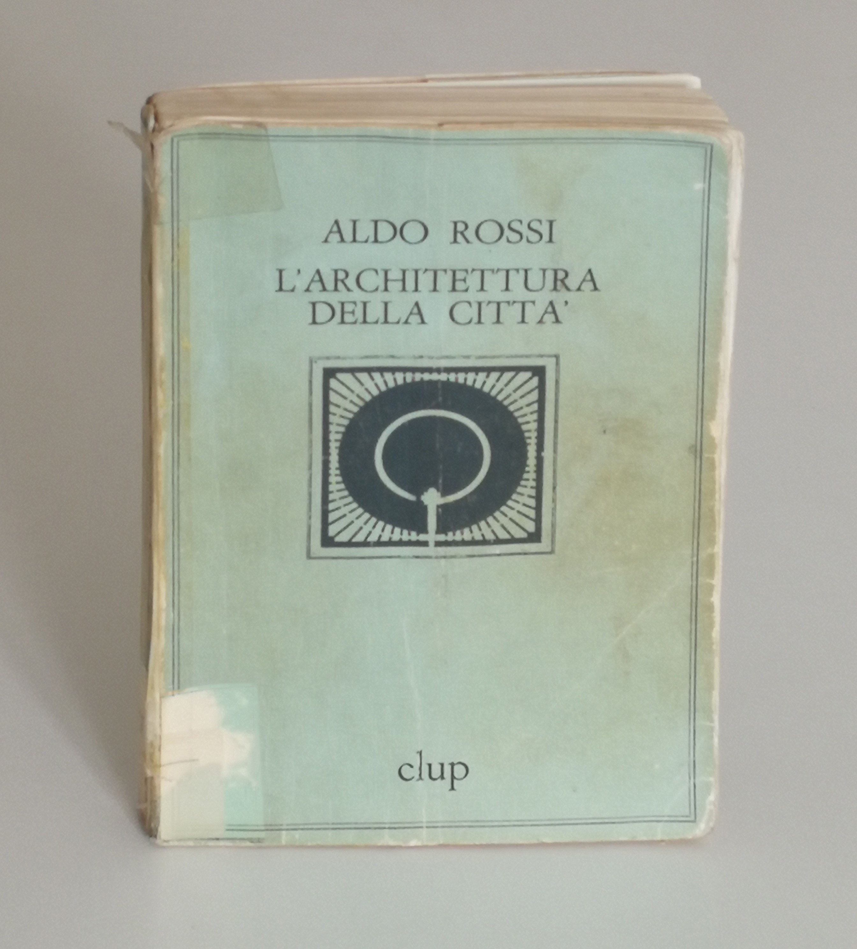
Typology
Elements
Locus
Politics and Choice
Aldo Rossi, The Architecture of the City (1966)
Notes:
But the most famous ‘project’ of his was ‘L’architettura della citta’’ – The Architecture of the City
Like Collage City, we’ll muscle through each topic, and cover the book as any building
Organized into 4 parts
Typology
Elements
Locus
Politics and Choice

Slide 9
3 Propositions
The city has a temporal dimension
All areas of a city are continuous
Within the city, there are primary elements that can retard/accelerate the city’s own processes
Refer page 63
Notes:
3 Propositions to the City that summarize Rossi’s approach

Slide 10
FUNCTIONALISM
Notes:
Functionalism
­First, there was the problem of Functionalism
Rossi believed that the Modernists’ ambition to make architecture ‘machine-like’ reduced the architectural project to a mere function
He called this: ‘Naïve Functionalism’

Slide 11
“Through them [functionalism and organicism] form is divested of its most complex derivations: type is reduced to a simple scheme of organization, a diagram of circulation routes, and architecture is seen as possessing no autonomous value.” [46]
Notes:
His criticism was simply that architecture was incredibly rich with many influence, but to reduce it to a mere machine was to take away all of its complexities…

Slide 12
“Through them [functionalism and organicism] form is divested of its most complex derivations: type is reduced to a simple scheme of organization, a diagram of circulation routes, and architecture is seen as possessing no autonomous value.” [46]
“The question “for what purpose?” ends up as a simple justification that prevents an analysis of what is real.” [46]
Notes:
Likewise, <<Quote… “The question “for what purpose?”…>>
As if an architectural work that functioned as ‘promised’ was equivalent to good architecture – not equivalent!
Organicism
Refer to page 56
“derived from biology”, relating the city to a human body

Slide 13
Functionalism:
“What does it do?”
Notes:
“what does it do?”

Slide 14
Functionalism:
“What does it do?”
Functionalism:
“Why is it?”
Notes:
“Why is it?”

Slide 15
Functionalism:
“What does it do?”
Functionalism:
“Why is it?”
“What is it?”
Notes:
<…>

Slide 16
Functionalism:
“What does it do?”
Functionalism:
“Why is it?”
“What is it?”
“When is it?”
Notes:
Maybe most curious, “When is it?”

Slide 17
MONUMENTS
Notes:
To understand Rossi’s argument against Functionalism, he presented his idea of Monuments.

Slide 18
“they are a past that we are still experiencing.” [59]
Notes:
He stated that <<Quote… “they are a past that we are still experience.” [59]>>
So an idea of ‘history’ embodied in a physical structure

Slide 19
“they are a past that we are still experiencing.” [59]
‘PERSISTENCES’
Notes:
The term ‘Persistences’ is critical in understanding why Monuments formed a central part of his understanding of Architecture and the City
Monuments were significant not because they were large or located in a prominent location, but because they gave definition to the formal appearance of the city, persisting through time.

Slide 20
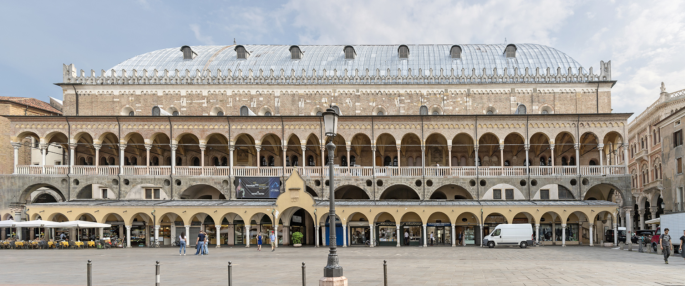
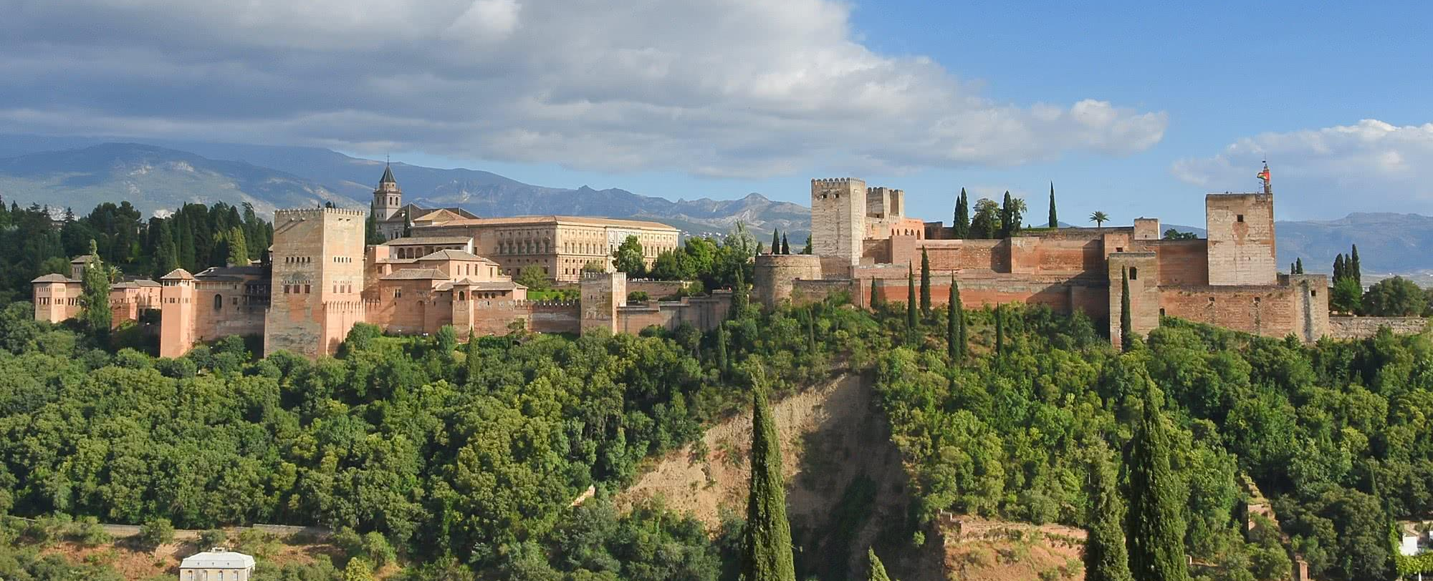
“they are a past that we are still experiencing.” [59]
‘PERSISTENCES’
‘PROPELLING ELEMENTS’
‘PATHOLOGICAL ELEMENTS’
Palazzo della Ragione, Padua, Italy
Alhambra, Granada, Spain
Notes:
In dissecting the nature of persistences, he defined 2 variations
The first being ‘PROPELLING ELEMENTS’
And the second as ‘PATHOLOGICAL ELEMENTS’
As the names suggest, propelling elements move a city forward, while pathological, rather than relating it to disease, should be thought of abnormal, or stunting

Slide 21
“permanence I mean not only that one can still experience the form of the past in this monument but that the physical form of the past has assumed different functions and has continued to function, conditioning the urban area in which it stands and continuing to constitute an important urban focus.” [59]
‘PROPELLING ELEMENTS’
Palazzo della Ragione, Padua, Italy
Notes:
For Propelling elements, he singled at the Palazzo della Ragione in Padua, stating that by <<Quote…>

Slide 22
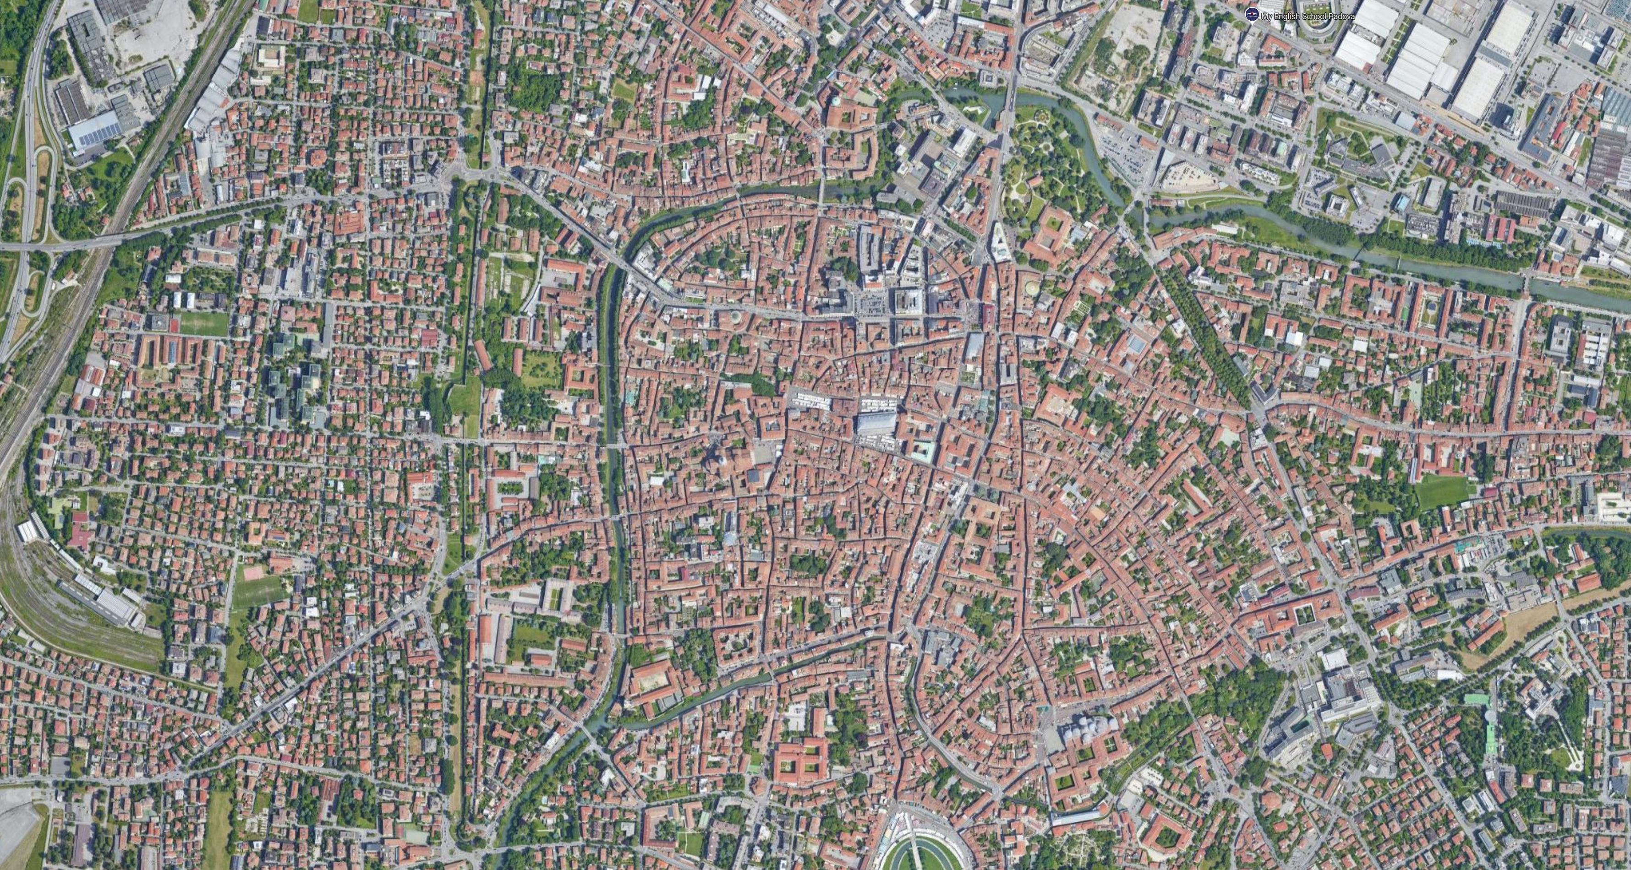
Notes:
Here we see an aerial photo of the Palazzo in Padua, and you can see how centrally, how embedded it is within the larger context of the city.

Slide 23
“it stands virtually isolated in the city; nothing can be added.” [60]
‘PATHOLOGICAL ELEMENTS’
Alhambra, Granada, Spain
Notes:
On the other hand, for Pathological Elements he looked at the Alhambra in Spain, stating that <<Quote… it stands virtually isolated in the city; nothing can be added>>

Slide 24
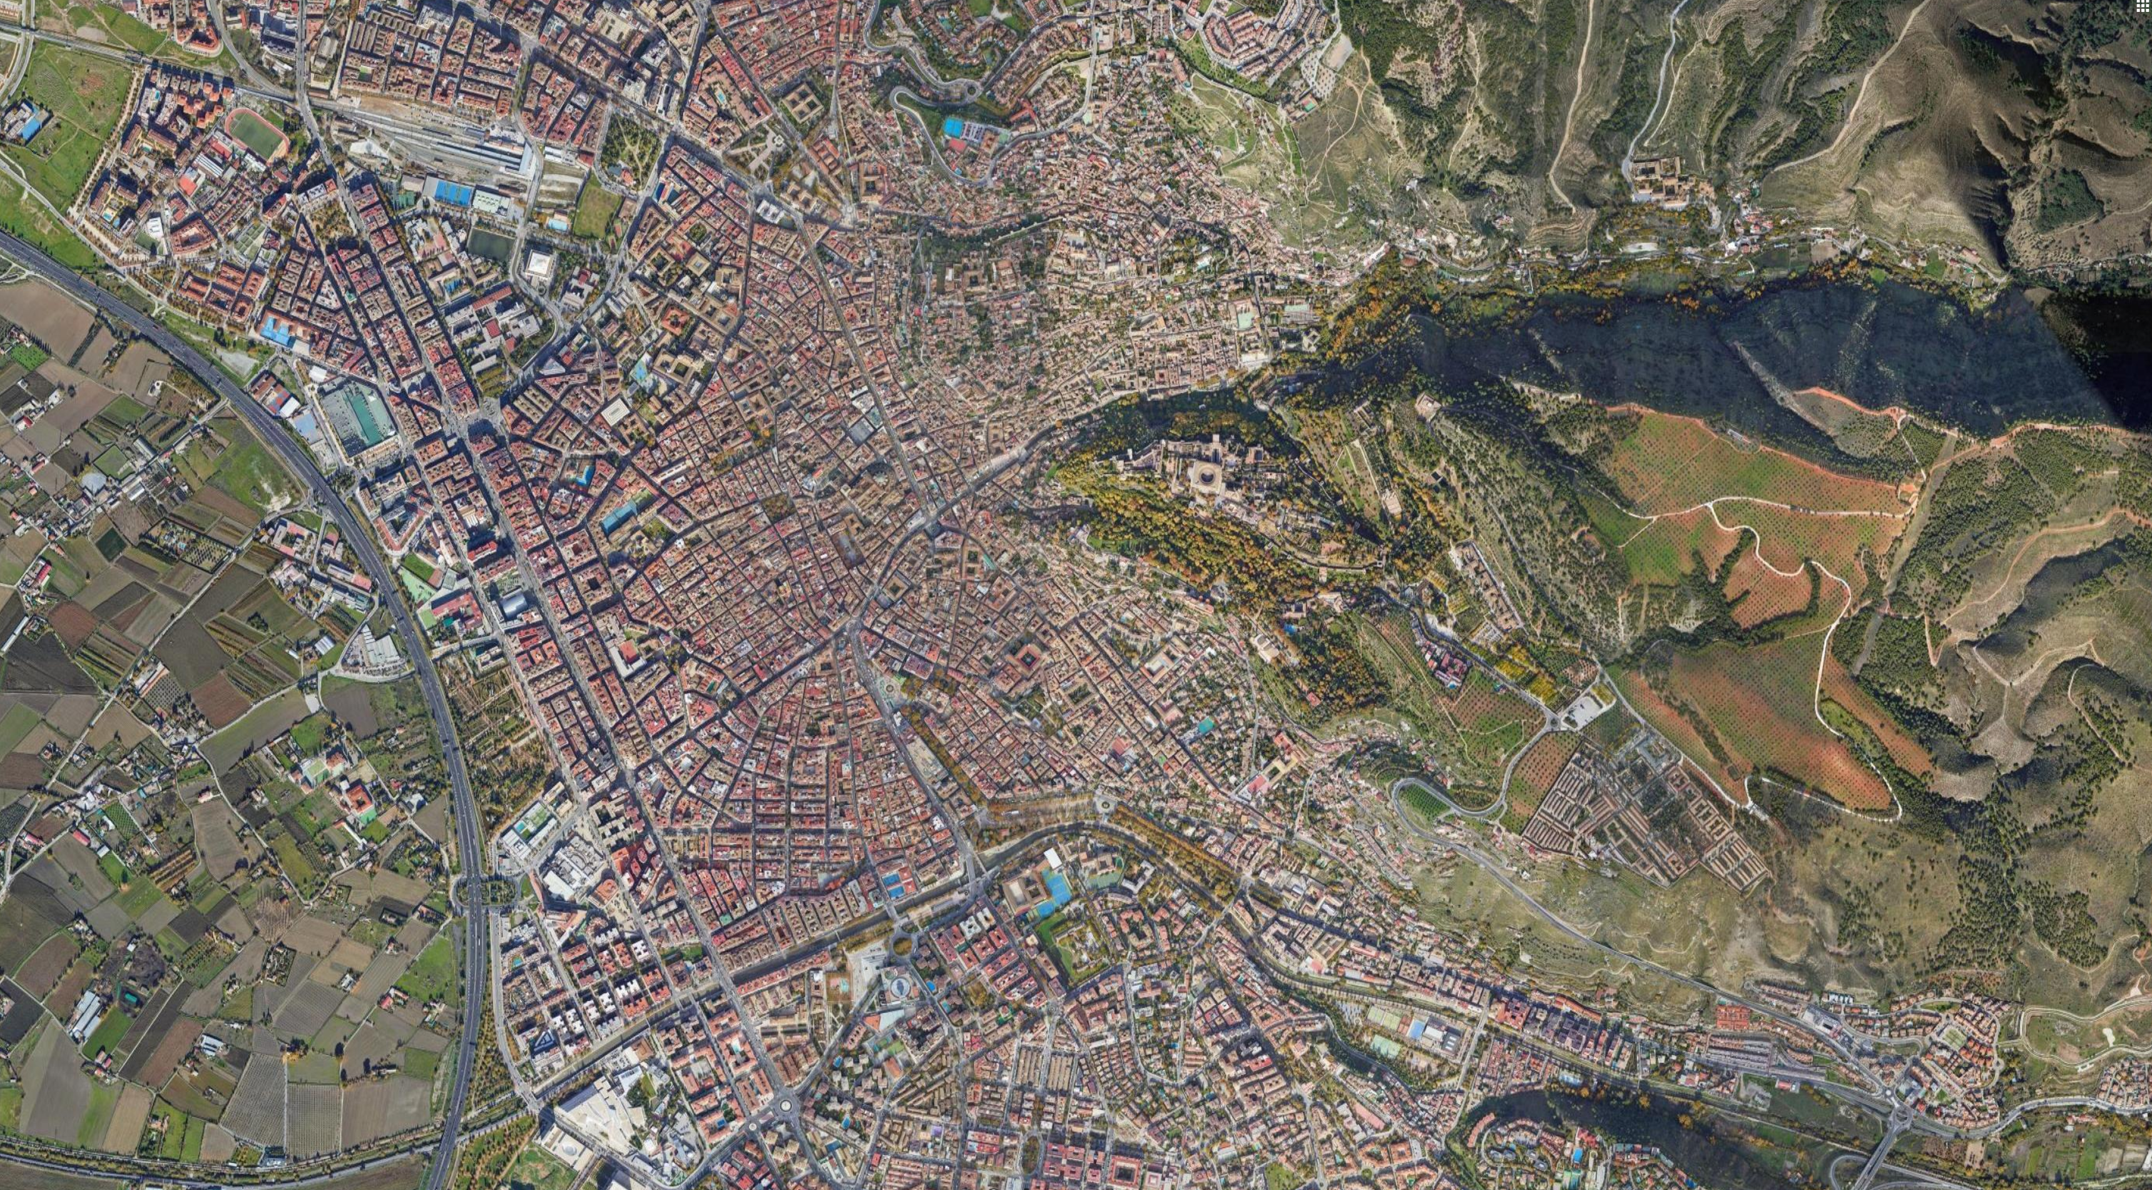
Notes:
When we look at the aerial of the Alhambra, we can see the separation between the city and itself
It’s clearly ever present in the background, but Rossi claims that it acts more as an exception rather than as something which actively engages with the city.
In large part this is conditioned by the topography

Slide 25
“But in both cases the urban artifacts are a part of the city that cannot be suppressed because they constitute it.” [60]
‘PERSISTENCES’
‘PROPELLING ELEMENTS’
‘PATHOLOGICAL ELEMENTS’
Palazzo della Ragione, Padua, Italy
Alhambra, Granada, Spain
Notes:
But it’s not so much a question of good vs. bad, but that Monuments – propelling in particular - help to define the memory of cities by evolving cities
<<Quote…>

Slide 26
“A monument’s persistence or permanence is a result of its capacity to constitute the city, its history and art, its being and memory.”
‘PERSISTENCES’
‘PROPELLING ELEMENTS’
‘PATHOLOGICAL ELEMENTS’
Palazzo della Ragione, Padua, Italy
Alhambra, Granada, Spain
Notes:
Moreover, <<Quote…>>

Slide 27
“the dynamic process of the city tends more to evolution than preservation, and that in evolution monuments are not only preserved but continuously presented as propelling elements of development.” [60]
Notes:
So in summary as to why Rossi singles out Monuments, he stated that <<Quote…>>
Monuments are continuously ‘presented’ through the evolution of the city.
Importantly, this preservation/presenting dichotic has nothing to do about function.
Just because a building has a function, and even that its form was resolved with a certain function in mind, doesn’t make that work of architecture defined principally by its functional role.
Going beyond architecture as a machine idea.
In both the Palazzo della Ragione and the Alhambra, function was pliable throughout history

Slide 28
The ‘Study Area’
[64]
Notes:
The ‘study area’
Rossi wants to clarify the scope/scale in how cities should studied

Slide 29
While there is an overall plan of a city, one should operate only on parts.
[64]
Notes:
He outlined 2 particular propositions as they related to his conception of the city
First, that while there is an overall plan of the city, you can only operate it on parts

Slide 30
While there is an overall plan of a city, one should operate only on parts.
The city cannot be reduced to a single idea.
[64]
Notes:
And second, that the city cannot be reduced to a single idea.
The city is far too complex to reduce.

Slide 31
ZONING
[64]
Notes:
These two premises regarding how the city should be approached (by the architect) goes against what Rossi considered a quintessential Modernist and Functionalist practice: Zoning
Not that it’s inherently wrong, but inherently a weak approach.

Slide 32
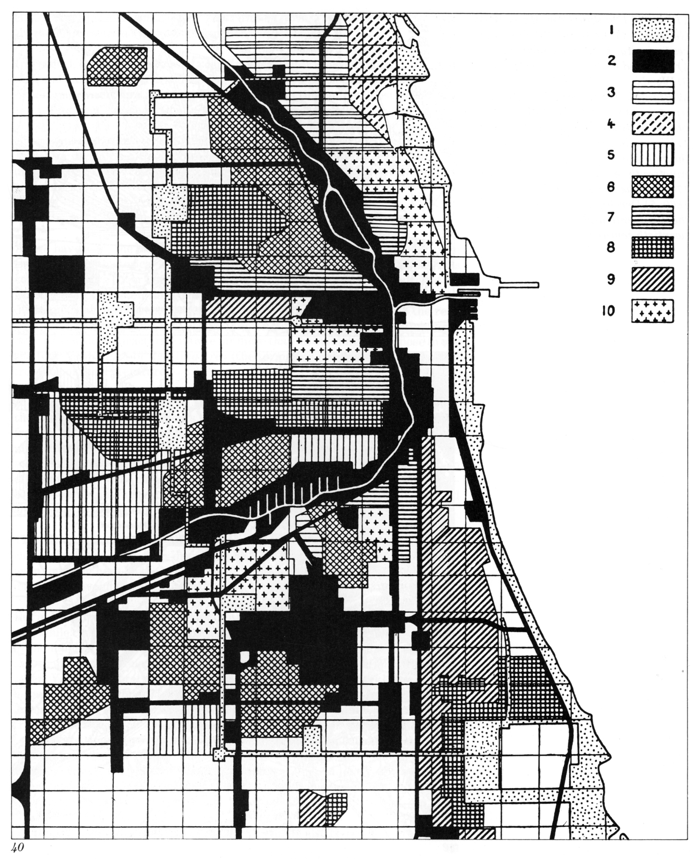
“This theory [zoning] is limiting in that it conceives of the city as a series of moments which can be compared in a simple way and which can be resolved on the basis of a simple rule of functional differentiation” [66]
Zoning of Chicago [66]
Notes:
<<Quote…>>
This ‘functional differentiation’ goes back to Rossi’s original critique
Here, that a zone is meant ‘to do something’ (functional) rather than ‘be something’

Slide 33
Housing Typologies
Notes:
Rossi considered housing as a critical part of the city, in that it forms its essential ‘substance,’ the significant ‘stuff’, the ‘filler’ that gives shape to cities.
He goes through a few examples, some housing typologies in Berlin, from Blocks to Villas – again, the point here is not to specify different housing types and to judge their merits, but simply to show that housing typologies can vary drastically, and when a lot of them are put together, can begin to give form to large swathes of a city.

Slide 34
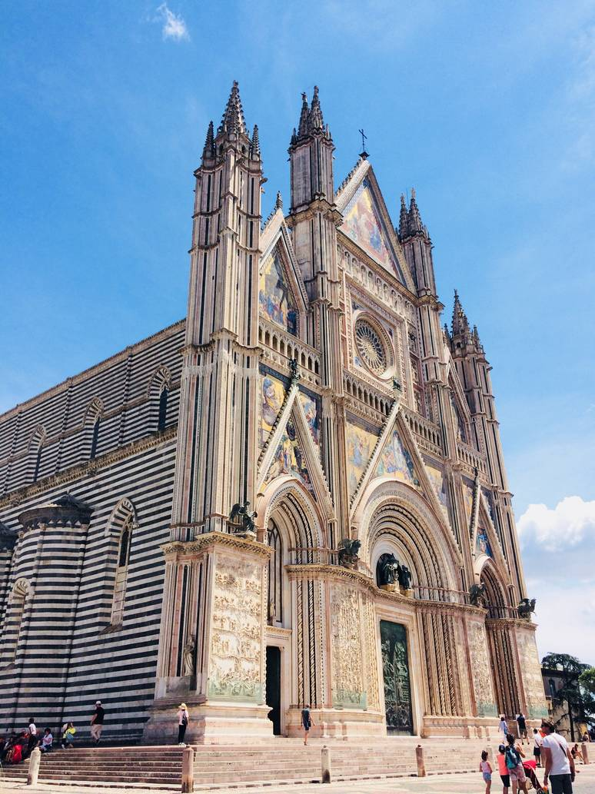
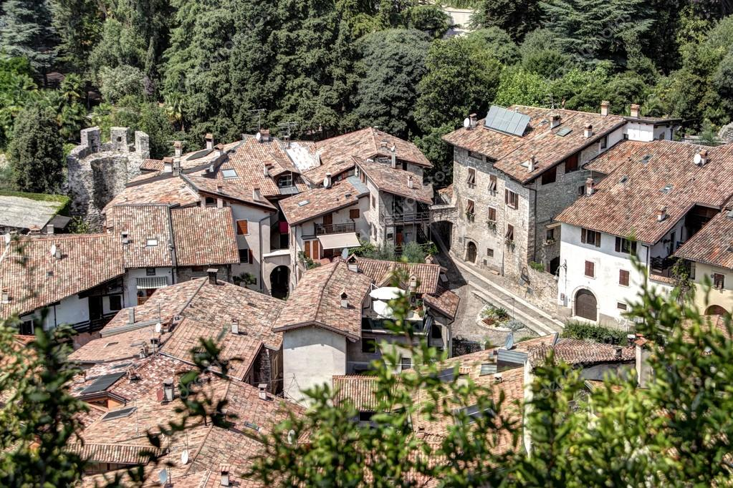
Left: Monuments – Public, Symbolic, Conventional
Right: Housing – Private, Personal
Notes:
The main issue here is not the enumeration of housing typologies, but that there are two kinds of ‘players’ in the city: Monuments and Housing, and together they form a dynamic, they condition the city as something in tension rather than as static.
Think of Rowe’s dichotic of Texture and Object

Slide 35
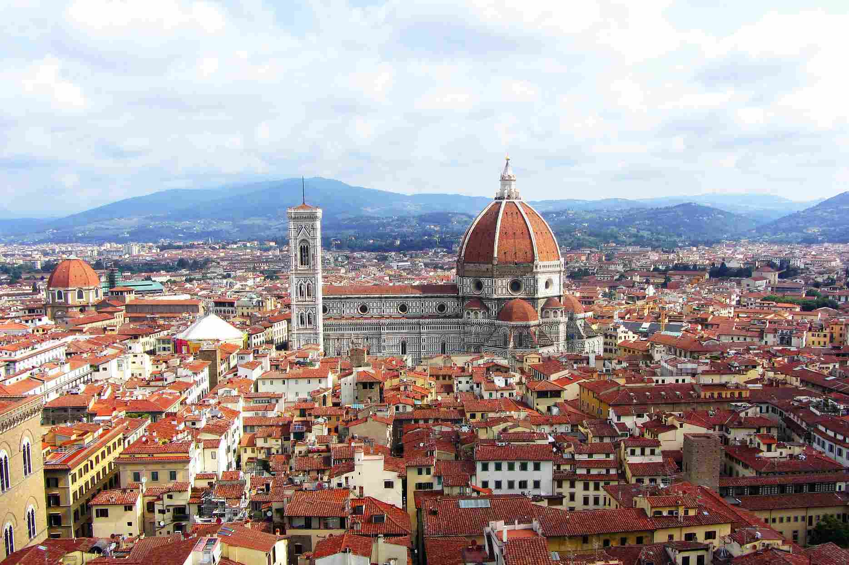
Florence, Italy
Notes:
Throughout his work, most of his examples refer to historical Italian cities, in Florence the Monument is the Duomo and the housing conditions it, but also in a more modern context…

Slide 36
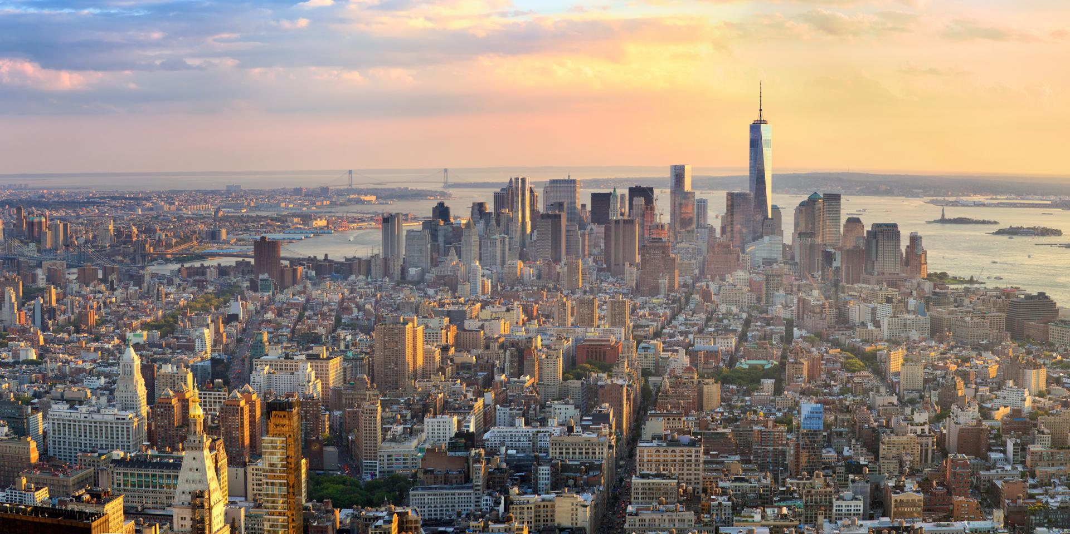
New York City
Notes:
We have New York City, where the dynamic between Monuments and Housing prove to be widespread phenomenon.

Slide 37
PRIMARY ELEMENTS
Notes:
So, to recap, Rossi identified housing as a significant aspect to the form of the city because it constituted the majority ‘stuff’, the mass of the city.
But as a counterpart to this massing, there are what he called ‘Primary Elements’
Towards the beginning, on page 86, he swims around the definition of primary elements, but importantly, he describes them as a kind of counterpoint to housing.
He states that Primary Elements can certainly be understood through Monuments, but only in part.

Slide 38
“[Primary elements] in a general sense […] are those elements capable of accelerating the process of urbanization in a city, and they also characterize the processes of spatial transformation in an area larger than the city. Often they act as catalysts… Frequently they are not even physical, constructed, measurable artifacts…” [87]
Notes:
So he gives this broad definition as, <<Quote…>>
So what are we to glean from this?
So far, he’s building up this argument that the city is defined as if housing were a medium, and Primary Elements are catalysts that enable this urban medium.

Slide 39
“As the core of the hypothesis of the city as a man-made object, primary elements have an absolute clarity; they are distinguishable on the basis of their form and in a certain sense their exceptional nature within the urban fabric; they are characteristic, or better, that which characterizes the city. If one looks at the plan of any city, these immediately identifiable forms leap out as black spots.” [63]
Notes:
He stated that Primary Elements are visually identifiable, and that through them, they define the visual character of the city… <<Quote…>>

Slide 40
LOCUS
Notes:
Paradigmatic case of a Primary Element → the Locus
‘Locus’ meaning:
Latin → Location, Place, Spot
Genetics → Intersection point of DNA strand
Geometry → Ellipse is the locus of all points

Slide 41
“The locus is a relationship between a certain specific location and the buildings that are in it.” [103]
Notes:
Quite simply, he defines ‘Locus’ as <<Quote…>>

Slide 42
CONCRETE
ABSTRACT
Particular place in the city, tied to a geographic point and/or to actual buildings.
It significance resonates throughout time, memory, and is collective.
It is an historical artifact.
Notes:
And the significance for Rossi regarding Locus is that it represents something seemingly contradictory, something both Concrete and Abstract:
Concrete: It is tied to a particular place in the city, not just anywhere
Abstract: Its significance resonates throughout time, memory, and is collective (interpersonal) – it is an historical artifact.

Slide 43
Palazzo della Ragione, Padua, Italy (1172 – 1219)
Notes:
To demonstrate the idea of locus, he returns to the Palazzo della Ragione in Padua.
Remember, he used this example as a ‘Propelling Monument’, because it promoted growth in the city.
Regarding Locus, we see that it has a physical presence, it occupies a concrete location.
Yet its significance is broad, and extends over almost a thousand years in the city of Padua.
Contributes the character of this region of Padua

Slide 44
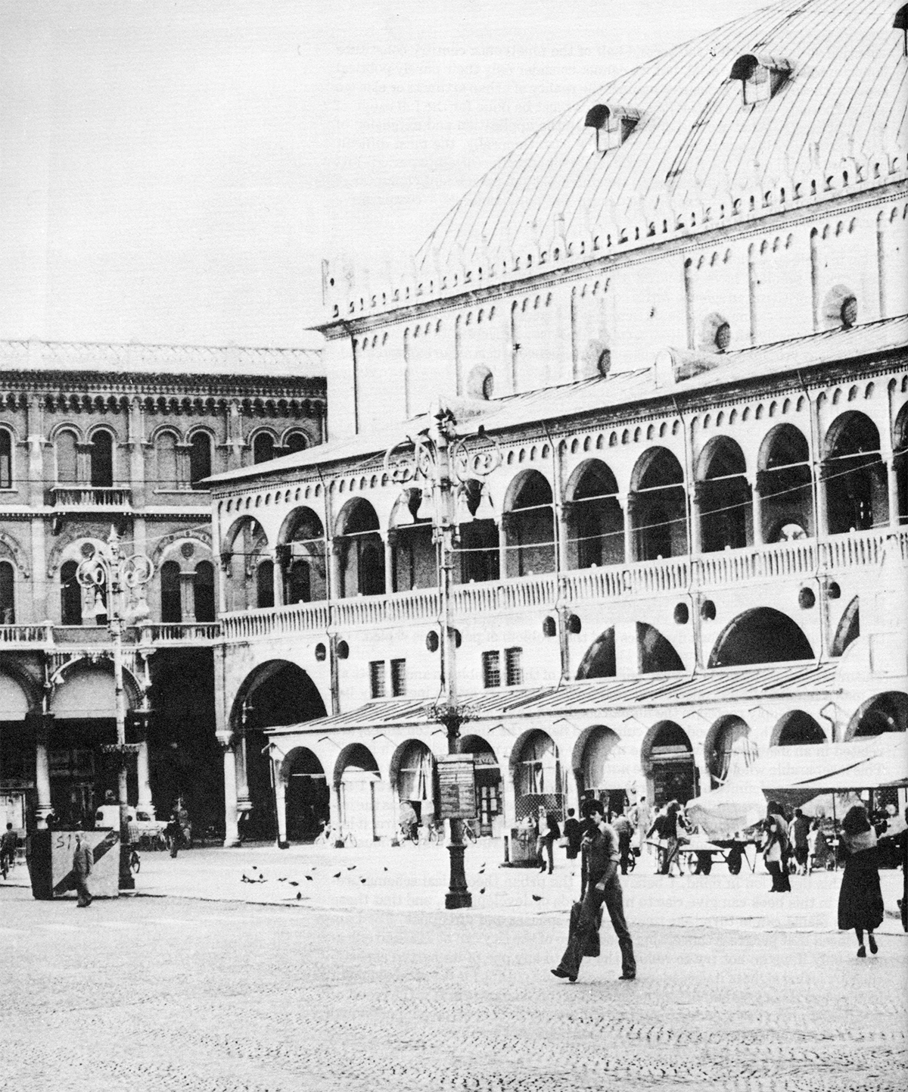
“one is struck by the multiplicity of functions that a building of this type can contain over time and how these functions are entirely independent of the form. At the same time, it is precisely the form that impresses us; we live it and experience it, and in turn it structures the city.” [29]
Palazzo della Ragione, Padua, Italy (1172 – 1219)
Notes:
As yet another argument against Functionalism, he stated that … <<Quote…>>
The form is concrete, perceivable, yet the significance of the structure has been unfolding over the last thousand years.
Indication of Rossi’s take on form: Form is incredibly important for architecture, but not because of appearances, but of how form can be intrinsically tied to architecture’s impact with the city

Slide 45
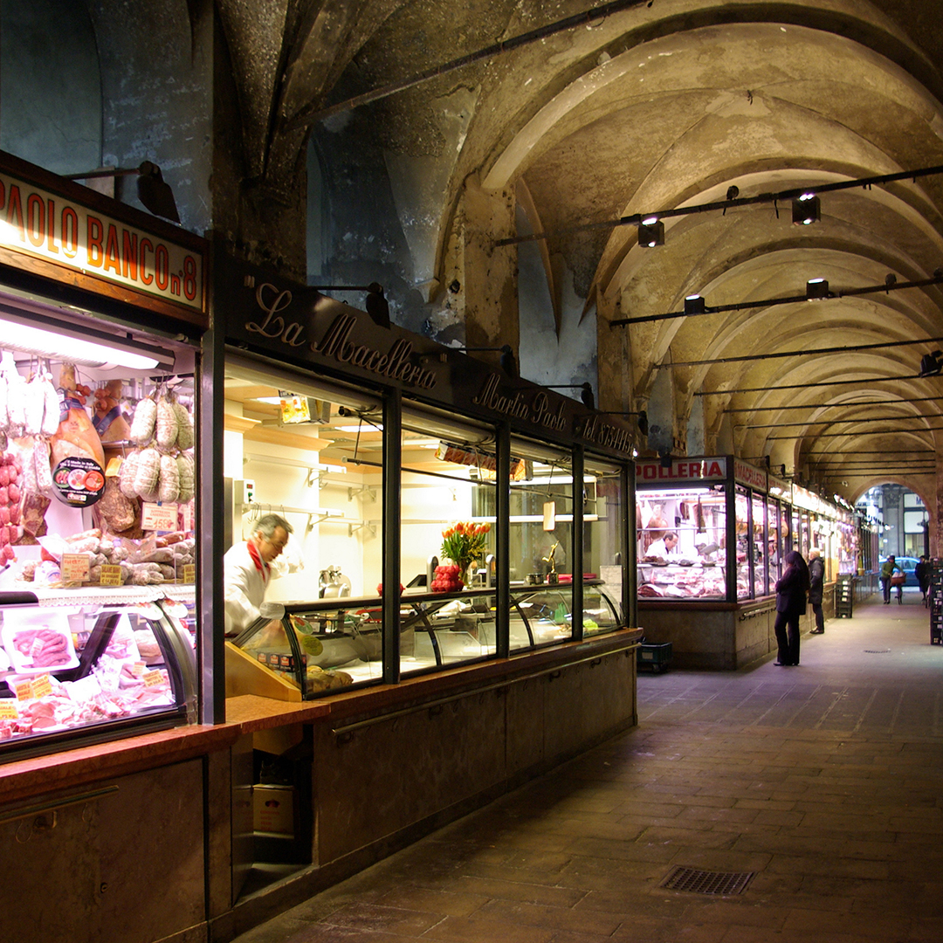
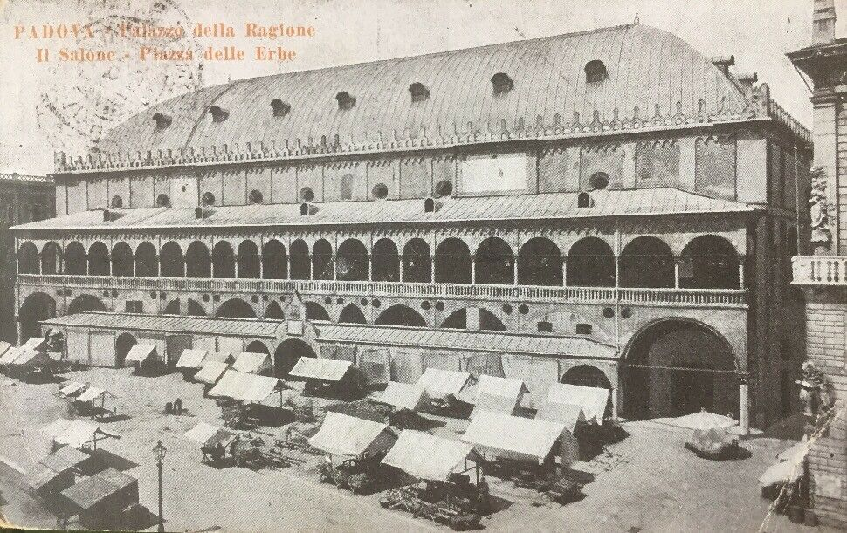
Palazzo della Ragione, Padua, Italy (1172 – 1219)
Notes:
In the arcades, we see butchers, but also outside of the building limits onto its courtyard, we see that it engages with the city through this outside market.
Through this constant engagement with the city, the Palazzo becomes integral to the characterization of the city.

Slide 46
A city has memory, as defined by its history
Notes:
So, if we take stock of the ideas put forward and line the up, we can reason things like this:
‘A city has memory’

Slide 47
A city has memory, as defined by its history
This memory is constructed by its forms
Notes:
‘This memory is constructed by its forms’

Slide 48
A city has memory, as defined by its history
This memory is constructed by its forms
These forms are constituted by the dynamic between Primary Elements and ‘lesser’ elements, most notably including Housing
Notes:
‘These forms are constituted by the dynamic between Primary Elements and lesser elements most notably including Housing

Slide 49
A city has memory, as defined by its history
This memory is constructed by its forms
These forms are constituted by the dynamic between Primary Elements and lesser elements, most notably including Housing
Through their dynamic, loci (locus) establish ‘significant points’
Notes:
Through their dynamic, loci (locus) direct the city’s history

Slide 50
A city has memory, as defined by its history
This memory is constructed by its forms
These forms are constituted by the dynamic between Primary Elements and lesser elements, most notably including Housing
Through their dynamic, loci (locus) establish ‘significant points’
Significance and meaning in architecture is accrued collectively
Notes:
Significance and meaning in architecture is accrued collectively

Slide 51
A city has memory, as defined by its history
This memory is constructed by its forms
These forms are constituted by the dynamic between Primary Elements and lesser elements, most notably including Housing
Through their dynamic, loci (locus) establish ‘significant points’
Significance and meaning in architecture is accrued collectively
Contrary to the organic (organicist) model, the city is a man-made act
Notes:
Contrary to the organic (organicist) model, the city is a man-made act

Slide 52
“it must be understood that the city represents the progress of human reason, is a human creation par excellence; and this statement has meaning only when the fundamental point is emphasized that the city and every urban artifact are by nature collective.” [57]
Notes:
<<Quote…>>

Slide 53
“One can say that the city itself is the collective memory of its people, and like memory it is associated with objects and places. The city is the locus of the collective memory. This relationship between the locus and the citizenry then becomes the city’s predominant image, both of architecture and of landscape, and as certain artifacts become part of its memory, new ones emerge.” [130]
Notes:
Another quote that sums up how all the parts come together, <<Quote…>>

Slide 54
“The study of history seems to offer the best verification of certain hypotheses about the city, for the city is in itself a repository of history.” [127]
Notes:
Let’s focus on the problem of history in Rossi’s approach – he stated that <<Quote…>>

Slide 55
“The study of history seems to offer the best verification of certain hypotheses about the city, for the city is in itself a repository of history.” [127]
2 Views of History [128]
Notes:
Drilling down on what he means exactly by history, he breaks this concept up into 2 parallel ideas.

Slide 56
“The study of history seems to offer the best verification of certain hypotheses about the city, for the city is in itself a repository of history.” [127]
2 Views of History [128]
1. A man-made object built over time.
Notes:
The first, which he says is the easier to comprehend, is history as ‘A man-made object built over time.’
‘Historical texts’
A sequence, from past to present.

Slide 57
“The study of history seems to offer the best verification of certain hypotheses about the city, for the city is in itself a repository of history.” [127]
2 Views of History [128]
1. A man-made object built over time.
2. A synthesis of collective values.
Notes:
The second, which is the more abstract notion of history for him, is that of a ‘Synthesis of collective values.’
By this, he takes on an atemporal approach, meaning time is collapsed into a single view, where we cannot separate the present from the past.
The definition of the city is simultaneously constituted of all of its phases, its past moments, and like space, are in contact with one another.

Slide 58
“Generally, the most difficult historical problems of the city are resolved by dividing history into periods and hence ignoring or misunderstanding the universal and permanent character of the forces of the urban dynamic.” [27]
Notes:
By thinking of history in this second manner, we can get around to arbitrarily dividing a city into its ‘periods.’
In criticism, he stated that … <<Quote…>>
So a characterization of places in terms of periods, while temporally useful, doesn’t really describe something in its full complexity.
But to reiterate, these two notions of history are not a matter of better/worse, but about simultaneity.

Slide 59
The City as a Shaping
Notes:
So Rossi is describing the city – through its collective memory – less as a fixed aggregate of physical buildings, than as a gerund (a verb that functions as a noun).
The city as a shaping.

Slide 60
“There are people who do not like a place because it is associated with some ominous moment in their lives; others attribute an auspicious character to a place. All these experiences, their sum, constitute the city.” [29-30]
Notes:
<<Quote…>> - aggregate of experiences

Slide 61
“The value of history seen as a collective memory, as the relationship of the collective to its place, is that it helps us to grasp the significance of the urban structure, its individuality, and its architecture which is the form of this individuality.” [131]
“There are people who do not like a place because it is associated with some ominous moment in their lives; others attribute an auspicious character to a place. All these experiences, their sum, constitute the city.” [29-30]
Notes:
<<Quote…>>

Slide 62
“The value of history seen as a collective memory, as the relationship of the collective to its place, is that it helps us to grasp the significance of the urban structure, its individuality, and its architecture which is the form of this individuality.” [131]
“This individuality […] is an event and a form… This shaping is a permanent aspect of a city’s unique artifacts, monuments, and the idea we have of it.” [131]
Notes:
<<Quote…>>

Slide 63
“the union between the past and the future exists in the very idea of the city that it flows through in the same way that memory flows through the life of a person” [131]
Notes:
To summarize the point further, <<Quote…>>
So the definition of the city is something that is in perpetual development, either through propelling elements or those that are pathological
A constant ebb and flow
Here he describes the city much like the comparison with a person’s life, which is defined by their personal memory – but in this case, memory is collective, and belongs to the city rather than the individual.

Slide 64
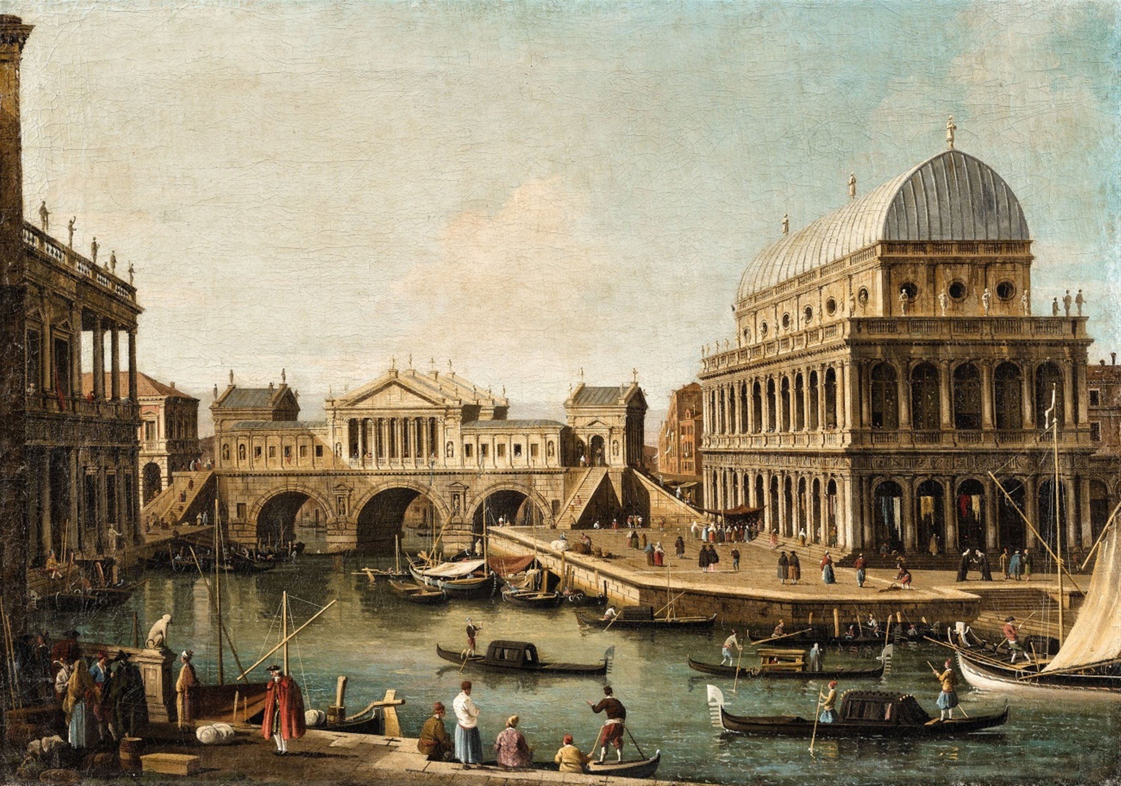
Giovanni Antonio Canaletto, Capriccio (1753 -59)
Notes:
I find this painting, which Rossi points out, as particularly instructive to his theory of the city.
Canaletto – “Analogous Venice”
Prolific but rather unremarkable 18th century painter (like popular art)
Kind of like postcard painting
But all is not what it seems!

Slide 65
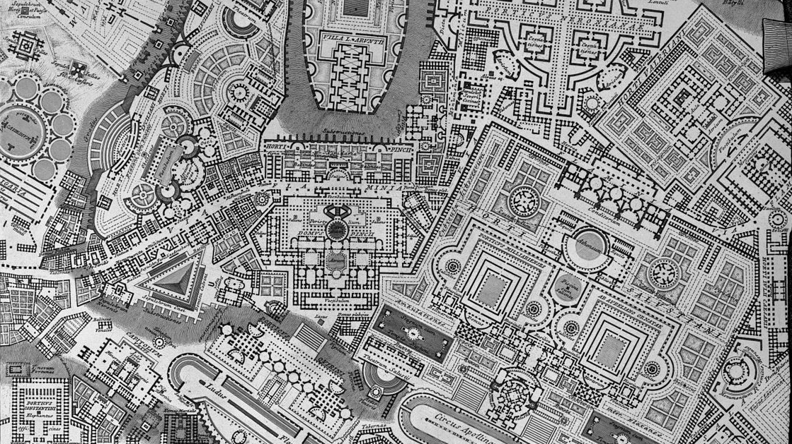
Notes:
In fact, this painting is a kind of Campo Marzio of Venice (~1774)
Drawn Giambattista Piranesi

Slide 66
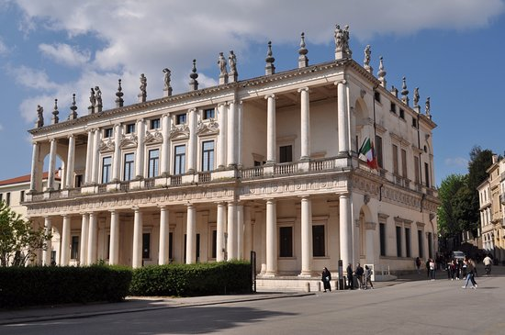
Giovanni Antonio Canaletto, Capriccio (1753 -59)
Andrea Palladio, Palazzo Chiericati (c. 1680)
Notes:
So, going back to Canaletto’s painting, what we see is fiction of Venice – a typical view composed of three Palladian works of architecture, only one of which is actually in Venice!
Palazzo Chiericati

Slide 67
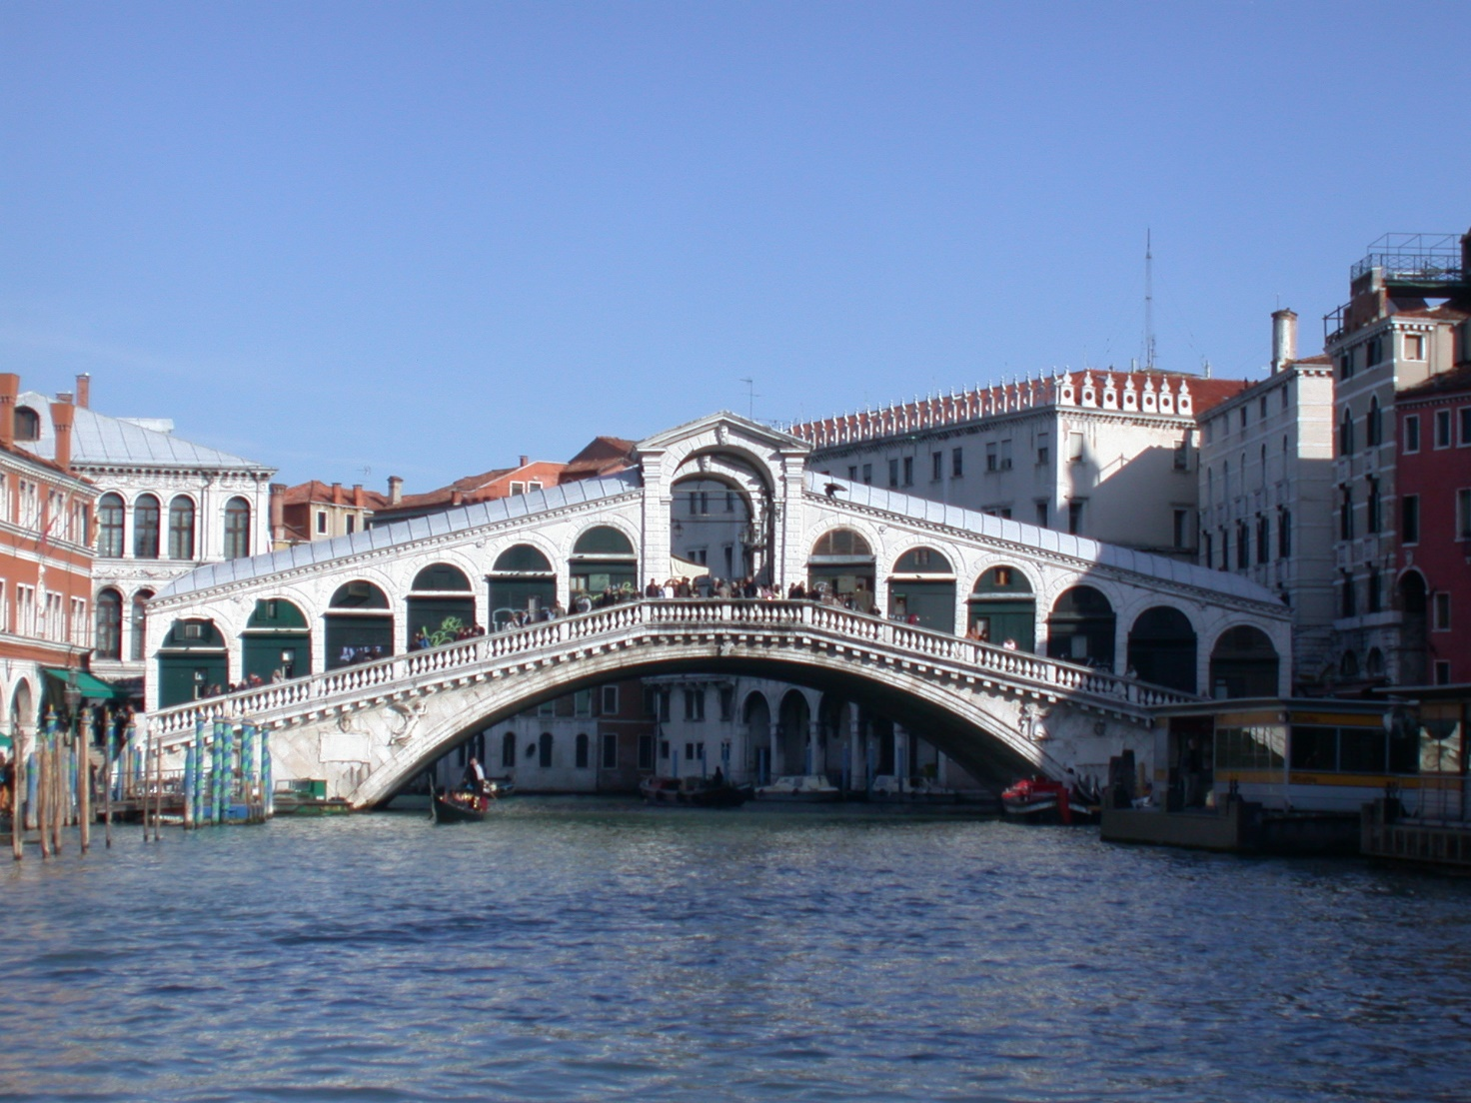
Giovanni Antonio Canaletto, Capriccio (1753 -59)
Andrea Palladio, Ponte di Rialto (1588 – 91)
Notes:
Ponte Rialto

Slide 68
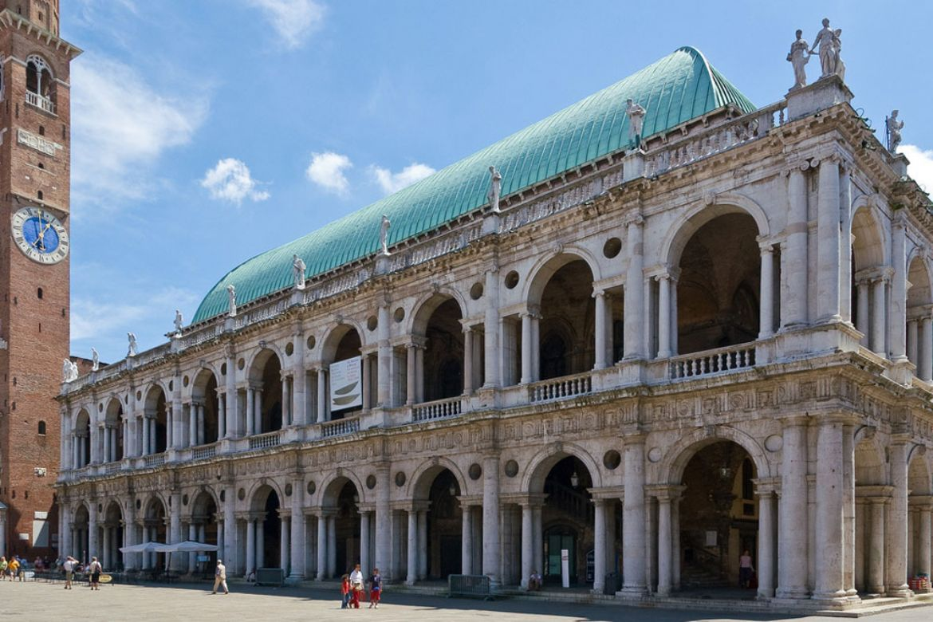
Giovanni Antonio Canaletto, Capriccio (1753 -59)
Andrea Palladio, Basilica di Vicenza (1549 – 1614)
Notes:
Basilica di Vicenza
All 3 works are produced by Andrea Palladio, and are located in the Italian region called Vicenza

Slide 69
Giovanni Antonio Canaletto, Capriccio (1753 -59)
Notes:
But they are not co-located
But for Rossi, that doesn’t matter, because they capture the architectural form of Venice, just like for Piranesi, his aggregate works of Rome constituted for him, the form of the city through its architecture.

Slide 70
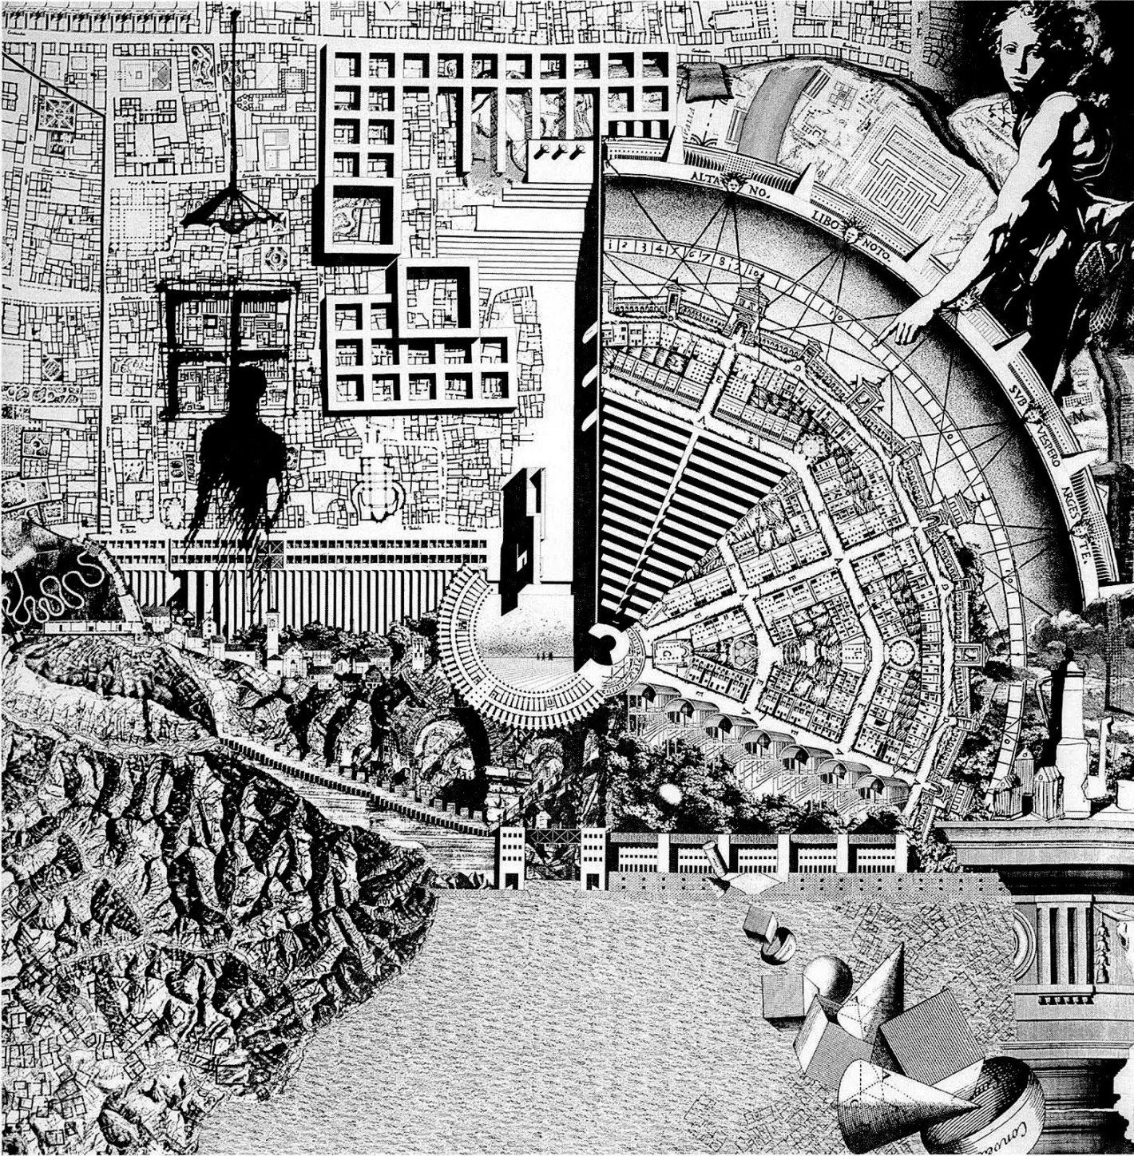
Aldo Rossi, Bruno Reichlin, Fabio Reinhart, Eraldo Consolascio
Città Analoga (1976)
Notes:
La Città Analoga
Collectively produced image
1976 Venice Biennale
No single explanation
Beyond the ‘authorial approach’, towards a collective

Slide 71
“L’architettura sono le architetture”
Aldo Rossi, Bruno Reichlin, Fabio Reinhart, Eraldo Consolascio
Città Analoga (1976)
Notes:
L’architettura sono le architetture
All architecture is made of the aggregation of other architecture
All located within a historical lineage
An assemblage of photocopies
Drawing – Building – City
Architecture crosses the medium

Slide 72
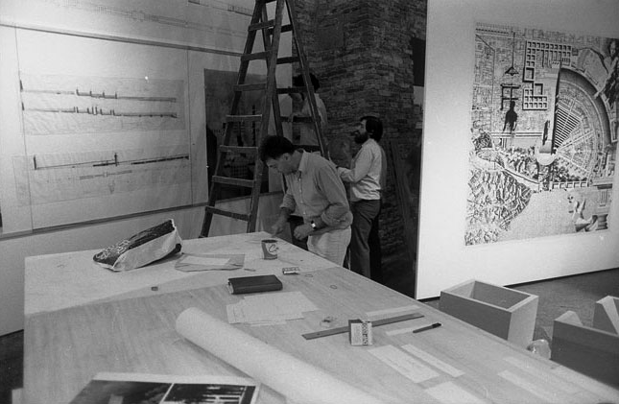
Aldo Rossi, Bruno Reichlin, Fabio Reinhart, Eraldo Consolascio
Città Analoga (1976)
Notes:
Is consonant with his notion of the city (as drawing), no single meaning
So in this case, to speak of the city is to understand history, and to involve either is necessarily a social (collective) action.

Slide 73
Notes:
Conceptually equivalent renderings of City

Slide 74
ANALOGY

Slide 75
“Analogy expresses itself through a process of architectural design whose elements are preexisting and formally defined, but whose true meaning is unforeseen at the beginning and unfolds only at the end of the process. Thus the meaning of the process is identified with the meaning of the city.” [18]

Slide 76
ANALOGY
TYPOLOGY
Notes:
Rossi’s concept of Analogy is immediately tied to reference of another important word: Typology

Slide 77
TYPOLOGY
“I would define the concept of type as something that is permanent and complex, a logical principle that is prior to form and that constitutes it.” [40]
“Ultimately, we can say that type is the very idea of architecture, that which is closest to its essence.” [41]

Slide 78
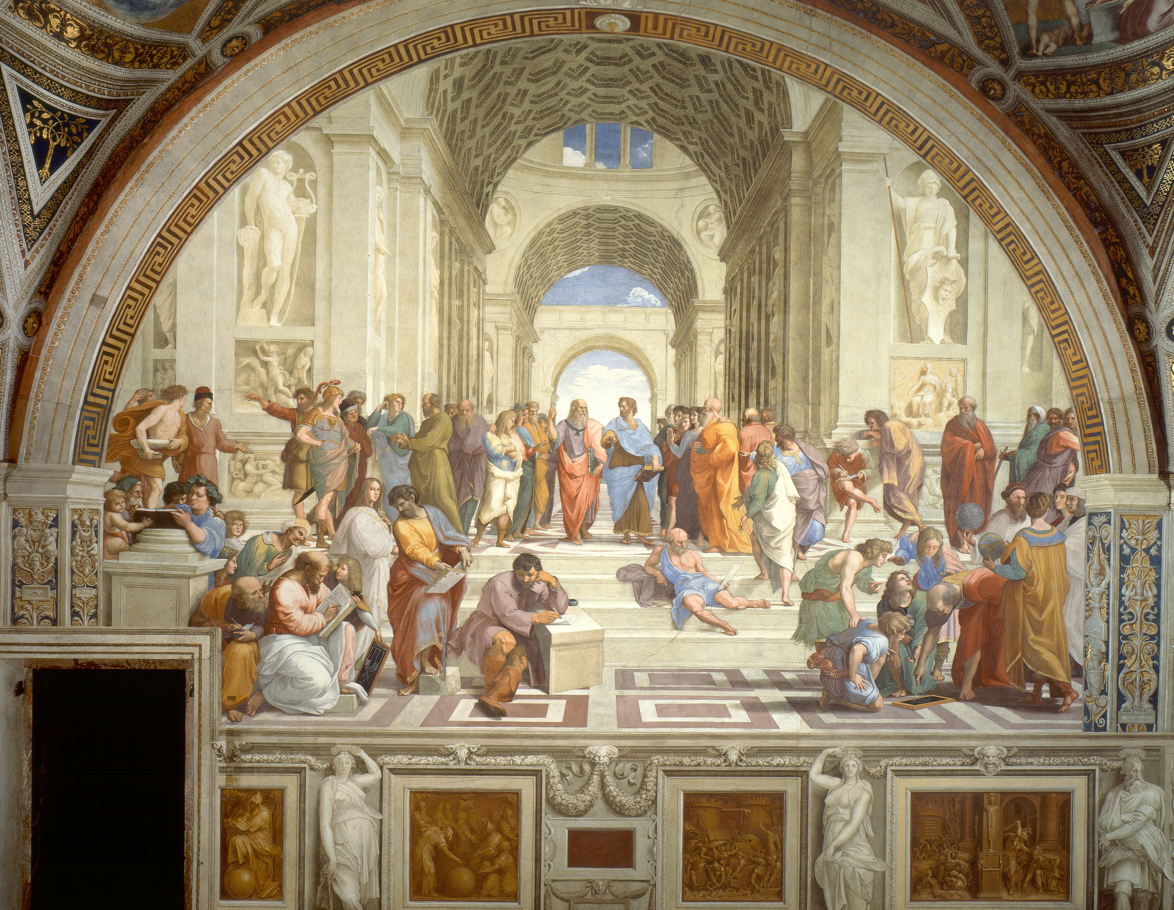
Notes:
This idea of essence, as preexisting, undoubtedly finds its Western origins in Ancient Greece, specifically from the ideas of Plato
Raphael, The School of Athens (1509- 1511)
Significant symbol of the Renaissance, as this painting illustrated human knowledge, reasoning, par excellence
Filled with various characters, including philosophers, mathematicians, artists, scientists, politicians, and military figures

Slide 79
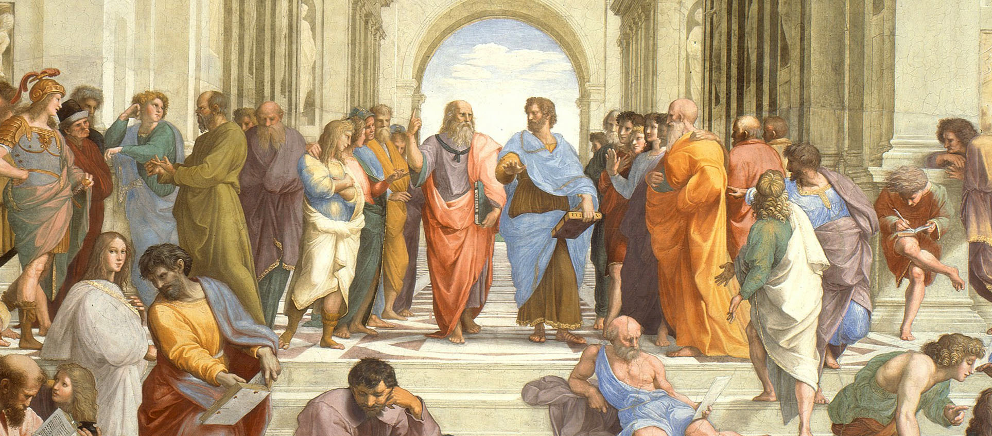
Raphael, The School of Athens (1509- 1511)
Notes:
For our purposes, what concerns us most, and who occupy the center of this piece, the center of human knowledge are…

Slide 80
PLATO
ARISTOTLE
Notes:
Plato on the left, holding a copy of Timeaus
Finger pointing up, as true knowledge is metaphysical, beyond the material world
And his student, Aristotle, holding a copy of his Ethics
Hand down – reality is experienced by our senses (the world)

Slide 81
TRUTH
KNOWLEDGE
BELIEF
Notes:
As a philosopher, Plato’s task revolved around the problem of knowledge, or more specifically, how do we come to know
He believed that knowledge was the intersection between our beliefs (which may or may not necessarily be accurate), and truth
We can never just know truth, we must believe in something, and if our belief is correct, then knowledge is attained
But how do we come to know? How do we come to know things irrefutably?

Slide 82
TRUTH
KNOWLEDGE
BELIEF
RECOLLECTION
Notes:
Contrary to either of the methods (science, religious faith), Plato believed that knowledge came from Recollection.
Prior to our mortality, we existed in the heavens (not Abrahamic (Judaism, Christianity, Islam) model), in perfection
We didn’t ‘KNOW’, we existed in truth
But being mortals now, we can never experience that full truth, but there are remnants of truth in our spirit
And so for Plato, we KNOW through RECOLLECTION – we acknowledge little bits of truth
These moments of truth, from which knowledge takes, are known as FORMS
‘Forms’ were wooden templates from which stonemasons ensured accuracy in reproduction.
The master stonemasons would produce them to ensure that workers would produce accurate reproductions

Slide 83
‘Platonic Solids’ (tetrahedron, octahedron, cube, icosahedron <dodecahedron>)
From Johannes Kepler’s Mysterium Cosmographicum (1597)
Notes:
Most well-known FORMS: Platonic solids
Called after him b/c he suggested that elemental forms structured the ‘elements’ (fire, air, earth, water, sun)
Earth: Cube
Air: Octahedron
Water: Icosahedron
Fire: Tetrahedron

Slide 84
As the soul is immortal, has been born often, and has seen all things here and in the underworld, there is nothing which it has not learned; so it is in no way surprising that it can recollect the things it knew before, both about virtue and other things. As the whole of nature is akin, and the soul has learned everything, nothing prevents a man, after recalling one thing only - a process men call learning - discovering everything else for himself, if he is brave and does not tire of the search, for searching and learning are, as a whole, recollection.
Plato, Meno (c. 380BC)

Slide 85
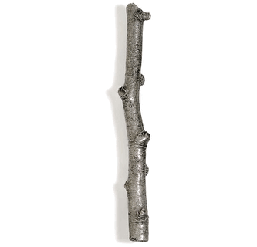
Notes:
Example of straightness

Slide 86
Notes:
We can call a branch straight, even though it clearly isn’t straight
Likewise, we can call a line we drew straight, even though if we were to zoom in at a microscopic scale, it wouldn’t be straight
So no such things as anything that is perfectly straight
How can we say something is straight?
Deep inside, in an physically unfettered existence, we could have direct access to Straightness
Straightness, as truth, is unchanging, but we cannot gain access to this with our senses, but only with our minds

Slide 87
Notes:
- Along a similar line, Plato would claim that we can never see a perfect circle, yet we can all imagine it perfectly

Slide 89
“If there is anything beautiful besides the Beautiful itself, it is beautiful for no other reason than that it shares in that Beautiful, and I say so with everything.”
Plato, Meno (c. 380BC)

Slide 90
“nothing else makes it beautiful other than the presence of, or the sharing in, or however you may describe its relationship to that Beautiful we mentioned, for I will not insist on the precise nature of the relationship, but that all beautiful things are beautiful by the Beautiful.”
Plato, Meno (c. 380BC)
Notes:
Here, the “Beautiful” is the form of the beautiful

Slide 91
When the wax in someone’s mind is thick, copious, smooth, and worked to a proper consistency, then, when the things which come through the senses are imprinted on that tablet of the heart, as Homer calls it, in an obscure allusion to its similarity to wax, the imprints which come into being in those people and under those conditions are clean, and adequately deep, and they last a long time. To begin with, people of that sort are good learners; secondly, they have good memories; and third, they don’t transpose their imprints with respect to their perceptions, but make true judgments.
Plato, Theaetetus (c. 369 BC)

Slide 92
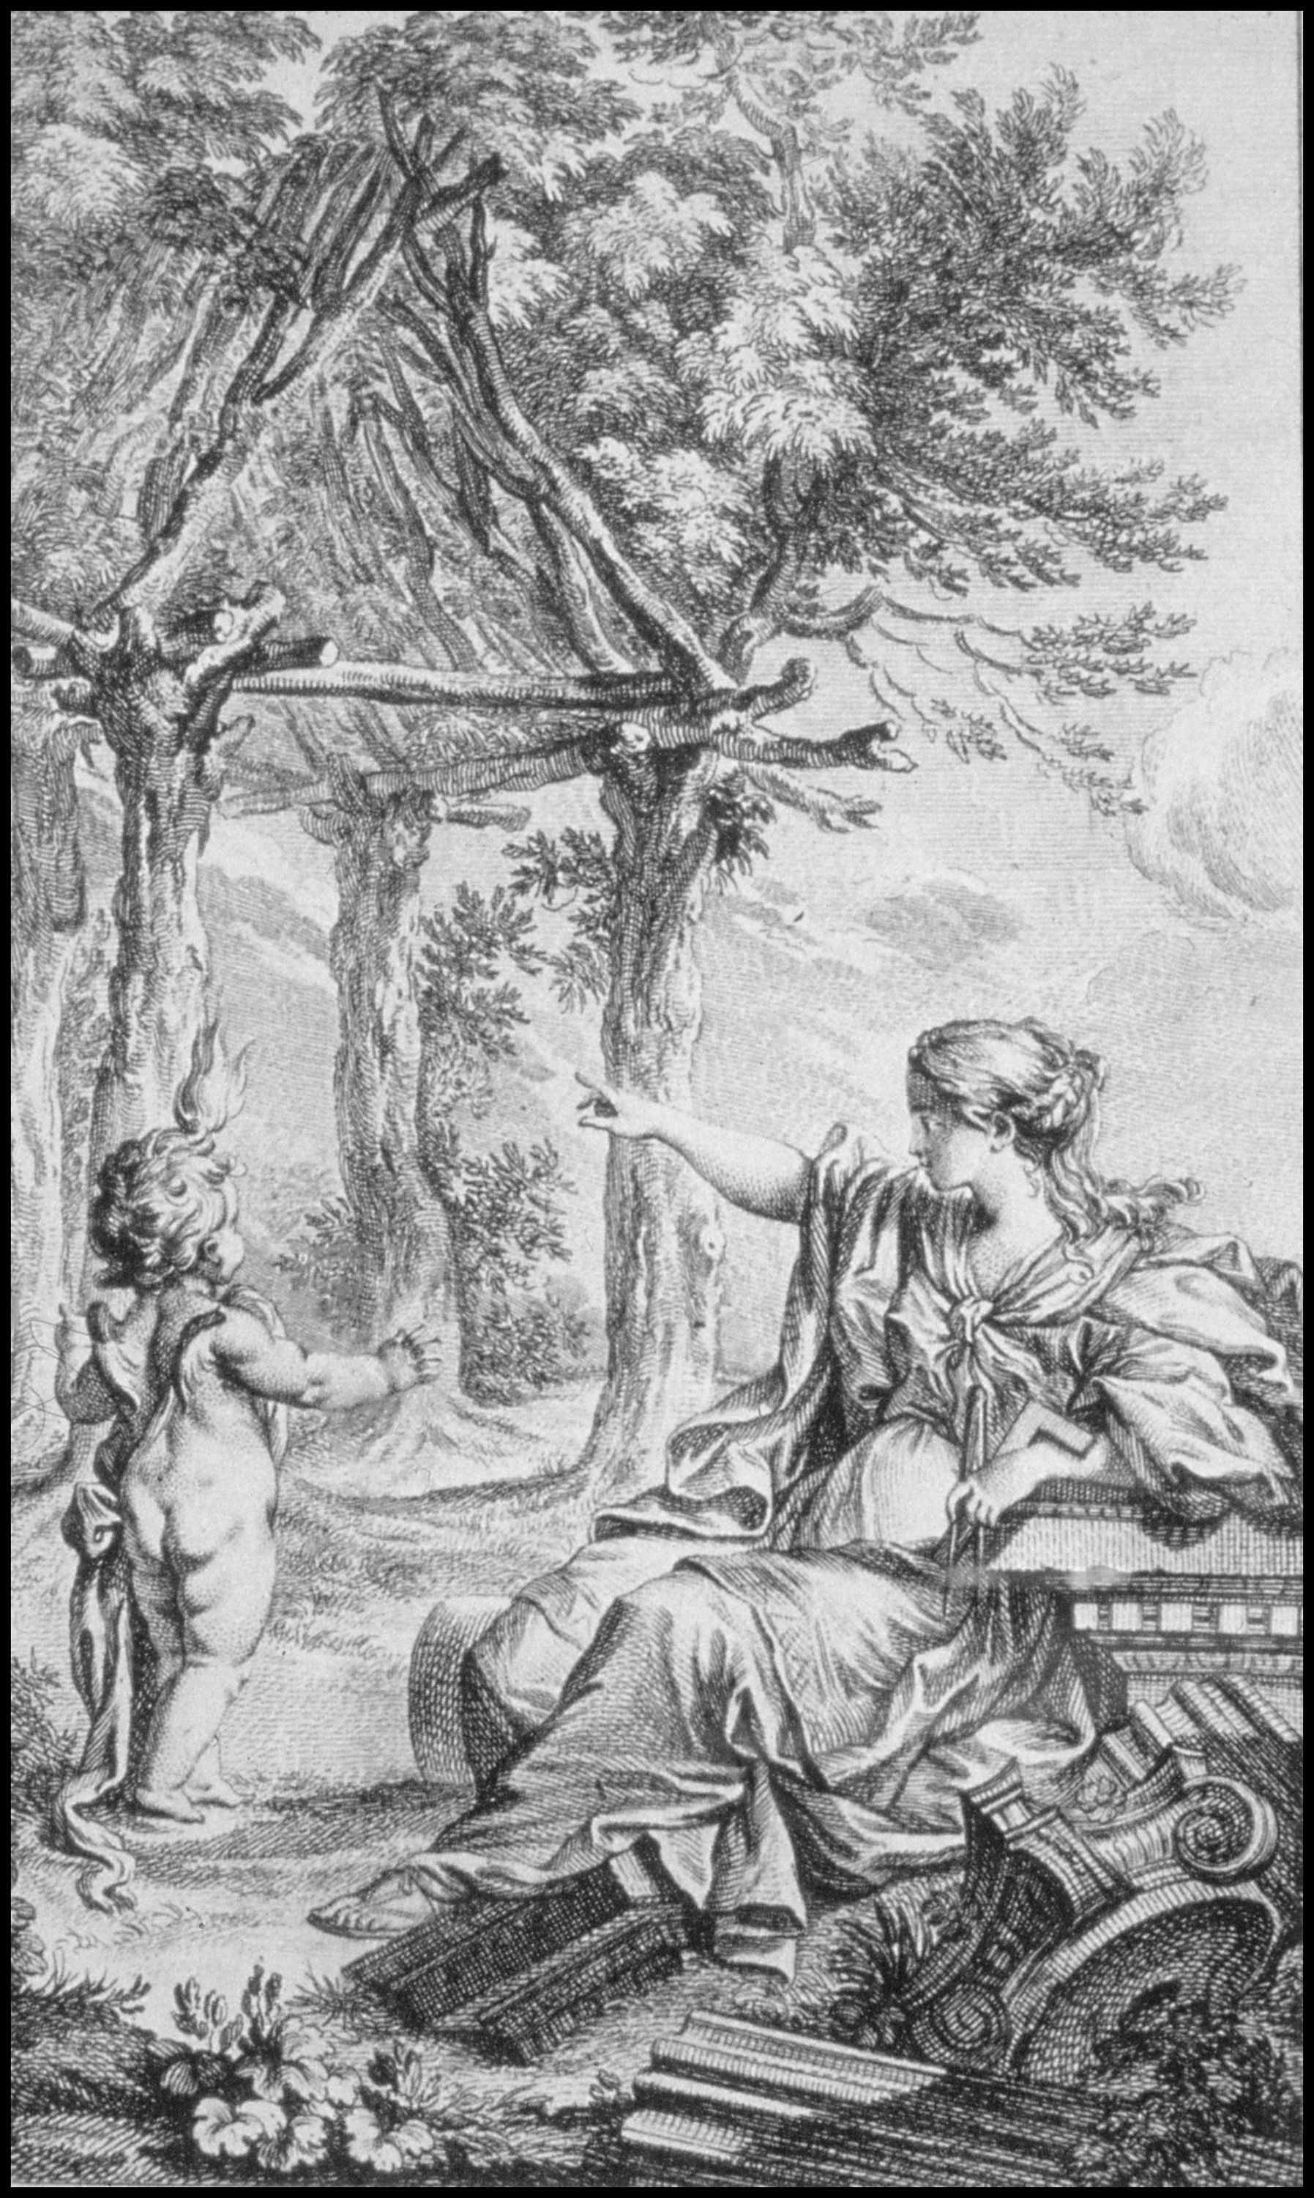
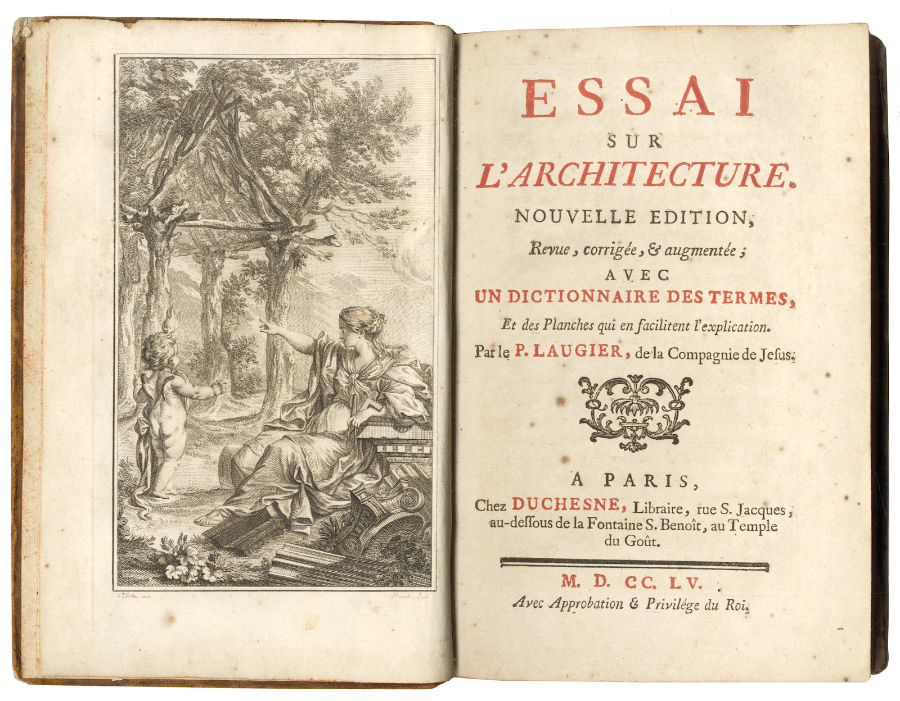
Marc-Antoine Laugier, Essai sur l’architecture (1753)
Notes:
How does this relate to architecture?
One of the earliest modern illustrations of this idea of an essence, comes from the Enlightenment
Laugier’s article Essai sur ‘architecture, 1753
Among other issues, most known for ‘identifying’ the origins of architecture
In the example of the PRIMITIVE HUT
The idea that architecture is provided naturally

Slide 93
“Let us look at man in his primitive state without any aid or guidance other than his natural instincts. He is in need of a place to rest. On the banks of a quietly flowing brook he notices a stretch of grass; its fresh greenness is pleasing to his eyes, its tender down invites him; he is drawn there and, stretched out at leisure on this sparkling carpet, he thinks of nothing else but enjoying the gift of nature; he lacks nothing, he does not wish for anything. But soon the scorching heat of the sun forces him to look for shelter…
Marc-Antoine Laugier, Essai sur l’architecture (1753)

Slide 94
“A nearby forest draws him to its cooling shade; he runs to find a refuge in its depth, and there he is content. But suddenly mists are rising, swirling round and growing denser, until thick clouds cover the skies; soon, torrential rain pours down on this delightful forest. The savage, in his leafy shelter, does not know how to protect himself from the uncomfortable damp that penetrates everywhere; he creeps into a nearby cave and, finding it dry, he praises himself for his discovery. But soon the darkness and foul air surrounding him make his stay unbearable again…
Marc-Antoine Laugier, Essai sur l’architecture (1753)

Slide 95
“He leaves and is resolve to make good by his ingenuity the careless neglect of nature. He wants to make himself a dwelling that protects but does not bury him. Some fallen branches in the forest are the right material for his purpose; he chooses four of the strongest, raises them upright and arranges them in a square; across their top he lays four other branches; on these he hoists from two sides yet another row of branches which, inclining towards each other, meet at their highest point. He then covers this kind of roof with leaves so closely packed tha tneither sun nor rain can penetrate…
Marc-Antoine Laugier, Essai sur l’architecture (1753)

Slide 96
“Thus, man is housed. Admittedly, the cold and heat will make him feel uncomfortable in this house which is open on all sides but soon he will fill in the space between two posts and feel secure.
Such is the course of simple nature; by imitating the natural process, art was born. All the splendors of architecture ever conceived have been modeled on the little rustic hut I have just described.”
Marc-Antoine Laugier, Essai sur l’architecture (1753)

Slide 97
“The parts that are essential are the cause of beauty, the parts introduced by necessity cause every license, the parts added by caprice cause every fault.”
Marc-Antoine Laugier, Essai sur l’architecture (1753)
Notes:
Laugier
Not only formal resemblance, but moral imperative
Truth in architectural form – closer to perfection, virtuousness

Slide 98
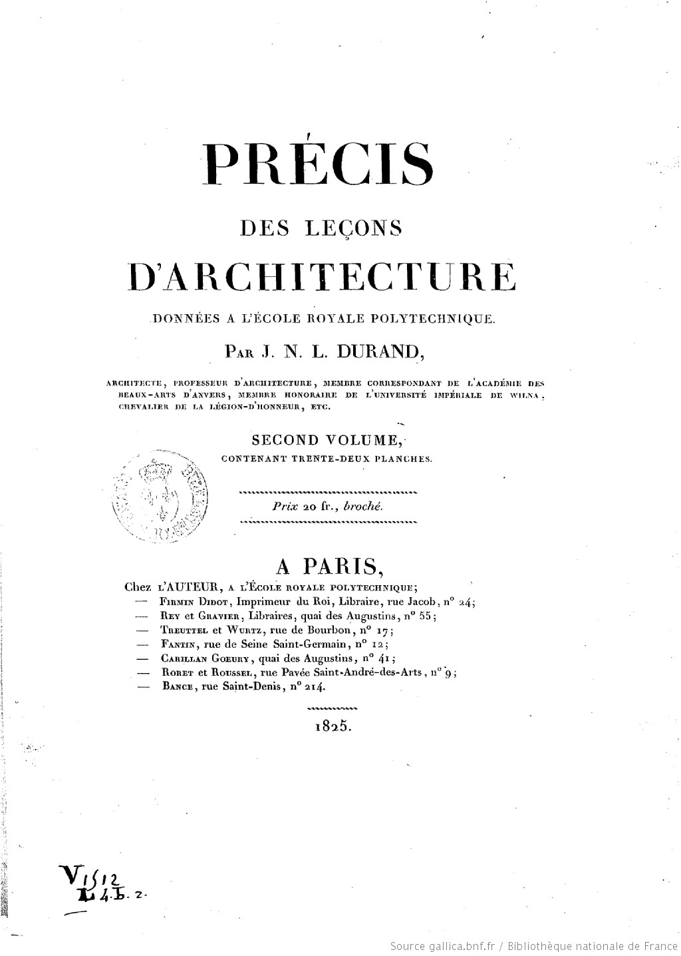
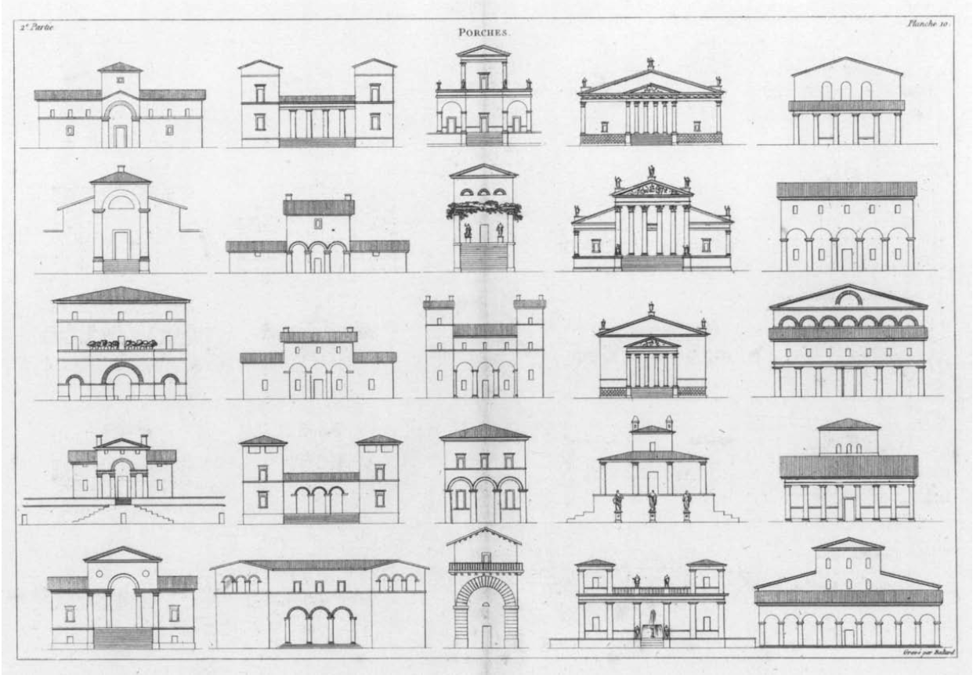
Jean-Nicolas-Louis Durand, Précis des leçons d'architecture (1809)
Notes:
The changing role of Typology
According to the historical narrative of Anthony Vidler (teaching at Cooper Union and Yale), one of the best known essays on Typology, “The Third Typology”, describes a second phase of typology
From nature (the first - Enlightenment), to a model (i.e. a blueprint, process – First Industrial Revolution)

Slide 99
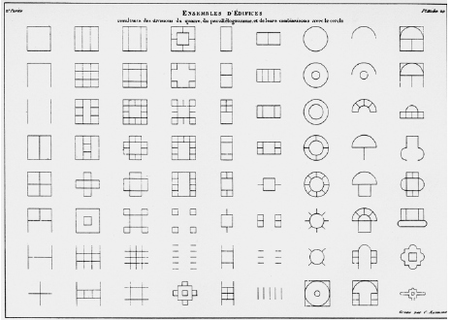
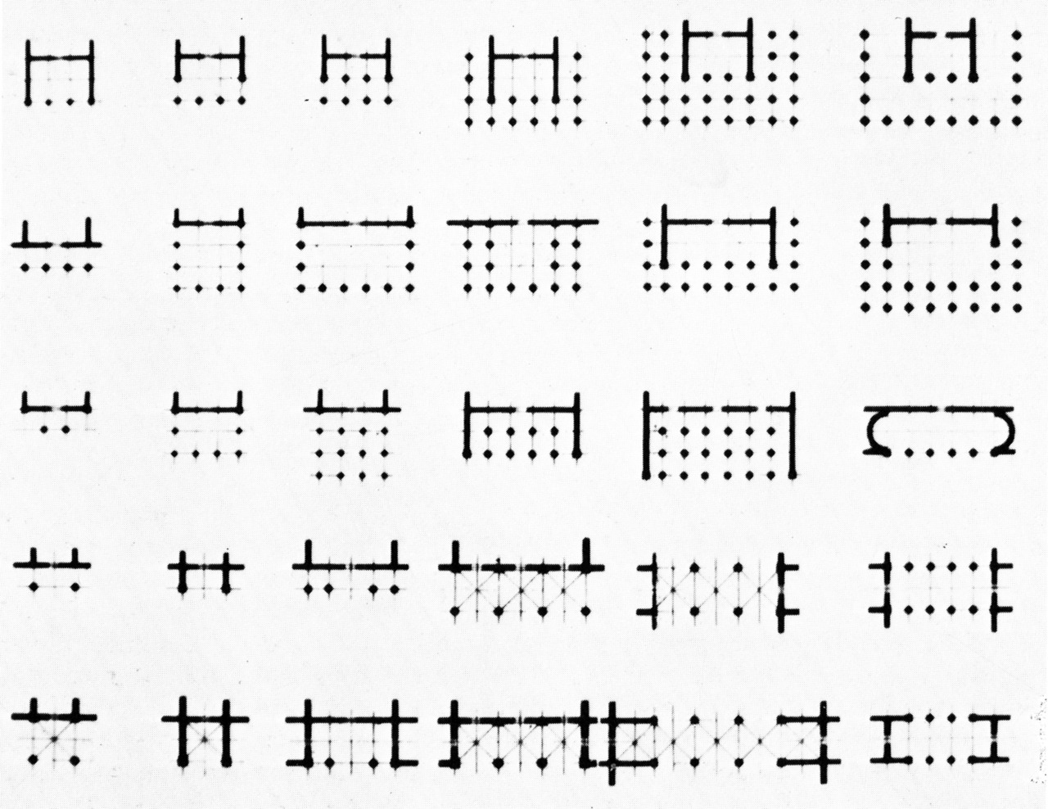
Jean-Nicolas-Louis Durand, Précis des leçons d'architecture (1809)
Notes:
- Exemplified by Vidler in the JNL Durand’s Precis, drawn as a lesson book for students to learn ‘good architecture’

Slide 100
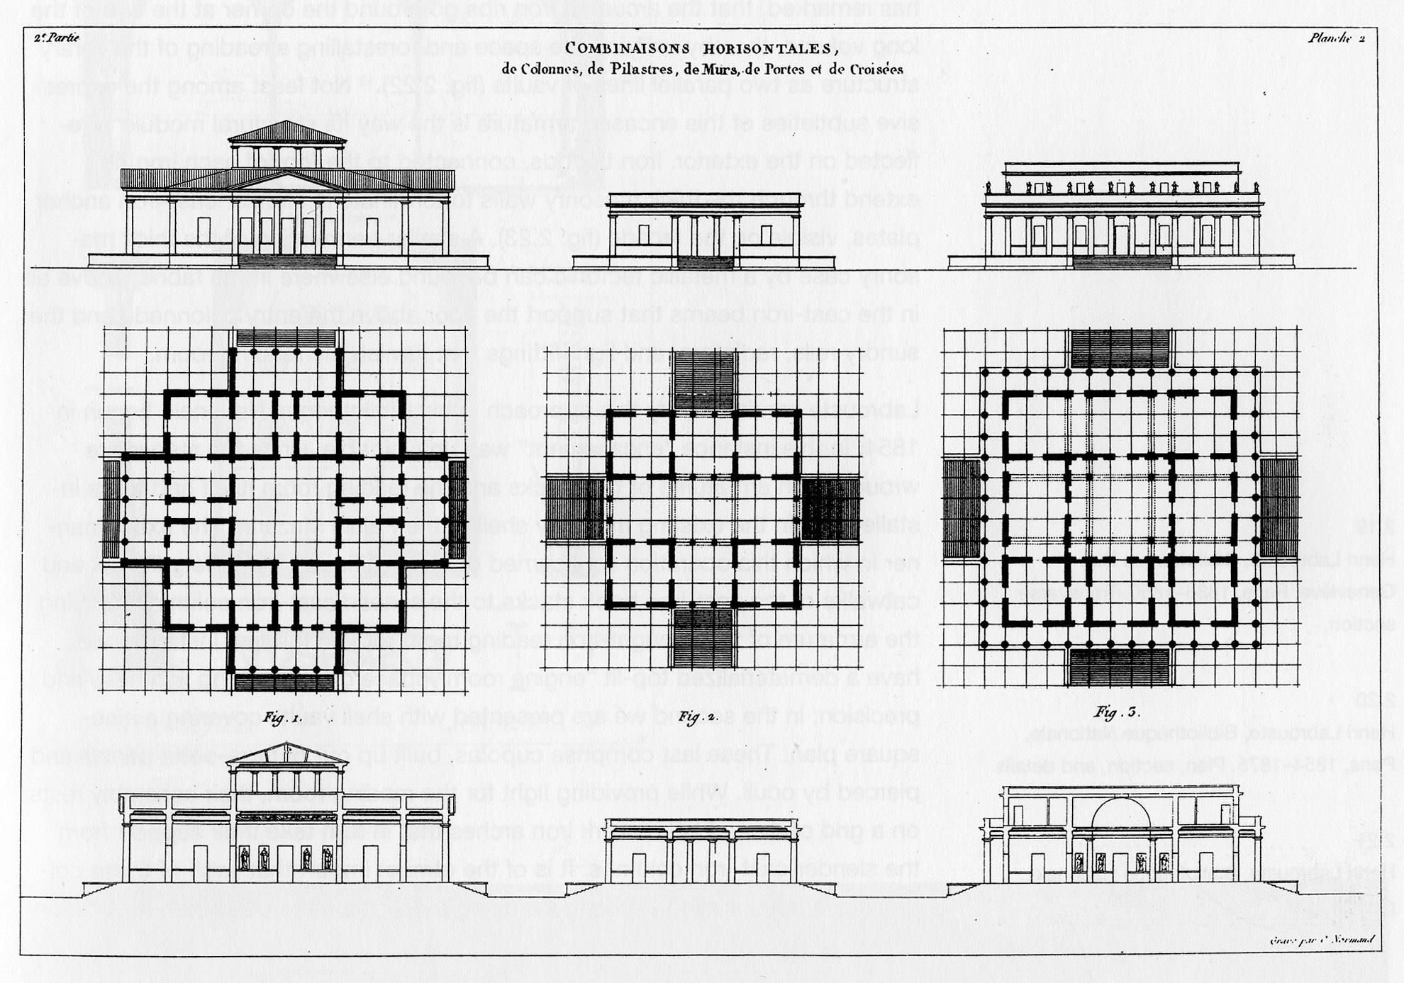
Jean-Nicolas-Louis Durand, Précis des leçons d'architecture (1809)
Notes:
From typological classes, one could develop into more elaborate structures
But regardless of the complexity of a given work, there remained a typological essence

Slide 101
Left: Aldo Rossi, Bruno Reichlin, Fabio Reinhart, Eraldo Consolascio, Città Analoga (1976)
Right: Giovanni Antonio Canaletto, Capriccio (1753 -59)
Notes:
Moving over the final, third, typological phase as narrated by Vidler, if the first was Nature, the second was Model/Process, the third was of the City (exemplified by Rossi)
This notion of Autonomy seated in Rossi’s understanding of the Architecture and the City
That the city is a memory for architecture
But not a memory as in something stuck in the past, but as an active memory that shapes our understanding of architecture today
In other words, we can conceive of ‘types’ not through nature or process, but from architecture itself
This itself is the root of the notion of Autonomy

Slide 102
Right: Giovanni Antonio Canaletto, Capriccio (1753 -59)
Notes:
- So back to Rossi’s usage of Canaletto’s painting of a fictional Venice, Architecture comes from Architecture

Slide 103
“L'architettura sono le architetture”
“Architecture is (the) architecture(s)”
Right: Giovanni Antonio Canaletto, Capriccio (1753 -59)
Notes:
- So back to Rossi’s usage of Canaletto’s painting of a fictional Venice, Architecture comes from Architecture

Slide 104
Enlightenment
(Nature → Moral)
First Industrial Revolution
(Model → Process)
Contemporary
(City → Autonomy)
Anthony Vidler, The Third Typology (1977)
Notes:
- What they all have in common is the concept of architecture’s Origin, its ‘Ur’ state, its ontological basis

