Slide 1
REVIEW
Describe the Smithsons’ notion of
‘Scale of Association’

Slide 2
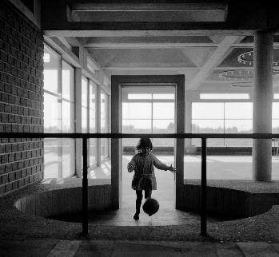
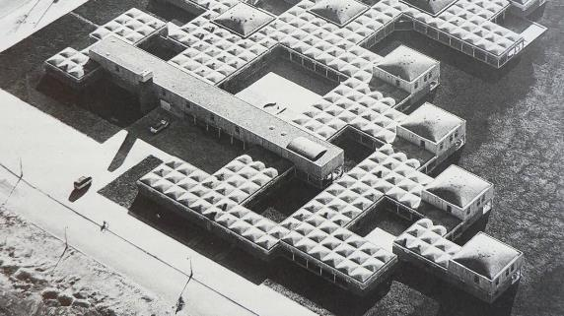
REVIEW
Describe qualities of this project

Slide 3
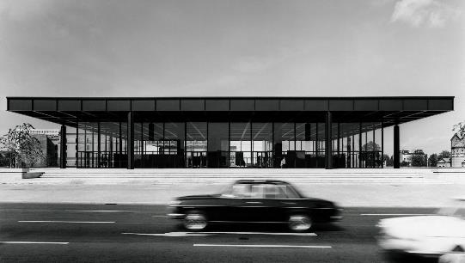
REVIEW
Describe qualities of this project

Slide 4
REVIEW
Name and describe each of Fumihiko Maki’s conception of design

Slide 5
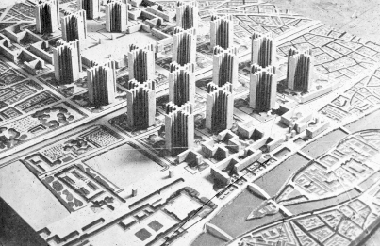
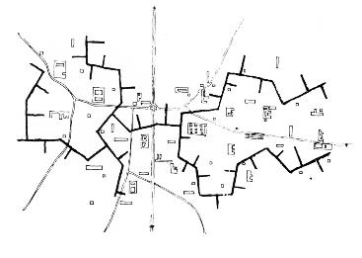
REVIEW
Compare and Contrast

Slide 6
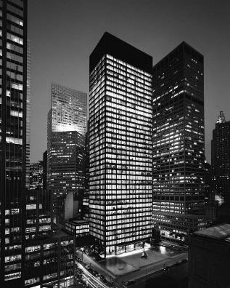
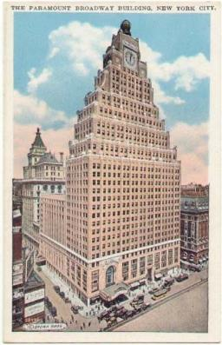
REVIEW
Compare and Contrast

Slide 7
The City
Part 1 of 3
Contemporary Architecture Theory
Eugene Han
Fall 2020, 11:15 – 12:30 pm
Online Instruction

Slide 8
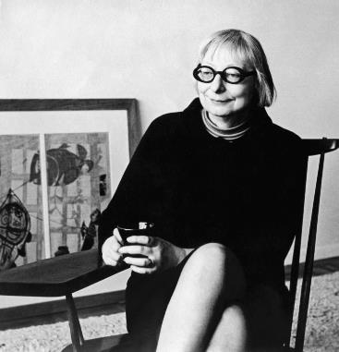
Jane Jacobs
American / Canadian; 1916 - 2006
Notes:
Urban activist
Started with writing – Architectural Forum
For the major part of her professional career, resident of NYC – Greenwich Village
Not formally trained in architecture, nor practiced as such
Largely a writer/activist more so than a designer, nevertheless, important for architecture.
Great example as a check to Modernism
We often practice and theorize in a disciplinary bubble – this is important, because otherwise it would be difficult to change for the better – but it’s important to remember that even though our discipline may largely insular, it has a real effect on the public, and our ideas should acknowledge that.
Major concern was to provide a voice for urban planning that responded to the as-seen rather than the idealized, rational models that dominated both Europe and the US
Rather than the city as an equation to be rationalized and made efficient, her model was the vitality present in certain neighborhoods
Argued for the casual, intimate scale of the neighborhood (rather than that driven by the demands of the scale of the city)

Slide 9
4 Conditions For the City
Notes:
Neighborhood-driven approach

Slide 10
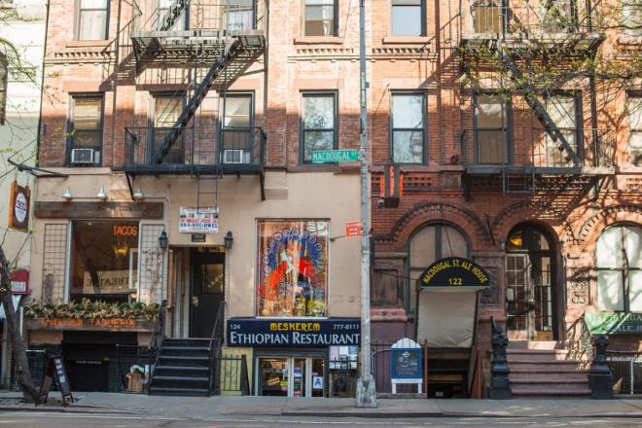
4 Conditions For the City
Mixed Primary Use
Notes:
MIXED PRIMARY USE
Rationalist (Modernist) models don’t consider the value of DIVERSITY
Parks/museums/schools/hospitals/dwellings/offices
Different people/organizations/purposes
Neighborhoods have to have strangers
It’s good when strangers pass by
Many types of people coming together
Can’t have a thriving neighborhood if all dictated by same aims
Must be a collection

Slide 11
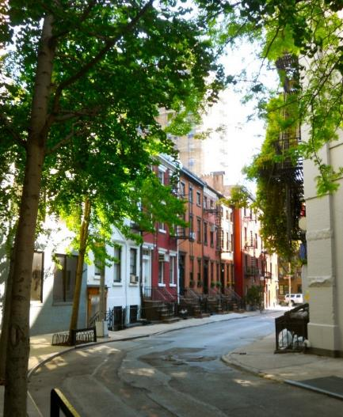
4 Conditions For the City
Mixed Primary Use
Short Blocks rather than large blocks
Notes:
SHORT BLOCKS
With short blocks, pedestrians can carve out new routes
Clear formal prescription
Streets themselves didn’t become monolithic, but could adopt new and ever-changing images

Slide 12
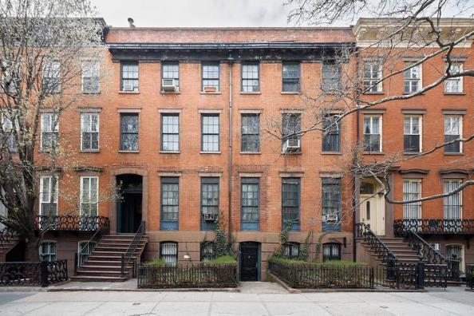
4 Conditions For the City
Mixed Primary Use
Short Blocks rather than large blocks
Allow for the aging of building
Notes:
AGING BUILDING
Economic bent
Lower classes could afford older buildings

Slide 13
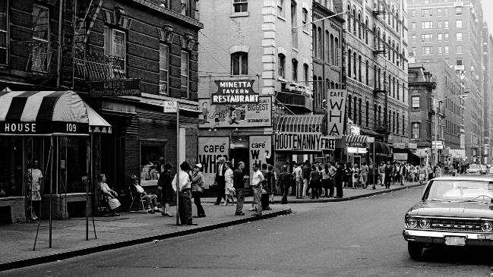
4 Conditions For the City
Mixed Primary Use
Short Blocks rather than large blocks
Allow for the aging of building
Acceptance of population density
Notes:
POPULATION DENSITY
Concentration of people to allow for diversity, street-level life

Slide 14
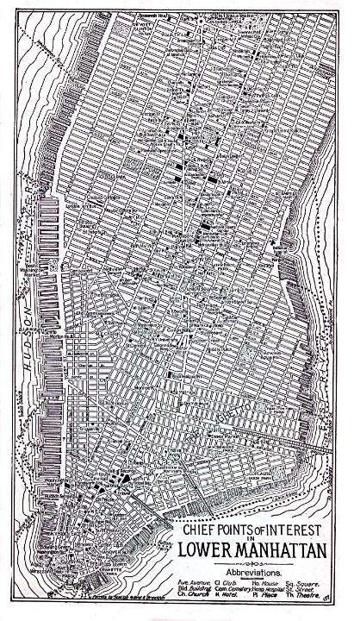
The Street as Driver
“Streets provide the principal visual scenes in cities.”
Notes:
Most important ‘Driver’
Streets define neighborhood
Look at Greenwich Village (& West Village) heavily street-based morphology
Sidewalk
Major opportunity because it enables diversity
MUCH more important than ‘open space’ (public plazas, courtyards, etc)
Contrast with Corbusier’s urban planning
Public space has to be thriving space, not just open

Slide 15
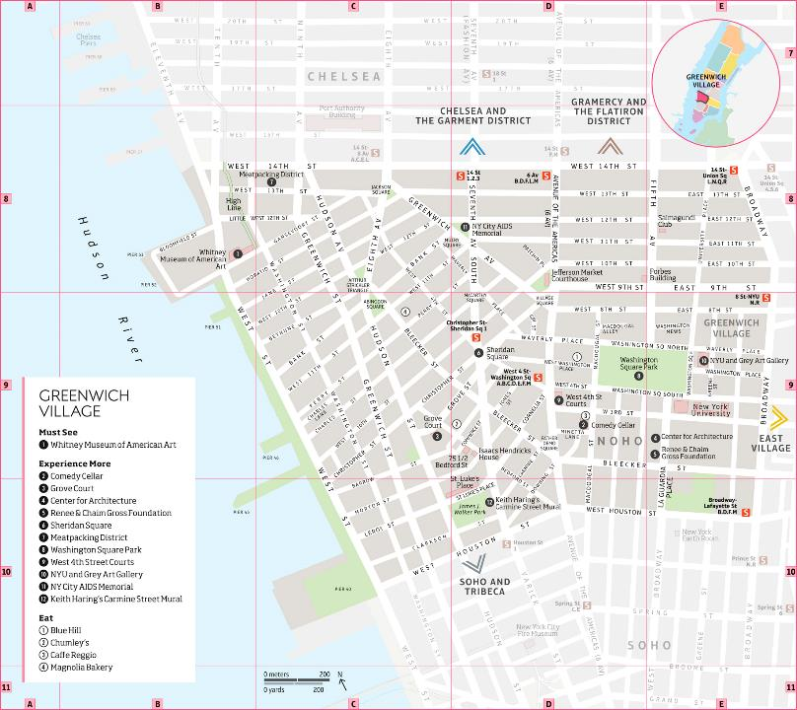
The Street as Driver
“Streets provide the principal visual scenes in cities.”
Notes:
During her time (mid-20th century), big debate as to which was the future living model: City vs. Suburbs
Major work was The Death and Life of the Great American City (1961)
A manifesto, but also symbolic because not from an architect, but an activist
Believed that the reality of cities should reflect the pedestrianized activity that are always promised in the renderings
There seemed to always be a disconnect b/w what planners/architects thought was right, versus what citizens actually did
Reacts against many Modernist planners, especially Le Corbusier

Slide 16
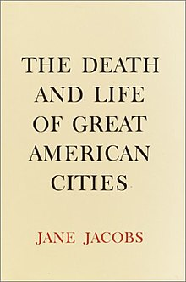
“As in all Utopias, the right to have plans of any significance belonged only to the planners in charge.”
Jane Jacobs, The Death and Life of Great American Cities (1961)

Slide 17
"This book is an attack on current city planning and rebuilding. It is also, and mostly, an attempt to introduce new principles of city planning and rebuilding, different and even opposite from those now taught in everything from schools of architecture and planning to Sunday supplements and women's magazines. My attack is not based on quibbles about rebuilding methods or hair-splitting about fashions in design. It is an attack, rather, on the principles and aims that have shaped modern, orthodox city planning and rebuilding."
Jane Jacobs, The Death and Life of Great American Cities (1961)

Slide 18
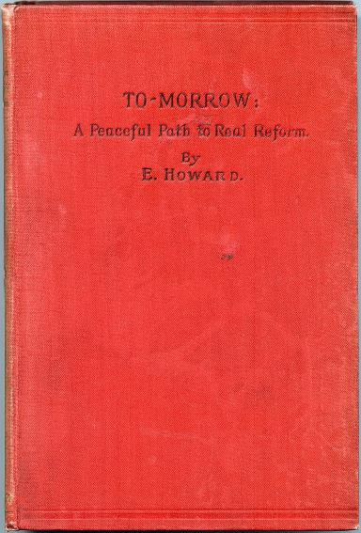
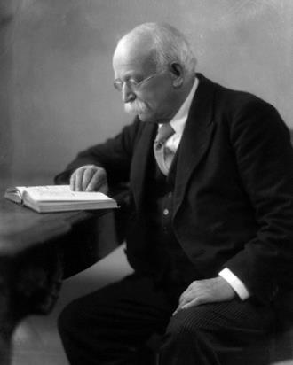
Ebenezer Howard, ‘The Garden City’ (1898)
Notes:
In The Death and Life – targets a number of architects/urban planners
Ebenezer Howard – a British planner that create ‘The Garden City concept’
Stated that Howard was against cities to begin with, so makes no sense that he should then structure cities.

Slide 19
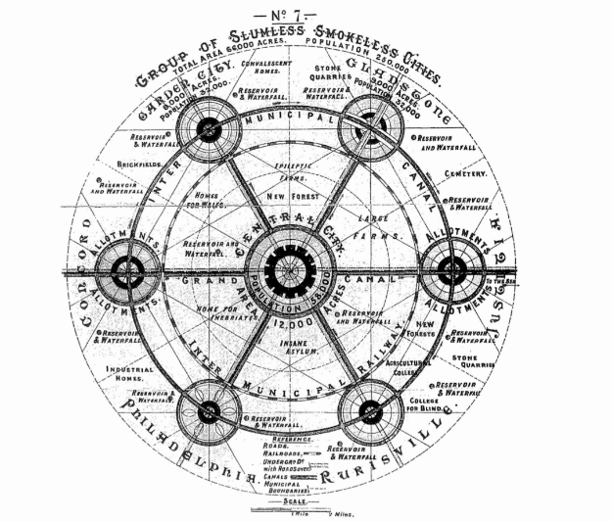
Ebenezer Howard, ‘The Garden City’ (1898)
Notes:
Corrective to the state of London toward end of 19th century
Lower density of the city, greater distribution into the countryside
So general strategy was of distribution away from city
Segmentation of cities – industry, residence, agriculture, etc.

Slide 20
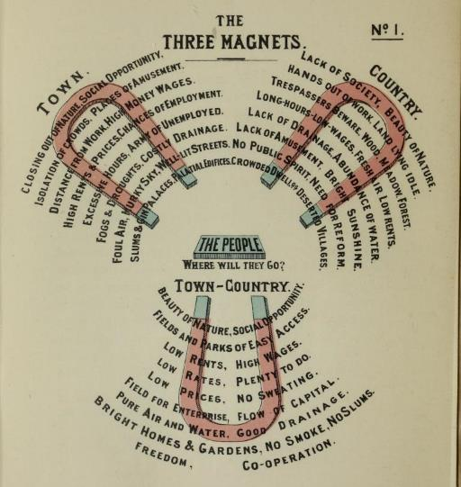
Ebenezer Howard, ‘The Garden City’ (1898)
Notes:
So rather than resulting in major metropolitan cities, you’d end up with a hybrid between town and country – the ‘Town-Country’ (read off slide)

Slide 21
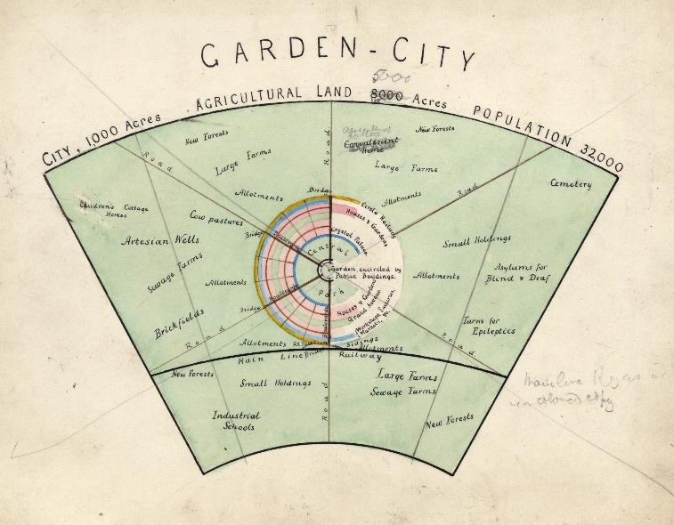
Ebenezer Howard, ‘The Garden City’ (1898)
Notes:
Maximum of any cluster was to be within 30,000 people
Problem w/ Howard: too simplistic reduction of ‘programs’
Suburban living was the model for city living – which for Jacobs made no sense – city living had to have its own standards.
Didn’t take into account that aspects of living was folded into commerce, socialization, work, etc.

Slide 22
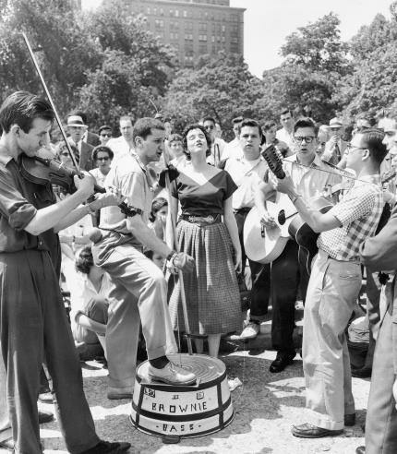
“A city cannot be a work of art”
Greenwich Village, NYC (c. 1960)
Notes:
“A city cannot be a work of art.”
Unlike a painting, you don’t ‘compose’ cities like an object, as in a masterplan such as with the Garden City
The design of cities is neither about pure function or about achieving the picturesque

Slide 23
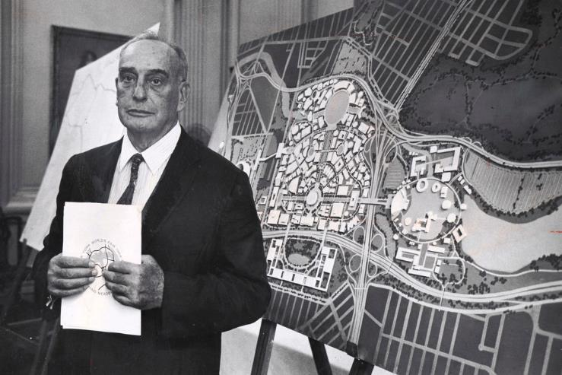
Robert Moses (1888 – 1981)
Notes:
Central ‘target’ of Jacobs – Robert Moses
Jacobs’ career was in large part defined by her opposition to Robert Moses, who held many senior positions in planning and urban development throughout the 20th century in New York state and especially New York City
Too many projects to mention – web search for various
Moses believed in the efficacy of infrastructure, and in spirit, adopted the likes of Le Corbusier’s approach of wide and varied infrastructure coupled with large residential complexes that were copy pasted across wide neighborhoods
Top-down efficacy of planning

Slide 24
Washington Square Park
Lower Manhattan Expressway
Notes:
Two specific projects – and Jacobs’ activism against their planning, typified her attitude towards architecture and the city
Washington Square Park
Lower Manhattan Expressway

Slide 25
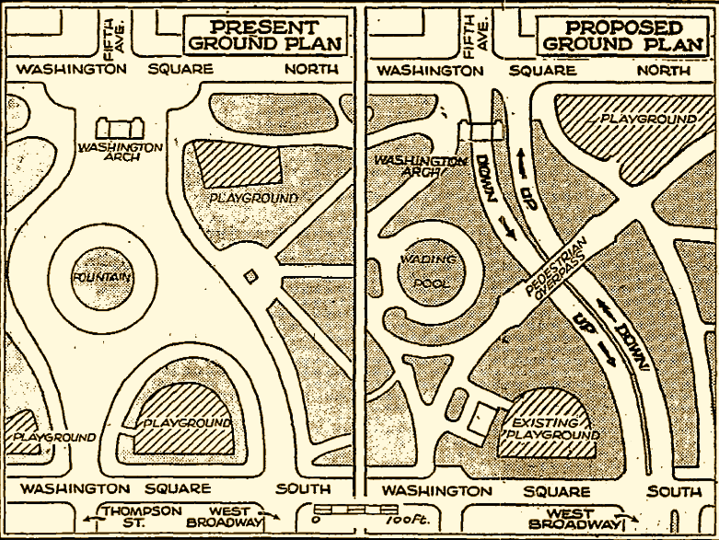
Greenwich Village, NYC (c. 1960)
Right: Robert Moses, infrastructural proposal for Washington Square Park (1955)
Notes:
Washington Square Park
Plan to run lowered roads through the park, effectively cutting it in half, with an elevated pedestrian walkway for connection
For Jacobs, this design would fundamentally prevent the park’s capacity for congregation, for community activities

Slide 26
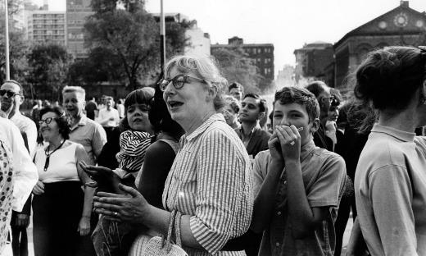
Greenwich Village, NYC (c. 1960)
Right: Robert Moses, infrastructural proposal for Washington Square Park (1955)
Notes:
Photo of Jacobs during one of the protests
Important to note – she was an activist, she actively participated in protests both on site and at public municipal hearings

Slide 27
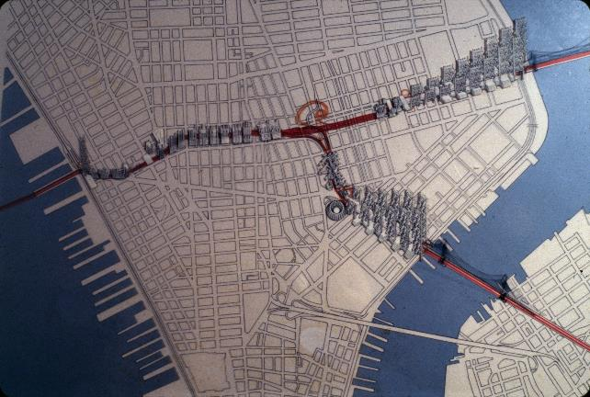
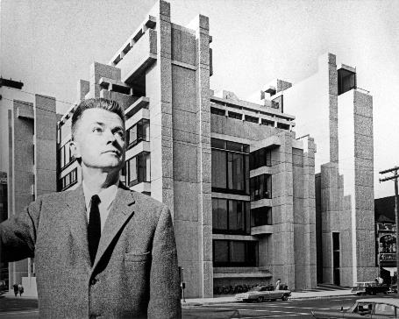
Hybrid residential/infrastructural proposal for the Lower Manhattan Expressway (LOMEX) development (1961)
Right: Paul Rudolph, Rudolph Hall (Yale University) (1963)
Notes:
The next project that epitomized Jacobs’ project was her protest against the Lower Manhattan Expressway project (LOMEX)
First proposed in 1935, up until the 60s
To connect the Holland Tunnel with the Williamsburg Bridge and Manhattan Bridge

Slide 28
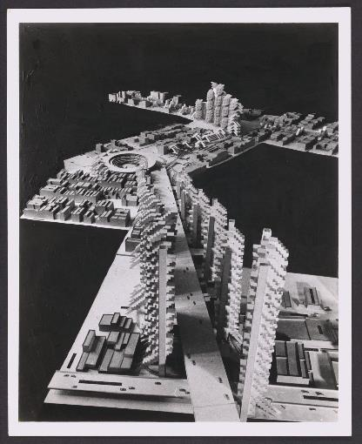
Hybrid residential/infrastructural proposal for the Lower Manhattan Expressway (LOMEX) development (1961)
Notes:
50’ into the air
Went through various design iterations, but was composed of a spine expressway, with residences and public functions ‘attached’ to this spine

Slide 29
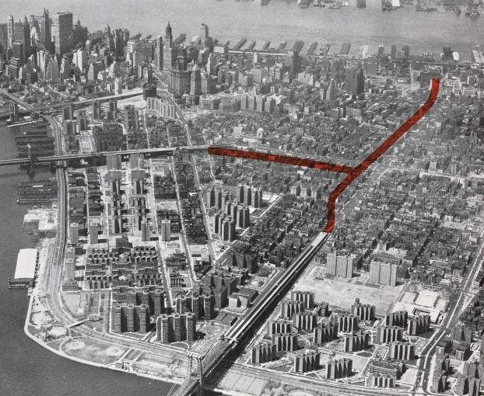
Hybrid residential/infrastructural proposal for the Lower Manhattan Expressway (LOMEX) development (1961)
Notes:
Moses knew it could be heavily federally funded, b/c connected NJ to Long island
Was interstate, so heavy federal subsidies (only 10%)

Slide 30
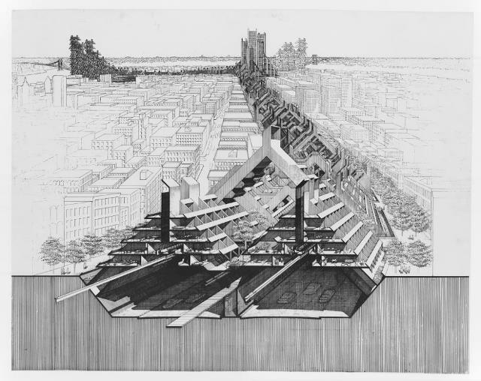
Hybrid residential/infrastructural proposal for the Lower Manhattan Expressway (LOMEX) development (1961)
Notes:
Absolutely massive in scope, and designed around a model that could be repeated all the way through
As you can see, cut right through Lower Manhattan
Jacobs protested in 1958

Slide 31
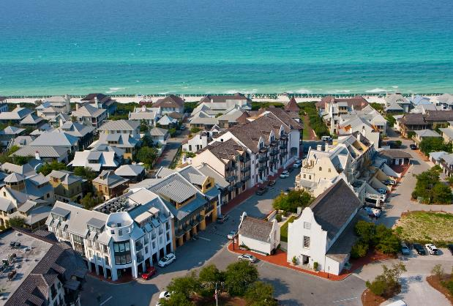
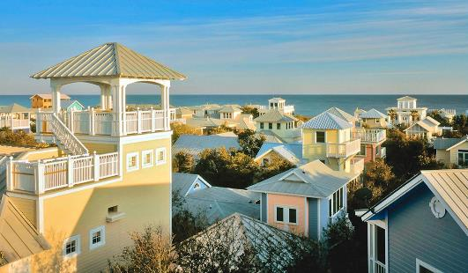
Left: Celebration, FL (1996) Right: Seaside, FL (1981 – 1988)
Notes:
Precedent to NEW URBANISM
One of their primary goals is to design with ‘livable, walkable streets’
With New Urbanism, produces communities as ‘formalized’ as the ones that it originally were against
Seaside FL
First fully planned according to New Urbanism guidelines
So ‘fabricated’ that it was used to film The Truman Show
Celebration FL (1996)
Neighborhood owned and planned by Disney Corporation
Comes with the idea of the ‘Disney-fication’ of architecture and the city

Slide 32
The Truman Show (1998)
Right: Seaside, FL (1981 – 1988)
Notes:
Truman Show comparison

Slide 33
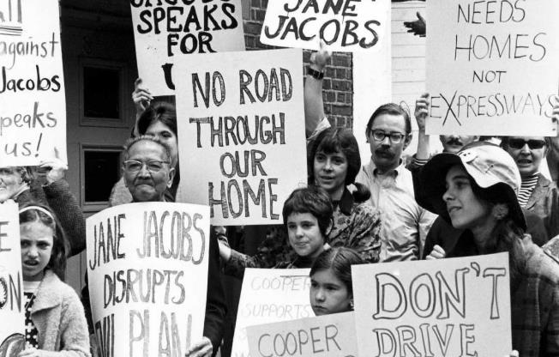
Right: Seaside, FL (1981 – 1988)
Notes:
But to be fair, Jacobs was a proponent of:
Community shaping of neighborhoods
Bottom-up city planning
The important of age in architecture and communities
Cities developed through generations, not overnight
So even though appearances similar, very different in spirit than Seaside or Celebration
Perhaps just not that compatible with the BUSINESS of architecture, which demands overnight building, especially today
Problem with the industry, not as a criticism of Jacobs

Slide 34
“There is a quality even meaner than outright ugliness or disorder, and this meaner quality is the dishonest mask of pretended order, achieved by ignoring or suppressing the real order that is struggling to exist and to be served.”

Slide 35
Jacobs’ priorities for design
“think about processes”
“work inductively, reasoning from particulars to the general”
“seek for ‘unaverage’ clues involving very small quantities, which reveal the way larger and more ‘average’ quantities are operating.”
Notes:
Jacobs’ prescription
1. “To think about processes”
The buildings that make up a city are part of a collective process – they don’t stand alone, but are part of complex systems
So when we act for change, we are participating in larger processes, rather than reductive relations
2. “To work inductively, reasoning from particulars to the general, rather than the reverse”
Bottom-up
Recognize the actual activities that take place
Deductive planning is the norm, and relies on rules and theories rather than what can be seen by the ordinary citizen
3. “To seek for “unaverage” clues involving very small quantities, which reveal the way larger and more “average” quantities are operating.”
A recognition of the complex
The complex may not have direct solutions
To reiterate that a city is complex, manifold, and cannot be comprehended at once nor by any individual.
The “unaverage” can be physical, appearance, economic, cultural, etc.

Slide 36
The City
Part 1 of 3 (Kevin Lynch)
Contemporary Architecture Theory
Eugene Han
Fall 2020, 11:15 – 12:30 pm
Online Instruction
September 14, 2020

Slide 37
Kevin Lynch
American; 1918 - 1984
Notes:
Legacy is not all that present
Referenced everywhere
Architecture
Art
Psychology
Behavioral studies
Social sciences, etc.

Slide 38
The Image of the City (1960)
Notes:
His 1960 book serves as his main source
Took the position that the city was a perpetually changing environment, and so it was more appropriate to identify the structures for change rather than to come up with idealized compositions

Slide 39
“Our purpose is simply to consider the need for identity and structure in our perceptual world, and to illustrate the special relevance of this quality to the particular case of the complex, shifting urban environment.”
Kevin Lynch, The Image of the City
Notes:
<Quote> “Our purpose is simply to consider…”
Special emphasis on “perceptual world” – not just about how we design cities, but how people see them

Slide 40
IMAGEABILITY
Identity
Structure
Meaning
Notes:
Not concerned with what an individual identifies as important for a city, but attempted to summarize collective value – that is, how meaningful parts of a city were perceived by a group of people
3 key points when discussing Imageability
Identity
A distinction of one object from another
E.g. a circle is not a square, and so it is something within itself
Structure
A spatial relationship to the things around it
Meaning
Practical or emotional meaning to the observer
These 3 key points work together, are fundamentally integrated when imaging the city

Slide 41
IMAGEABILITY
Notes:
Key word: IMAGEABILITY
Propose a way of understanding architecture and the city by means of how it looks
Implicit in this approach, he was stating that appearance was not superficial

Slide 42
IMAGEABILITY
“that quality in a physical object which gives it a high probability of evoking a strong image in any given observer”

Slide 43
Boston
Jersey City
Los Angeles
Notes:
3 Cities of Image Analysis
Boston, Jersey City, and Los Angeles
Chosen for Variety

Slide 44
City Analysis - Boston
Notes:
Boston
Defined by squares and vistas
Memorable views, largely due to the irregular layout of the city and its neighborhoods… city dating back to 1630 with Puritans

Slide 45
City Analysis - Boston
Notes:
He surveyed citizens, and found that each had a distinctive mental structure of their particular neighborhood, yet there was no cohesive common overall view.
Critically, he’s not commenting so much on ‘good practice,’ but about how meaning can be understood in terms of how the city is seen by himself and by its citizens

Slide 46
“It is a difficult system to draw, or to image as a whole, and must usually be handled by concentrating on the sequence of joints.”
City Analysis - Boston

Slide 47
City Analysis – Jersey City
Notes:
Jersey City
Less distinctive than Boston, namely due to large expanses of land without significant markers

Slide 48
City Analysis – Jersey City
Notes:
High fragmentation of mental maps from inhabitants – little collective coherence

Slide 49
“This is really one of the most pitiful things about Jersey City. There isn’t anything that if someone came here from a far place, that I could say, “Oh I want you to see this, this is so beautiful.”
City Analysis – Jersey City
Notes:
<quote>…
Noted that if there was any major coherence, it was the fact that you could see New York City from across the Hudson.
Characterized as ‘Low Imageability’
So very much a like-for-like comparison b/w Boston and Jersey City, with higher image success in Boston

Slide 50
City Analysis – Los Angeles
Notes:
Los Angeles
More of an apple-to-orange comparison

Slide 51
City Analysis – Los Angeles
Notes:
Described downtown (the diagram) as a vacuum, much less dense than Boston / Jersey City
Though mentioned that Broadway (pictured) was visually significant as both a path and an edge.

Slide 52
City Analysis – Los Angeles Pershing Square – ‘high imageability’
Notes:
He mentioned Pershing Square, however, as it was a feature of high imageability within a city that was otherwise quite featureless.

Slide 53
“Los Angeles seemed to be hard to envision or conceptualize as a whole.”
City Analysis – Los Angeles
Notes:
In sum, <Quote…>

Slide 54
Paths
Nodes
Edges
Landmarks
Districts
Elements of a City Image
Notes:
If you were reading the keys to the maps of the 3 cities, you saw 5 important symbols, or what he called ‘elements of a city image’
All pretty self-explanatory
Paths
Edges
Districts
Nodes
Landmarks

Slide 55
Paths
Elements of a City Image
Notes:
Paths
Oftentimes talks about streets, but could serve as pedestrian paths, transit lines, canals, railroads.
For most, the most prominent image element (think of Jacobs)

Slide 56
Edges
Elements of a City Image
Notes:
Edges
Most often facing an open area, such as buildings onto a park, but also things like shores
Linear elements
Stated that although less visually significant than paths, are important as an organizing feature (of figuring out the seam between one feature and another)

Slide 57
Districts
Elements of a City Image
Notes:
Districts
One identifiable neighborhood in opposition to another
Must be able to say you’re “inside of it”
Visually created with some common, identifying character

Slide 58
Nodes
Elements of a City Image
Notes:
Nodes
Points of overlapping or intersecting routes
Like districts, the observer must be able to be “inside of it”
Condensation of some physical character

Slide 59
Landmarks
Elements of a City Image
Notes:
Landmarks
An important visual marker, but the observer doesn’t enter it
They symbolize a constant direction

Slide 60
Singularity
Directional Differentiation
Form Quality
Visual Scope
Continuity
Motion Awareness
Dominance
Time Series
Clarity of Joint
Names and Meaning
‘Form Qualities’ of a City Image
Notes:
Identifying aggregate formations & attributes that occur when combining various elements (elements ‘in practice’)
Form Qualities
Singularity
‘figure-ground clarity’
How easily it is to distinguish an object from its context
Form Simplicity
Ability to understand totality of an object
//VERY subjective
Continuity
Continuance of an edge, e.g. street or a skyline
Dominance
…
He’s not coming up with an idealized model
Instead, he’s defining idealized elements and composites that can have incredibly diverse effects when applied to various cities
Critically, these elements and their effects are determined not by ‘engineering’ a city, but by criteria of perception
Principal takeaway: we should train ourselves to see the complexity inherent in the image of the city
Seeing is not so simple once we engage with the various layers of the city

Slide 61
The City
Part 1 of 3 (Christopher Alexander)
Contemporary Architecture Theory
Eugene Han
Fall 2020, 11:15 – 12:30 pm
Online Instruction
September 14, 2020
Notes:
- Third architect I’ve chosen for the first of three sections on ‘The City’ – understood collectively in their counter-Modernist approaches… they quite varied within themselves

Slide 62
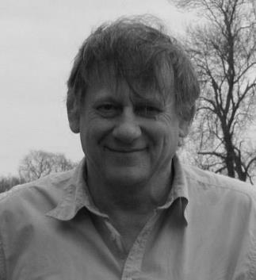
Christopher Alexander
British / American; 1936
Notes:
- For numerous reasons not among the most circulated theorists in architecture today, namely because he can be thought of as an ‘anti-architect architect’… if that makes sense
- Berkeley guy

Slide 63
PATTERNS
Notes:
If the keyword for Lynch was ‘Imageability’, then that of Alexander is ‘Patterns’
Pattern: How a physical design (house/street/neighborhood… wall/door) responds to human living conditions and relationships
Provided nothing short of a manual for good environmental design, using 253 patterns
Most importantly, patterns establish relationships, not the ‘image’ of a building
Direct influence on computer programming – Object-Oriented Programming

Slide 64
“With the invention of a teachable discipline called “architecture,” the old process of making form was adulterated and its chances of success destroyed.”
Notes on the Synthesis of Form, pg. 58
Notes:
Called for an inherently adaptive process of design, and so any attempt to encapsulate tradition in design (e.g. the ‘discipline of architecture’) stymied the potential for adaptive design.

Slide 65
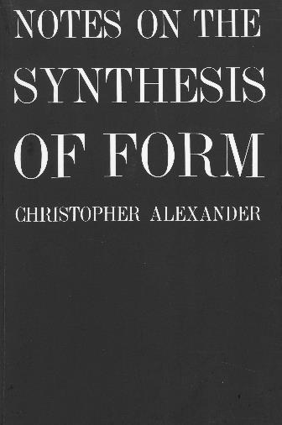
Notes on the Synthesis of Form (1964)
Notes:
Reading looked at Alexander’s explicit attempt to formulate good practice in architectural design, but prior to this was his publication Notes…, in which he laid out his framework.
An attempt to outline Alexander’s approach to design
Not about refining a solution to a problem, but about prioritizing the process of understanding the connectedness of things – relationships
Recognizes the inherent complexity and ‘fitness’ of solutions that have developed over centuries
Specifically identifying “peasant farmhouses”, and indigenous “mud huts” structures
Identifies these structures as he sees a meaningful fitness between ‘form’ and ‘context’

Slide 66
FITNESS
FORM
CONTEXT
Notes on the Synthesis of Form (1964)
Notes:
In the context of ‘Fitness’, it is a relationship between form and context
Form: the ‘object’ of design
Context: Acknowledgement of the many things that affect the ‘object’ (form)
A clear counterpoint to tabula rasa development
But also not a simple dyadic of Form|Context… instead, form must be though of as within a much larger network of many things… a multi-faceted context

Slide 67
FITNESS
FORM
CONTEXT
“The form is a part of the world over which we have control, and which we decide to shape while leaving the res to the world as it is.”
Pg. 18-19
Notes on the Synthesis of Form (1964)
Notes:
A clear counterpoint to tabula rasa development
In the context of ‘Fitness’, it is a relationship between form and context

Slide 68
FITNESS
FORM
CONTEXT
“The form is a part of the world over which we have control, and which we decide to shape while leaving the res to the world as it is.”
Pg. 18-19
“The context is that part of the world which puts demands on this form; anything in the world that makes demands of the form is context.”
Pg. 19
Notes on the Synthesis of Form (1964)

Slide 69
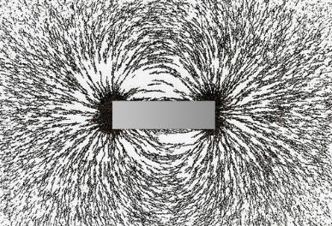
FITNESS
FORM
CONTEXT
“The form is a part of the world over which we have control, and which we decide to shape while leaving the res to the world as it is.”
Pg. 18-19
“The context is that part of the world which puts demands on this form; anything in the world that makes demands of the form is context.”
Pg. 19
Notes on the Synthesis of Form (1964)
Notes:
Example of a ‘frictionless’ relationship between form and context
Iron filings around a magnet
The iron ‘objects’ are directly influenced by the forces produced by positive-negative ends of a magnet

Slide 70
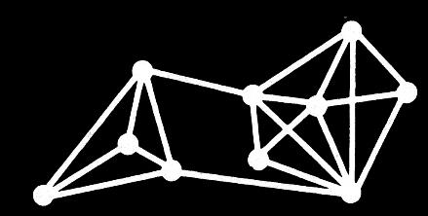
Notes:
The book delves into relatively abstract language, quickly leaving traditional architectural discourse (another reason why not so popular)
Almost philosophical approach to design/form
The point is that in the design process, we should acknowledge the constellation of considerations ‘around’ the object under investigation (like the points/nodes in the above diagrams)
When we consider how to improve or design for situations, we can then recognize the manifold relationships inherent between form and context (e.g. 2 ‘relationships’ in above diagram)

Slide 71
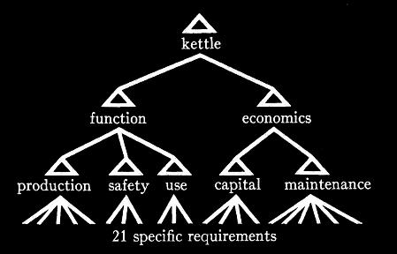
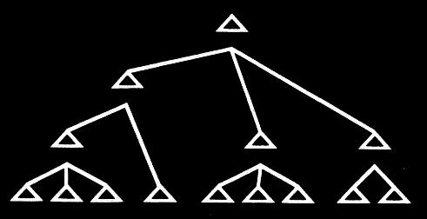
Notes:
In the design of something as simple as a kettle, we can draw out

Slide 72
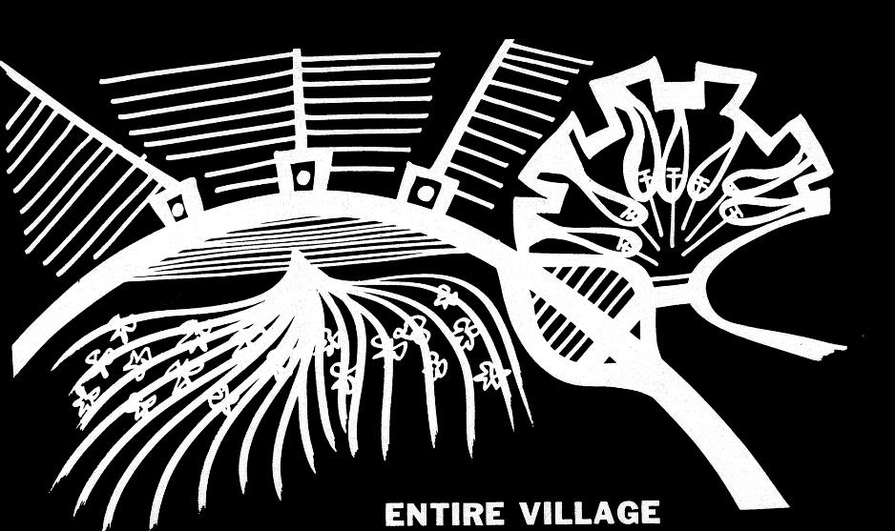
Notes:
Provided a paradigmatic case of his method, looking to deconstruct the forms and relationships of a village (in diagram)

Slide 73
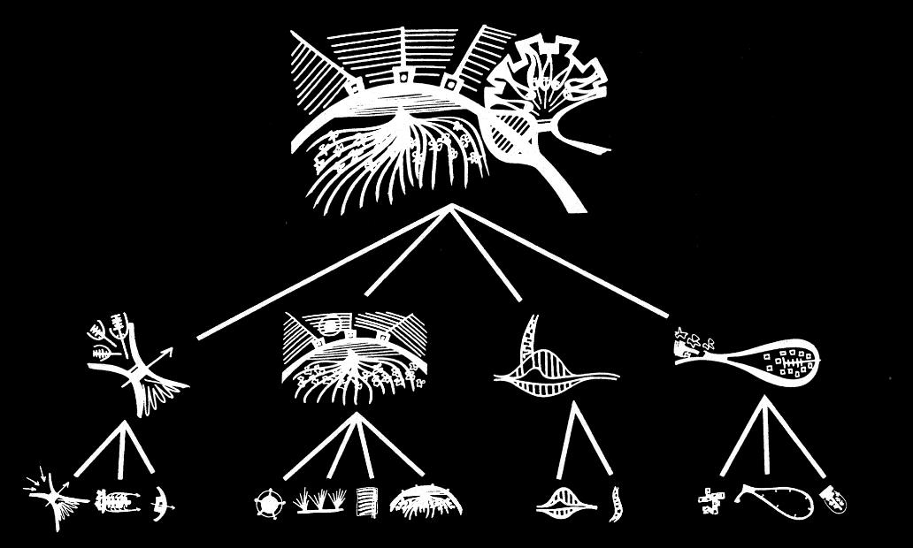
Notes:
In the appendix of Notes…, breaks down and explains how the village can be broken down into sets, which can then be broken down into lower-level elements
This process naturally evolves into his later publication, and what he is more known for in…

Slide 74
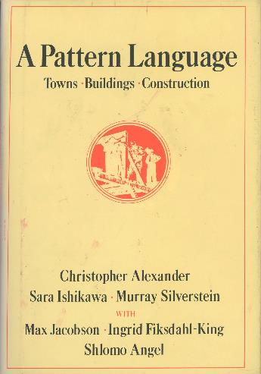
A Pattern Language (1977)
Notes:
A Pattern Language, published 13 years later in 1977
Intention is to give everyone the tools to make good architecture / cities… or more specific, ‘good design’ in general
The title ‘Pattern Language’ is quite intentional, as it is thought that Alexander is providing words, but does not prescribe the sentences of architecture
His general approach completely counter to Modernist building principles
Abhorred high-rises and massive glass fenestration
Certainly not fashionable during the time of writing

Slide 75
“There are two essential purposes behind this format.”
“First, to present each pattern connected to other patterns, so that you grasp the collection of all 253 patterns as a whole, as a language, within which you can create an infinite variety of combinations.”
“Second, to present the problem and solution of each pattern in such a way that you can judge it for yourself, and modify it, without losing the essence that is central to it.”
Pg. xi
A Pattern Language (1977)

Slide 76
INDEPENDENT REGIONS
THE DISTRIBUTION OF TOWN
CITY COUNTRY FINGERS
AGRICULTURAL VALLEYS
LACE OF COUNTRY STREETS
COUNTRY TOWN
THE COUNTRYSIDE
MOSAIC OF SUBCULTURES
SCATTERED WORK
MAGIC OF THE CITY
LOCAL TRANSPORT AREAS
COMMUNITY OF 7000
SUBCULTURE BOUNDARY
IDENTIFIABLE NEIGHBORHOOD
NEIGHBORHOOD BOUNDARY
…
253. THINGS FROM YOUR LIFE
A Pattern Language (1977)
Notes:
So why include Alexander?
An example of an architect working counter to mainstream Modernist principles, but still with a kind of prescriptive approach
But of course, this prescription yields no specific ‘solution,’ but a framework which prioritizes the interconnectedness of things over the ‘design object’
Still a ‘universal’ approach, but a universal approach that attempts to recognize differences

Slide 77
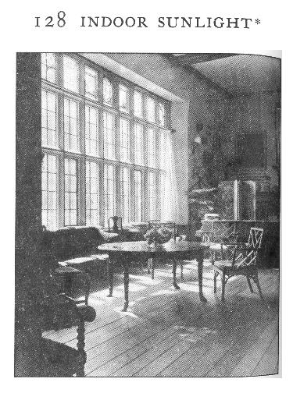
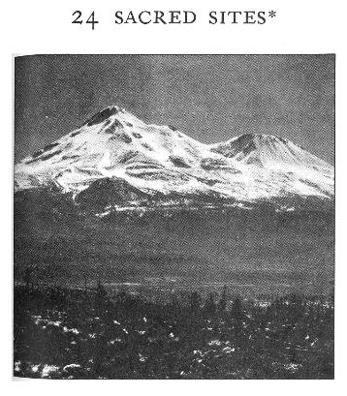
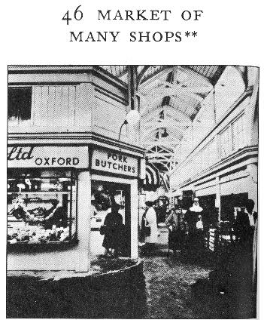
A Pattern Language (1977)
Notes:
Symbolic, programmatic, sanitary considerations

Slide 78
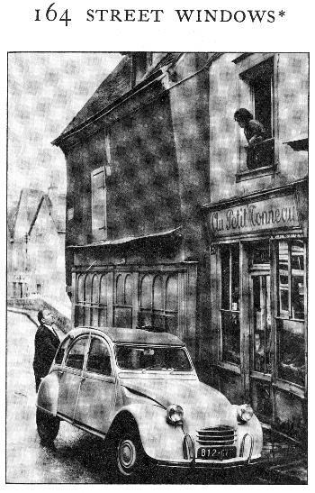
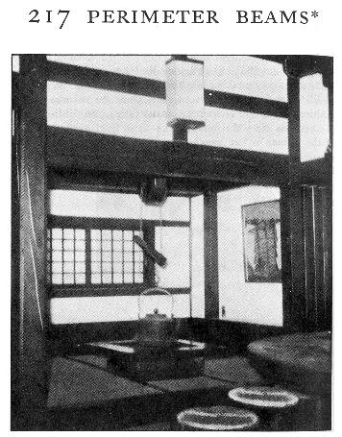
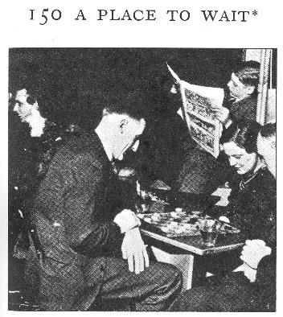
A Pattern Language (1977)
Notes:
Temporal, building element, structural element

